Slide 1
Past Projects
Lung Allocation
Affordable housing in NYC and Singapore
Allocating Marijuana Retail Licenses in Washington State
Road Space Rationing in Beijing
On allocation of online advertising
The allocation Process of Florida's Quota/Limited Entry Hunt Permits
Clinic scheduling allocation
Permit lotteries for Mount Whitney climbers
Dormitory allocation at the University of Minnesota
Indian Premier League Players’ Auction

Slide 2
Warm Up
A | B | C
1,2 | 1,3 | 3
4 | 2,4 | 1, 2, 4
3
Suppose we use a single (district-wide) tie-breaker, and the order is 4 > 1 > 3 > 2. What are the resulting (strict) priorities fore each school?
If we use a lottery to produce a single (district-wide) tie-breaker, what is the chance that this tie-break ordering is 4 > 1 > 3 > 2 ?
If we use a single (district-wide) lottery:
What is the chance that 1 gets higher priority than 2 at every school?
What is the chance that 2 gets higher priority than 1 at every school?
If we use independent lotteries at each school:
What is the chance that 1 gets higher priority than 2 at every school?
What is the chance that 2 gets higher priority than 1 at every school?

Slide 3
Engineering The Allocation of Public Resources

Slide 4
Plan for Today
Tiebreaking in School Choice (Recap)
Advantages of Centralized Assignment
Thickens the market, addresses congestion
College Admissions Reform Debate
Study Guide Review (+ Story Time?)

Slide 5
Building Intuition
Why does a single lottery typically leave more students unassigned?
In what circumstances is this NOT the case?

Slide 6
Some of My Results
Theorem. If students list same number of schools, more matches with independent lotteries.
Theorem.
Always more first choices with a single lottery.

Slide 7
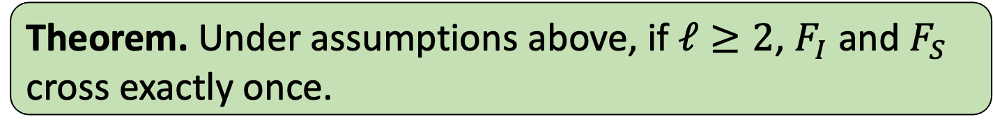
Single-Crossing of Rank Distributions
Theorem. Under assumptions above, if $ℓ≥2$, $F_{I}$ and $F_{S}$ cross exactly once.
Notes:
Comment that analogous results hold with non-equal list lengths (still more first choices under STB, and conditional rank distributions exhibit single-crossing).

Slide 8
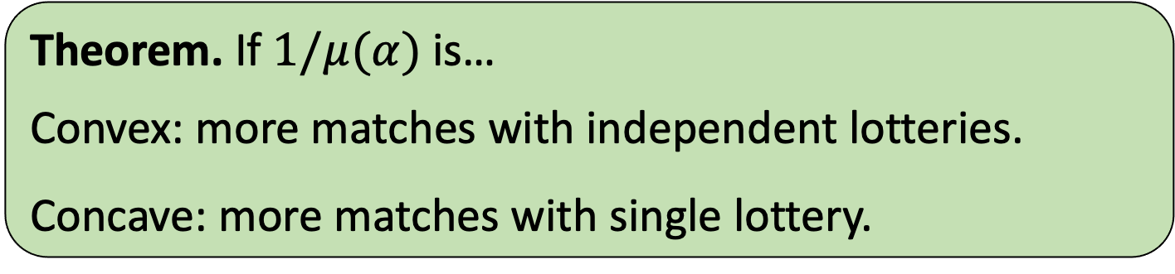
Some of My Results
Theorem. If students list same number of schools, more matches with independent lotteries.
Theorem. If $1/μ(α)$ is…
Convex: more matches with independent lotteries.
Concave: more matches with single lottery.
Theorem.
Always more first choices with a single lottery.

Slide 9
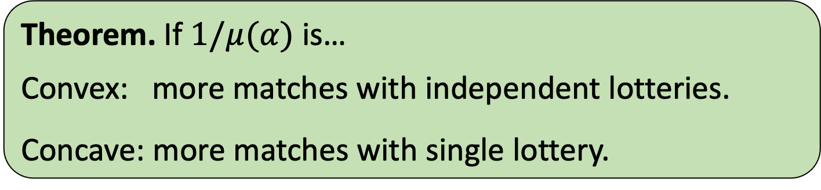
Taking Theory to Practice…
Theorem. If $1/μ(α)$ is…
Convex: more matches with independent lotteries.
Concave: more matches with single lottery.
New York City (Abdulkadiroglu et al. 2009)
Amsterdam (de Haan et al. 2015)

Slide 10
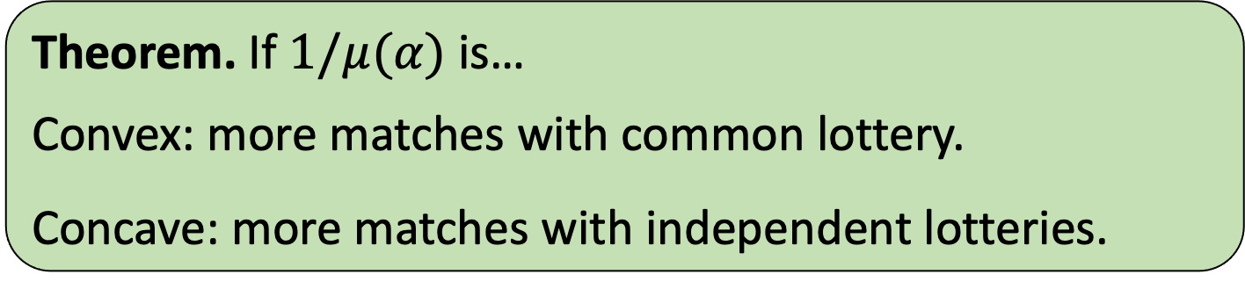
Taking Theory to Practice…
Theorem. If $1/μ(α)$ is…
Convex: more matches with common lottery.
Concave: more matches with independent lotteries.
New York City (Abdulkadiroglu et al. 2009)
Amsterdam (de Haan et al. 2015)

Slide 11
Should we choose single or multiple tiebreaking?

Slide 12
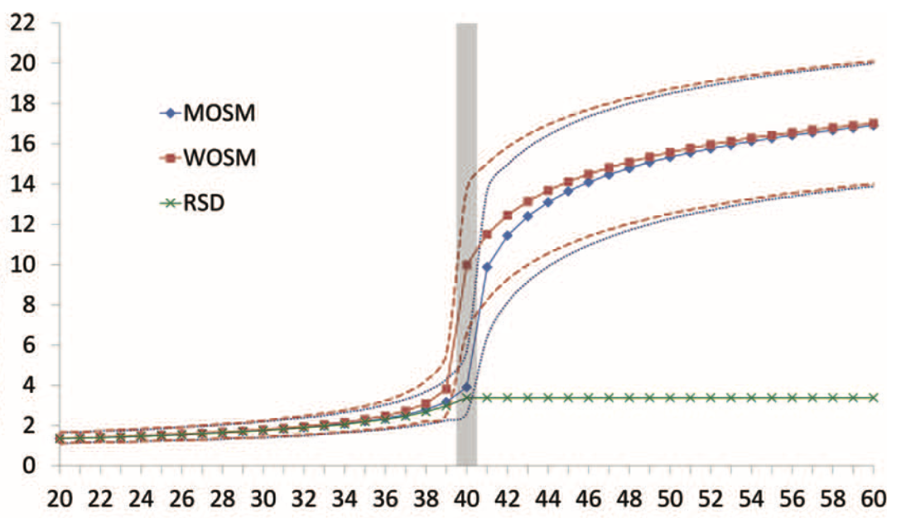
Effect of Competition
Average rank is similar if there are excess seats.
Single lottery is MUCH better if seats are highly competitive.
School-Specific Lotteries
District-Wide Lottery

Slide 13
College Admissions
What problems do you see with the current process?

Slide 14
College Admissions Debate
Should there be a centralized matching algorithm?

Slide 15
Faculty Positions
Should there be a centralized matching algorithm?

Slide 16
Incomplete Information
People don’t know their own preferences!

Slide 17
NYC Lottery Numbers
What effect will publishing lottery numbers have?

Slide 18
Study Guide: Session 1
Concepts
Allocation (Assignment)
Preference Profile
Pareto Efficient (PE)
Rank Efficient
Dynamic Mechanism
Direct (Revelation) Mechanism
Algorithms
Serial Dictatorship
First Choices First (Boston)
Facts
Serial Dictatorship is PE
First Choices First is PE.
Neither is guaranteed to be Rank Efficient.
Notes:
Probably good to cover SD in first class, to split these ideas up.

Slide 19
Study Guide: Session 2
Concepts
Endowment
Truthful
(Strategy-Proof, Incentive Compatible)
Individually Rational
The Core
Pair Efficiency
Algorithms
Top Trading Cycles
Facts
Top Trading Cycles is PE, SP, IR.
Top Trading Cycles gives the unique allocation in the core
Top Trading Cycles is the only algorithm with these properties.
Notes:
Probably good to cover SD in first class, to split these ideas up.

Slide 20
Study Guide: Sessions 3 and 4
Concepts
Random Mechanism
Transposition
Symmetry
Algorithms
TTC-RE
RSD
Facts
RSD is Pareto efficient, truthful and symmetric.
TTC-RE Pareto efficient, truthful and symmetric.
Every known Pareto efficient, truthful, and symmetric mechanism is equivalent to RSD!
Notes:
Probably good to cover SD in first class, to split these ideas up.

Slide 21
Study Guide: Session 5
Concepts
Priority
(No) Justified Envy
Non-wasteful
Algorithms
First Choices First
(Boston)
Generalized TTC
Facts
No Justified Envy + Pareto efficient may be impossible.
No Justified Envy + Non-wasteful always possible.
Boston, Chicago, England stopped using FCF.
New Orleans stopped using Generalized TTC.
Many districts do not specify their algorithm.

Slide 22
Study Guide: Sessions 6 and 7
Concepts
Blocking Pair
Stability
The Core (new context)
Truncation
Unraveling
Facts
Stability = IR+Non-wasteful + No Justified Envy
There may be multiple stable assignments.
Student-Proposing DA finds “student optimal” stable assignment, School-Proposing DA finds “student pessimal” and “school optimal” stable assignment.
Rural Hospital Theorem: any two stable assignments assign the same students and the same number of seats at each school.
Student-Proposing DA is truthful for students.
School-Proposing DA is not truthful for students. Only students with multiple stable partners can benefit from misreporting
Algorithms
School-Proposing Deferred Acceptance
Student-Proposing Deferred Acceptance

Slide 23

Study Guide: Session 8
With Couples
In “simple” many-to-one matching markets,
Stable matchings always exist.
The set of assigned students and assigned positions is the same for every stable matching.
There is a student-optimal stable match.
Student-proposing DA (with any proposal order) finds the student-optimal match.
Student-proposing DA is truthful for students.
Despite this, these properties “nearly” hold in residency matching data!

Slide 24

Study Guide: Session 9
Weak Stability
Strong Stability
Single Tiebreaking (STB)
Multiple/Independent Tiebreaking (MTB)
MTB matches more students, but gives fewer one of their top choices
Any matching that is strongly stable is weakly stable. But strongly stable matchings may not exist!
When there are ties in priority
Weakly stable matchings always exist.
They can be found using a truthful mechanism.
The set of assigned students and assigned positions is the same for every weakly stable matching.
There is a student-optimal weakly stable match.
Optimizing over weakly stable matchings is NP-hard, not truthful.

