Slide 1
Engineering the Allocation of Public Resources
Session 1: Intro + Pareto Efficiency
Notes:
Could reach out to Christian Kroer, John Dickerson…

Slide 2
One possibility: allocate randomly
Group Work:
Introduce yourself to your group! Share your name, your program, and something that you are excited about.
Identify (at least) one positive feature of random allocation, and (at least) one concern or shortcoming.
Brainstorm an alternative procedure. Be Specific. Does this procedure address one of your listed shortcomings for random allocation?
When you are ready to discuss, write your pro and con on the board.
Notes:
Pros: it’s fair, simple, transparent.
Cons: it’s inefficient, doesn’t give fruit to those in need.
Possible solutions to inefficiency:
Serial dictatorship.
Allow aftermarket trading. Friction makes this difficult. Maybe I don’t know who got the banana! Furthermore, this isn’t allowed in many markets (i.e. housing, school choice, organs). When it is allowed, how to conduct trades? There’s a risk that we might attract new participants with less need
Possible solutions to targeting:
Ask who is in need (i.e. who ate breakfast?): won’t get truthful answers
Guess who is in need (ask about income, look at weight): intrusive, imperfect
Have people demonstrate their need (i.e. push-up contest, willingness to wait after class). We’ll come back to this later in the course.

Slide 3
How To Design A System?
In practice: copy what we see elsewhere, possibly with modifications.
Notes:
In practice, we copy what we see elsewhere.

Slide 4
An Engineering Approach
First, define requirements and/or an objective.
Then try to design an algorithm that satisfies these requirements or maximizes the objective.

Slide 5
Possible Goals
Efficient
Fair
Truthful
Questions:
How do we define efficiency?
Give people fruit that they like?
Minimize time and effort?
How do we define fairness?
Equal priority?
Give to the hungriest?
How do we know people’s preferences and needs?
Hopefully, they tell us!
Notes:
Is random efficient? Doesn’t give fruit that they like, but minimizes communication and effort.

Slide 6
Course Overview
Optional supplementary resource:
Market Design: Auctions and Matching (Haeringer)
Unit 1: Foundations (Efficiency, Fairness, Truthfulness)
Serial Dictatorship
First Preferences First
Top Trading Cycles
Deferred Acceptance
Unit 2: Selecting for Diversity (Quotas and Reserves)
Minimum and Maximum Quotas
Minimum Guarantee Reserves
Over-and-Above Reserves
Matching with Contracts
Unit 3: Dynamic Matching
Exchange Cycles + Chains
Waitlist with Deferral
Waitlist without Deferral
Independent Lotteries
Common Lottery
Board Game Swaps
Dorm Room Allocation
School Choice
Residency Matching
US Visa Allocation
Matching for Gap Year Programs
Chilean Constitutional Assembly
Indian Affirmative Action
Affordable Housing Allocation
Organ Allocation
Living Donation
Deceased Donation
Public Housing
Public Housing
Inclusionary Zoning
Midterm #1
February 20-24
Midterm #2
March 27-31
Final Exam
May 6-12

Slide 7
Possible Bonus Content
Auction Theory
First Price (pay as bid) Auction
Second Price (uniform price) Auction
Ascending Auction
Online Advertising
Fishing Quota Allocation
Multi-Unit Demand
Multi-Period “Fake Money”
Single-Period Virtual Currency
Matching with Externalities
Group Lottery
Individual Lottery
Food Banks
Course Allocation
Hiking Permits
Marathon Registration
Broadway Ticket Lotteries

Slide 8
Course Goals: Relationships
I want to get to know you as a person!

Slide 9
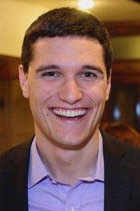
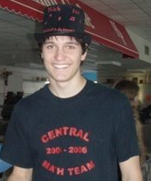






About Me
BA, Math and Computer Science
Professor, Industrial and Systems Engineering
Hobbies:
Board Games
Ultimate Frisbee
Camping
World Travel
PhD, Operations Research
Professor, Decisions Risk and Operations

Slide 10



Slide 11
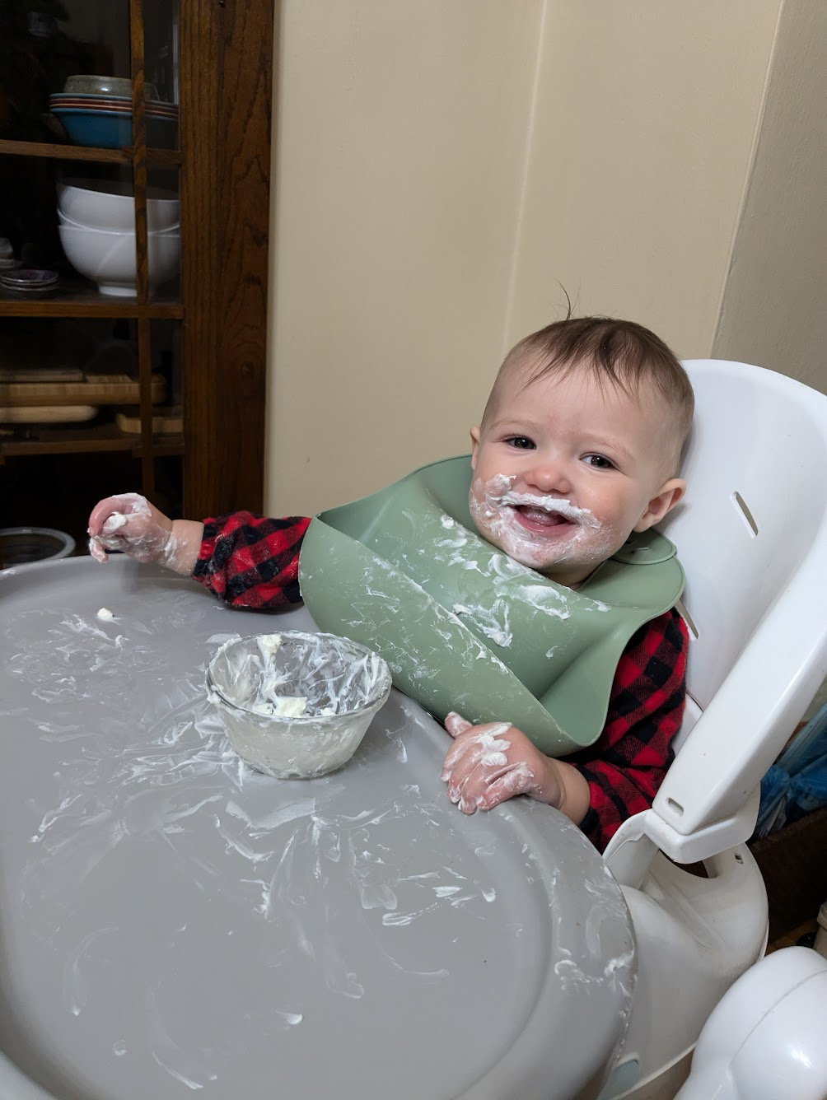


Slide 12
Course Goals: Relationships
I want to get to know you as a person!
What you can do:
Attend class, use name tents (first few weeks)
Ask lots of questions! (lots of new terms, reminders are good)
Laptops and phones away
Come to office hours:
11-11:45 Tuesday, Thursday
By appointment (e-mail me to schedule arnosti@umn.edu)
Make these slightly more specific and catchier? Define and discuss key concepts such as fairness, efficiency.
Understand algorithms…

Slide 13
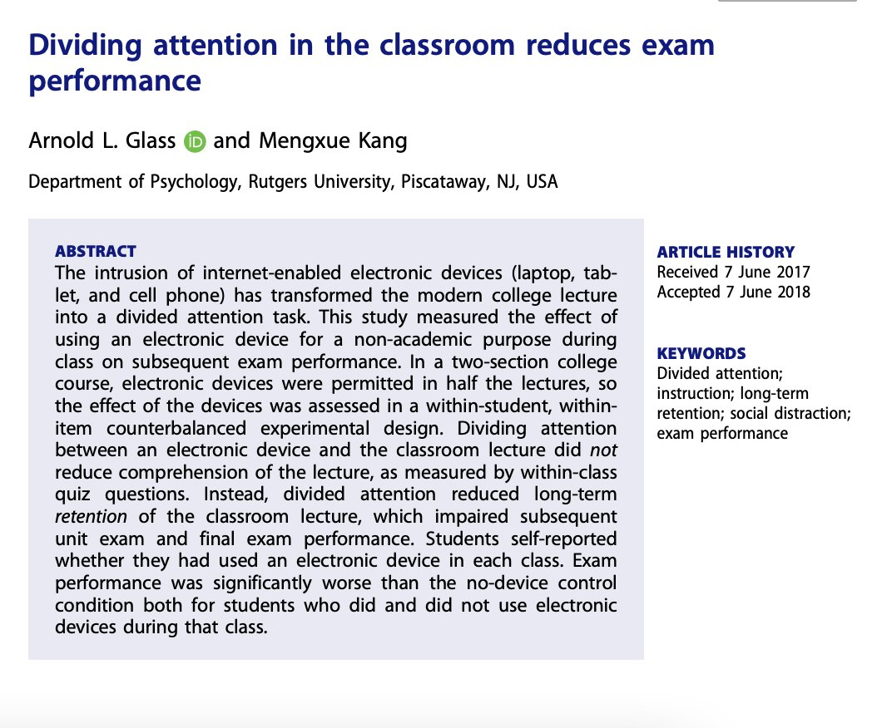

Slide 14
Course Goals: Fun
Ideal: Your favorite course at the University of Minnesota.
Plausible: Your favorite course this semester.
Baseline: Interesting and thought-provoking.
How you can help:
Commit to spending time outside of class
Share your thoughts with me (in person or anonymously)
This is my passion project!

Slide 15
Course Goals: Learning
Key concepts and definitions (i.e. efficiency, fairness, truthfulness).
Algorithms that are (or could be) used.
Relationships between concepts and algorithms.
Assess existing solutions.
Use knowledge to propose new solutions.
Make these slightly more specific and catchier? Define and discuss key concepts such as fairness, efficiency.
Understand algorithms…

Slide 16
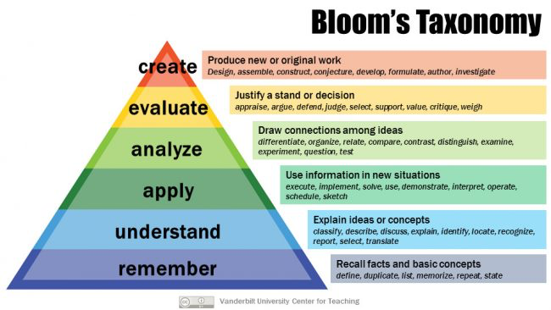

Slide 17
Teaching Philosophies
Lots of practice
Rapid feedback
Low stress

Slide 18
Grading
Homework: 45%
Due before each class
Drop lowest 3 scores
Exams: 45%
Two midterms and a final (15% each)
24 hour take home
Open notes
Attendance: 10%
Scored out of 25
Project: Extra Credit

Slide 19
Two Types of Homework
Reflection + Critical Thinking
Apply knowledge to real world
Analyze definitions and algorithms
May discuss with classmates
x
Concept Check
Used as diagnostic
Immediate feedback
Open notes
Individual – do not discuss!
Notes:
Last year: 16 concept checks, 10 reflection and critical thinking

Slide 20
AI Policy
AI Tools CANNOT be used on Exams or Concept Checks
AI Tools MAY be used on Reflection + Critical Thinking, but must be disclosed.
One Student Answer to Pre-Class Review:

Slide 21
Pre-Class Review
Worst performance: final logic question
Two ways to prove that all great algorithms are good:
Prove that any great algorithm must also be good
Prove that any algorithm that is not good cannot be great (contrapositive)
All Algorithms
Good
Great

Slide 22
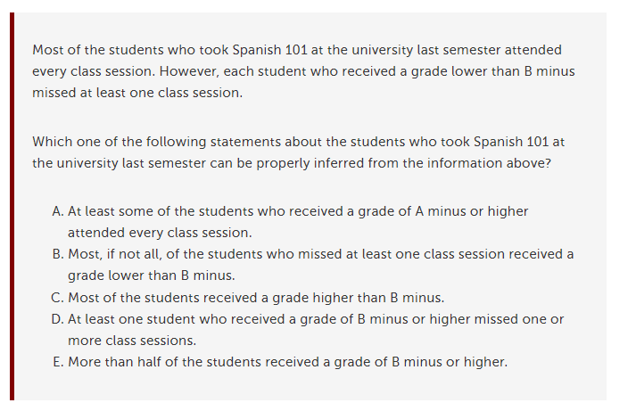
LSAT Question
This course will require similar logic and attention to small details!

Slide 23
Break

Slide 24
Unit 1: Foundations
Efficient
Fair
Truthful
Precise language and definitions are important!

Slide 25
Allocating Efficiently

Slide 26




Our Setting
1
2
3
4
We wish to allocate objects to a set of agents.
The objects are different, and the agents care about which they receive.
Key Assumptions:
Consequentialist: agents care about outcome, not process.
Unit Demand: agents demand at most one item.
No Externalities: agents care only about their own allocation.
Strict Preferences: agents can rank all items (no ties).
Known Preferences: agents know their own ranking of items.
No Money!

Slide 27
Preference
Profile
1 | 2 | 3 | 4
Favorite
Least Favorite
Notes:
Agent 2 has “base ranking”, everyone else has one fruit that they rate unusually highly.

Slide 28
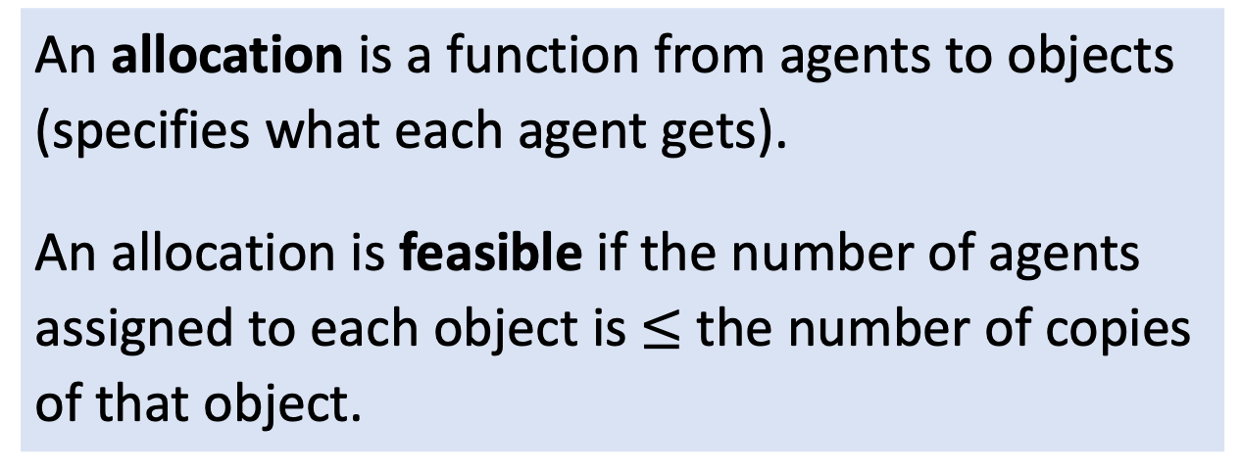
Feasible Allocations
An allocation is a function from agents to objects (specifies what each agent gets).
An allocation is feasible if the number of agents assigned to each object is $≤$ the number of copies of that object.
1
2
3
4

Slide 29
Which would you say is more efficient? Why?
1 | 2 | 3 | 4
1 | 2 | 3 | 4
ADBC
DACB

Slide 30
Defining Rank Efficiency
A feasible allocation is Rank Efficient if there is no other feasible allocation that has a lower sum of ranks.
Informal: maximize total happiness (utilitarian)

Slide 31
Defining Pareto Efficiency
A feasible allocation is Pareto Efficient if there is no other feasible allocation that is at least as good for every agent, and strictly better for some agent.
In other words, if you can help any agent without hurting another, the allocation is NOT Pareto efficient.
Informal: allocation is inefficient if some group of people want to switch objects.

Slide 32
Group Work
1. Is this allocation Pareto Efficient?
2. Is this allocation Pareto Efficient?
1 | 2 | 3 | 4
1 | 2 | 3 | 4
3. How many Pareto Efficient allocations can you find?

Slide 33
Session 1 Printout
Name: ____________________
Pareto Efficient Allocations:
________________________
________________________
________________________
________________________
________________________
________________________
________________________
1 | 2 | 3 | 4

Slide 34
Session 1 Printout
Name: ____________________
Pareto Efficient Allocations:
________________________
________________________
________________________
________________________
________________________
________________________
________________________
1 | 2 | 3 | 4

Slide 35


Group Work
1. Is this allocation Pareto Efficient?
2. Is this allocation Pareto Efficient?
1 | 2 | 3 | 4
1 | 2 | 3 | 4
3. How many Pareto Efficient allocations can you find?

Slide 36
1 | 2 | 3 | 4
Notes:
Under RSD, occurs with probability 1/24 (when order is 1234)

Slide 37
1 | 2 | 3 | 4
Notes:
Under RSD, occurs with probability 1/2 (when 2 goes before 1)

Slide 38
1 | 2 | 3 | 4
Notes:
Under RSD, happens 1/4 of the time (whenever 2 goes last)

Slide 39
1 | 2 | 3 | 4
Notes:
Under RSD, happens with probability 3/24 (orders 1423, 4123, 1243)

Slide 40
1 | 2 | 3 | 4
Notes:
Under RSD, happens with probability 2/24 (orders 1324, 3124)

Slide 41
How To Find Pareto Efficient Allocations?

Slide 42
Serial Dictatorship
1 | 2 | 3 | 4
1 | 2 | 3 | 4
Place agents in some order.
One by one, have them choose favorite remaining option.
Group Work:
Which allocation does Serial Dictatorship with order 1, 2, 3, 4, find?
Is the allocation of the Serial Dictatorship always Pareto Efficient? Why or why not?

Slide 43
“First Choices First” Algorithm
Give as many agents their first choice as possible.
Give as many of the remaining agents their second choice as possible.
Give as many of the remaining agents their third choice as possible.
To make this well-defined, must specify how
to choose among agents: suppose 1 > 2 > 3 > 4.
…
1 | 2 | 3 | 4
1 | 2 | 3 | 4
Group Work:
Which allocation does “First Choices First” find?
Is the allocation of “First Choices First” always Pareto Efficient? Why or why not?
Notes:
We’ll come back to this later! If we run FCF with single tiebreaking, we end up with only two assignments (equally likely): ADBC, DABC.

Slide 44
Utilitarianism
Goal: maximize “total happiness.”
How could we turn this into an algorithm?

Slide 45
Optimization
1 | 2 | 3 | 4
1 | 2 | 3 | 4
The sum of ranks of an allocation is calculated by adding the rank that each agent gives to his or her object.
A feasible allocation is rank efficient if no other feasible allocation has a lower sum of ranks.
Group Work:
In our example, which allocations are rank efficient?
In general, is every rank efficient allocation Pareto efficient?
In general, is every Pareto efficient allocation rank efficient?
Pareto Efficient
Rank Efficient

Slide 46
Implementing Serial Dictatorship
Two Approaches:
Dynamic mechanism (ask people to choose one at a time).
Direct mechanism (ask people to tell you their preferences).
When is a dynamic mechanism better?
When is a direct mechanism better?
Notes:
Discuss the Williams College housing draw? (Implemented as a dynamic mechanism.) Faculty office selection at Columbia (Implemented as a dynamic mechanism.)

Slide 47
Dynamic vs Direct
Doesn’t require participants to provide as much information.
Reasonable if either number of people or number of prizes is small.
Only requires one round of back and forth, and thus may take less time.
Reasonable if not too many options for people to rank.
Notes:
SPPS Data: https://www.spps.org/domain/1235
Also, dynamic may not get their hopes up (why did you ask me to rank all this stuff that wasn’t going to be available?)
If there aren’t too many options, direct is good (not to hard to report preferences).
Also if most people’s choices will be relevant (i.e. relative abundance of items).
Dynamic may be good if there are lots of items to choose from (so reporting preferences is a pain) or severe scarcity of items (so we don’t want to get people’s hopes up).

Slide 48
Dynamic vs Direct
Doesn’t require participants to provide as much information.
Reasonable if either number of people or number of prizes is small.
Only requires one round of back and forth, and thus may take less time.
Reasonable if not too many options for people to rank.
Group Work: Would you recommend a direct or dynamic implementation?
Office Assignment: 15 faculty assigned to 18 offices.
IE 5541: 50 students assigned to 10 project teams.
Notes:
SPPS Data: https://www.spps.org/domain/1235
Also, dynamic may not get their hopes up (why did you ask me to rank all this stuff that wasn’t going to be available?)
If there aren’t too many options, direct is good (not to hard to report preferences).
Also if most people’s choices will be relevant (i.e. relative abundance of items).
Dynamic may be good if there are lots of items to choose from (so reporting preferences is a pain) or severe scarcity of items (so we don’t want to get people’s hopes up).

Slide 49
Study Guide
Concepts
Allocation (Assignment)
Preference Profile
Pareto Efficient (PE)
Rank Efficient
Dynamic Mechanism
Direct (Revelation) Mechanism
Algorithms
Serial Dictatorship
Facts
Serial Dictatorship is PE
Serial Dictatorship is not guaranteed to be Rank Efficient.
Notes:
Probably good to cover SD in first class, to split these ideas up.

Slide 50
Homework
Concept Check 1 (Due Tomorrow, 11:59 pm)
(Based on past years, Question #1 is most challenging)
Reflection + Critical Thinking 1 (Due next Monday, 11:59 pm)

Slide 51
HW
This could be a HW question! First probably better direct, second dynamic, third could go either way, fourth probably direct.
Raffle: 1000 contestants entered into a drawing for 5 prizes.
SPPS: 2700 students assigned to 11 high schools.

Slide 52
Serial Dictatorship: Two Implementations
Dynamic mechanism (ask people to choose one at a time).
Direct mechanism (ask people to tell you their preferences).
When is a dynamic mechanism better?
When is a direct mechanism better?
Revelation Principle (Informal):
any outcome that can be achieved with a dynamic mechanism can be achieved with a direct mechanism (under certain assumptions).
Intuition: ask people their preferences, then simulate the dynamic mechanism and act on their behalf.
For most of class, we will focus on direct mechanisms.
Does it make sense to do revelation principle before talking about incentives? What does “simulate their behavior” mean if we don’t have a model to predict how they will behave?
Notes:
Discuss the Williams College housing draw? (Implemented as a dynamic mechanism.) Faculty office selection at Columbia (Implemented as a dynamic mechanism.)

