Slide 1
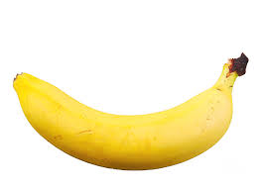

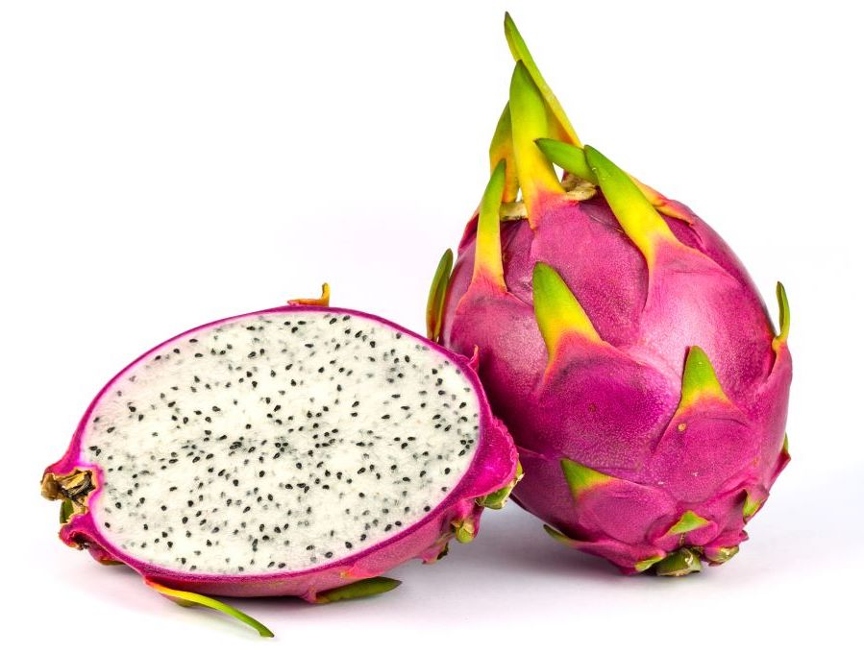
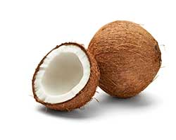
Warm Up
Name: __________________________
1 | 2 | 3 | 4
Consider the allocation ABCD. Is it
Pareto Efficient?
Individually Rational?
Core?
Consider the allocation DABC. Is it
Pareto Efficient?
Individually Rational?
Core?
What allocations are in the core?
__________________________________________________

Slide 2
Warm Up
Name: __________________________
1 | 2 | 3 | 4
Consider the allocation ABCD. Is it
Pareto Efficient?
Individually Rational?
Core?
Consider the allocation DABC. Is it
Pareto Efficient?
Individually Rational?
Core?
What allocations are in the core?
__________________________________________________

Slide 3


Warm Up
1 | 2 | 3 | 4
Consider the allocation ABCD. Is it
Pareto Efficient?
Individually Rational?
Core?
Consider the allocation DABC. Is it
Pareto Efficient?
Individually Rational?
Core?
What allocations are in the core?
ABDC
__________________________________________________

Slide 4
Allocations vs Mechanisms
The following are properties of allocations:
Pareto efficient.
Individually rational.
Core.
Can an allocation be truthful? No.
Truthfulness depends on what would have happened with different preferences. In other words, truthfulness is a property of a mechanism.
A mechanism is {Pareto efficient, individually rational, core} if it always selects an allocation with these properties.

Slide 5
Engineering Systems for Allocating Public Goods
Lecture 3: Top Trading Cycles + Fairness

Slide 6
Plan for Today
Homework Discussion: Pareto Efficiency
How many Pareto Efficient allocations can there be?
Does Serial Dictatorship find all of them?
Top Trading Cycles Algorithm
Algorithm Description
Important Properties
Defining “fairness”
Symmetry
Creating Fair Mechanisms

Slide 7
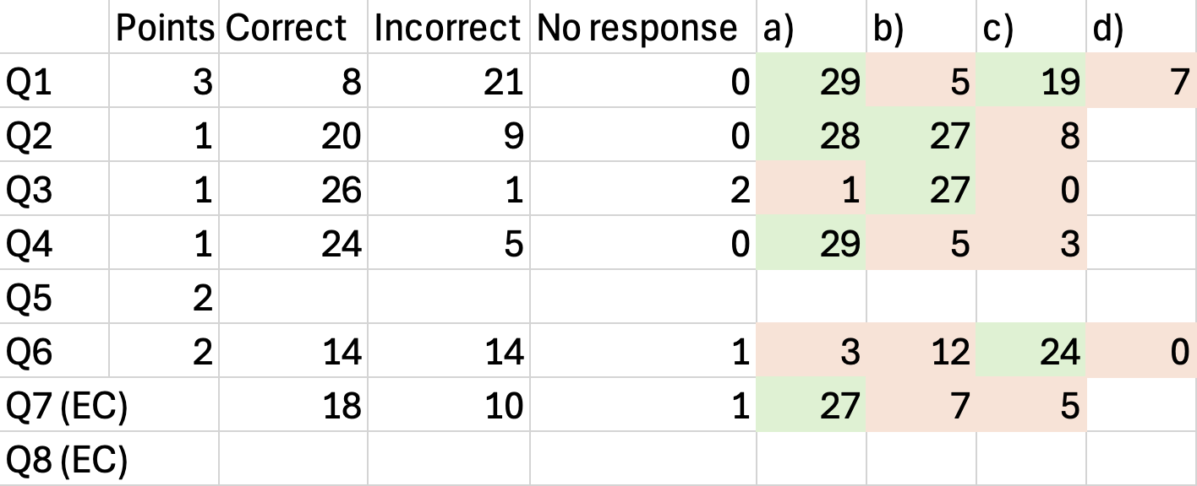
Concept Check 2
Anonymous form: Partial Credit??

Slide 8
Concept Check Q1
1 | 2 | 3 | 4
A | A | B | B
B | D | C | A
C | C | D | D
D | B | A | C
1 | 2 | 3 | 4
A | A | B | B
B | B | C | A
C | D | D | D
D | C | A | C
M Recommends ADBC.
M is Truthful.
Why can’t M give A to 2?
Why can’t M give C to 2?

Slide 9
Concept Check Q2
1 | 2 | 3 | 4
A | A | B | B
B | D | C | A
C | C | D | D
D | B | A | C
Why isn’t ACBD in the core?
Note:
Any core allocation must give 2 A, and 3 B.
Unique core allocation is CABD
Initial Allocation

Slide 10
Concept Check Q6
1 | 2 | 3 | 4
A | A | B | B
B | D | C | A
C | C | D | D
D | B | A | C
Suppose two agents start with each other’s favorite object.
Can there be a Pareto efficient assignment in which neither gets their first choice?
Yes! ADCB
Initial Allocation

Slide 11
Q7 & Q8 Extra Credit
Almost everyone attempted it!
Consider the following algorithm for board game trades:
1. Start with the initial allocation, and look for mutually beneficial pairwise swaps.
a) If there are no such swaps, terminate and produce the current allocation.
b) If there is one mutually beneficial pairwise swap, execute it.
c) If there are multiple mutually beneficial pairwise swaps, execute the one that improves the total sum of ranks the most. Break ties in favor of low-index agents.
2. Repeat step 1, with treating the current allocation as the "new" initial allocation.
Is outcome always Individually Rational?
Is outcome always Pareto Efficient?
Is this mechanism Truthful?
Proof by counter example
Agent 1 : A > B > C
Agent 2: B > C > A
Agent 3: C > A > B
The best allocation is ABC where everyone gets their top choice. But if we start with BCA then no one can make a mutually beneficial trade.

Slide 12
Q7 & Q8 Extra Credit
Almost everyone attempted it!
Consider the following algorithm for board game trades:
1. Start with the initial allocation, and look for mutually beneficial pairwise swaps.
a) If there are no such swaps, terminate and produce the current allocation.
b) If there is one mutually beneficial pairwise swap, execute it.
c) If there are multiple mutually beneficial pairwise swaps, execute the one that improves the total sum of ranks the most. Break ties in favor of low-index agents.
2. Repeat step 1, with treating the current allocation as the "new" initial allocation.
Is outcome always Individually Rational?
Is outcome always Pareto Efficient?
Is this mechanism Truthful?
Proof by counter example
Agent 1 : A > B > C
Agent 2: B > C > A
Agent 3: C > A > B
Take the above assignment as the true preferences. Now suppose that Agent 1 reports instead
Agent 1: A > C > B
This allows a trade to happen between agent 1 and 2 resulting in CBA. Then a trade between agent 1 and 3 resulting in ABC which is better than the honest report.

Slide 13
Reflection and Critical Thinking Review
Only one Pareto efficient allocation?
If (and only if) it is possible to give everyone their first choice.
Every feasible allocation is Pareto efficient?
If (and only if) everyone has the same preferences.
Intuition:
When people have different preferences, not many PE allocations.
When people have similar preferences, many PE allocations.

Slide 14
Can Serial Dictatorship find EVERY Pareto Efficient Allocation? (Extra Credit)
If you believe the answer is NO:
Find a Pareto efficient allocation that cannot be found by Serial Dictatorship.
(For example, a Pareto efficient allocation where nobody gets their first choice.)
If you believe the answer is YES:
Given any Pareto efficient allocation, show that Serial Dictatorship with some choosing order finds this allocation.
Is this even possible?

Slide 15
Can There Be a Pareto Efficient Allocation In Which Nobody Gets Their First Choice?
Claim:
In every Pareto efficient allocation, some agent gets their first choice.
Equivalent Claim:
If no agent gets their first choice, the allocation is not Pareto efficient.
Proof Approach:
Argue that if nobody gets their first choice, the allocation is not PE.
How? Look for a trade that doesn’t make anybody worse off.

Slide 16
Proof Demonstration

Slide 17
Recall: our definition of the core
A proposed allocation is blocked by a coalition of agents if the coalition “can benefit from ignoring the proposal.”
Formally, the coalition can distribute its initial games in a way that:
everyone in the coalition agrees is at least as good as the proposal, and
someone in the coalition prefers to the proposal.
A proposed allocation is in the core if no coalition blocks it.
Individually Rational: no individual can block (benefit from ignoring our proposal).
Pareto Efficient: the entire group cannot block (benefit from ignoring our proposal).
Core: no subset of agents can benefit from ignoring our suggestion.
Therefore, all core allocations are individually rational + Pareto efficient.

Slide 18
Questions from Last Class (Answered!)
Is there always an allocation in the core?
Can there be more than one allocation in the core?
How can we find an allocation in the core?
Can we find this allocation in a way that is truthful?
Yes
No
Top Trading Cycles
Yes

Slide 19




Top Trading Cycles
Observation: if a group can trade with each other and all get their favorite game, then if you recommend anything else, they will block your recommendation.
Algorithm:
Each person “points” to their favorite remaining game.
Everyone that is part of a “loop” gets the game they are pointing to.
Return to Step 1.
1: A > C > B
3: A > B > C
Note: People can point to their own game.
Question: Is there always a loop?
2: B > A > C

Slide 20
Top Trading Cycles Practice
1 | 2 | 3 | 4
1 | 2 | 3 | 4
1 | 2 | 3 | 4
Group Work:
Suppose we start from the allocation shown, and apply Top Trading Cycles.
What cycle clears first?
What is our final allocation?
Notes:
Analyzing TTC-RE:
Initial allocations that lead to final allocation of DABC: 2 starts with A or 1 starts with D (10), CBAD, BCDA.
Initial allocations that lead to final allocation of ADBC: 2 starts with D (6): ADBC, ADCB, BDAC, CDAB, CDBA, BDCA.
Initial allocations that lead to final allocation of ABCD: ABCD
Initial allocations that lead to final allocation of ACBD: ACBD, BCAD
Initial allocations that lead to final allocation of ABDC: ABDC, ACDB, CBDA
Note that whoever gets the apple always ends up with their first choice.

Slide 21
Top Trading Cycles Practice (Example 1)
Group Work: If we start from the allocation shown, and apply Top Trading Cycles,
What cycle clears first?
What is our final allocation?
Initial Allocation
Final Allocation

Slide 22
Top Trading Cycles Practice (Example 2)
Group Work: If we start from the allocation shown, and apply Top Trading Cycles,
What cycle clears first?
What is our final allocation?
Initial Allocation
Final Allocation

Slide 23
Top Trading Cycles: Dynamic vs Direct Implementations

Slide 24
Top Trading Cycles Practice
Individual Work: If we start from the allocation shown, and apply Top Trading Cycles,
What cycle clears first?
What is our final allocation?
Initial Allocation
Final Allocation

Slide 25
6 Person (Example 1)
6 Person (Ex 1 Soln)
1 | 2 | 3 | 4 | 5 | 6
E | F | C | A | F | A
C | C | A | E | B | F
A | E | B | F | A | E
D | A | E | B | D | D
F | D | D | C | E | B
B | B | F | D | C | C
1 | 2 | 3 | 4 | 5 | 6
E | F | C | A | F | A
C | C | A | E | B | F
A | E | B | F | A | E
D | A | E | B | D | D
F | D | D | C | E | B
B | B | F | D | C | C

Slide 26
6 Person (Example 2)
6 Person (Ex 2 Soln)
1’ | 2’ | 3’ | 4’ | 5’ | 6’
E | F | C | A | F | A
C | C | A | E | B | F
A | E | B | F | A | E
D | A | E | B | D | D
F | D | D | C | E | B
B | B | F | D | C | C
1’ | 2’ | 3’ | 4’ | 5’ | 6’
E | F | C | A | F | A
C | C | A | E | B | F
A | E | B | F | A | E
D | A | E | B | D | D
F | D | D | C | E | B
B | B | F | D | C | C

Slide 27
6 Person (Print)
1 | 2 | 3 | 4 | 5 | 6
E | F | C | A | F | A
C | C | A | E | B | F
A | E | B | F | A | E
D | A | E | B | D | D
F | D | D | C | E | B
B | B | F | D | C | C
1’ | 2’ | 3’ | 4’ | 5’ | 6’
E | F | C | A | F | A
C | C | A | E | B | F
A | E | B | F | A | E
D | A | E | B | D | D
F | D | D | C | E | B
B | B | F | D | C | C

Slide 28
7 Person Example 1
1 | 2 | 3 | 4 | 5 | 6 | 7
E | C | F | B | B | F | G
F | D | E | C | A | E | B
D | G | G | E | D | D | C
B | A | D | A | G | A | A
A | F | A | D | F | B | D
C | B | B | F | C | G | E
G | E | C | G | E | C | F
1 | 2 | 3 | 4 | 5 | 6 | 7
E | C | F | B | B | F | G
F | D | E | C | A | E | B
D | G | G | E | D | D | C
B | A | D | A | G | A | A
A | F | A | D | F | B | D
C | B | B | F | C | G | E
G | E | C | G | E | C | F

Slide 29
7 Person Example 2
1’ | 2’ | 3’ | 4’ | 5’ | 6’ | 7’
F | E | C | D | B | F | E
B | D | E | E | F | D | B
C | G | B | C | C | G | C
E | B | D | F | A | A | F
A | A | F | A | D | E | A
D | F | A | B | G | C | G
G | C | G | G | E | B | D
1’ | 2’ | 3’ | 4’ | 5’ | 6’ | 7’
F | E | C | D | B | F | E
B | D | E | E | F | D | B
C | G | B | C | C | G | C
E | B | D | F | A | A | F
A | A | F | A | D | E | A
D | F | A | B | G | C | G
G | C | G | G | E | B | D

Slide 30
8 Person (Example 1)
8 Person (Ex 1 Soln)
1 | 2 | 3 | 4 | 5 | 6 | 7 | 8
D | B | G | H | B | A | D | C
G | D | F | D | C | E | F | E
B | C | A | E | G | G | A | D
E | F | C | A | E | H | G | G
F | G | E | G | F | C | B | B
C | E | H | B | A | F | C | F
H | H | D | C | H | B | H | A
A | A | B | F | D | D | E | H
1 | 2 | 3 | 4 | 5 | 6 | 7 | 8
D | B | G | H | B | A | D | C
G | D | F | D | C | E | F | E
B | C | A | E | G | G | A | D
E | F | C | A | E | H | G | G
F | G | E | G | F | C | B | B
C | E | H | B | A | F | C | F
H | H | D | C | H | B | H | A
A | A | B | F | D | D | E | H

Slide 31
8 Person (Example 2)
8 Person (Ex 2 Soln)
1’ | 2’ | 3’ | 4’ | 5’ | 6’ | 7’ | 8’
D | B | G | H | B | A | D | C
G | D | F | D | C | E | F | E
B | C | A | E | G | G | A | D
E | F | C | A | E | H | G | G
F | G | E | G | F | C | B | B
C | E | H | B | A | F | C | F
H | H | D | C | H | B | H | A
A | A | B | F | D | D | E | H
1’ | 2’ | 3’ | 4’ | 5’ | 6’ | 7’ | 8’
D | B | G | H | B | A | D | C
G | D | F | D | C | E | F | E
B | C | A | E | G | G | A | D
E | F | C | A | E | H | G | G
F | G | E | G | F | C | B | B
C | E | H | B | A | F | C | F
H | H | D | C | H | B | H | A
A | A | B | F | D | D | E | H

Slide 32
8 Person (Print)
1 | 2 | 3 | 4 | 5 | 6 | 7 | 8
D | B | G | H | B | A | D | C
G | D | F | D | C | E | F | E
B | C | A | E | G | G | A | D
E | F | C | A | E | H | G | G
F | G | E | G | F | C | B | B
C | E | H | B | A | F | C | F
H | H | D | C | H | B | H | A
A | A | B | F | D | D | E | H
1’ | 2’ | 3’ | 4’ | 5’ | 6’ | 7’ | 8’
D | B | G | H | B | A | D | C
G | D | F | D | C | E | F | E
B | C | A | E | G | G | A | D
E | F | C | A | E | H | G | G
F | G | E | G | F | C | B | B
C | E | H | B | A | F | C | F
H | H | D | C | H | B | H | A
A | A | B | F | D | D | E | H

Slide 33
9 Person Example 1
1 | 2 | 3 | 4 | 5 | 6 | 7 | 8 | 9
B | C | G | B | G | H | H | B | B
A | G | C | I | B | C | C | A | A
I | B | E | H | F | E | D | I | G
H | I | H | G | D | F | F | H | D
D | F | I | D | I | I | E | F | C
F | D | D | F | H | D | G | D | F
G | A | F | E | C | G | A | C | I
C | E | B | C | E | B | B | E | E
E | H | A | A | A | A | I | G | H
1 | 2 | 3 | 4 | 5 | 6 | 7 | 8 | 9
B | C | G | B | G | H | H | B | B
A | G | C | I | B | C | C | A | A
I | B | E | H | F | E | D | I | G
H | I | H | G | D | F | F | H | D
D | F | I | D | I | I | E | F | C
F | D | D | F | H | D | G | D | F
G | A | F | E | C | G | A | C | I
C | E | B | C | E | B | B | E | E
E | H | A | A | A | A | I | G | H

Slide 34
9 Person Example 2
1 | 2 | 3 | 4 | 5 | 6 | 7 | 8 | 9
H | G | G | B | C | C | A | E | C
E | E | A | H | E | I | C | I | F
F | I | I | C | H | G | I | H | D
C | F | D | G | D | A | B | A | A
B | H | H | A | A | D | D | B | I
I | D | F | D | I | E | E | F | G
D | A | B | F | F | H | H | G | B
G | B | C | E | G | F | F | D | H
A | C | E | I | B | B | G | C | E
1 | 2 | 3 | 4 | 5 | 6 | 7 | 8 | 9
H | G | G | B | C | C | A | E | C
E | E | A | H | E | I | C | I | F
F | I | I | C | H | G | I | H | D
C | F | D | G | D | A | B | A | A
B | H | H | A | A | D | D | B | I
I | D | F | D | I | E | E | F | G
D | A | B | F | F | H | H | G | B
G | B | C | E | G | F | F | D | H
A | C | E | I | B | B | G | C | E

Slide 35
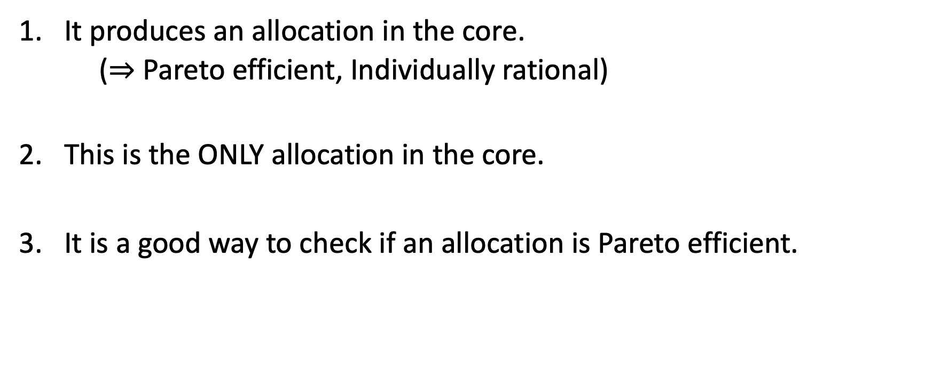
Nice Features of Top Trading Cycles (Part 1)
A core allocation always exists!
It produces an allocation in the core.
($⇒$ Pareto efficient, Individually rational)
This is the ONLY allocation in the core.
It is a good way to check if an allocation is Pareto efficient.

Slide 36
Why is TTC Outcome In The Core?
You come with your proposed coalition.
1. Does your coalition include anyone in the first cycle?
Yes! Then must include everyone in first cycle, and give them same object as TTC.

Slide 37
Why is TTC Outcome In The Core?
Nobody in first cycle can be made better off
Nobody in second cycle can be made better off without harming someone in first cycle.
Nobody in third cycle can be made better off without harming someone in first two cycles.
…
So if you come with a coalition, any way of improving for someone

Slide 38
Using TTC to Determine Pareto Efficiency
You start from an initial allocation, and run Top Trading Cycles.
Suppose TTC finds at least one swap. Was the initial allocation Pareto efficient?
Suppose TTC does not find any swaps. Was the initial allocation Pareto Efficient?
Conclusion: can use TTC to check if an allocation is Pareto efficient!

Slide 39
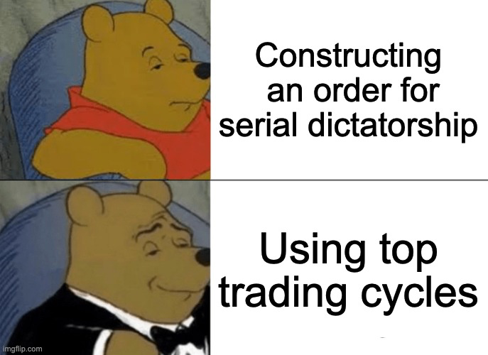
To Check if an Allocation is Pareto Efficient
Before: see if there is some order for serial dictatorship that produces it.
Now: run TTC from this allocation, see if we get the same allocation back.

Slide 40
Break

Slide 41
Back to Board Game Trades
1 | 2 | 3
TTC recommends ABC.
Maybe core is not so important.
What if instead, these are our goals:
Pareto efficient
Individually Rational
Truthful
Does TTC satisfy all three properties?
Is there a truthful mechanism that recommends CBA?

Slide 42
Top Trading Cycles Incentives
Group Work:
Reset to the initial state.
Repeat top trading cycles, but now you can point to anyone.
Try to get a better object than last time. Can you?
Maybe just authorize one person in each group to lie?
Or discuss possible lying strategies in advance?

Slide 43
Nice Features of Top Trading Cycles (Part 2)
TTC is Pareto efficient, individually rational, and truthful! (Roth 1982)
TTC is the only mechanism that is Pareto efficient, individually rational, and truthful. (Ma 1994)
TTC is the only mechanism that is Pair efficient, individually rational, and truthful. (Ekici 2024)

Slide 44
An Amazing Fact!
1 | 2 | 3 | 4
Suppose that on this instance, we wish to recommend DABC.
Then either
Our mechanism is not truthful.
OR
On some other instance, it fails to select a PE + IR allocation.

Slide 45
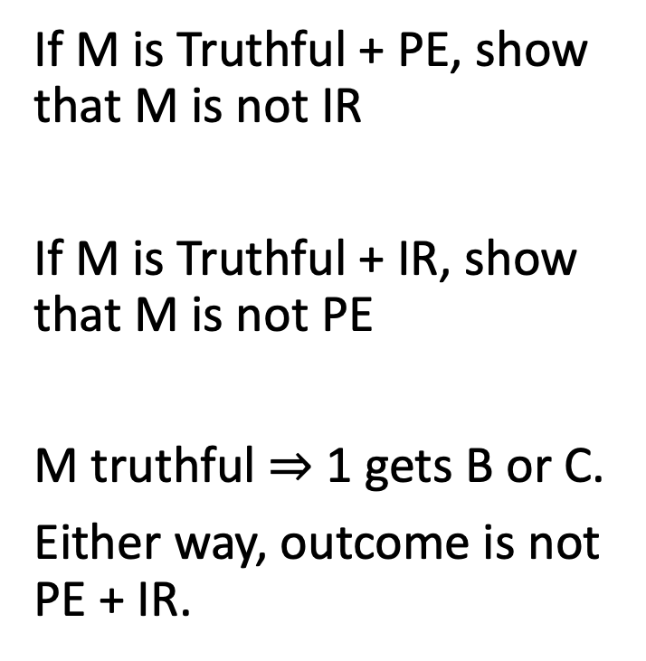
Proving a Special Case
On this profile, mechanism M recommends CBA:
If M is Pareto Efficient + Individually Rational, show that M is not Truthful
1 | 2 | 3
1 | 2 | 3
If M is Truthful + PE, show that M is not IR
If M is Truthful + IR, show that M is not PE
M truthful $⇒$ 1 gets B or C.
Either way, outcome is not PE + IR.

Slide 46
TTC avoids two types of bad behavior!
Suppose we want to suggest a Pareto Efficient, Individually Rational allocation. We have two concerns about “bad behavior”:
People might not tell us their true preferences
People might not follow our recommendations
There is only ONE truthful mechanism: TTC.
There is only ONE core allocation: the one recommended by TTC.
Solution: truthful
Solution: core

Slide 47
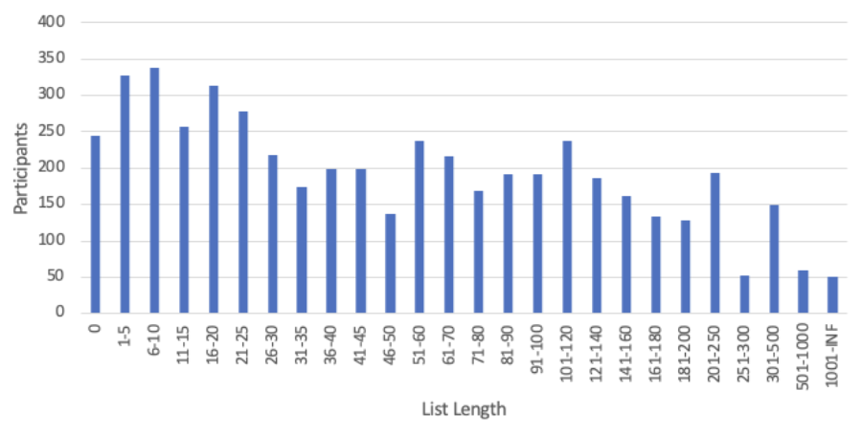
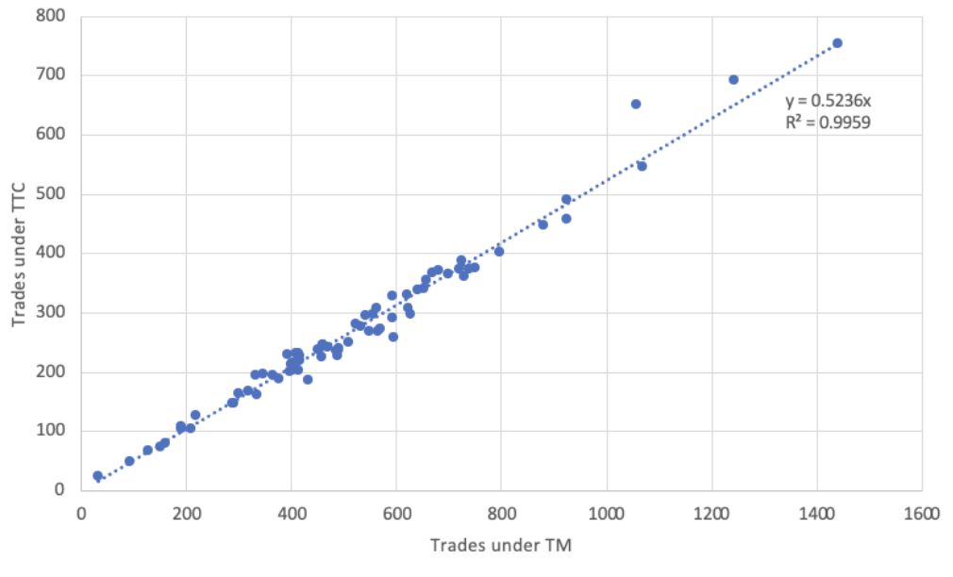
Board game trades use Trade Maximizer. Should they switch to Top Trading Cycles?
Data from 82 math trades from 2016-2022
65 of them involve > 4,000 games.

Slide 48
What if people bring multiple games?
Not sure this is worth going into. (Relevant for application, but not as relevant for future of course.)
Could also ask, what if we have fewer games than people (Less relevant for application, more relevant for future of course.)

Slide 49
Making “Fair” Versions of Serial Dictatorship and Top Trading Cycles
Serial Dictatorship is not fair:
the person who goes first gets an advantage!
Top Trading Cycles from an arbitrary endowment is also not fair:
someone might start with the “best” object!
How could we make these fair?
Random Serial Dictatorship (RSD): have people choose in a random order.
Top Trading Cycles from Random Endowments (TTC-RE): give items randomly, then run TTC.

Slide 50
Two Settings
Designer controls all items
Algorithm: Serial Dictatorship
Every order of agents is Pareto efficient and truthful.
Can find any Pareto efficient allocation (with some order).
Could we use Top Trading Cycles?
Sure! Apply TTC from any allocation
Each item owned by an agent
Algorithm: Top Trading Cycles
Pareto efficient, truthful, and individually rational.
Finds the unique core allocation.
Could we use Serial Dictatorship?
Concern: result would not be IR

Slide 51
Our Next Goal: Define Fairness
Intuitive definition: treat people equally!
This generally requires randomization.

Slide 52
How To Define Fairness?
“Treat People Equally” Could Mean:
Equal Allocation. People have the same chance of receiving each item
Equal Rank Distribution. People have identical chance of receiving their first, second, third choice…
Symmetry. (Defined on next slides.)
Other Definitions of Fairness (not discussed today):
Equal treatment of equals
Envy-Free
Notes:
Another option: Envy Free. However, to even define it we need agents to be able to compare randomized bundles (or describe how they do this). In addition, depending on how this is defined, RSD is not envy-free (see paper by Alex Nesterov).

Slide 53
Random Mechanisms
A random mechanism is a probability distribution over deterministic mechanisms.
A random mechanism is Pareto efficient if all of the deterministic mechanisms which it might choose are Pareto efficient.
A random mechanism is truthful (strategy-proof) if all of the deterministic mechanisms which it might choose are truthful.
There are other ways to define efficiency and truthfulness for random mechanisms, but today we will focus on the definitions above.

Slide 54
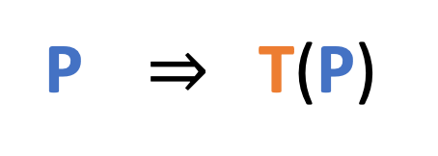
Transposing Preferences
A transposition is a swap of two positions.
1 | 2 | 3 | 4
We can apply transposition T to any preference profile P:
1 | 2 | 3 | 4
1 | 2 | 3 | 4
P $⇒$ T(P)

Slide 55
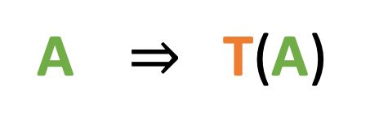
Transposing Allocations
A transposition is a swap of two positions.
1 | 2 | 3 | 4
We can also apply transposition T to any allocation A:
1 | 2 | 3 | 4
1 | 2 | 3 | 4
A $⇒$ T(A)

Slide 56
Defining Symmetry
A random mechanism M is symmetric if for any
Preference profile P, Allocation A, and Transposition T:
Prob(M(P) = A) = Prob(M(T(P)) = T(A)).
Intuition:
We are not systematically favoring one agent over another.
Swapping two agent’s preferences should just swap the final allocation.
Note: An equivalent definition says that this must hold for any permutation (possibly involving more than two agents).

Slide 57
Simple recipe to make a symmetric mechanism
Create deterministic mechanisms with different “roles”.
Assign agents randomly to roles.

Slide 58
Random Serial Dictatorship
Roles are “agent who chooses first”, “agent who chooses second”…
Randomly assign agents to roles (random order of selection)

Slide 59
Top Trading Cycles from Random Endowments
Roles are “agent who starts with A”, “agent who starts with B”, …
Randomly assign agents to roles (random initial allocation)

Slide 60
Session 3 Study Guide
Concepts
Random Mechanism
Transposition
Symmetry
Algorithms
TTC
TTC-RE
RSD
Facts
Top Trading Cycles gives the unique allocation in the core
Top Trading Cycles is PE, SP, IR.
Top Trading Cycles is the only algorithm with these properties.
RSD is Pareto efficient, truthful and symmetric.
TTC-RE is Pareto efficient, truthful and symmetric.
Notes:
Probably good to cover SD in first class, to split these ideas up.

Slide 61
References
Shapley and Scarf (1974). On Cores and Indivisibility. Journal of Mathematical Economics.
Postlewaite and Roth (1977). Weak vs Strong Domination in a Market with Indivisible Goods. Journal of Mathematical Economics.
Roth (1982) Incentive compatibility in a market with indivisible goods. Economics letters.
Ma (1994): Strategy-Proofness and the Strict Core in a Market with Indivisibilities. International Journal of Game Theory.
Sethuraman (2023). An alternative proof of a characterization of the TTC mechanism. Operations Research Letters.
Ekici (2023): Pair-efficient reallocation of indivisible objects. Theoretical Economics.
Ekici and Sethuraman (2024). Characterizing the TTC rule via pair-efficiency: A short proof. Economics letters.
Introduce TTC (credit to David Gale)
Prove the Core is Unique
Prove TTC is truthful
Prove TTC is the only mechanism that is truthful, IR, PE
Simplifies proof of (4)
Prove TTC is the only mechanism that is truthful, IR, Pair Eff.
Simplifies proof of (6)
Short note (Me + Felipe)

Slide 62
Coming Up
Concept Check 3 (due tomorrow at 11:59 pm)
Reflection and Critical Thinking 2 (due next Monday at 11:59 pm)

