Slide 1
Warm Up
Student Preferences
School Priorities
Each school has 1 seat
1 | 2 | 3 | 4
B | C | C | C
D | B | B | D
A | D | D | B
C | A | A | A
A | B | C | D
3 | 3 | 1 | 1
1 | 4 | 3 | 2
4 | 1 | 2 | 4
2 | 2 | 4 | 3
Group Work:
What is the outcome of First Choices First? Does it respect priorities?
What is the outcome of Generalized Top Trading Cycles? Does it RP?
Find an assignment that assigns all 4 students and respect priorities.

Slide 2
Warm Up
FCF Outcome
GTTC Outcome
Respects Priorities
1 | 2 | 3 | 4
B | C | C | C
D | B | B | D
A | D | D | B
C | A | A | A
1 | 2 | 3 | 4
B | C | C | C
D | B | B | D
A | D | D | B
C | A | A | A
1 | 2 | 3 | 4
B | C | C | C
D | B | B | D
A | D | D | B
C | A | A | A
2 has justified envy for 4
4 has justified envy for 1
Group Work:
What is the outcome of First Choices First? Does it respect priorities?
What is the outcome of Generalized Top Trading Cycles? Does it RP?
Find an assignment that assigns all 4 students and respect priorities.

Slide 3
Allocating Public Resources
Lesson 6: Deferred Acceptance

Slide 4
Plan for Today
Quick Recap
Introduce “Deferred Acceptance” algorithms for finding assignments that are non-wasteful and respect priorities (“stable”).
Properties of these algorithms.

Slide 5
An Engineering Approach
First, specify criteria (“axioms”).
Then ask, which systems satisfy these criteria?

Slide 6


From Unit 1
Efficient | Fair | Truthful
Efficient | Fair | Truthful
(Symmetric)
Random allocation
Rank Efficient (w/random tie-break)
Serial Dictatorship
Random Serial Dictatorship
(= TTC from Random Endowments)

Slide 7
School Choice
School choice algorithms typically don’t treat students equally (are not symmetric).
Instead, each school has a priority ranking of students.
No Justified Envy (“Respects Priorities”):
Whenever one student envies another, the second student has higher priority at the coveted school.

Slide 8

Review From Last Class
Pareto Efficient | Respects Priorities | Truthful
Pareto Efficient | Respects Priorities | Truthful
Pareto Efficient | Respects Priorities | Truthful
Pareto Efficient | Respects Priorities | Truthful
First Preferences First (Boston)
Generalized Top Trading Cycles
No algorithm guarantees Pareto Efficiency and Respecting Priorities
1 | 2 | 3
A | B | A
B | A | B
C | C | C
A | B | C
2 | 1 | 1
1 | 3 | 2
3 | 2 | 3
4 Pareto Efficient Allocations
None of them Respect Priorities!

Slide 9
Non-wastefulness
Non-wasteful
An assignment is non-wasteful if no student prefers an under-enrolled school to their own assignment.
Pareto Efficient
Student Preferences
School Priorities
1 | 2 | 3
A | B | A
B | A | B
C | C | C
A | B | C
2 | 1 | 1
1 | 3 | 2
3 | 2 | 3
From Homework:
In this example, only one non-wasteful assignment respects priorities.

Slide 10
Questions
Is there always an assignment that is non-wasteful and respects priorities? If so, how can we find one?
Could there be multiple assignments with these properties? If so, can we choose the “best” one?
Can we make this mechanism truthful?

Slide 11
A Dynamic Admissions Mechanism
Each school admits # applicants equal to vacancies (wait-lists others).
Students reject all but their favorite offer.
Repeat until each school either
is filled, or
has admitted every applicant.
The direct version of this mechanism is called “School Proposing Deferred Acceptance (DA)”
Schools make offers.
All student acceptances tentative (“deferred”) until the end.

Slide 12
Example from last class
Each school has 5 seats
A | 9 | 13 | 10 | 6 | 3 | 15 | 11 | 5 | 1 | 2 | 14 | 7 | 12 | 4 | 8
B | 14 | 15 | 12 | 2 | 4 | 1 | 11 | 6 | 8 | 10 | 13 | 5 | 3 | 9 | 7
C | 8 | 4 | 6 | 3 | 1 | 12 | 2 | 9 | 7 | 13 | 15 | 11 | 5 | 10 | 14
1 | 2 | 3 | 4 | 5 | 6 | 7 | 8 | 9 | 10 | 11 | 12 | 13 | 14 | 15
A | A | A | A | C | B | B | B | A | A | A | A | B | A | C
C | B | B | C | A | A | A | A | B | B | B | B | C | B | B
B | C | C | B | B | C | C | C | C | C | C | C | A | C | A

Slide 13
Outcome of School Proposing DA
A | 9 | 13 | 10 | 6 | 3 | 15 | 11 | 5 | 1 | 2 | 14 | 7 | 12 | 4 | 8
B | 14 | 15 | 12 | 2 | 4 | 1 | 11 | 6 | 8 | 10 | 13 | 5 | 3 | 9 | 7
C | 8 | 4 | 6 | 3 | 1 | 12 | 2 | 9 | 7 | 13 | 15 | 11 | 5 | 10 | 14
1 | 2 | 3 | 4 | 5 | 6 | 7 | 8 | 9 | 10 | 11 | 12 | 13 | 14 | 15
A | A | A | A | C | B | B | B | A | A | A | A | B | A | C
C | B | B | C | A | A | A | A | B | B | B | B | C | B | B
B | C | C | B | B | C | C | C | C | C | C | C | A | C | A

Slide 14
Analyzing School Proposing DA
Why is this assignment non-wasteful?
Any school with vacancies has admitted every applicant.
Applicants choose their favorite school that admits them.
Why does this assignment respect priorities?
If you envy another student, you were not admitted to their school.
Schools admit from the top of their priority list.
Is there easy “verification” that this assignment respects priorities?
Publish the cutoff scores!

Slide 15
Could there be more than one non-wasteful allocation that respects priorities?

Slide 16
Another Way To Find Non-Wasteful Matching that Respects Priorities
Idea: start from wasteful matching that respects priorities, and gradually make it less wasteful.
Possible Algorithm:
Start from a matching where no student is assigned.
Pick any school with a vacant seat.
Look at all students who prefer that school to their current assignment.
Among these students, assign the one with highest priority at the school to the empty seat (remove from their previous school, if necessary).
Repeat steps 2-4 until either (i) there are no empty seats, or (ii) no student wants to claim any empty seat.
Equivalent to school proposing DA!

Slide 17
Could there be more than one non-wasteful allocation that respects priorities?
1 | 2
A | B
B | A
A | B
2 | 1
1 | 2
1A, 2B respects priorities (no envy).
1B, 2A respects priorities (no justified envy).

Slide 18
Student-Proposing Deferred Acceptance
Unassigned students apply to favorite school which they have not yet applied to.
Schools tentatively hold best applicants up to their capacity, reject the rest.
Repeat until each student either
is assigned,
has applied to every school on his or her list.
“Student Proposing Deferred Acceptance (DA)”
Students make offers.
All school acceptances tentative (“deferred”) until the end.

Slide 19
Example from last class
Each school has 5 seats
A | 9 | 13 | 10 | 6 | 3 | 15 | 11 | 5 | 1 | 2 | 14 | 7 | 12 | 4 | 8
B | 14 | 15 | 12 | 2 | 4 | 1 | 11 | 6 | 8 | 10 | 13 | 5 | 3 | 9 | 7
C | 8 | 4 | 6 | 3 | 1 | 12 | 2 | 9 | 7 | 13 | 15 | 11 | 5 | 10 | 14
1 | 2 | 3 | 4 | 5 | 6 | 7 | 8 | 9 | 10 | 11 | 12 | 13 | 14 | 15
A | A | A | A | C | B | B | B | A | A | A | A | B | A | C
C | B | B | C | A | A | A | A | B | B | B | B | C | B | B
B | C | C | B | B | C | C | C | C | C | C | C | A | C | A

Slide 20
Outcome of Student Proposing DA
A | 9 | 13 | 10 | 6 | 3 | 15 | 11 | 5 | 1 | 2 | 14 | 7 | 12 | 4 | 8
B | 14 | 15 | 12 | 2 | 4 | 1 | 11 | 6 | 8 | 10 | 13 | 5 | 3 | 9 | 7
C | 8 | 4 | 6 | 3 | 1 | 12 | 2 | 9 | 7 | 13 | 15 | 11 | 5 | 10 | 14
1 | 2 | 3 | 4 | 5 | 6 | 7 | 8 | 9 | 10 | 11 | 12 | 13 | 14 | 15
A | A | A | A | C | B | B | B | A | A | A | A | B | A | C
C | B | B | C | A | A | A | A | B | B | B | B | C | B | B
B | C | C | B | B | C | C | C | C | C | C | C | A | C | A

Slide 21
Analyzing Student Proposing DA
Why is this assignment non-wasteful?
Any school with vacancies has not rejected any applicant.
Applicants have applied to any school they prefer to their assignment.
Why does this assignment respect priorities?
If you envy another student, you were rejected from their school.
This implies that you are lower priority than anyone matched there.
Is there easy “verification” that this assignment respects priorities?
Publish the cutoff scores!

Slide 22
Note on Proposal Order
For both student-proposing and school-proposing algorithms,
the order in which proposals are made does not matter.
Any proposal order results in the same final assignment.
(However, the two algorithms may produce different assignments.)

Slide 23
School Proposing vs Student Proposing
School Proposing DA and Student Proposing DA are both nonwasteful, respect priorities.
Which students prefer each outcome?

Slide 24
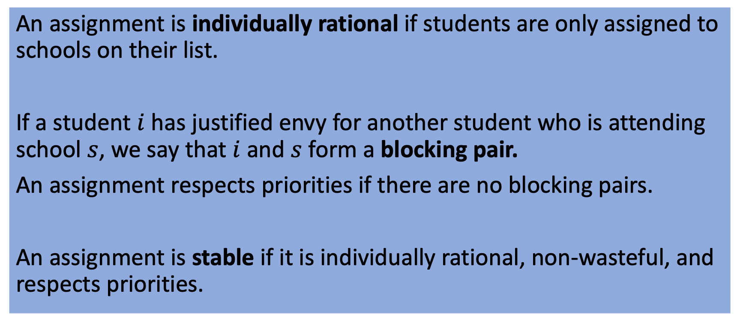
Incomplete Lists
In practice, students don’t list every school.
An assignment is individually rational if students are only assigned to schools on their list.
If a student $i$ has justified envy for another student who is attending school $s$, we say that $i$ and $s$ form a blocking pair.
An assignment respects priorities if there are no blocking pairs.
An assignment is stable if it is individually rational, non-wasteful, and respects priorities.

Slide 25
A | B | C
7 (94) | 12 (88) | 4 (99)
12 (92) | 5 (86) | 6 (91)
4 (91) | 15 (84) | 7 (89)
3 (90) | 8 (83) | 10 (87)
14 (87) | 9 (79) | 11 (75)
9 (86) | 13 (78) | 13 (67)
2 (84) | 14 (76) | 15 (62)
5 (75) | 10 (75) | 1
8 (64) | 2 (72) | 2
6 (62) | 11 (70) | 3
1 (61) | 1 (67) | 5
10 | 3 (60) | 8
11 | 4 | 9
13 | 6 | 12
15 | 7 | 14
Group Work:
What is the outcome of Student-Proposing Deferred Acceptance? What are school cutoffs?
What is the outcome of School-Proposing Deferred Acceptance? What are school cutoffs?
Which students get a different outcome? Which outcome do they prefer?
1 | 2 | 3 | 4 | 5 | 6 | 7 | 8
A (62) | A (84) | B (60) | A (91) | B (86) | A (62) | A (94) | B (83)
B (67) | B (72) | A (90) | C (99) | A (75) | C (91) | C (89) | A (64)
9 | 10 | 11 | 12 | 13 | 14 | 15
A (86) | C (89) | B (70) | A (92) | B (78) | B (76) | B (84)
B (79) | B (75) | C (75) | B (86) | C (67) | A (87) | C (62)
Each school has 5 seats

Slide 26
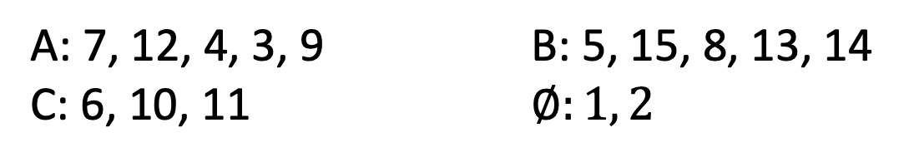
In Class Example
A | B | C
7 (94) | 12 (88) | 4 (99)
12 (92) | 5 (86) | 6 (91)
4 (91) | 15 (84) | 7 (89)
3 (90) | 8 (83) | 10 (87)
14 (87) | 9 (79) | 11 (75)
9 (86) | 13 (78) | 13 (67)
2 (84) | 14 (76) | 15 (62)
5 (75) | 10 (75) | 1
8 (64) | 2 (72) | 2
6 (62) | 11 (70) | 3
1 (61) | 1 (67) | 5
10 | 3 (60) | 8
11 | 4 | 9
13 | 6 | 12
15 | 7 | 14
What is the outcome of Student-Proposing DA?
A: 7, 12, 4, 3, 9 B: 5, 15, 8, 13, 14
C: 6, 10, 11 $∅:1, 2$
1 | 2 | 3 | 4 | 5 | 6 | 7 | 8
A (62) | A (84) | B (60) | A (91) | B (86) | A (62) | A (94) | B (83)
B (67) | B (72) | A (90) | C (99) | A (75) | C (91) | C (89) | A (64)
9 | 10 | 11 | 12 | 13 | 14 | 15
A (86) | C (89) | B (70) | A (92) | B (78) | B (76) | B (84)
B (79) | B (75) | C (75) | B (86) | C (67) | A (87) | C (62)
Each school has 5 seats

Slide 27
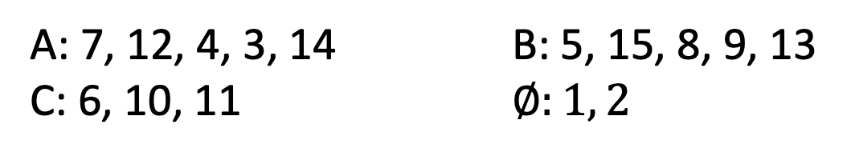
In Class Example
A | B | C
7 (94) | 12 (88) | 4 (99)
12 (92) | 5 (86) | 6 (91)
4 (91) | 15 (84) | 7 (89)
3 (90) | 8 (83) | 10 (87)
14 (87) | 9 (79) | 11 (75)
9 (86) | 13 (78) | 13 (67)
2 (84) | 14 (76) | 15 (62)
5 (75) | 10 (75) | 1
8 (64) | 2 (72) | 2
6 (62) | 11 (70) | 3
1 (61) | 1 (67) | 5
10 | 3 (60) | 8
11 | 4 | 9
13 | 6 | 12
15 | 7 | 14
What is the outcome of School-Proposing DA?
A: 7, 12, 4, 3, 14 B: 5, 15, 8, 9, 13
C: 6, 10, 11 $∅:1, 2$
1 | 2 | 3 | 4 | 5 | 6 | 7 | 8
A (62) | A (84) | B (60) | A (91) | B (86) | A (62) | A (94) | B (83)
B (67) | B (72) | A (90) | C (99) | A (75) | C (91) | C (89) | A (64)
9 | 10 | 11 | 12 | 13 | 14 | 15
A (86) | C (89) | B (70) | A (92) | B (78) | B (76) | B (84)
B (79) | B (75) | C (75) | B (86) | C (67) | A (87) | C (62)
Each school has 5 seats

Slide 28
Amazing Fact #1
If a student is assigned in one stable matching, they are assigned in all stable matchings!

Slide 29
Amazing Fact #2
Student Optimality: all students agree that student-proposing DA gives the best possible stable match, and school-proposing DA gives the worst possible stable match!
Among all feasible outcomes that respect priorities, there is one that ALL students agree is at least as good as any other!
If we focus on all feasible outcomes, this is clearly not the case.

Slide 30
Why is there a student-optimal stable matching?
Suppose that we have two stable matchings, yellow and blue.
If 2 prefers blue, B must prefer yellow
(else 2 has justified envy in yellow)
If B prefers yellow, 3 must prefer blue
(else 3 has justified envy in blue)
If 3 prefers blue, C must prefer yellow
(else 3 has justified envy in yellow)
If C prefers yellow, 4 must prefer blue
(else 4 has justified envy in blue)
If 4 prefers blue, D must prefer yellow
(else 4 has justified envy in yellow)
1 2 3 4 5 6 7
A B C D E F G
1 2 3 4 5 6 7
A B C D E F G
Can create new stable matching which all students agree is at least as good as yellow and blue.
In each cycle:
Students agree which is better.
Schools believe other is better.
Can create new stable matching which all students agree is better than yellow or blue.

Slide 31
Consequence of Amazing Fact #2
If Student-Proposing and School-Proposing Deferred Acceptance produce the same outcome, then this is the only stable match.

Slide 32
Discussion
What to do about students who are not assigned to any school?
Common Approaches:
Administrative assignment to school with vacancies
Second round involving only schools that still have vacancies

Slide 33
Questions
How to find assignment that is non-wasteful and respects priorities?
Could there be multiple assignments with these properties? If so, can we choose the “best” one?
Can we make this mechanism truthful?
Deferred Acceptance
Yes!
Student-proposing: best for students.
School-proposing: best for schools.
Next Class

Slide 34
Study Guide
Concepts
Blocking Pair
Stability
Facts
Stability = IR + Non-wasteful + No Justified Envy
There may be multiple stable assignments.
The same students are assigned in all stable assignments.
Stable assignments verified by “cutoff scores”
Student-Proposing DA finds student optimal stable assignment: all students agree it’s at least as good as any other stable assignment.
School-Proposing DA finds student pessimal and school optimal stable assignment.
Algorithms
School-Proposing Deferred Acceptance
Student-Proposing Deferred Acceptance

Slide 35
Coming Up
Reflection & Critical Thinking 3 (includes midterm survey)
Also remember: anonymous feedback link
Midterm #1 (available February 15 – 19; see next slide)
Office hours from 11-11:45 on T, Th, and by appointment

Slide 36
Midterm #1
24-hour take-home exam on Canvas.
Available Thursday February 15 through Monday February 19.
Your 24 hour clock starts when you open the exam.
Must be completed by NOON on Monday February 19.
Open notes: may use any Canvas materials + your lecture notes.
May NOT use any other resources.

Slide 37
Cutoff Description of Stable Matching
Each school’s cutoff = priority of lowest student to attend
(or 0 if there are vacant seats)
All students go to their favorite school where they clear the cutoff.
How could a student benefit from lying?
They could change the cutoffs!
1 | 2
A | B
B | A
A | B
2 | 1
1 | 2
1 | 2
A | B
B
A | B
2 | 1
1 | 2
School-Optimal Cutoffs
Student-Optimal Cutoffs
Only Stable Cutoffs

Slide 38
Is Deferred Acceptance Truthful?
Each school has 1 seat
Student Preferences
School Priorities
1 | 2 | 3 | 4
B | C | C | C
D | B | B | D
A | D | D | B
C | A | A | A
A | B | C | D
3 | 3 | 1 | 1
1 | 4 | 3 | 2
4 | 1 | 2 | 4
2 | 2 | 4 | 3
Group Work:
What is the outcome of Student-Proposing Deferred Acceptance?
What is the outcome of School-Proposing Deferred Acceptance?
Under each mechanism, can any student benefit from misreporting?

Slide 39
Is Deferred Acceptance Truthful?
Each school has 1 seat
Student Preferences
School Priorities
1 | 2 | 3 | 4
B | C | C | C
D | B | B | D
A | D | D | B
C | A | A | A
A | B | C | D
3 | 3 | 1 | 1
1 | 4 | 3 | 2
4 | 1 | 2 | 4
2 | 2 | 4 | 3
Both algorithms:
Result in DACB.
Group Work:
What is the outcome of Student-Proposing Deferred Acceptance?
What is the outcome of School-Proposing Deferred Acceptance?
Under each mechanism, can any student benefit from misreporting?

Slide 40
Deferred Acceptance: Student Proposing
Student Preferences
School Priorities
1 | 2 | 3 | 4
B | C | C | C
D | B | B | D
A | D | D | B
C | A | A | A
A | B | C | D
3 | 3 | 1 | 1
1 | 4 | 3 | 2
4 | 1 | 2 | 4
2 | 2 | 4 | 3
Student 1 applies to B, 2, 3, 4 apply to C.
Students 2 and 4 are rejected by C.

Slide 41
Deferred Acceptance: Student Proposing
Student Preferences
School Priorities
1 | 2 | 3 | 4
B | C | C | C
D | B | B | D
A | D | D | B
C | A | A | A
A | B | C | D
3 | 3 | 1 | 1
1 | 4 | 3 | 2
4 | 1 | 2 | 4
2 | 2 | 4 | 3
Student 2 applies to B, student 4 applies to D.
Student 2 is rejected by B.

Slide 42
Deferred Acceptance: Student Proposing
Student Preferences
School Priorities
1 | 2 | 3 | 4
B | C | C | C
D | B | B | D
A | D | D | B
C | A | A | A
A | B | C | D
3 | 3 | 1 | 1
1 | 4 | 3 | 2
4 | 1 | 2 | 4
2 | 2 | 4 | 3
Student 2 applies to D.
Student 4 is rejected by D.

Slide 43
Deferred Acceptance: Student Proposing
Student Preferences
School Priorities
1 | 2 | 3 | 4
B | C | C | C
D | B | B | D
A | D | D | B
C | A | A | A
A | B | C | D
3 | 3 | 1 | 1
1 | 4 | 3 | 2
4 | 1 | 2 | 4
2 | 2 | 4 | 3
Student 4 applies to B.
Student 1 is rejected by B.

Slide 44
Deferred Acceptance: Student Proposing
Student Preferences
School Priorities
1 | 2 | 3 | 4
B | C | C | C
D | B | B | D
A | D | D | B
C | A | A | A
A | B | C | D
3 | 3 | 1 | 1
1 | 4 | 3 | 2
4 | 1 | 2 | 4
2 | 2 | 4 | 3
Student 1 applies to D.
Student 2 is rejected by D.

Slide 45
Deferred Acceptance: Student Proposing
Student Preferences
School Priorities
1 | 2 | 3 | 4
B | C | C | C
D | B | B | D
A | D | D | B
C | A | A | A
A | B | C | D
3 | 3 | 1 | 1
1 | 4 | 3 | 2
4 | 1 | 2 | 4
2 | 2 | 4 | 3
Student 2 applies to A.
No further rejections, so the match DACB is finalized.

Slide 46
Deferred Acceptance: School Proposing
Student Preferences
School Priorities
1 | 2 | 3 | 4
B | C | C | C
D | B | B | D
A | D | D | B
C | A | A | A
A | B | C | D
3 | 3 | 1 | 1
1 | 4 | 3 | 2
4 | 1 | 2 | 4
2 | 2 | 4 | 3
Schools A and B admit student 3, schools C and D admit student 1.
School A is rejected by student 3, school C is rejected by student 1.

Slide 47
Deferred Acceptance: School Proposing
Student Preferences
School Priorities
1 | 2 | 3 | 4
B | C | C | C
D | B | B | D
A | D | D | B
C | A | A | A
A | B | C | D
3 | 3 | 1 | 1
1 | 4 | 3 | 2
4 | 1 | 2 | 4
2 | 2 | 4 | 3
School A admits student 1, school C admits student 3.
School A rejected by student 1, school B rejected by student 3.

Slide 48
Deferred Acceptance: School Proposing
Student Preferences
School Priorities
1 | 2 | 3 | 4
B | C | C | C
D | B | B | D
A | D | D | B
C | A | A | A
A | B | C | D
3 | 3 | 1 | 1
1 | 4 | 3 | 2
4 | 1 | 2 | 4
2 | 2 | 4 | 3
Schools A and B admit student 4.
School A rejected by student 4.

Slide 49
Deferred Acceptance: School Proposing
Student Preferences
School Priorities
1 | 2 | 3 | 4
B | C | C | C
D | B | B | D
A | D | D | B
C | A | A | A
A | B | C | D
3 | 3 | 1 | 1
1 | 4 | 3 | 2
4 | 1 | 2 | 4
2 | 2 | 4 | 3
School A admits student 2.
No further rejections, so the match DACB is finalized.

Slide 50
Is Deferred Acceptance Truthful?
Each school has 1 seat
Student Preferences
School Priorities
1 | 2 | 3 | 4
A | B | D | A
C | D | B | D
D | C | A | B
A | B | C | D
3 | 2 | 2 | 2
4 | 3 | 1 | 4
1 | 4 | 3 | 1
2 | 1 | 4 | 3
Group Work:
What is the outcome of Student-Proposing Deferred Acceptance?
What is the outcome of School-Proposing Deferred Acceptance?
Under each mechanism, can any student benefit from misreporting?

Slide 51
Is Deferred Acceptance Truthful?
Each school has 1 seat
Student Preferences
School Priorities
1 | 2 | 3 | 4
A | B | D | A
C | D | B | D
D | C | A | B
A | B | C | D
3 | 2 | 2 | 2
4 | 3 | 1 | 4
1 | 4 | 3 | 1
2 | 1 | 4 | 3
Student-Proposing:
Results in CBDA.
School-Proposing:
Results in CBAD.
Group Work:
What is the outcome of Student-Proposing Deferred Acceptance?
What is the outcome of School-Proposing Deferred Acceptance?
Under each mechanism, can any student benefit from misreporting?

Slide 52
School-Proposing DA is not truthful for students
A truncation strategy truthfully reports the top k of the list (for some k), but leaves remaining schools off the list.
Any student with multiple stable partners will get their least favorite under School-Proposing DA.
This student can guarantee their favorite stable partner by truncating their list below this option. (Eliminates worse stable matchings.)

Slide 53
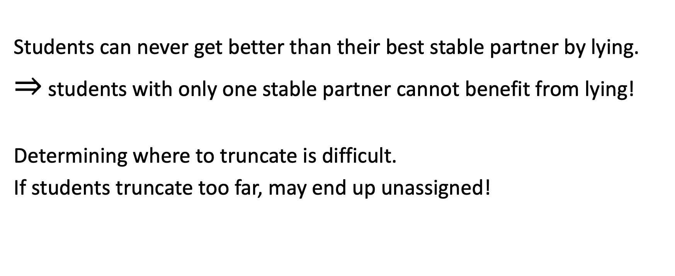
Limited Benefit from Lying in School-Proposing DA
Students can never get better than their best stable partner by lying.
$⇒$ students with only one stable partner cannot benefit from lying!
Determining where to truncate is difficult.
If students truncate too far, may end up unassigned!

Slide 54
Student-Proposing DA is Truthful for Students
1 | 2
A | B
B | A
A | B
2 | 1
1 | 2
However, schools might benefit from lying.
No algorithm that always produces a stable assignment is truthful for both sides (Roth 1982).
Whichever side doesn’t get their way will benefit from suitable truncation.

Slide 55
Summary
Pareto Efficient | Non-wasteful | Respects Priorities | Truthful
First Preferences First (Boston)
Generalized Top Trading Cycles
School Proposing DA
Student Proposing DA
No algorithm guarantees Pareto Efficiency and Respecting Priorities (last class)

Slide 56
The “Marriage Problem”
Original terminology for 1-to-1 matching (men and women).

Slide 57
Coming Up
Reflection and Critical Thinking 3 (Due Monday at Midnight)
Deferred Acceptance for Residency Matching (on Tuesday)

Slide 58
Graduate Housing, Revisited (Homework)
What if people have preferences over roommates?
Setting:
We have 2-bedroom apartments, must pair people up.
Same as classic stable matching problem, except that any two people can be paired (not two-sided).
Does a stable matching always exist? How can we find it?

Slide 59
Reflection and Critical Thinking
Suppose that we have two stable matchings, yellow and blue.
We ask each student which matching they prefer (can be indifferent).
1 matches to A in both.
2 prefers blue, matches to B.
B must prefer yellow!
(Else yellow unstable)
3 must prefer blue!
(Else blue unstable)
1 2 3 4 5 6 7
A B C D E F G
1 2 3 4 5 6 7
In each cycle:
Students agree which is better.
Schools believe other is better.
A B C D E F G
Can create new stable matching which all students agree is better than yellow or blue.

Slide 60
Reflection and Critical Thinking
Suppose that we have two stable matchings, yellow and blue.
We ask each student which matching they prefer (can be indifferent).
1 matches to A in both.
2 prefers blue, matches to B.
B must prefer yellow!
(Else yellow unstable)
3 must prefer blue!
(Else blue unstable)
1 2 3 4 5 6 7
A B C D E F G
1 2 3 4 5 6 7
In each cycle:
Students agree which is better.
Schools believe other is better.
A B C D E F G
Can create new stable matching which all students agree is better than yellow or blue.

Slide 61
Homework Problem
Student Preferences
School Priorities
1 | 2 | 3 | 4 | 5
B | C | C | C | E
D | B | E | D | C
A | D | D | B | A
A | B | C | D | E
1 | 4 | 5 | 1 | 3
5 | 2 | 2 | 2 | 5
 | 1 | 3 | 3
 |  | 4 | 4

Slide 62
Residency Matching
Problem: Market was “unraveling.” Hospitals raced to make earlier and earlier offers. (Years before graduation!)
Solution: A centralized match in final year of medical school. Students and hospitals rank each other. Then apply hospital-proposing DA.
Timeline:
Reform happened in 1951
Earliest academic study of DA in 1962 (Gale & Shapley)
Nobody realized the connection until 1984! (Roth)

Slide 63
Stability
What does this remind you of?
The CORE!
Concern: We recommend a match, but cannot enforce it.
Will anybody be able to profitably deviate from recommendation?
An assignment is individually rational if each matched doctor and hospital agree that being matched to each other is better than being unmatched.
A doctor d and a hospital h form a blocking pair if
d prefers h to d’s suggested assignment, and
h has an unfilled position OR prefers d to another doctor assigned to it.
An assignment is stable if it is individually rational and has no blocking pairs.

Slide 64
One Definition, Two Interpretations
Fact: An assignment is stable if and only if it is non-wasteful and respects priorities.
 | Residency Matching | School Choice
Terminology | Hospital Preferences | School Priorities
 | Stable | Nonwasteful + Respects Priorities
Motivation | People might deviate | Procedural Fairness

Slide 65
The Core: Comparing to Unit 1
Both Settings:
Core = Outcomes such that no subset can agree on profitable deviation.
Allocation with endowments:
No direct relationship between what I get and who my object goes to.
Unique core allocation.
Two-sided matching:
Each agent is also an object!
Core (stable matchings) not unique.

Slide 66
Which Stable Matching Should We Choose?
School-Proposing
Student-Proposing
A | B | C
7 (94) | 12 (88) | 4 (99)
12 (92) | 5 (86) | 6 (91)
4 (91) | 15 (84) | 7 (89)
3 (90) | 8 (83) | 10 (87)
14 (87) | 9 (79) | 11 (75)
9 (86) | 13 (78) | 13 (67)
2 (84) | 14 (76) | 15 (62)
5 (75) | 10 (75) | 1
8 (64) | 2 (72) | 2
6 (62) | 11 (70) | 3
1 (61) | 1 (67) | 5
10 | 3 (60) | 8
11 | 4 | 9
13 | 6 | 12
15 | 7 | 14
A | B | C
7 (94) | 12 (88) | 4 (99)
12 (92) | 5 (86) | 6 (91)
4 (91) | 15 (84) | 7 (89)
3 (90) | 8 (83) | 10 (87)
14 (87) | 9 (79) | 11 (75)
9 (86) | 13 (78) | 13 (67)
2 (84) | 14 (76) | 15 (62)
5 (75) | 10 (75) | 1
8 (64) | 2 (72) | 2
6 (62) | 11 (70) | 3
1 (61) | 1 (67) | 5
10 | 3 (60) | 8
11 | 4 | 9
13 | 6 | 12
15 | 7 | 14
Which students are unassigned in each case?
Which students prefer School-Proposing? Student-Proposing?
Which students are indifferent?

