Slide 1
Warm Up
School Priorities
A | B | C
3 | 5 | 1
4 | 2 | 2
1 | 4 | 3
6 | 6 | 4
5 | 3 | 5
Each school has 2 seats
Group Work:
What is the outcome of student-proposing DA?
What is the outcome of school-proposing DA?
Student Preferences
1 | 2 | 3 | 4 | 5 | 6
A | C | B | A | A | A
C | B | A | C | B | B
1 | 2 | 3 | 4
2 | 3 | 1 | 1
3 | 1 | 2 | 2
4 | 4 | 4 | 3
Roommate Preferences
Group Work:
Which roommate pairings are stable?

Slide 2
Allocating Public Resources
Lesson 7

Slide 3
Plan for Today
Midterm Survey Response
Truthfulness of Deferred Acceptance
Intro to Residency Matching

Slide 4
Survey Results
How are you feeling about the course material?
I am still processing these ideas, but will feel confident with them after a bit more practice. 12
I have a solid understanding of concepts and algorithms discussed so far. 5
How does the workload of this course compare to others that you are taking this semester?
The workload is lower than my other courses 1
The workload is similar to my other courses. 13
The workload is higher than my other courses. 4

Slide 5
Most Challenging Material
Proofs
Stability, Deferred Acceptance

Slide 6
Positive Comments
Continue teaching the way you do. You are one of the best professors I have had these past three years.
This class is so fun, I look forward to it every week. Thank you for being so passionate about what you teach!
I really appreciate... how comfortable it feels to asks questions during class
It is like a logic puzzle, which keeps me challenged and invested
I also have liked learning about how it is very important in which the way words are defined.
I like turning these "moral" concepts of "fairness" and "truthfulness" into quantifiable algorithms and ways of looking at allocations.
Reminder: anonymous comment form on Canvas!

Slide 7
Regarding the first claim, since the newly added school is ranked lower than the school to which the student was assigned, this addition does not affect the original assignment for this student. The student was matched with their highest preference considering all available options, and adding a less preferred option does not change their best match according to their preferences. Therefore, the original match for this student remains a valid, non-wasteful match that respects both the student's preferences and the school's priorities.

Slide 8
Suggestions
I like the time of office hours, but it isn't the most convenient time to ask questions on homework since I haven't had the chance to look at it yet.
Is there anyway we could have a 5 minute break during class to use the bathroom, get water, stretch, etc. I don't want to miss material from class for going to the bathroom or having to go get water.
I think that it would be helpful to have a semester outline/schedule available at all times on canvas indicating unit coverage and midterm dates so that students can plan ahead easily.
I wish that terminologies used in class and slides can keep consistent. For example, in slide 6 page 6, "first preferences first " is used to mean "first choices first." This makes a little bit confused at the first sight.
Possibly make the homeworks a bit shorter, I think I have spent close to 2 hours on this homework which seems a bit excessive.

Slide 9
My Thoughts on Class

Slide 10
Homework Review

Slide 11
Effect of Removing Schools from List
1 | 2 | 3
B | B | C
A | C | B
C | A | A
In this example, only ACB is stable.
Removing schools from a student’s list cannot create justified envy…
A | B | C
1 | 3 | 1
2 | 1 | 2
3 | 2 | 3
1 | 2 | 3
A | B | C
 | C | B
 | A | A
… but it can create new stable matches!
In this case, ACB and ABC are both stable.

Slide 12
Effect of Adding Schools To Bottom of List
1 | 2
A | B
 | A
In this example, only AB is stable.
Adding a school to the bottom of a student’s list cannot create justified envy…
A | B
2 | 1
1 | 2
1 | 2
A | B
B | A
… but it can create new stable matches!
In this case, AB and BA are both stable.

Slide 13
An Excellent Answer
When considering the updated preferences, the original matching is
non-wasteful:
The original matching is non-wasteful when considering the original preferences, which means every students do not prefer an under-enrolled school to their assignments.
We note that removing some schools from the student's preference does not change the list of under-enrolled schools .
The student does not prefer any under-enrolled schools to their assignment, which is still true when remonving some schools from the student's preference list.
Other students do not prefer any under-enrolled schools to their assignments.
respecting priorities:
We note that removing some schools from the student's preference does not change schools' preferences.
There might be less envy from the student toward others, and there're won't be new envy from the student toward other students. Therefore, there's no jusified envy from the student toword other students, since the original matching respects priorities.
There's no new envy from other students to the students, nor other students to other students.
This change might create a new non-wasteful matching that respects priorities.
Consider the following "incorrect" preferences:
1: A>B; 2:B>C>A
A: 2>1; B:1>2; C: 2>1.
Based on these incorrect preferences, both the student-proposed DA and he school-proposed DA suggest 1A2B.
Now, suppose the original matching is 1A2B, and the true preferences are the same, except 2: B>A.
Then based on these new preferences, the school-proposed DA will suggests 1B2A. 1B2A is wasteful when considering the incorrect preferences, since then 2 prefers C. Hence, 1B2A is a new non-wasteful matching that respects priorities.

Slide 14
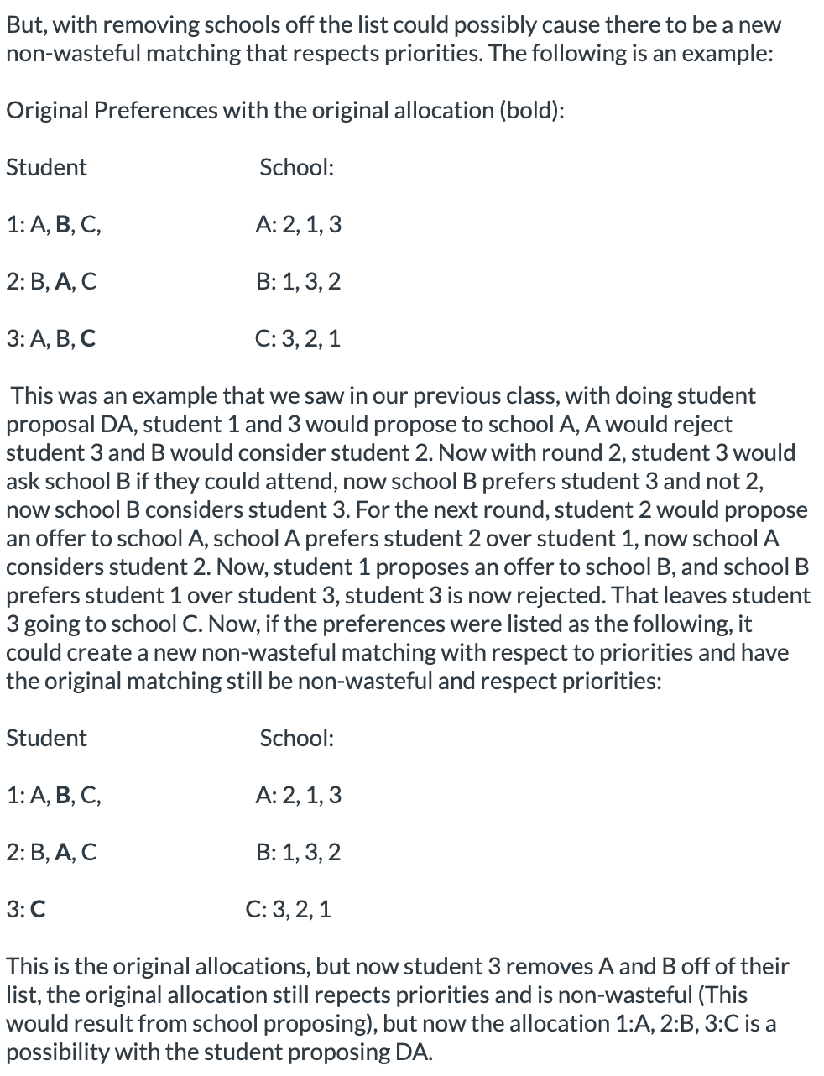
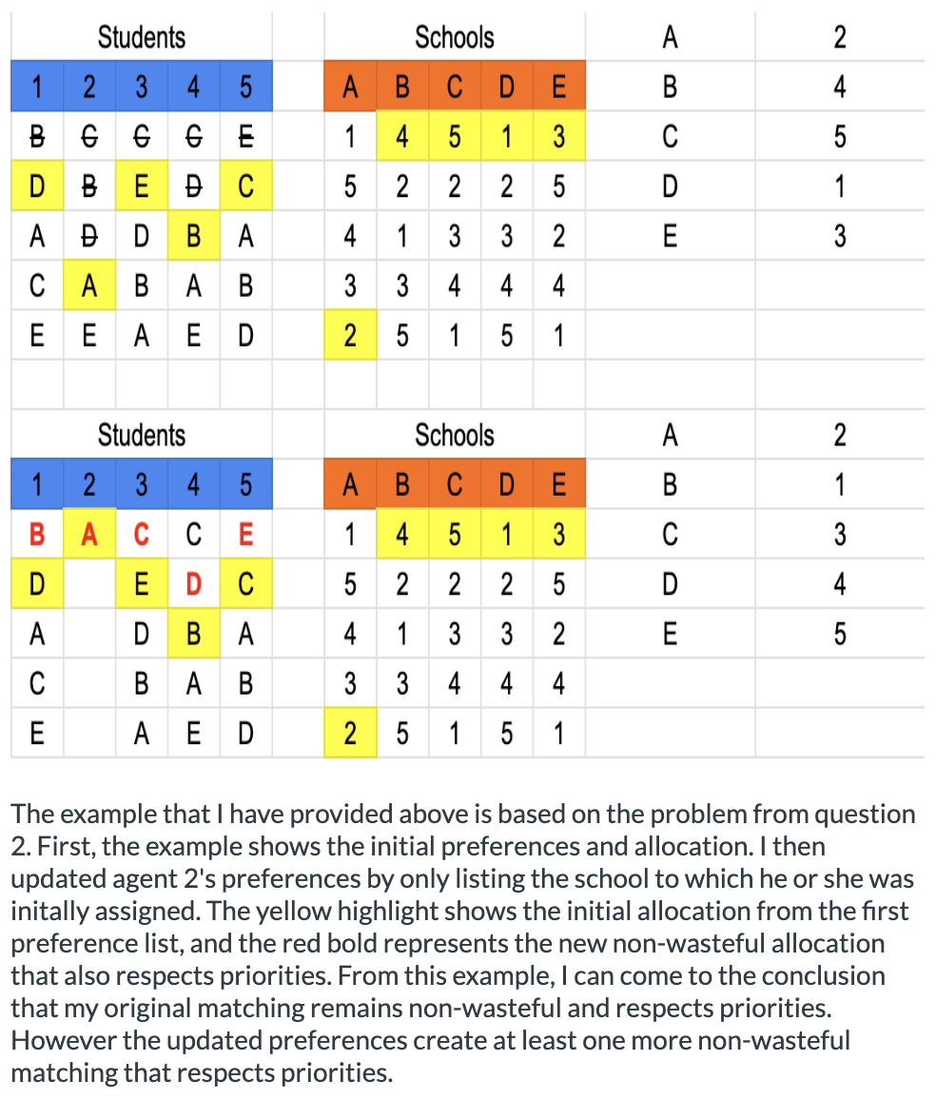
Other Good Answers…

Slide 15
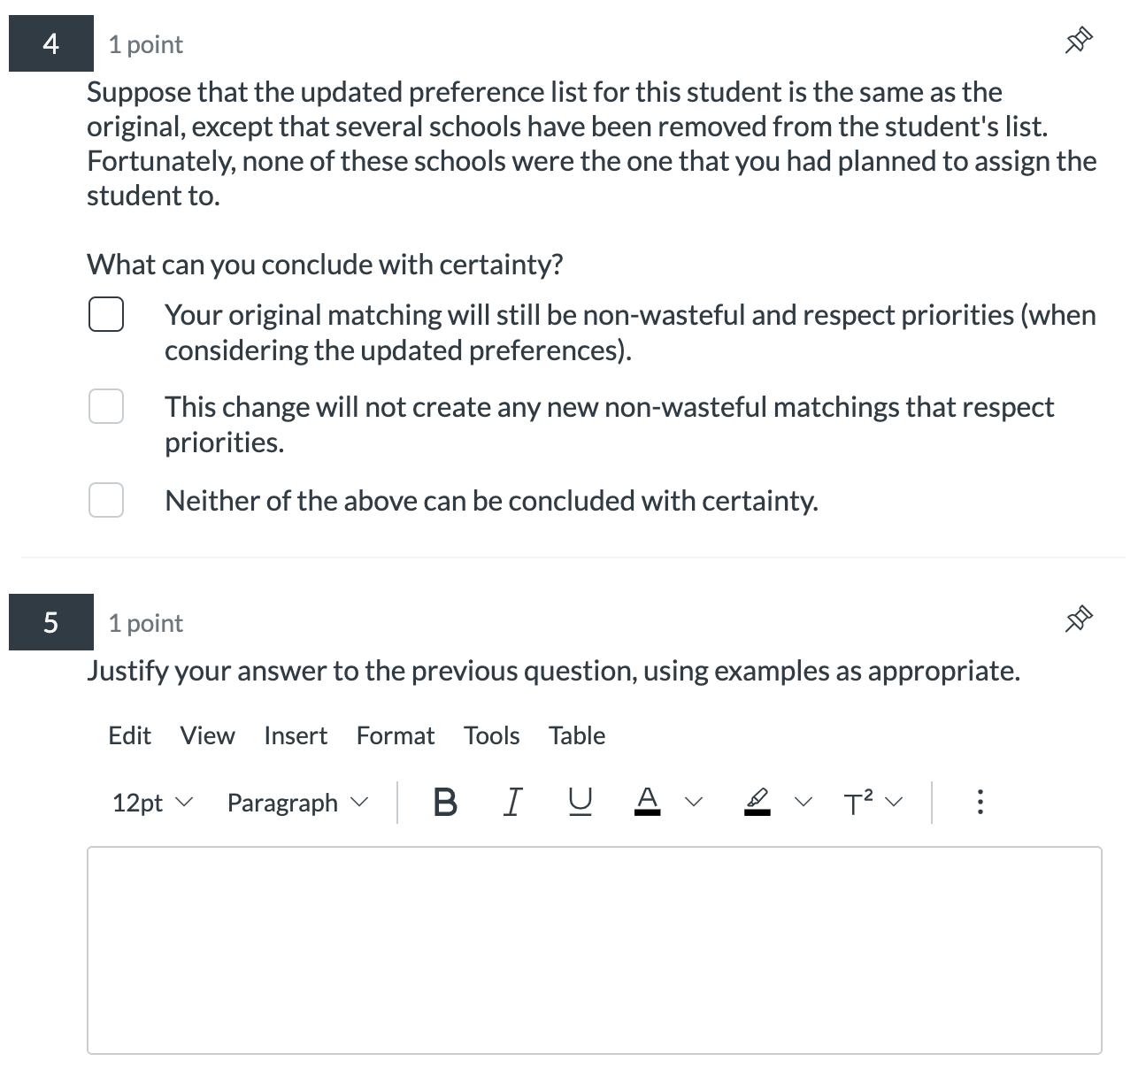
Not demonstrating effort…
Since the list still includes the school that you were planning to send them to, and it was originally non wasteful and respected priorities, then the allocation is not affected.

Slide 16
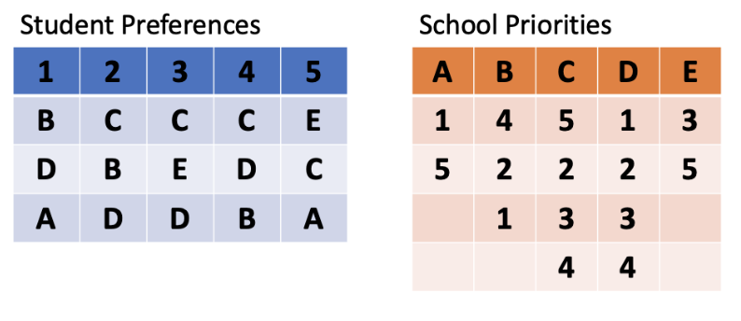
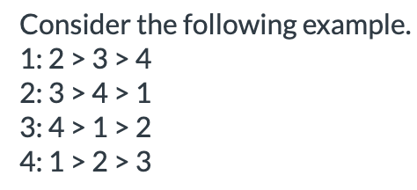

Homework Review
Almost everyone got the DA question correct.
Roommate problem was a mixed bag
Several correct examples given!
“You can always find a stable matching by using deferred acceptance”

Slide 17
Recap: Deferred Acceptance Algorithm
Key word: deferred.
Participants can always reconsider if better opportunities arise.
(Unlike first preferences first.)
Alternative Description of Student-Proposing DA:
Try to give all students their top school that has not rejected them. Resolve conflicts by using school priority lists to reject students. Repeat until finding a feasible assignment.

Slide 18
Results from Last Class
(Mathematicians call amazing facts “theorems”)
A student’s “stable partners” are the schools that the student gets in some stable matching.
Theorem (Student Optimality). The student proposing deferred acceptance algorithm gives each student their favorite stable partner.
Theorem (Lone Wolf). If a student is unassigned in one stable matching, then that student is unassigned in every stable matching.
Among all feasible outcomes that respect priorities, there is one that ALL students agree is at least as good as any other!

Slide 19
Feelings About Proofs

Slide 20
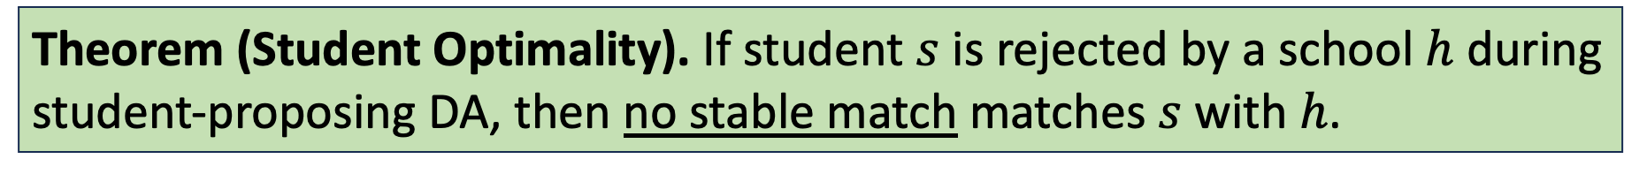
Results from Tuesday’s Class
Theorem (Student Optimality). If student $s$ is rejected by a school $h$ during student-proposing DA, then no stable match matches $s$ with $h$.
Suppose that this is true for all rejections so far. Then consider the |C_h| students tentatively held when s is rejected. We know that algorithm outcome is stable. By inductive assumption, no stable matching matches them to any rejected school. So in any stable matching, they either get $h$ or envy everyone who does. If $s$ is matched to $h$, then at least one of them will covet a spot at $h$ in any stable match, and this envy will be justified.
This says why student proposing DA produces optimal assignment.
Also implies that if someone is unmatched by student proposing DA, they will also be unmatched in other stable matchings. (Ideally, also get converse.)

Slide 21
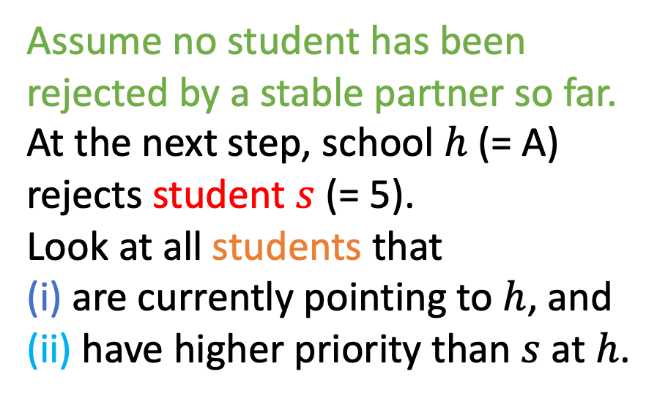
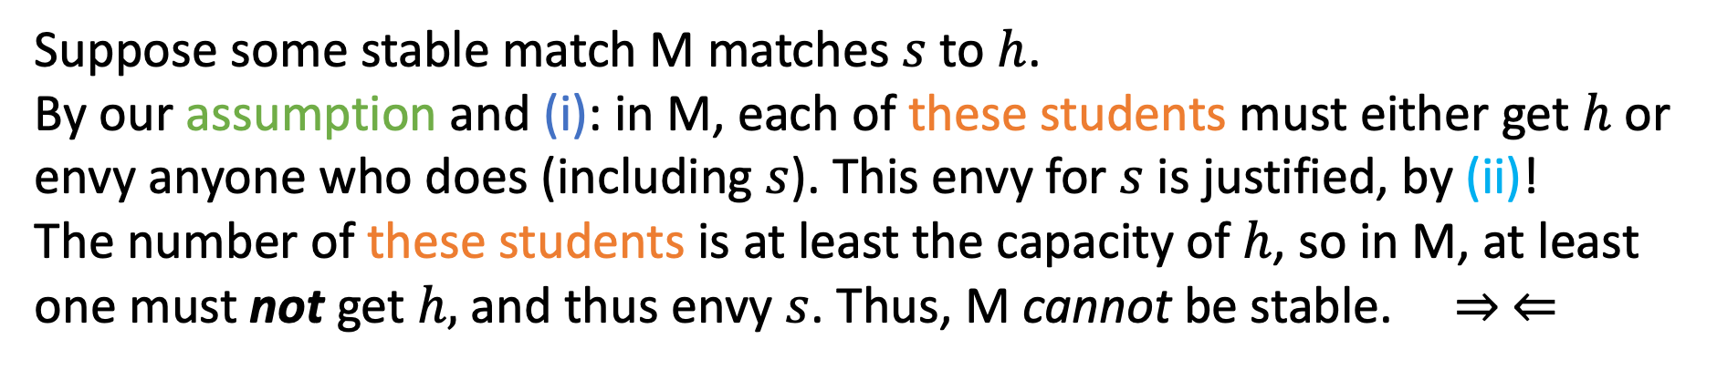
Definition. A student’s “stable partners” are the schools that the student gets in some stable matching.
Claim. In Student-Proposing DA, no student is rejected by a stable partner.
Assume no student has been rejected by a stable partner so far.
At the next step, school $h$ (= A) rejects student $s$ (= 5).
Look at all students that
(i) are currently pointing to $h$, and
(ii) have higher priority than $s$ at $h$.
1 | 2 | 3 | 4 | 5 | 6 | 7 | 8 | 9
B | C | C | C | A | B | B | A | A
D | B | … | D | … | … | C | B | …
… | A |  | D |  |  | … | …
 | … |  | …
Suppose some stable match M matches $s$ to $h$.
By our assumption and (i): in M, each of these students must either get $h$ or envy anyone who does (including $s$). This envy for $s$ is justified, by (ii)!
The number of these students is at least the capacity of $h$, so in M, at least one must not get $h,$ and thus envy $s$. Thus, M cannot be stable. $⇒ ⇐$

Slide 22
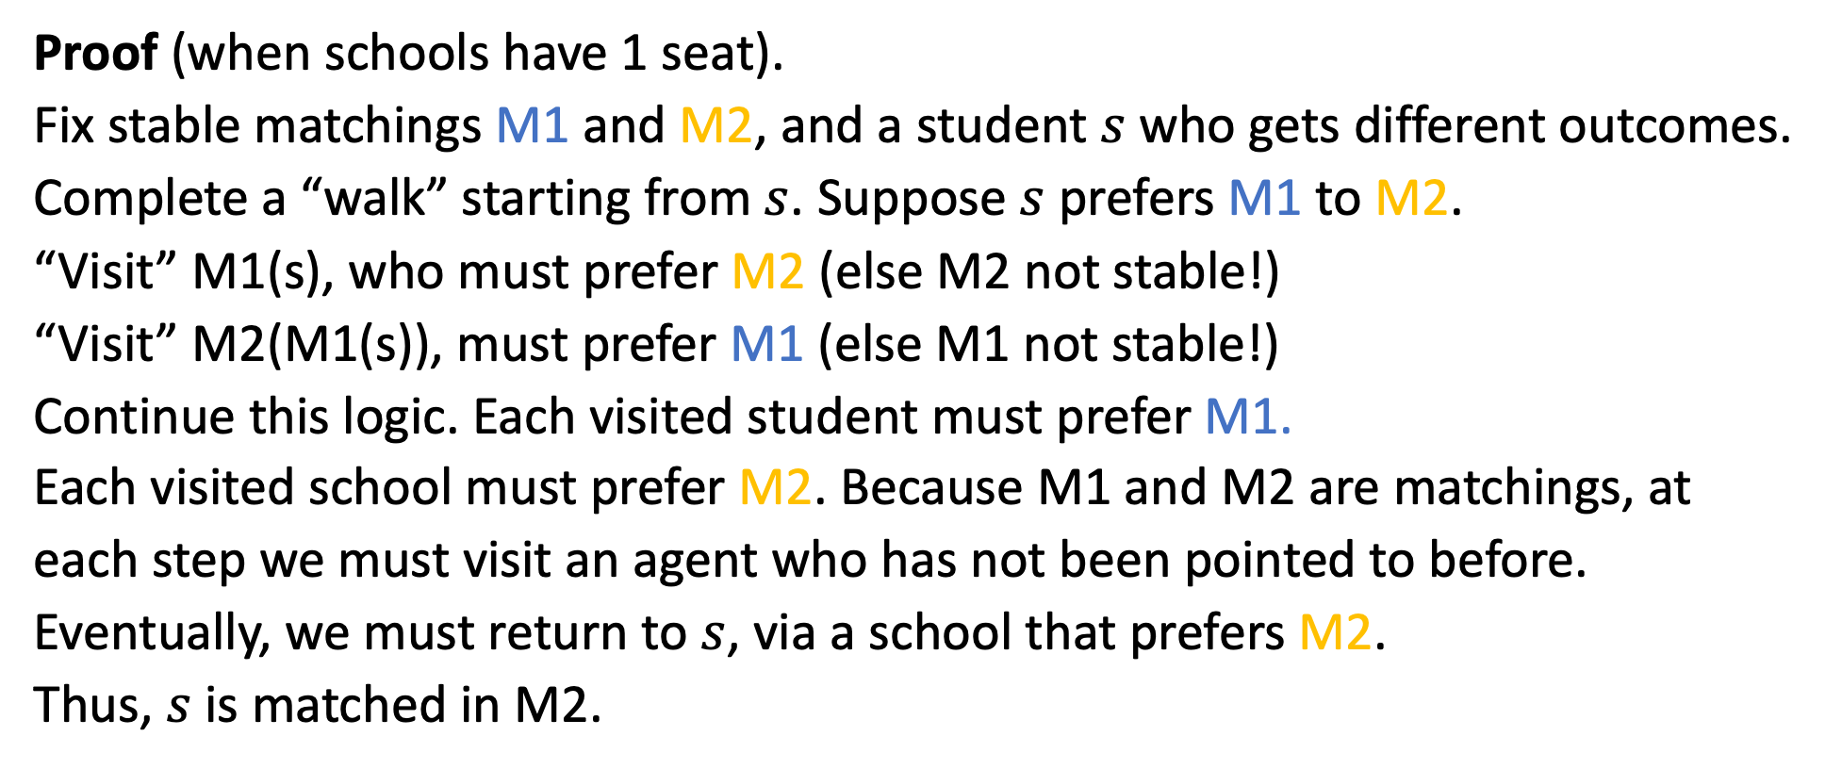
Theorem (Lone Wolf). If a student is unassigned in one stable matching, then that student is unassigned in every stable matching.
Proof (when schools have 1 seat).
Fix stable matchings M1 and M2, and a student $s$ who gets different outcomes.
Complete a “walk” starting from $s$. Suppose $s$ prefers M1 to M2.
“Visit” M1(s), who must prefer M2 (else M2 not stable!)
“Visit” M2(M1(s)), must prefer M1 (else M1 not stable!)
Continue this logic. Each visited student must prefer M1.
Each visited school must prefer M2. Because M1 and M2 are matchings, at each step we must visit an agent who has not been pointed to before.
Eventually, we must return to $s$, via a school that prefers M2.
Thus, $s$ is matched in M2.
1 2 3 4 5 6 7
A B C D E F G
Remark: when schools have multiple seats, consider market formed by breaking each school into many schools with a single seat.
Remark: same argument is used to prove that set of stable matchings forms a lattice.
Meet = “give all students their preferred option between M1 and M2” and join = “give all schools their preferred option”

Slide 23
Is Deferred Acceptance Truthful?
Student Preferences
School Priorities
Each school has 1 seat
1 | 2 | 3 | 4
B | C | C | C
D | B | B | D
A | D | D | B
C | A | A | A
A | B | C | D
3 | 3 | 1 | 1
1 | 4 | 3 | 2
4 | 1 | 2 | 4
2 | 2 | 4 | 3
Group Work:
What is the outcome of Student-Proposing Deferred Acceptance?
What is the outcome of School-Proposing Deferred Acceptance?
Under each mechanism, can any student benefit from misreporting?

Slide 24
Is Deferred Acceptance Truthful?
Student Preferences
School Priorities
Each school has 1 seat
1 | 2 | 3 | 4
B | C | C | C
D | B | B | D
A | D | D | B
C | A | A | A
A | B | C | D
3 | 3 | 1 | 1
1 | 4 | 3 | 2
4 | 1 | 2 | 4
2 | 2 | 4 | 3
Both algorithms:
Result in DACB.
Group Work:
What is the outcome of Student-Proposing Deferred Acceptance?
What is the outcome of School-Proposing Deferred Acceptance?
Under each mechanism, can any student benefit from misreporting?

Slide 25
Deferred Acceptance: Student Proposing
Student Preferences
School Priorities
1 | 2 | 3 | 4
B | C | C | C
D | B | B | D
A | D | D | B
C | A | A | A
A | B | C | D
3 | 3 | 1 | 1
1 | 4 | 3 | 2
4 | 1 | 2 | 4
2 | 2 | 4 | 3
Student 1 applies to B, 2, 3, 4 apply to C.
Students 2 and 4 are rejected by C.

Slide 26
Deferred Acceptance: Student Proposing
Student Preferences
School Priorities
1 | 2 | 3 | 4
B | C | C | C
D | B | B | D
A | D | D | B
C | A | A | A
A | B | C | D
3 | 3 | 1 | 1
1 | 4 | 3 | 2
4 | 1 | 2 | 4
2 | 2 | 4 | 3
Student 2 applies to B, student 4 applies to D.
Student 2 is rejected by B.

Slide 27
Deferred Acceptance: Student Proposing
Student Preferences
School Priorities
1 | 2 | 3 | 4
B | C | C | C
D | B | B | D
A | D | D | B
C | A | A | A
A | B | C | D
3 | 3 | 1 | 1
1 | 4 | 3 | 2
4 | 1 | 2 | 4
2 | 2 | 4 | 3
Student 2 applies to D.
Student 4 is rejected by D.

Slide 28
Deferred Acceptance: Student Proposing
Student Preferences
School Priorities
1 | 2 | 3 | 4
B | C | C | C
D | B | B | D
A | D | D | B
C | A | A | A
A | B | C | D
3 | 3 | 1 | 1
1 | 4 | 3 | 2
4 | 1 | 2 | 4
2 | 2 | 4 | 3
Student 4 applies to B.
Student 1 is rejected by B.

Slide 29
Deferred Acceptance: Student Proposing
Student Preferences
School Priorities
1 | 2 | 3 | 4
B | C | C | C
D | B | B | D
A | D | D | B
C | A | A | A
A | B | C | D
3 | 3 | 1 | 1
1 | 4 | 3 | 2
4 | 1 | 2 | 4
2 | 2 | 4 | 3
Student 1 applies to D.
Student 2 is rejected by D.

Slide 30

Deferred Acceptance: Student Proposing
Student Preferences
School Priorities
1 | 2 | 3 | 4
B | C | C | C
D | B | B | D
A | D | D | B
C | A | A | A
A | B | C | D
3 | 3 | 1 | 1
1 | 4 | 3 | 2
4 | 1 | 2 | 4
2 | 2 | 4 | 3
Student 2 applies to A.
No further rejections, so the match DACB is finalized.

Slide 31
Deferred Acceptance: School Proposing
Student Preferences
School Priorities
1 | 2 | 3 | 4
B | C | C | C
D | B | B | D
A | D | D | B
C | A | A | A
A | B | C | D
3 | 3 | 1 | 1
1 | 4 | 3 | 2
4 | 1 | 2 | 4
2 | 2 | 4 | 3
Schools A and B admit student 3, schools C and D admit student 1.
School A is rejected by student 3, school C is rejected by student 1.

Slide 32
Deferred Acceptance: School Proposing
Student Preferences
School Priorities
1 | 2 | 3 | 4
B | C | C | C
D | B | B | D
A | D | D | B
C | A | A | A
A | B | C | D
3 | 3 | 1 | 1
1 | 4 | 3 | 2
4 | 1 | 2 | 4
2 | 2 | 4 | 3
School A admits student 1, school C admits student 3.
School A rejected by student 1, school B rejected by student 3.

Slide 33
Deferred Acceptance: School Proposing
Student Preferences
School Priorities
1 | 2 | 3 | 4
B | C | C | C
D | B | B | D
A | D | D | B
C | A | A | A
A | B | C | D
3 | 3 | 1 | 1
1 | 4 | 3 | 2
4 | 1 | 2 | 4
2 | 2 | 4 | 3
Schools A and B admit student 4.
School A rejected by student 4.

Slide 34
Deferred Acceptance: School Proposing
Student Preferences
School Priorities
1 | 2 | 3 | 4
B | C | C | C
D | B | B | D
A | D | D | B
C | A | A | A
A | B | C | D
3 | 3 | 1 | 1
1 | 4 | 3 | 2
4 | 1 | 2 | 4
2 | 2 | 4 | 3
School A admits student 2.
No further rejections, so the match DACB is finalized.

Slide 35
Is Deferred Acceptance Truthful?
Student Preferences
School Priorities
Each school has 1 seat
1 | 2 | 3 | 4
A | B | B | A
C | D | D | D
D | C | A | B
A | B | C | D
3 | 2 | 2 | 2
4 | 3 | 1 | 4
1 | 4 | 3 | 1
2 | 1 | 4 | 3
Group Work:
What is the outcome of Student-Proposing Deferred Acceptance?
What is the outcome of School-Proposing Deferred Acceptance?
Under each mechanism, can any student benefit from misreporting?

Slide 36
Is Deferred Acceptance Truthful?
Student Preferences
School Priorities
Each school has 1 seat
1 | 2 | 3 | 4
A | B | B | A
C | D | D | D
D | C | A | B
A | B | C | D
3 | 2 | 2 | 2
4 | 3 | 1 | 4
1 | 4 | 3 | 1
2 | 1 | 4 | 3
Student-Proposing:
Results in CBDA.
School-Proposing:
Results in CBAD.
Group Work:
What is the outcome of Student-Proposing Deferred Acceptance?
What is the outcome of School-Proposing Deferred Acceptance?
Under each mechanism, can any student benefit from misreporting?

Slide 37
Cutoff Description of Stable Matching
Each school’s cutoff = priority of lowest student to attend
(or 0 if there are vacant seats)
All students go to their favorite school where they clear the cutoff.
How could a student benefit from lying?
They could change the cutoffs!
1 | 2
A | B
B | A
A | B
2 | 1
1 | 2
1 | 2
A | B
B
A | B
2 | 1
1 | 2
School-Optimal Cutoffs
Student-Optimal Cutoffs
Only Stable Cutoffs

Slide 38
School-Proposing DA is not truthful for students
A truncation strategy truthfully reports the top k of the list (for some k), but leaves remaining schools off the list.
Any student with multiple stable partners will get their least favorite under School-Proposing DA.
This student can guarantee their favorite stable partner by truncating their list below this option. (Eliminates worse stable matchings.)

Slide 39
School-Proposing DA: Not all Beneficial Deviations are truncations.
Student Preferences
School Priorities
Each school has 1 seat
1 | 2 | 3
A | B | C
B | C | A
C | A | B
A | B | C
2 | 1 | 1
1 | 2 | 3
3 | 3 | 2
School proposing DA produces BAC.
Student proposing DA produces ABC.
If 1 lies and reports A > C > B, then both algorithms produce ABC.

Slide 40
Student-Proposing DA is Truthful for Students!
1 | 2
A | B
B | A
A | B
2 | 1
1 | 2
However, schools might benefit from lying.
No algorithm that always produces a stable assignment is truthful for both sides (Roth 1982).
Whichever side doesn’t get their way will benefit from suitable truncation.

Slide 41
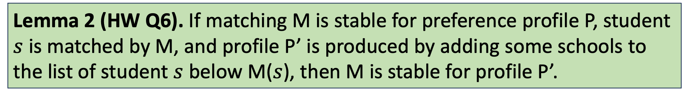
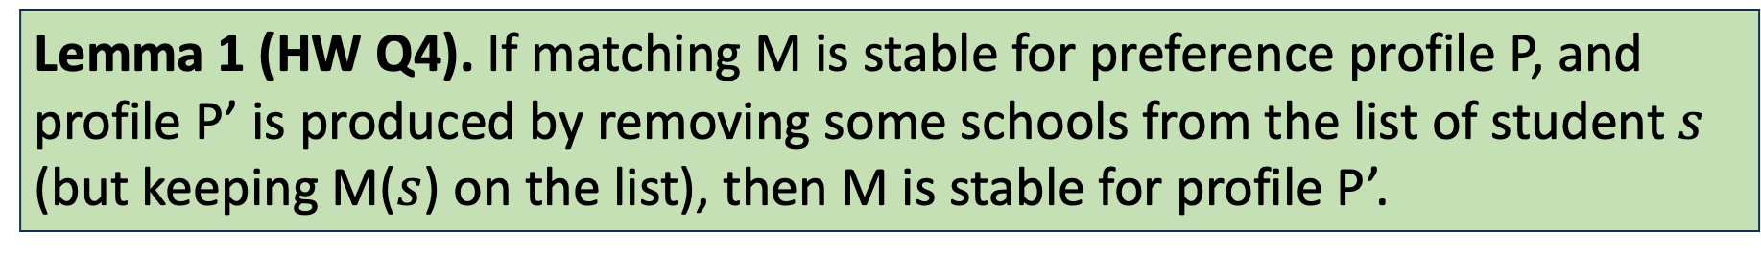
Results from Homework
(Mathematicians call useful observations “lemmas”)
Lemma 1 (HW Q4). If matching M is stable for preference profile P, and profile P’ is produced by removing some schools from the list of student $s$ (but keeping M($s$) on the list), then M is stable for profile P’.
Lemma 2 (HW Q6). If matching M is stable for preference profile P, student $s$ is matched by M, and profile P’ is produced by adding some schools to the list of student $s$ below M($s$), then M is stable for profile P’.

Slide 42
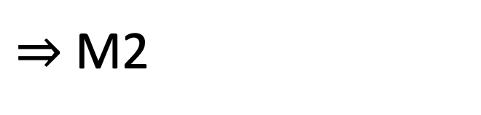
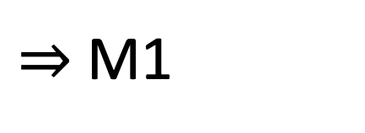
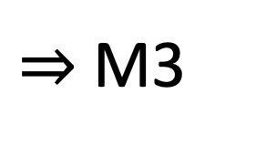
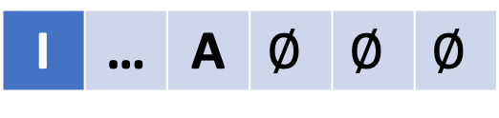
Proof
Theorem. Let $ℳ$ be a stable mechanism. For any preference profile P, no student can get anything better than their most preferred P-stable partner by lying.
Matching
P
I | … | A | … | B | …
$⇒$ M1
Fix others’ reports. Suppose when I report truth (P), best stable partner is B.
But, some lie (L) gets me A > B.
L
I | ? | ? | ? | ? | ?
$⇒$ M2
What if I truncate options below A?
Claim: I must not be matched.
WHY? How can we use one of the homework lemmas to prove this?
I | … | A | $$∅$$ | $$∅$$ | $$∅$$
$⇒$ M3

Slide 43
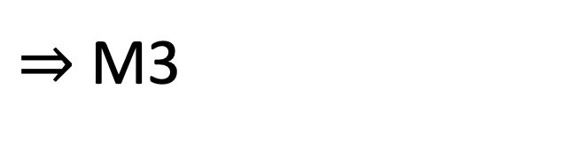
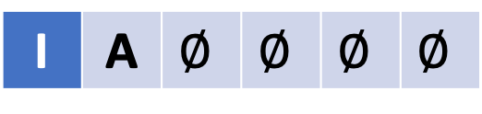
Proof
Theorem. Let $ℳ$ be a stable mechanism. For any preference profile P, no student can get anything better than their most preferred P-stable partner by lying.
Matching
P
I | … | A | … | B | …
$⇒$ M1
Fix others’ reports. Suppose when I report truth (P), best stable partner is B.
But, some lie (L) gets me A > B.
L
I | ? | ? | ? | ? | ?
$⇒$ M2
What if I truncate options below A?
Claim: I must not be matched.
If M3 matches me, then M3 is also stable when I report P (Lemma 2).
This contradicts that B is my best stable partner!
I | … | A | $$∅$$ | $$∅$$ | $$∅$$
$⇒$ M3
What if I list only A?
Is M2 still stable? Is M3 still stable?
What can we conclude?
I | A | $$∅$$ | $$∅$$ | $$∅$$ | $$∅$$

Slide 44
Proof
Theorem. Let $ℳ$ be a stable mechanism. For any preference profile P, no student can get anything better than their most preferred P-stable partner by lying.
Matching
P
I | … | A | … | B | …
$⇒$ M1
Fix others’ reports. Suppose when I report truth (P), best stable partner is B.
But, some lie (L) gets me A > B.
L
I | ? | ? | ? | ? | ?
$⇒$ M2
What if I truncate options below A?
Claim: I must not be matched.
If M3 matches me, then M3 is also stable when I report P (Lemma 2).
This contradicts that B is my best stable partner!
I | … | A | $$∅$$ | $$∅$$ | $$∅$$
$⇒$ M3
What if I list only A?
M2 is stable (Lemma 1), M3 is stable (Lemma 1)
This contradicts the Lone Wolf Theorem!
I | A | $$∅$$ | $$∅$$ | $$∅$$ | $$∅$$

Slide 45
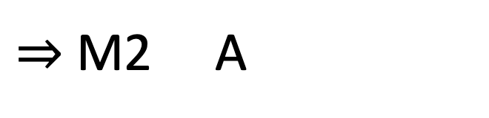
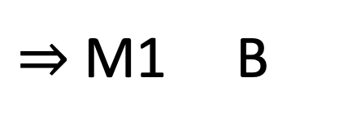
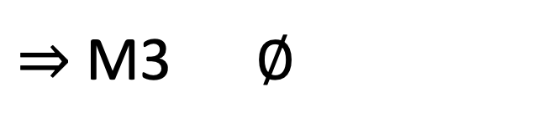
Proof
Theorem. Student proposing deferred acceptance is truthful for students.
Matching I Get
P
I | … | A | … | B | …
$⇒$ M1 B
Fix the report of other students.
Suppose: when I report truth (P), I get B.
But, there is some lie (L) that gets me A.
L
I | ? | ? | ? | ? | ?
$⇒$ M2 A
What if I truncate options below A?
Claim: I must not be matched.
If M3 matches me, then M3 is also stable when I report P (Lemma 2).
But when I report P, B is my best stable partner (Student Optimality.)
I | … | A | $$∅$$ | $$∅$$ | $$∅$$
$⇒$ M3 $∅$
What if I list only A?
M2 is stable (Lemma 1), M3 is stable (Lemma 1)
This contradicts the Lone Wolf Theorem!
I | A | $$∅$$ | $$∅$$ | $$∅$$ | $$∅$$

Slide 46
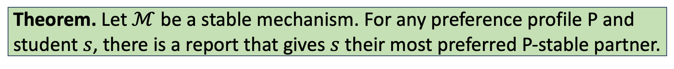
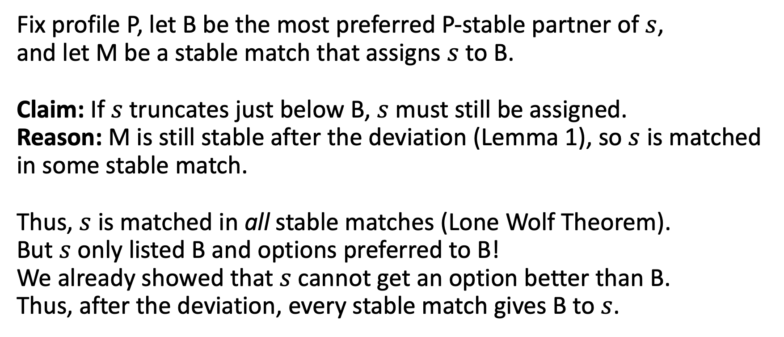
Theorem. Let $ℳ$ be a stable mechanism. For any preference profile P and student $s$, there is a report that gives $s$ their most preferred P-stable partner.
Fix profile P, let B be the most preferred P-stable partner of $s$,
and let M be a stable match that assigns $s$ to B.
Claim: If $s$ truncates just below B, $s$ must still be assigned.
Reason: M is still stable after the deviation (Lemma 1), so $s$ is matched in some stable match.
Thus, $s$ is matched in all stable matches (Lone Wolf Theorem).
But $s$ only listed B and options preferred to B!
We already showed that $s$ cannot get an option better than B.
Thus, after the deviation, every stable match gives B to $s$.

Slide 47
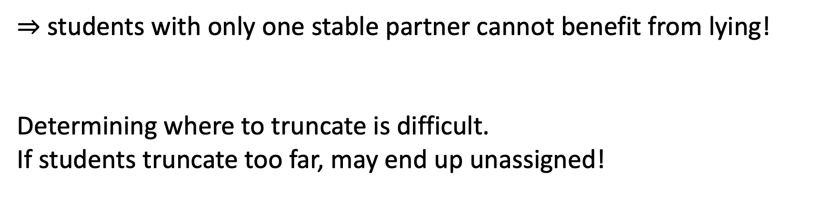
Important Consequences
Theorem. Student proposing deferred acceptance is truthful for students.
Theorem. Any other stable mechanism is not truthful for students. However, the best match that a student can get by lying is their best stable partner.
$⇒$ students with only one stable partner cannot benefit from lying!
Determining where to truncate is difficult.
If students truncate too far, may end up unassigned!

Slide 48
School-Proposing DA: Finding Beneficial Deviations
Student Preferences
School Priorities
Each school has 1 seat
1 | 2 | 3 | 4
A | B | B | A
C | D | D | D
D | C | A | B
A | B | C | D
3 | 2 | 2 | 2
4 | 3 | 1 | 4
1 | 4 | 3 | 1
2 | 1 | 4 | 3
Group Work: When using school proposing deferred acceptance,
Which students can benefit from misreporting?
What is the best outcome each of them can achieve?

Slide 49
Summary
Pareto Efficient | Non-wasteful | Respects Priorities | Truthful
First Preferences First (Boston)
Generalized Top Trading Cycles
School Proposing DA
Student Proposing DA
Recall, No algorithm guarantees Pareto Efficiency and Respecting Priorities.
Which properties are most important to you?

Slide 50
Break

Slide 51
Why I Love Deferred Acceptance (True Story)
On a second date in Brooklyn, a woman asked me,
“Have you heard of the marriage problem?”
Bringing up marriage on a second date?!?

Slide 52
Gale and Shapley (1962): The “Marriage Problem”
Original terminology for 1-to-1 matching (men and women).
Numberphile video: https://www.youtube.com/watch?v=Qcv1IqHWAzg
Part 2 (proofs): https://www.youtube.com/watch?v=LtTV6rIxhdo

Slide 53
Residency Matching
Why did they implement a match? Why not just do like most other professions?
Concern: market was unraveling. Negative consequences:
Thin markets (people don’t know who is available)
Also, don’t even know own preferences!
Maybe save all of this (think market, unraveling, congestion…) for last day before exam?

Slide 54
Okay, that’s why to standardize time. Why not just set a date?
(This is roughly what colleges in US do)
Residency programs can’t deal with the uncertainty (small numbers, important to fill spots, can’t easily take lots of extras)
Why not just force students to hold at most one offer, run waitlist procedure? Thickness causes congestion – hard to find right match in time. Extending time window doesn’t really work, as it slows down each step of process (people won’t be available).
This is why we use direct mechanism.
Why use DA? (Stability – what if we can’t enforce our suggestion). Core. Would people really deviate?
Why don’t other fields use centralized match? (i.e. for faculty positions)

Slide 55
Residency Matching
Problem: Market was “unraveling.” Hospitals raced to make earlier and earlier offers. (Years before graduation!)
Solution: A centralized match in final year of medical school. Students and hospitals rank each other. Then apply hospital-proposing DA.
Timeline:
Reform happened in 1951
Earliest academic study of DA in 1962 (Gale & Shapley)
Nobody realized the connection until 1984! (Roth)

Slide 56
Vocab Terms
The market was unraveling, creating a thin market.
A centralized algorithm was introduced to create a thick market and address congestion.
Today, job market for faculty positions exhibits exploding offers.

Slide 57
Top Trading Cycles References
Algorithm and Incentives
On Cores and Indivisibility, Shapley and Scarf (1974)
Incentive Compatibility in a Market with Indivisible Goods, Roth (1982)
Characterizations
Strategyproofness and the Strict Core in a Market with Indivisibilities, Ma (1994)
An Alternative Proof of a Characterization of the TTC Mechanism, Sethuraman (2015)
Pair Efficient Reallocation of Indivisible Objects, Ekici (2023)

Slide 58
Stability
What does this remind you of?
The CORE!
Concern: We recommend a match, but cannot enforce it.
Will anybody be able to profitably deviate from recommendation?
An assignment is individually rational if each matched doctor and hospital agree that being matched to each other is better than being unmatched.
A doctor d and a hospital h form a blocking pair if
d prefers h to d’s suggested assignment, and
h has an unfilled position OR prefers d to another doctor assigned to it.
An assignment is stable if it is individually rational and has no blocking pairs.

Slide 59
The Core: Comparing to Unit 1
Both Settings:
Core = Outcomes such that no subset can agree on profitable deviation.
Allocation with endowments:
No direct relationship between what I get and who my object goes to.
Unique core allocation.
Two-sided matching:
Each agent is also an object!
Core (stable matchings) not unique.

Slide 60
One Definition, Two Interpretations
Fact: An assignment is stable if and only if it is individually rational, non-wasteful and respects priorities.
 | Residency Matching | School Choice
Terminology | Hospital Preferences | School Priorities
 | Stable | Nonwasteful + IR + Respects Priorities
Motivation | People might deviate | Procedural Fairness

Slide 61
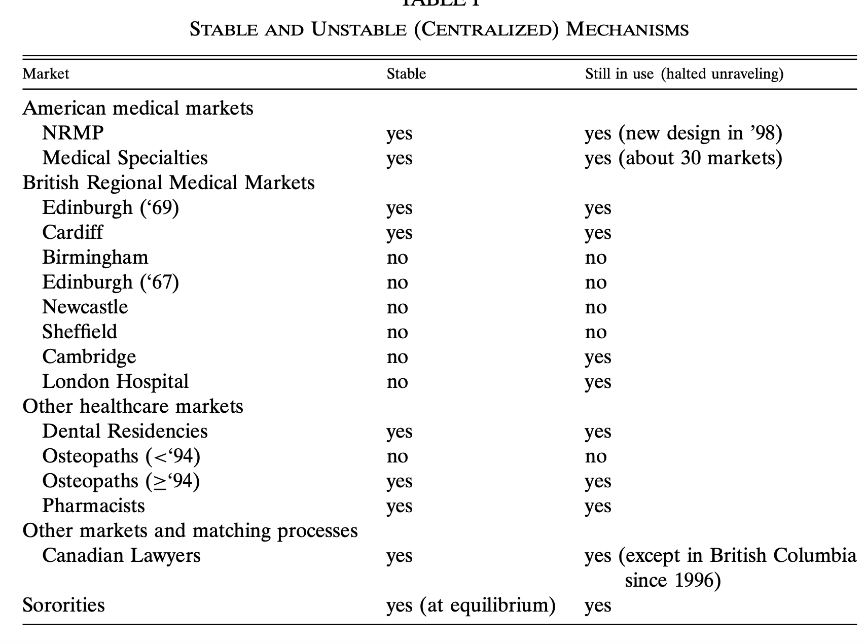
Does Stability Matter?
Maybe similar benefits for any centralized clearinghouse?
Evidence that stability leads to longevity (Roth 2002).
Roth (1990)

Slide 62
Coming Up
Concept Check 5 (due Wednesday at 11:59 pm)
Thursday: deep dive into residency matching practice

Slide 63
References (More on Canvas)
Stability, Lone Wolf
College Admissions and the Stability of Marriage, Gale and Shapley (1962)
Stable Marriage Assignment for Unequal Sets, McVitie & Wilson (1970)
Truthfulness:
Machiavelli and the Gale-Shapley Algorithm, Dubins and Freedman (1981)
The Economics of Matching: Stability and Incentives, Roth (1982)
Connection to Residency Matching:
The Evolution of the Labor Market for Medical Interns and Residents: A Case Study in Game Theory, Roth (1984)
The Redesign of the Matching Market for American Physicians: Engineering Aspects of Economic Design, Roth and Peranson (1999)

Slide 64
Study Guide
Concepts
Blocking Pair
Stability
Facts

