Slide 1
Warm Up
You are in charge of implementing a new residency matching algorithm.
You want to find a stable match, but aren’t sure which one.
Group Discussion:
Would you recommend student-proposing DA or school-proposing DA?
Explain your answer.
If you are not willing to make a recommendation, say why not.

Slide 2
The “Rural Hospital” Theorem
If somebody is matched (unmatched) in one stable matching, then they are matched (unmatched) in every stable matching.
Changing stable matchings does not affect the number of residents matched to each hospital.

Slide 3
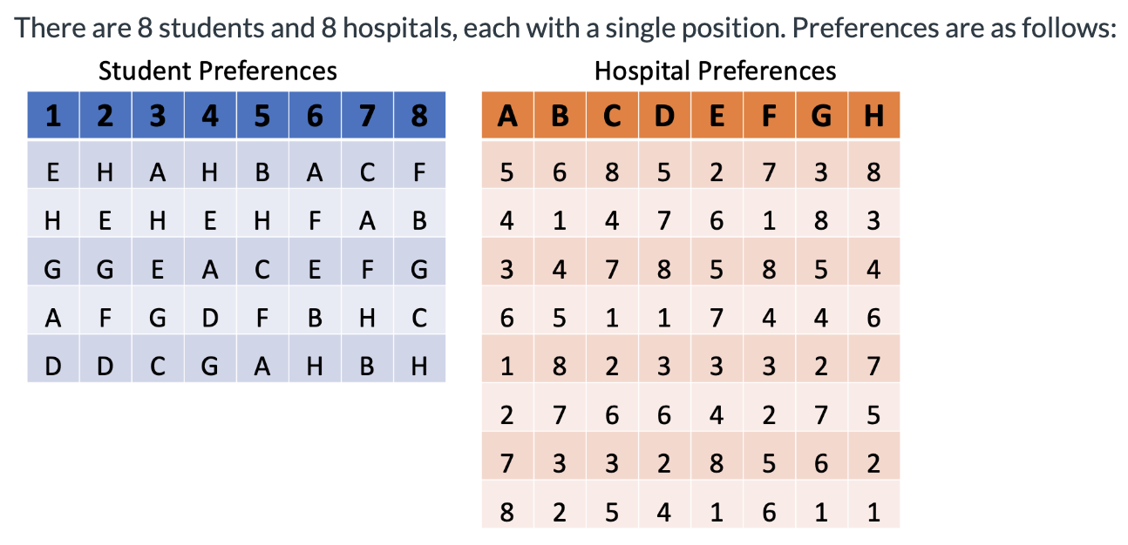
Homework Question 1 & 2 Recap
Which students can benefit from lying?

Slide 4
Recall from Tuesday
In school-proposing DA, some students may benefit from truncating.
No student can do better than the outcome from student-proposing DA.
Conclusion:
Any student with the same partner under both algorithms cannot manipulate. Any student with different partners can.

Slide 5
Engineering the Allocation of Public Resources
Stable Matching in Practice:
Dealing with Couples and Other Complexities

Slide 6
NRMP statistics
No hospital ever regrets rejecting a candidate….
(Not necessarily true with couples!)

Slide 7
Recap
Deferred Acceptance discovered in parallel by researchers and practitioners.
Residency Matching Reform (1951). Response to “unraveling” market. Hospitals raced to make earlier and earlier offers. (Years before graduation!)
Gale Shapley (1962). Fun thought experiment about matching men to women.
Nobody realized the connection until 1984! (Roth)

Slide 8
Today’s Story
Interplay between research and practice!

Slide 9
Plan for Today
NRMP Redesign: Matching with Couples
NRMP Redesign: Which Side Proposes?
When is there a “nearly unique” stable matching?

Slide 10
Recap: Reform Goals
Thicken the market by coordinating on an offer period.
Resolve congestion using a centralized matching algorithm.
Recommend a stable match, so no one can profitably deviate.

Slide 11
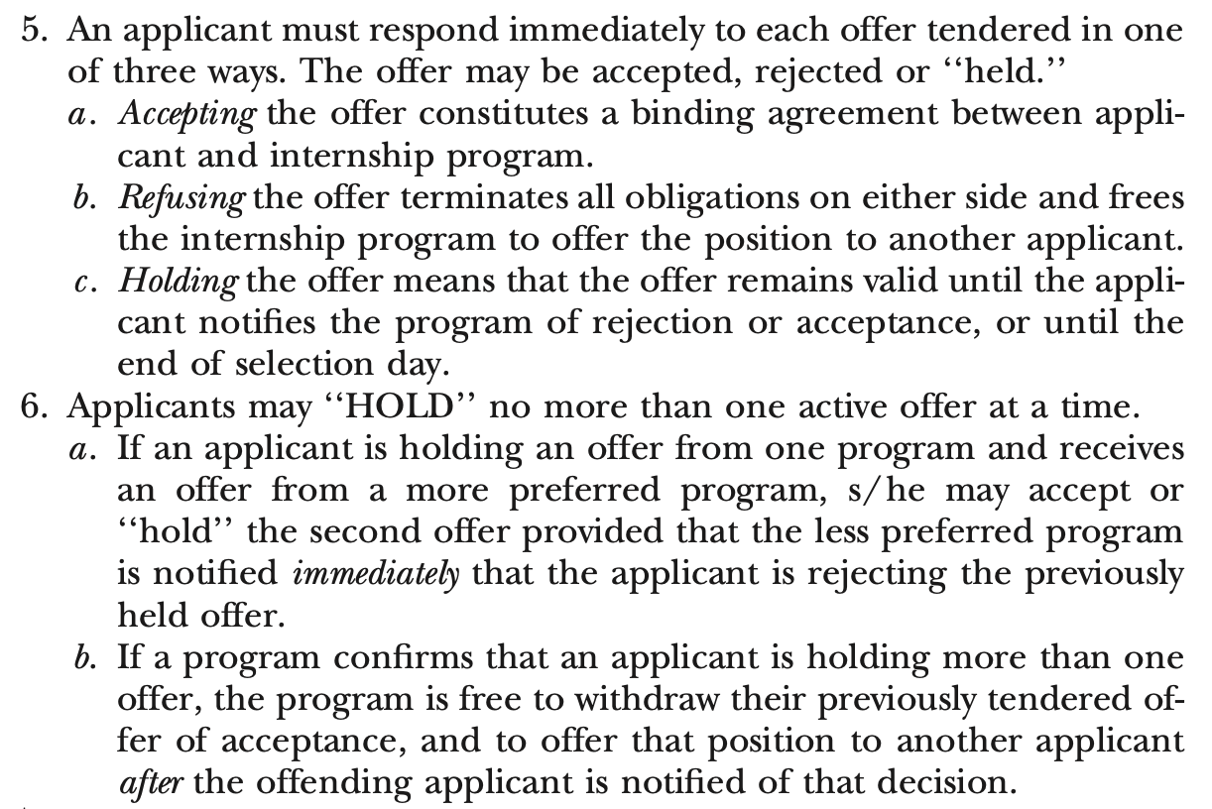
Clinical Psychology Match
“Offer Day” from 9 am to 4 pm.
Offers made over the phone.
With straightforward behavior and no deadline, equivalent to program-proposing Deferred Acceptance.

Slide 12
What Actually Happened?
On selection day the codirectors said that their general strategy was ‘‘don’t tie up offers with people who will hold them all day.’’ They therefore decided to make their first offers (for their five positions) to numbers 1, 2, 3, 5, and 12 on their rank-order list, with the rationale being that numbers 3, 5, and 12 had indicated that they would accept immediately and that 1 and 2 were so attractive as to be worth taking chances on.
Two phones were used to make these calls, starting precisely at 9:00 a.m. central standard time. Candidates 3, 5, and 12 accepted immediately, as promised. Candidate 1 was reached at 9:05 (on the fourth attempt, after three busy signals) and held the offer until 9:13, when he called back to reject it.
Roth and Xing, 1997

Slide 13
During this period, an incoming call (on a third phone whose number had been given to candidates) was received from the candidate ranked eighth, who now said that the program was her first choice. She was thanked and told she was still under consideration, and when candidate 1 called to reject the offer he was holding, the codirectors decided to make the next offer to candidate 8 (and not to number 4, as initially planned).
The offer to number 8 was then made and accepted immediately, and while that phone call was in progress, an incoming call from candidate 2 informed them that she had accepted another position. The decision was then made to offer the remaining position next to the highest-ranked remaining candidate who had indicated that he would accept immediately, number 10, and this offer was accepted at 9:21.
After the briefest of celebrations, the codirectors called the remaining candidates to inform them that all positions were filled. These calls were completed by 9:35, 35 minutes after the opening of the market. The five positions were filled with the candidates initially ranked 3, 5, 8, 10, and 12.
Roth and Xing, 1997

Slide 14
In Class Exercise
Resident Preferences
Hospital Preferences
1 | 2 | 3 | 4 | 5 | 6 | 7 | 8
C | I | A | C | D | A | B | C
G | B | D | E | A | F | D | D
D | F | C | I | C | D | A | I
F | A | G | A | G | C | I | F
I | D | F | B | E | I | F | G
E | E | H | F | B | E | E | E
A | H | I | H | I | B | G | H
B | G | E | D | F | H | C | B
H | C | B | G | H | G | H | A
A | B | C | D | E | F | G | H | I
4 | 2 | 5 | 6 | 1 | 7 | 6 | 4 | 3
3 | 4 | 3 | 4 | 5 | 8 | 5 | 5 | 2
1 | 7 | 7 | 8 | 3 | 2 | 1 | 2 | 1
2 | 6 | 4 | 3 | 8 | 3 | 4 | 7 | 5
6 | 3 | 6 | 1 | 6 | 6 | 2 | 1 | 7
7 | 8 | 2 | 7 | 2 | 1 | 7 | 8 | 4
5 | 5 | 1 | 5 | 7 | 5 | 8 | 6 | 8
8 | 1 | 8 | 2 | 4 | 4 | 3 | 3 | 6

Slide 15
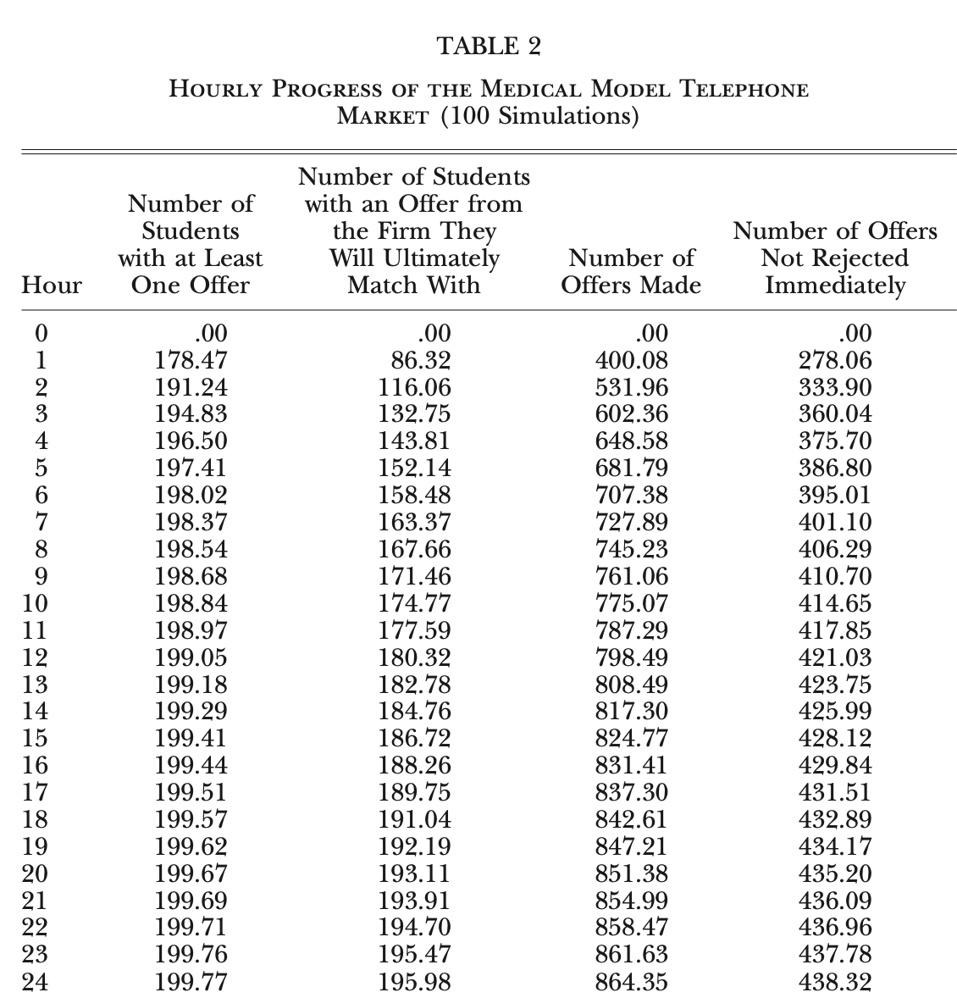
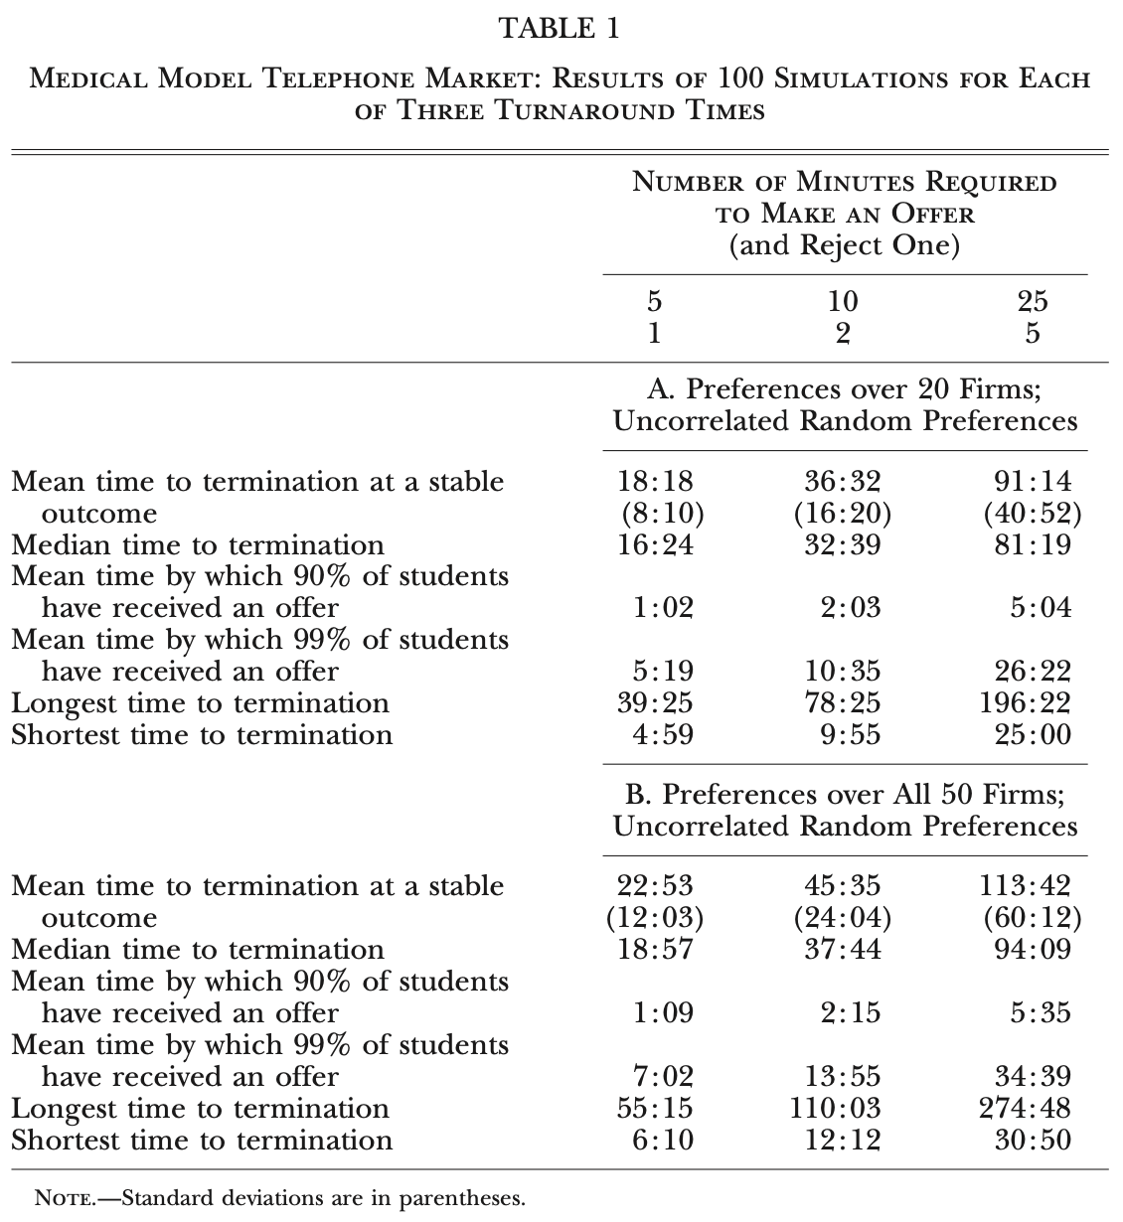
Simulation Results

Slide 16
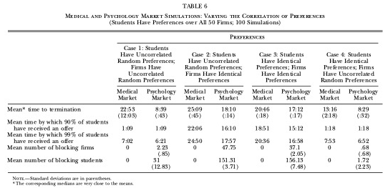
What if preferences are correlated?

Slide 17
Dynamic vs Direct Implementations
Dynamic process took too long.
Additional strategies available in dynamic implementation.
Harder to say ‘no’ (or hold an offer) over the phone.

Slide 18
Break

Slide 19
The NRMP Redesign

Slide 20
Matching with Couples
By 1980s, many couples participated in the match in the same year.
This violates one of our “Key Assumptions”:
3. No Externalities: agents care only about their own allocation.
What could happen if we ignore this?

Slide 21
Initial Matching with Couples Algorithm
Initially, the residency match accommodated couples as follows.
One member of the couple was designated the "lead member", and matched as normal.
Once their match was determined, the list of the "following member" was modified to remove any programs that were too far from the match of the lead member.
What problems could arise?

Slide 22
Quick Aside: School Choice in Chile
Another Example of Externalities (siblings). Current solution:
Assignment completed first for older grades.
Younger siblings’ preferences updated to list assignment of older sibling as first choice.
As though older sibling is “leading member” of the couple!

Slide 23
Incorporating Couples
Informal definition of blocking coalition:
A matching is blocked by a coalition if the coalition can agree upon an allocation that all members of the coalition weakly prefer, and some members strictly prefer.
Couples have preferences over PAIRS of positions.
1 | 2 | 3 | 4
A | A | B | A
A | B | C | B
C | C | D | C
D | C

Slide 24
Stable Matching Recap (Without Couples)
Important Results:
Stable matchings always exist.
The set of assigned students and assigned positions is the same for every stable matching.
There is a student-optimal stable match.
Student-proposing DA (with any proposal order) finds the student-optimal match.
Student-proposing DA is truthful for students.

Slide 25
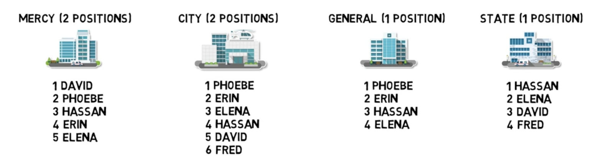
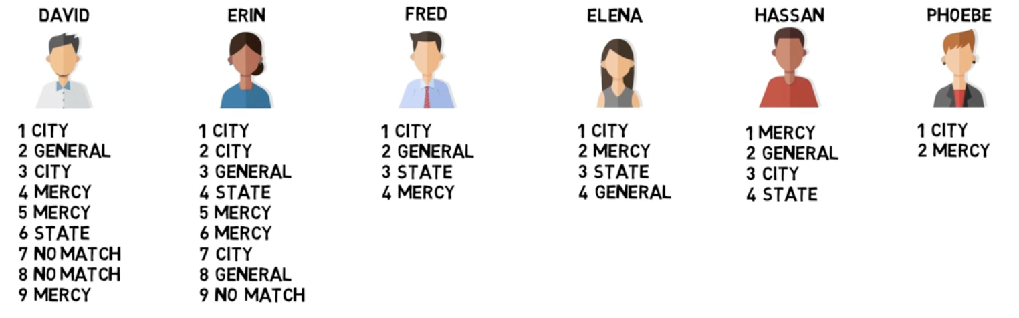
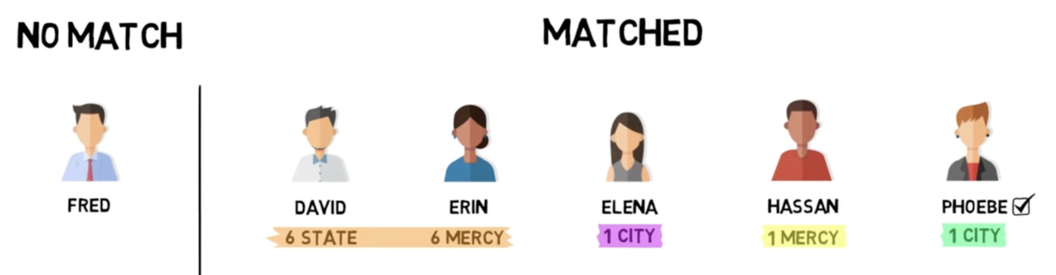
Do you think that the order of proposals could ever affect the final outcome?
5 Fred
After change, what is outcome if:
proposals from R to L?
proposals from L to R?

Slide 26
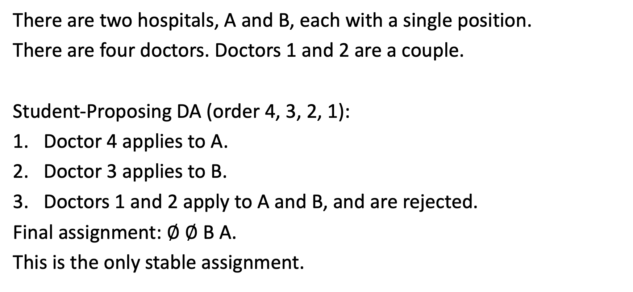
Incorporating Couples
A | B
4 | 2
1 | 3
There are two hospitals, A and B, each with a single position.
There are four doctors. Doctors 1 and 2 are a couple.
Student-Proposing DA (order 4, 3, 2, 1):
Doctor 4 applies to A.
Doctor 3 applies to B.
Doctors 1 and 2 apply to A and B, and are rejected.
Final assignment: $∅$ $∅$ B A.
This is the only stable assignment.
1 | 2 | 3 | 4
A | B | B | A
Final outcome depends on processing order!

Slide 27
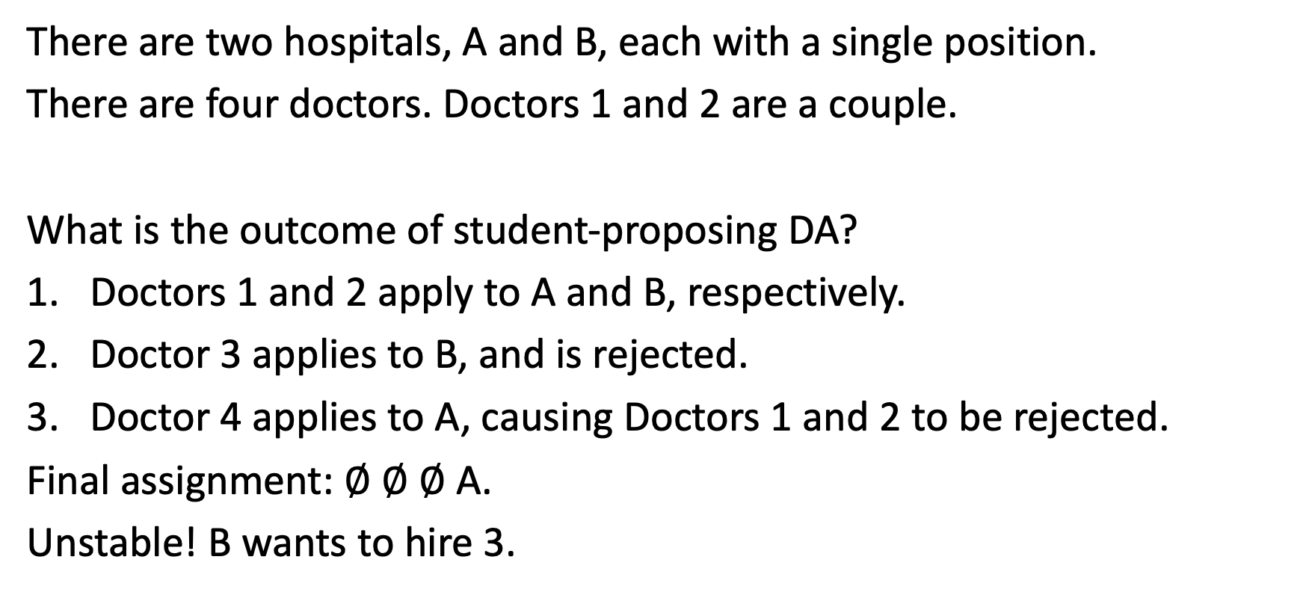
Incorporating Couples
A | B
4 | 2
1 | 3
There are two hospitals, A and B, each with a single position.
There are four doctors. Doctors 1 and 2 are a couple.
What is the outcome of student-proposing DA?
Doctors 1 and 2 apply to A and B, respectively.
Doctor 3 applies to B, and is rejected.
Doctor 4 applies to A, causing Doctors 1 and 2 to be rejected.
Final assignment: $∅$ $∅$ $∅$ A.
Unstable! B wants to hire 3.
1 | 2 | 3 | 4
A | B | B | A
May fail to find a stable assignment!

Slide 28
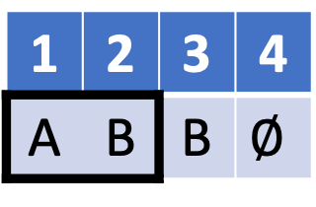
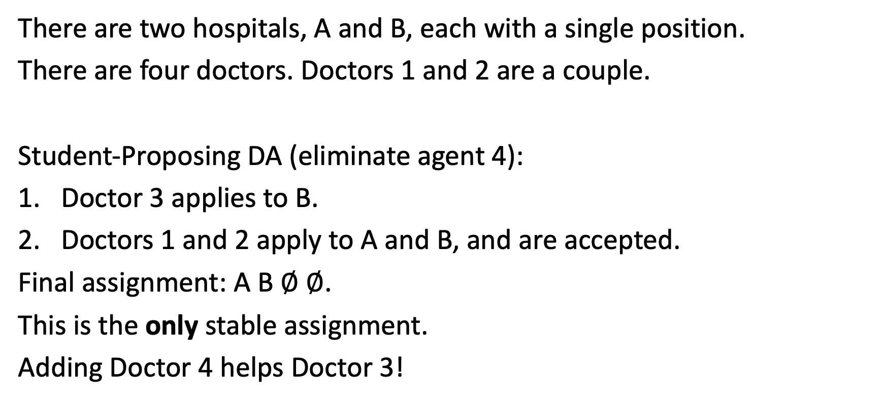
Incorporating Couples
A | B
4 | 2
1 | 3
There are two hospitals, A and B, each with a single position.
There are four doctors. Doctors 1 and 2 are a couple.
Student-Proposing DA (eliminate agent 4):
Doctor 3 applies to B.
Doctors 1 and 2 apply to A and B, and are accepted.
Final assignment: A B $∅$ $∅$.
This is the only stable assignment.
Adding Doctor 4 helps Doctor 3!
1 | 2 | 3 | 4
A | B | B | $$∅$$
No stable mechanism is population monotonic!

Slide 29

A | B
1 | 1
3 | 3
2 | 2
There are two hospitals, A and B, each with a single position.
There are three doctors. Doctors 1 and 2 are a couple.
There are four individually rational matchings:
A B $∅$
B A$∅$
$∅$ $∅$B
$∅$ $∅$A
1 | 2 | 3
A | B | A
B | A | B
blocked by 3B
blocked by 3A
blocked by 3A or 1B 2A
blocked by 1A, 2B
Which of these are stable?
No stable matching exists!

Slide 30
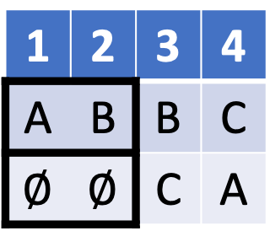
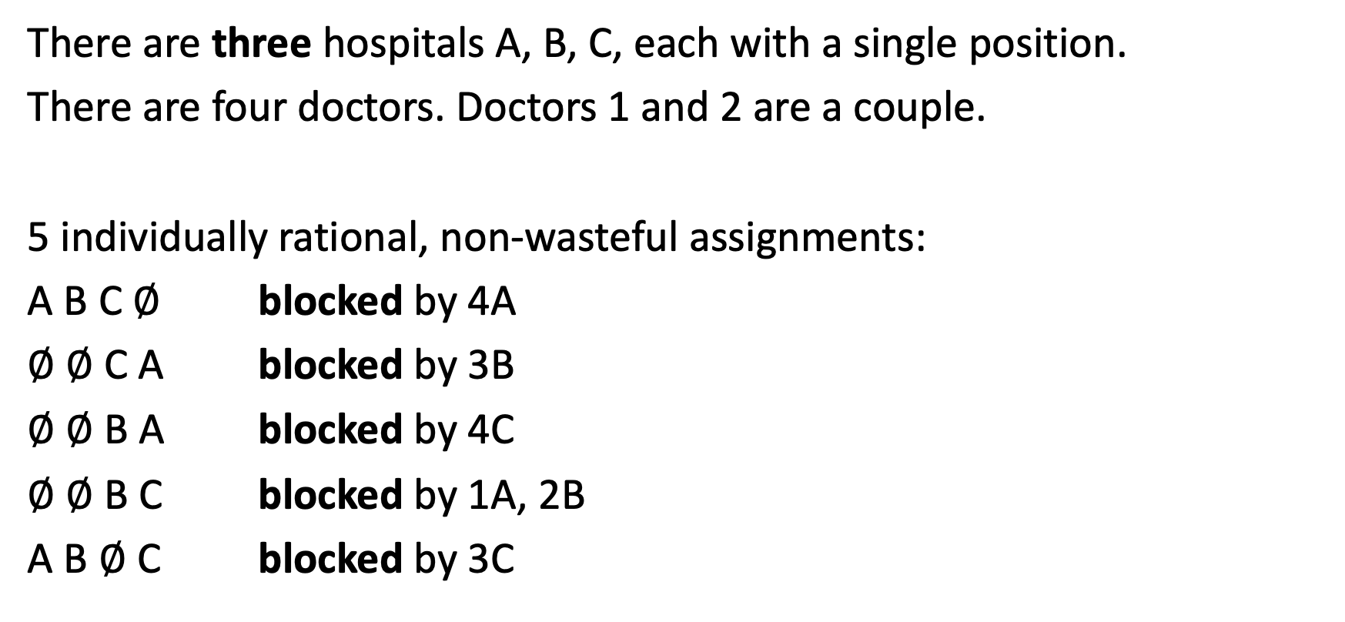
Incorporating Couples
A | B | C
4 | 2 | 3
1 | 3 | 4
There are three hospitals A, B, C, each with a single position.
There are four doctors. Doctors 1 and 2 are a couple.
5 individually rational, non-wasteful assignments:
A B C $∅$ blocked by 4A
$∅$ $∅$C A blocked by 3B
$∅$ $∅$B A blocked by 4C
$∅$ $∅$B C blocked by 1A, 2B
A B $∅$ C blocked by 3C
1 | 2 | 3 | 4
A | B | B | C
$∅$ | $$∅$$ | C | A
No stable matching exists!

Slide 31
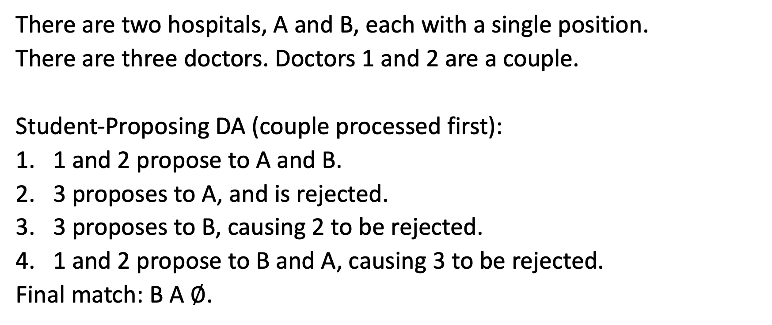
Truthfulness of DA
A | B
1 | 1
3 | 3
2 | 2
There are two hospitals, A and B, each with a single position.
There are three doctors. Doctors 1 and 2 are a couple.
Student-Proposing DA (couple processed first):
1 and 2 propose to A and B.
3 proposes to A, and is rejected.
3 proposes to B, causing 2 to be rejected.
1 and 2 propose to B and A, causing 3 to be rejected.
Final match: B A $∅$.
1 | 2 | 3
A | B | A
B | A | B
Could 3 benefit from lying?

Slide 32
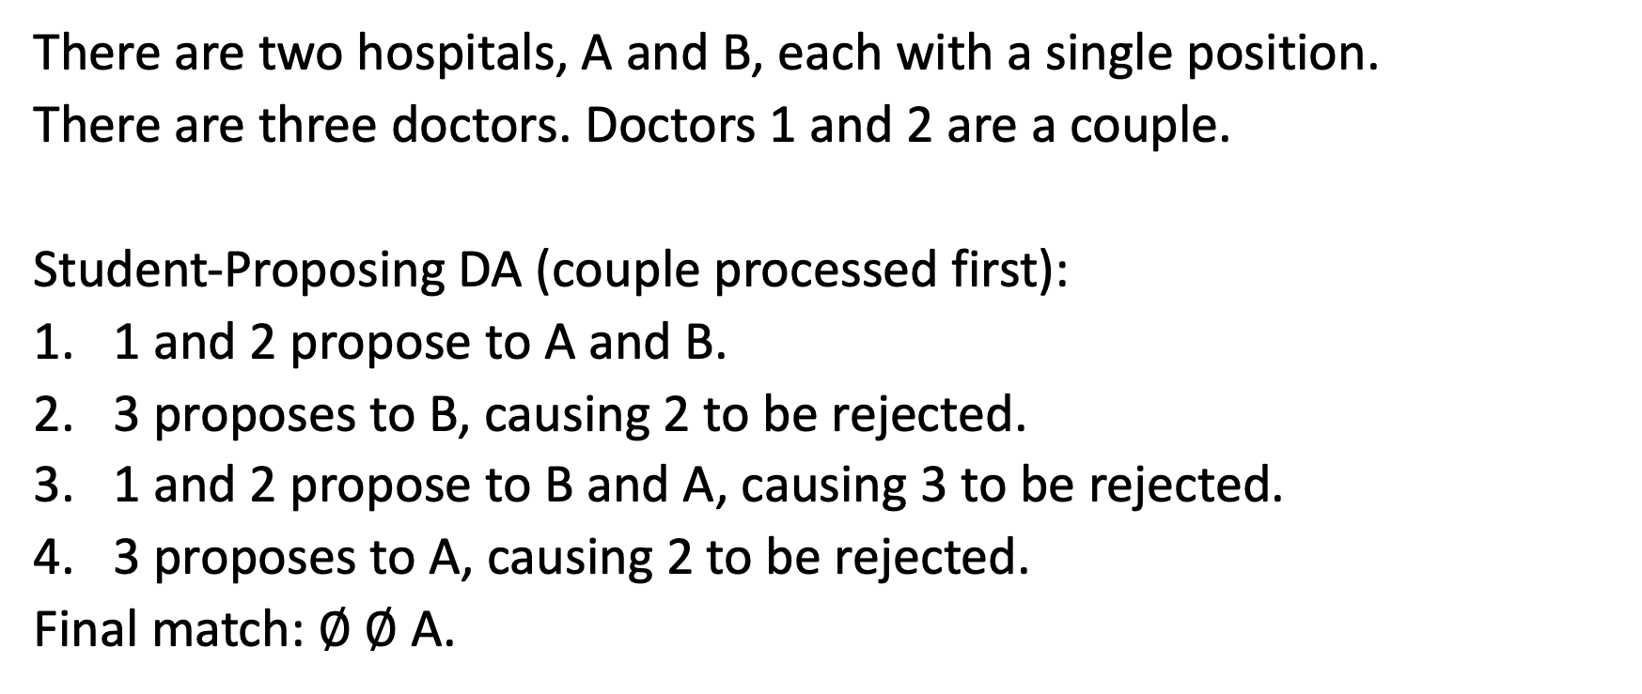
Truthfulness of DA
A | B
1 | 1
3 | 3
2 | 2
There are two hospitals, A and B, each with a single position.
There are three doctors. Doctors 1 and 2 are a couple.
Student-Proposing DA (couple processed first):
1 and 2 propose to A and B.
3 proposes to B, causing 2 to be rejected.
1 and 2 propose to B and A, causing 3 to be rejected.
3 proposes to A, causing 2 to be rejected.
Final match: $∅ ∅$ A.
1 | 2 | 3
A | B | B
B | A | A
Student-proposing DA not truthful!

Slide 33
Incorporating Couples
A | B | C
2 | 2 | 1
4 | 3 | 3
1 |  | 4
There are three hospitals A, B, C, each with a single position.
There are four doctors. Doctors 1 and 2 are a couple.
Student Proposing DA (in order 4, 3, 2, 1):
4 applies to C, and is tentatively accepted.
3 applies to B, and is tentatively accepted.
1 and 2 apply to A and B, causing 3 to be rejected.
3 applies to C, causing 4 to be rejected.
4 applies to A, causing 1 and 2 to be rejected.
1 | 2 | 3 | 4
A | B | B | C
C | A | C | A

Slide 34
Incorporating Couples
A | B | C
2 | 2 | 1
4 | 3 | 3
1 |  | 4
There are three hospitals A, B, C, each with a single position.
There are four doctors. Doctors 1 and 2 are a couple.
Student Proposing DA (in order 4, 3, 2, 1):
4 applies to C, and is tentatively accepted.
3 applies to C, causing 4 to be rejected.
4 applies to A, and is tentatively accepted.
1 and 2 apply to A and B, and are rejected
1 and 2 apply to C and A, causing 3 to be rejected
3 applies to B, and is accepted.
1 | 2 | 3 | 4
A | B | C | C
C | A | B | A
3 moved B lower and got a better outcome!
Student-proposing DA not truthful.

Slide 35
Couples Summary
Stable matchings may fail to exist.
Even when stable matchings exist:
Student-proposing DA may fail to find it.
Proposal order may matter.
Population monotonicity may fail.
Add examples showing that Rural hospital theorem may fail, DA not truthful, there is no student optimal stable assignment.

Slide 36

Stable Matching Recap
With Couples
In “simple” many-to-one matching markets,
Stable matchings always exist.
The set of assigned students and assigned positions is the same for every stable matching.
There is a student-optimal stable match.
Student-proposing DA (with any proposal order) finds the student-optimal match.
Student-proposing DA is truthful for students.
Love ruins everything!

Slide 37
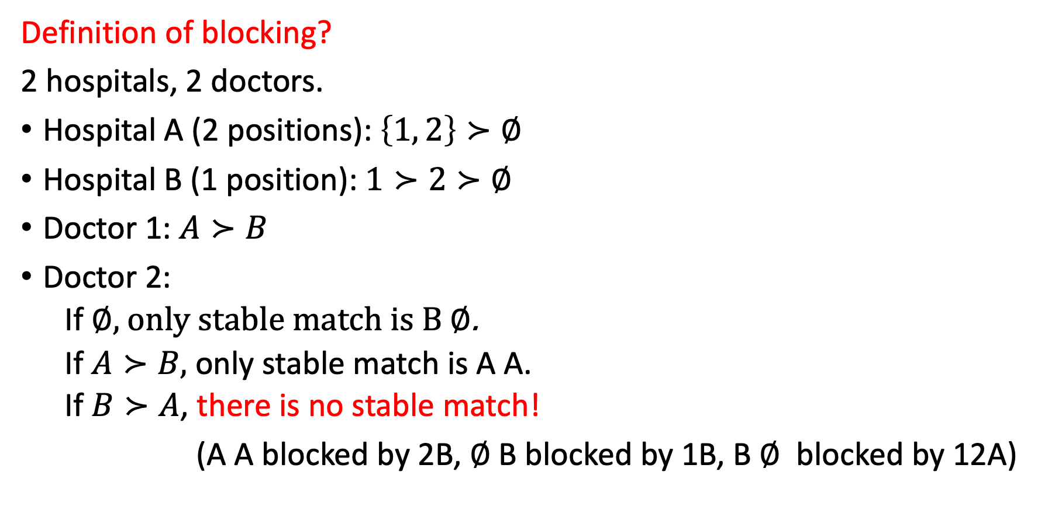
Similar problems if programs want pairs of residents (even if no couples)
Definition of blocking?
2 hospitals, 2 doctors.
Hospital A (2 positions): $\left\{1, 2\right\}≻∅$
Hospital B (1 position): $1≻2≻∅$
Doctor 1: $A≻B$
Doctor 2:
If $∅,$ only stable match is B $∅$.
If $A≻B,$ only stable match is A A.
If $B≻A$, there is no stable match!
(A A blocked by 2B, $∅$B blocked by 1B, B $∅$ blocked by 12A)
Fails population monotonicity.

Slide 38
What to do?

Slide 39
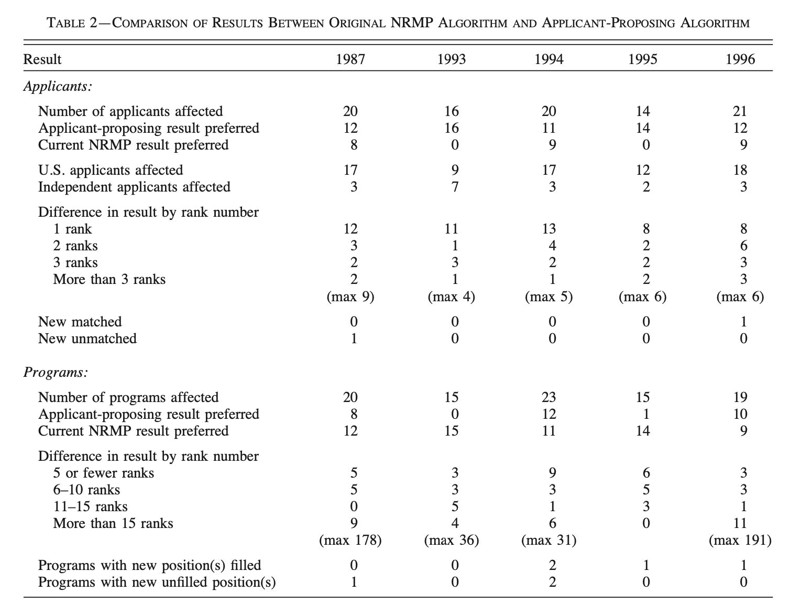
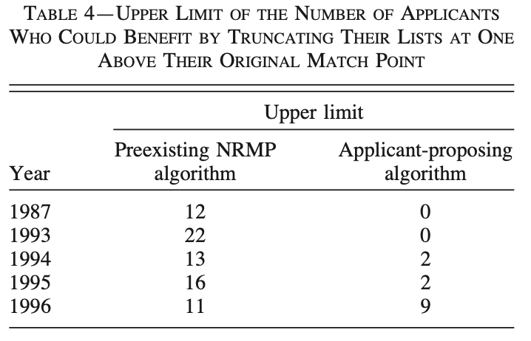
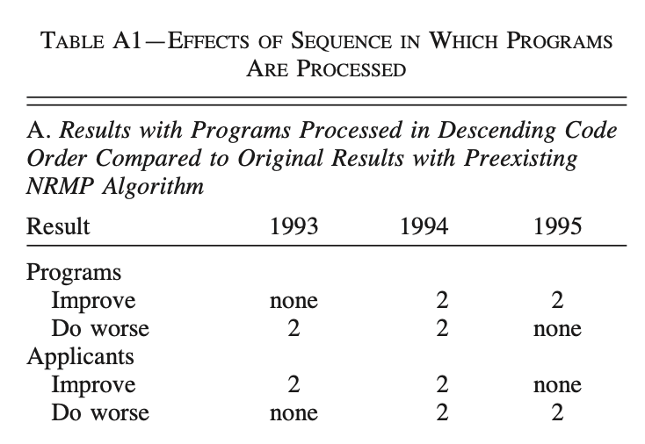
A Look at the Data
A stable match was always found.
The rural hospital theorem almost held.
Sequencing order hardly mattered.
Few applicants could benefit from misreporting.

Slide 40
A Helpful Analogy
Consider the design of suspension bridges. The Newtonian physics they embody is beautiful both in mathematics and in steel, and college students can be taught to derive the curves that describe the shape of the supporting cables. But no bridge could be built based only on this elegant theoretical treatment, in which the only force is gravity, and all beams are perfectly rigid. Real bridges are built of steel and rest on rock and soil and water, and so bridge design also concerns metal fatigue, soil mechanics, and the forces of waves and wind.
Roth and Peranson, 1999

Slide 41
Many design questions concerning these real-world complications cannot be answered analytically but, instead, must be explored using physical or computational models. Often these involve estimating magnitudes of phenomena missing from the simple Newtonian model, some of which are small enough to be of little consequence, while others will cause the bridge to fall down if not adequately addressed. Just as no suspension bridges could be built without an understanding of the underlying physics, neither could any be built without understanding many additional features, also physical in nature, but more varied and complex than addressed by the simple model.
Roth and Peranson, 1999

Slide 42
Practical Problems Inspire New Theory
Kojima, Pathak, Roth, 2010
Large Markets
In large random markets with few couples stable matchings exist.
In a “large market” with couples, stable matchings exist.
(Assumptions needed!)
Modifying Capacities
Given any instance of a stable matching problem with couples, we can find a “nearby” instance in which a stable matching exists:
Same preferences
Each hospital’s capacity changed by at most 2.
Total hospital capacity changed by at most 4.
Azevedo and Hatfield, 2018
Che, Kim, and Kojima 2019
Nguyen and Vohra, 2018

Slide 43
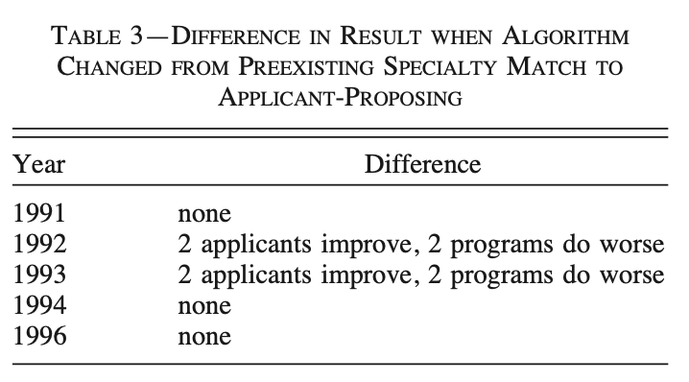
Which Side Proposes?
Doesn’t really matter!

Slide 44
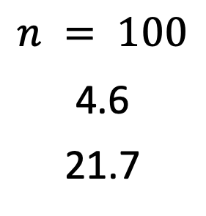
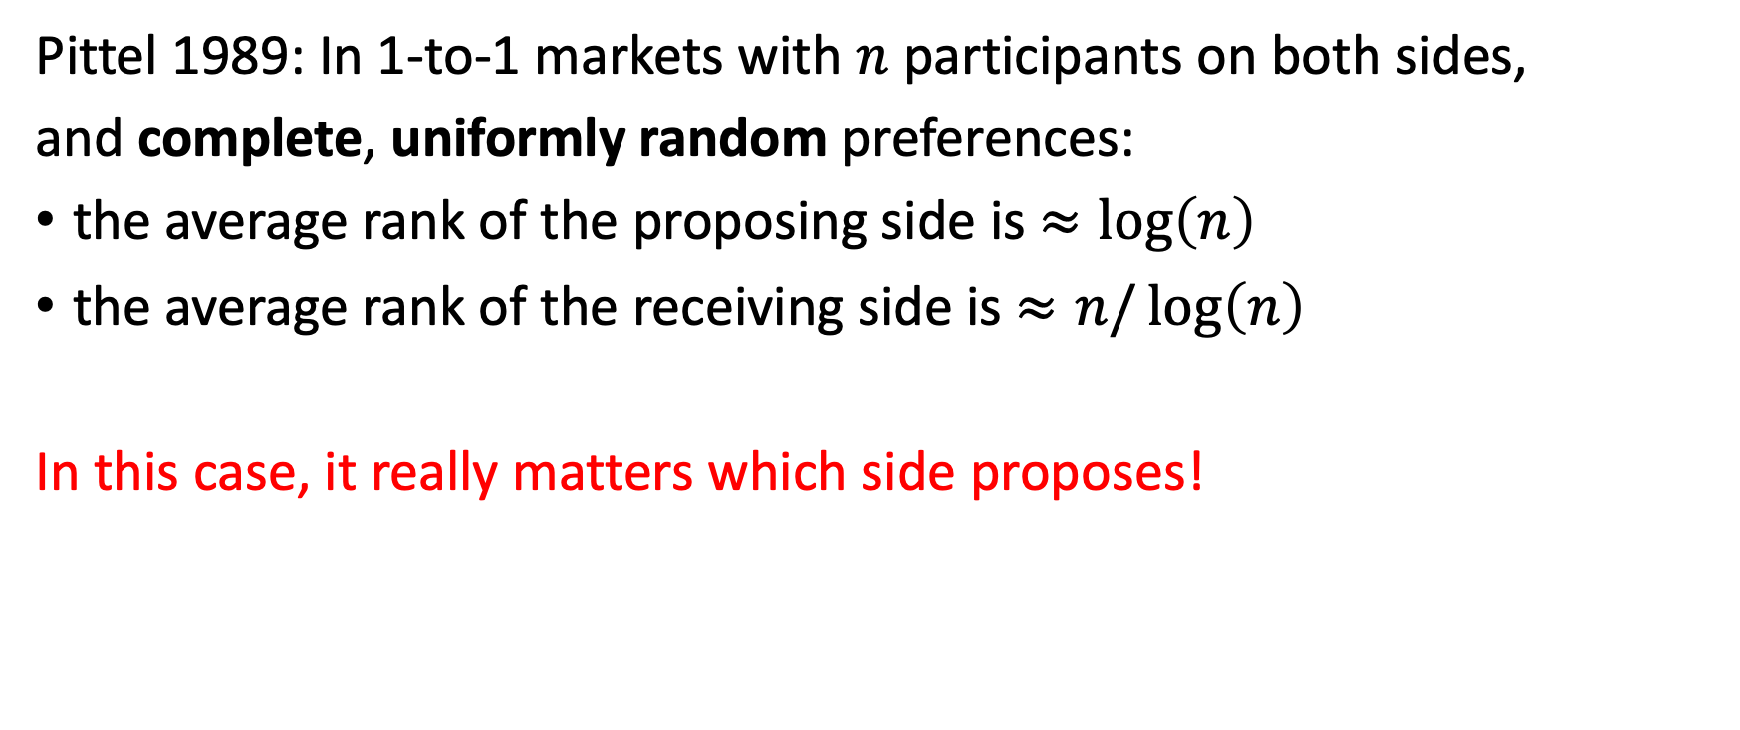
Prior Theory
Pittel 1989: In 1-to-1 markets with $n$ participants on both sides,
and complete, uniformly random preferences:
the average rank of the proposing side is $≈\log\left(n\right)$
the average rank of the receiving side is $≈n/\log\left(n\right)$
In this case, it really matters which side proposes!
$$n = 100$$
4.6
21.7

Slide 45
Practical Problems Inspire New Theory
Why do most participants have a unique stable partner?
Theory (Pittel 1989): with n men, n women, and iid random preferences, the proposing side makes a big difference!
Explanations in Roth-Peranson:
Short lists
Correlated preferences

Slide 46
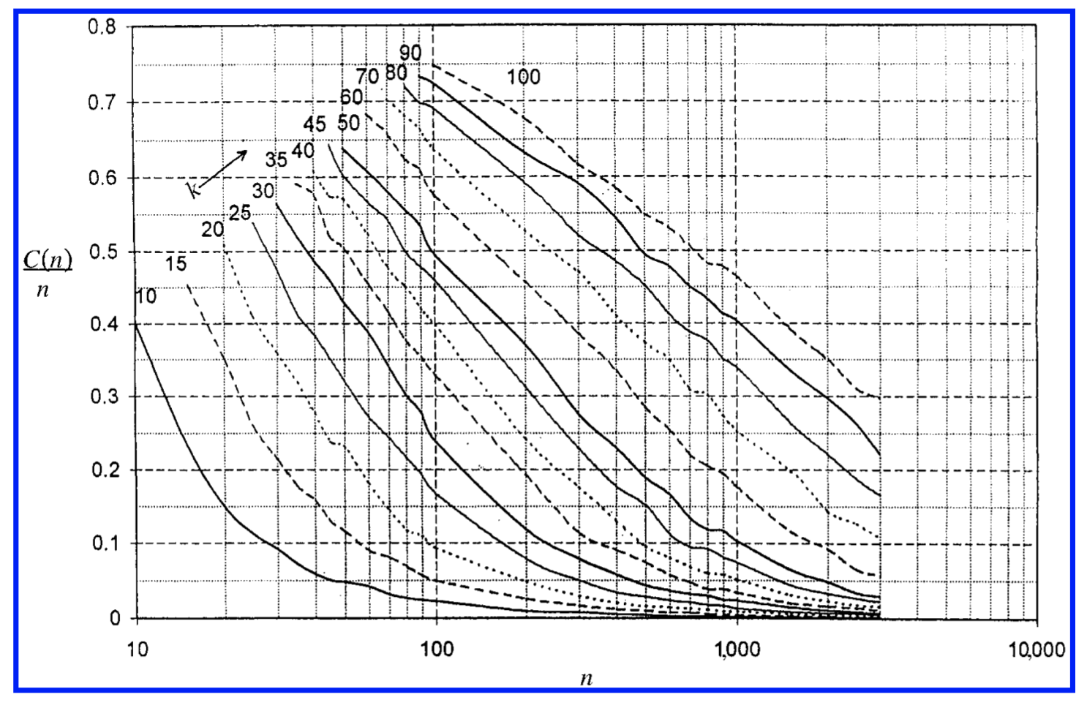
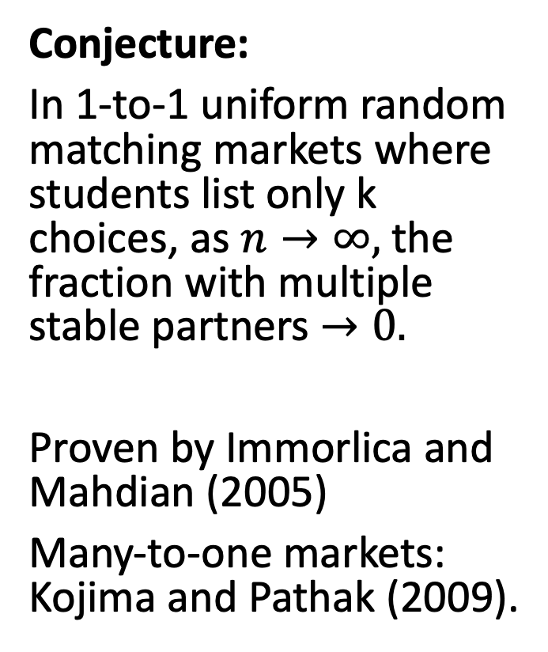
Simulation Results: Incomplete Lists
Conjecture:
In 1-to-1 uniform random matching markets where students list only k choices, as $n→∞,$ the fraction with multiple stable partners $→0.$
Proven by Immorlica and Mahdian (2005)
Many-to-one markets: Kojima and Pathak (2009).

Slide 47
Simulation Results: Incomplete Lists
Intuition:
A school has different stable partners if (and only if) it can trigger a “rejection chain” that returns to it.
With short lists, some schools will have unfilled positions. Rejection chains are likely to reach these schools before returning to the original one.

Slide 48
Re-evaluating Balanced Market
What about non-uniform random preferences?
Azevedo and Leshno (2016):
When the capacity of each school is large, there is generically a unique stable matching.
Ashlagi, Kanoria, Leshno (2017)

Slide 49
One Extra Student Can Make a Big Difference!
Ashlagi, Kanoria, Leshno (2017)

Slide 50
An Open Problem
Consider two 1-to-1 matching markets with complete random preferences
Market A: n men and m women, women propose.
Market B: n+1 men and m women, men propose.
Conjecture: men’s average rank is always lower (better) in Market A.
Potential Conclusion:
competition is more important than choice of algorithm.

Slide 51
Summary
Real-world markets include many complexities, which may break nice theoretical properties.
Nevertheless, simple theory can provide helpful guidance for these markets.
In the medical residency match, the choice of proposing side had a minimal effect on the final assignment (99.9% of students have a unique stable match).

Slide 52
Coming Up
Posted Tonight: Reflection and Critical Thinking 4
Next week:
Tuesday: Dealing with indifferences (ties in priority).
Thursday: Debating merits of centralized matching
(Should it be used for other labor markets?)

Slide 53
Recent Theory

Slide 54
Discussion Questions
Do you think that a centralized match should be used in the following markets? How would this work? What challenges might arise?
College admissions
Fraternity/Sorority Rush
Entry-level (new college grad) labor markets
Graduate school

