Slide 1
Engineering Systems for Allocating Public Goods
Stable Matching in School Choice:
Dealing with Ties in Priority

Slide 2

Stable Matching Recap
With Couples
In “simple” many-to-one matching markets,
Stable matchings always exist.
The set of assigned students and assigned positions is the same for every stable matching.
There is a student-optimal stable match.
Student-proposing DA (with any proposal order) finds the student-optimal match.
Student-proposing DA is truthful for students.
Student-proposing DA is population monotonic.

Slide 3
Recap: Last Class
Real-world markets include many complexities, which may break nice theoretical properties.
Nevertheless, simple theory can provide helpful guidance for these markets.
In the medical residency match, the choice of proposing side had a minimal effect on the final assignment (99.9% of students have a unique stable match).

Slide 4
Many Student in the Same Priority Class
Two notions of blocking pair:
Weak blocking pair: student prefers school, and has equal priority to another assigned student.
Strong blocking pair: student prefers school, and has higher priority than another assigned student.
Two notions of stability:
Strong stability (no weak blocking pairs)
Weak stability (no strong blocking pairs)
1 | 2 | 3 | 4 | 5 | 6
A | B | A | A | B | A
B | A | B | B | A | B
A | B
1 | 3,5
2, 3, 4 | 1,2,4,6
5, 6
NP-Hard to determine.
May not exist!
Always exist

Slide 5
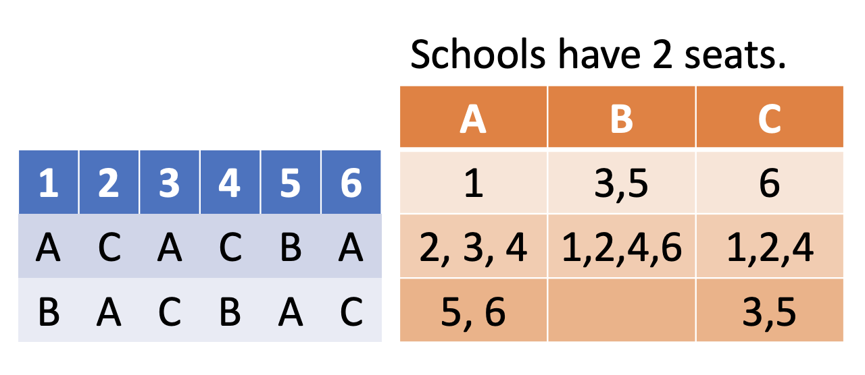
Example from HW

Slide 6
How To Find a Weakly Stable Matching?
1 | 2 | 3 | 4 | 5 | 6
A | B | A | A | B | A
B | A | B | B | A | B
1 | 2 | 3 | 4 | 5 | 6
A | B | A | A | B | A
B | A | B | B | A | B
A | B
1 | 3,5
2, 3, 4 | 1,2,4,6
5, 6
A | B
1 | 3
2 | 5
3 | 1
4 | 2
5 | 4
6 | 6
Then use
Deferred Acceptance.
Tiebreaking
Rule
Every weakly stable matching is stable in the market resulting from some tiebreaking rule.

Slide 7

Group Work:
Which properties hold for weakly stable matchings in markets with indifferences?
In “simple” many-to-one matching markets,
Stable matchings always exist.
The set of assigned students and assigned positions is the same for every stable matching.
There is a student-optimal stable match.
There is a truthful procedure that finds a stable match.

Slide 8
Can We Optimize Over Set of Stable Matches?
For example, may want to find a (weakly) stable matching that matches the maximum possible number of students.
Concerns:
NP-complete (Manlove 1999).
Not truthful.
Complex to explain, verify.
A | B
1, 2 | 1, 2
1 | 2
A | A
B | B
1 | 2
A | A
B

Slide 9
Can We Find a “Student Optimal” stable matching in a truthful way?
If there is a matching produced by student-proposing deferred acceptance with multiple tiebreaking that cannot be produced by deferred acceptance with single tiebreaking, then the matching is not a student-optimal stable matching.
However, single tiebreaking can also lead to a matching that is not a student-optimal stable matching. Thus there will sometimes be a potential opportunity to improve on the outcome of deferred acceptance with single tiebreaking. Theorem 1, our main theoretical result, implies that there exists no strategy-proof mechanism (stable or not) that Pareto improves on the deferred acceptance algorithm with single tiebreaking. That is, the potential inefficiency of student-pro- posing deferred acceptance with single tiebreaking is the cost of strategy-proofness.
-Abdulkadiroglu, Pathak, Roth (2009)

Slide 10
How to Break Ties?
Due to challenges optimizing over the set of stable matches (in terms of incentives, computation, and transparency), in practice school districts settle for weak stability, and use pre-specified tie-breaking rules (usually lotteries).

Slide 11
Warm Up
List all priority profiles that could result from a single district-wide lottery.
List all priority profiles that could result from using independent lotteries.
What questions do you have about tie-breaking?
1 | 2 | 3
A | B | B
C | A | C
B | C | A
A | B | C
1,2 | 1 | 3
3 | 2,3 | 1
 |  | 2

Slide 12
Warm Up
List all priority profiles that could result from a single district-wide lottery.
List all priority profiles that could result from using independent lotteries.
What questions do you have about tie-breaking?
1 | 2 | 3
A | B | B
C | A | C
B | C | A
A | B | C
1,2 | 1 | 3
3 | 2,3 | 1
 |  | 2

Slide 13
Warm Up
List all priority profiles that could result from a single district-wide lottery.
List all priority profiles that could result from using independent lotteries.
What questions do you have about tie-breaking?
1 | 2 | 3
A | B | B
C | A | C
B | C | A
Independent Lotteries
B: 2 > 3 B: 3 > 2
A | B | C
1 | 1 | 3
2 | 2 | 1
3 | 3 | 2
A | B | C
1 | 1 | 3
2 | 3 | 1
3 | 2 | 2
A: 1 > 2
A: 2 > 1
A | B | C
1,2 | 1 | 3
3 | 2,3 | 1
 |  | 2
A | B | C
2 | 1 | 3
1 | 2 | 1
3 | 3 | 2
A | B | C
2 | 1 | 3
1 | 3 | 1
3 | 2 | 2

Slide 14
Warm Up
List all priority profiles that could result from a single district-wide lottery.
List all priority profiles that could result from using independent lotteries.
What questions do you have about tie-breaking?
1 | 2 | 3
A | B | B
C | A | C
B | C | A
Single Lottery
A | B | C
1,2 | 1 | 3
3 | 2,3 | 1
 |  | 2
1 > 2 > 3
1 > 3 > 2
2 > 1 > 3
2 > 3 > 1
3 > 1 > 2
3 > 2 > 1
A | B | C
1 | 1 | 3
2 | 2 | 1
3 | 3 | 2
A | B | C
1 | 1 | 3
2 | 3 | 1
3 | 2 | 2
A | B | C
2 | 1 | 3
1 | 2 | 1
3 | 3 | 2
A | B | C
2 | 1 | 3
1 | 2 | 1
3 | 3 | 2
A | B | C
1 | 1 | 3
2 | 3 | 1
3 | 2 | 2
A | B | C
2 | 1 | 3
1 | 3 | 1
3 | 2 | 2

Slide 15
District Lottery vs Independent Lotteries
1 | 2 | 3
A | A | C
B | C | B
A | B | C
1, 2 | 1, 3 | 2,3
Group Work:
If each school breaks ties independently, what is the chance that all three students match?
If the district runs one lottery, what is the chance that all three students match?

Slide 16
Break

Slide 17
Data from NYC
Data from Boston
Group Work:
What do you notice?
What questions do you have about this data?
Based on this data, which tiebreaking procedure would you choose?

Slide 18
Data from NYC
Data from Boston
Single Tie-Breaking gives more first choices
Independent Tie-Breaking
leaves more students unassigned, but gives more students their first choice.

Slide 19
Weak Definition of “Student Optimality”
A weakly stable matching is said to be “student optimal” if there is no other weakly stable matching that is at least as good for all students.
What does it mean that matching M is student optimal:
Original definition: given any other stable match, all students agree that M is at least as good, and some student thinks that M is better.
This definition: given any other stable match, some student thinks that M is better.
This is much weaker. In my opinion, it should not be called “student optimal.” I would prefer “undominated”.

Slide 20
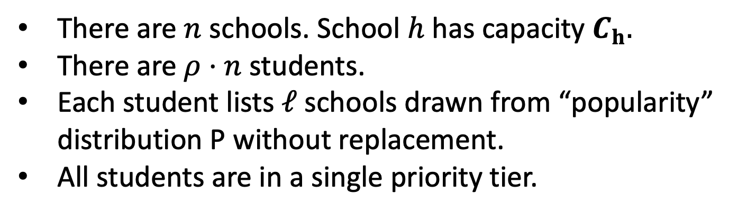
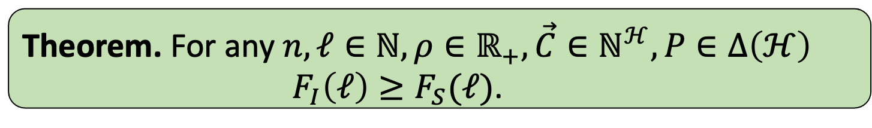

Model Assumptions
There are $n$ schools. School $h$ has capacity $C_{h}.$
There are $ρ⋅n$ students.
Each student lists $ℓ$schools drawn from “popularity” distribution P without replacement.
All students are in a single priority tier.
Theorem. For any $n, ℓ∈ℕ, ρ∈ℝ_{+}, \vec{C}∈ℕ^{ℋ}, P∈Δ\left(ℋ\right)$
$F_{I}\left(ℓ\right)≥F_{S}(ℓ)$.
Fraction matched with independent lotteries.
Fraction matched with a single lottery.
$$≥$$

Slide 21
Some of My Results
Theorem. If students list same number of schools, more matches with independent lotteries.
Theorem.
Always more first choices with a single lottery.

Slide 22
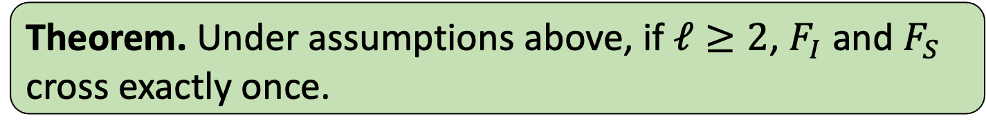
Single-Crossing of Rank Distributions
Theorem. Under assumptions above, if $ℓ≥2$, $F_{I}$ and $F_{S}$ cross exactly once.
Notes:
Comment that analogous results hold with non-equal list lengths (still more first choices under STB, and conditional rank distributions exhibit single-crossing).

Slide 23
Lawsuits in Amsterdam

Slide 24
Lottery Numbers in New York

Slide 25
Coming Up
Concept Check 6 (due Wednesday at 11:59 pm)
Midterm #1 (available Thursday after class, due no later than Monday night)
Algorithm Practice Problems (on Canvas)

Slide 26
Data from NYC

