Slide 1
Do “Community Preference” Policies Violate the Fair Housing Act?
Part 3: My Conclusions
Nick Arnosti (not a legal scholar)

Slide 2
What are the effects of New York’s “Community Preference” Policy?
Part 3: My Conclusions
Nick Arnosti (not a legal scholar)

Slide 3
Talk Overview
Details of allocation process
Different unit types.
Developer screening algorithm.
Consequence:
Community Preference disproportionately affects low-income applicants!
Revisiting Beveridge’s and Siskin’s reports.

Slide 4
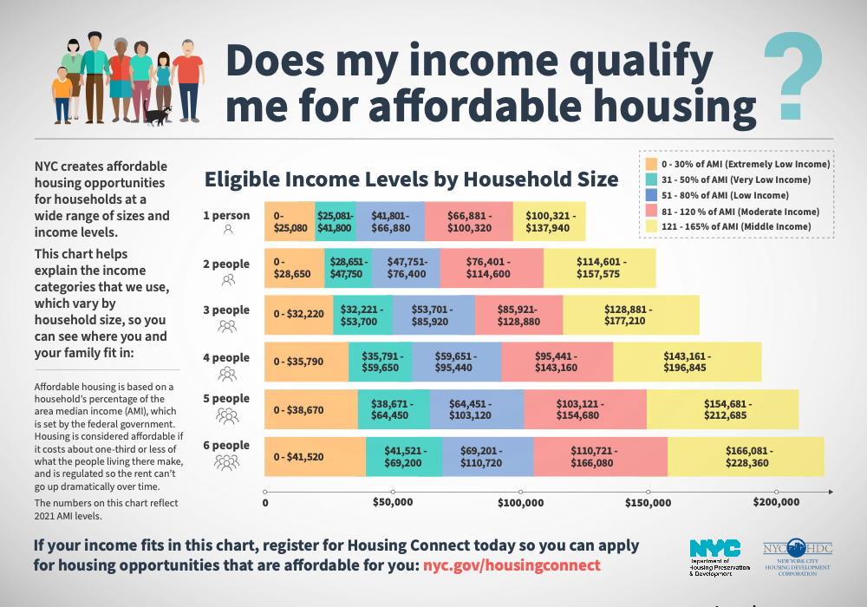
Aren’t all applicants low income?
No.

Slide 5
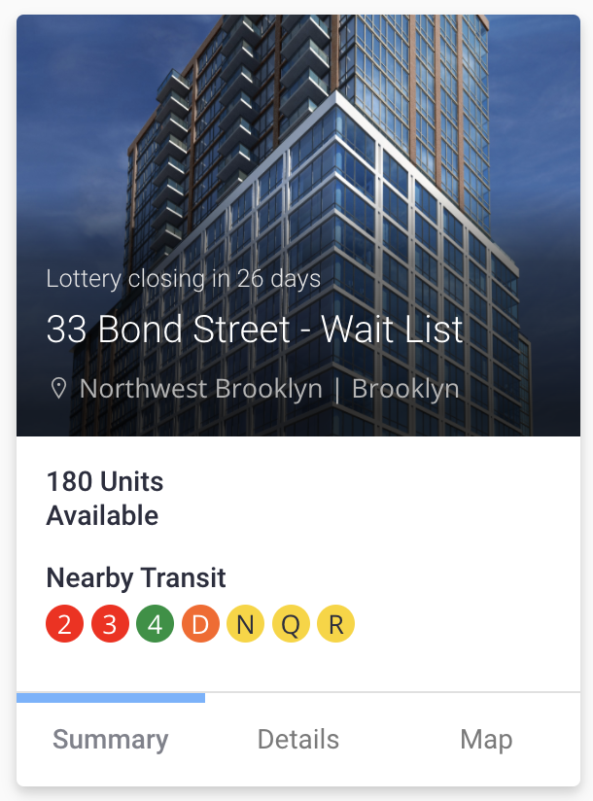
Units distinguished by
# bedrooms, AMI target.
Only applicants with appropriate
household size and income qualify
Some 2 bedroom apartments for
Family of 4 on $32,000
Family of 4 on $160,000

Slide 6
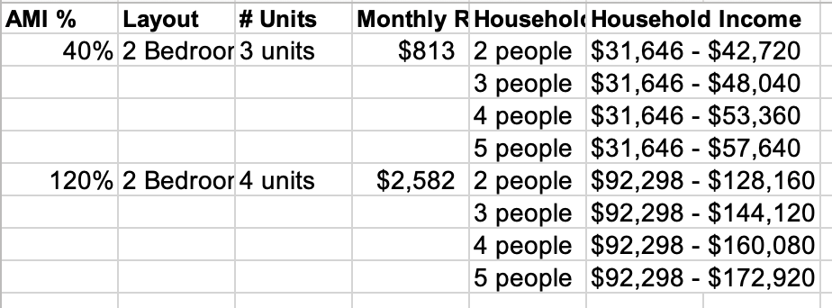
Units distinguished by
# bedrooms, AMI target.
Only applicants with appropriate
household size and income qualify
Some 2 bedroom apartments for
Family of 4 on $32,000
Family of 4 on $160,000

Slide 7
Units distinguished by
# bedrooms, AMI target.
Only applicants with appropriate
household size and income qualify
Some 2 bedroom apartments for
Family of 4 on $32,000
Family of 4 on $160,000

Slide 8
Units distinguished by
# bedrooms, AMI target.
Only applicants with appropriate
household size and income qualify
Conclusion:
NOT all eligible households are low-income.
Some 2 bedroom apartments for
Family of 4 on $32,000
Family of 4 on $160,000

Slide 9
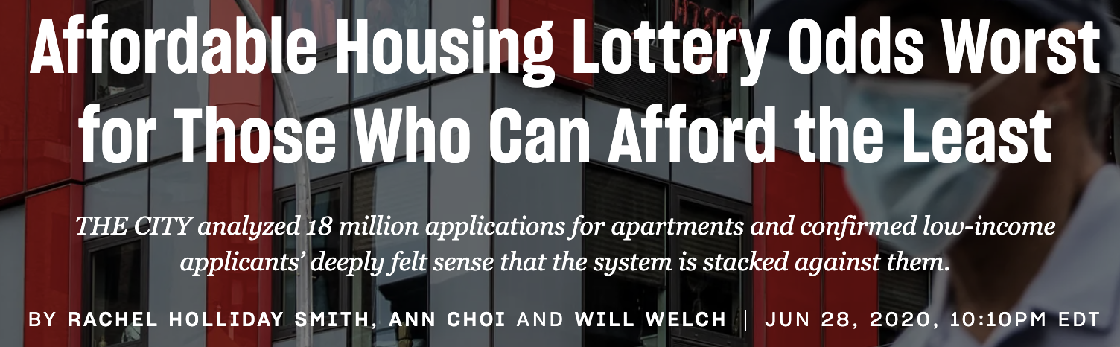

Slide 10
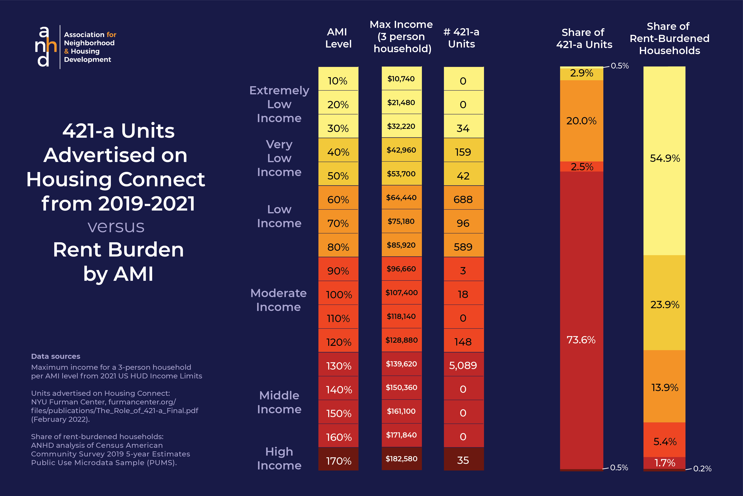

Slide 11
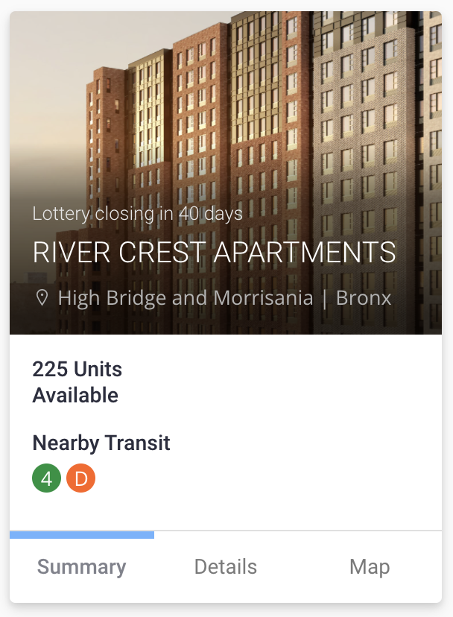

Slide 12
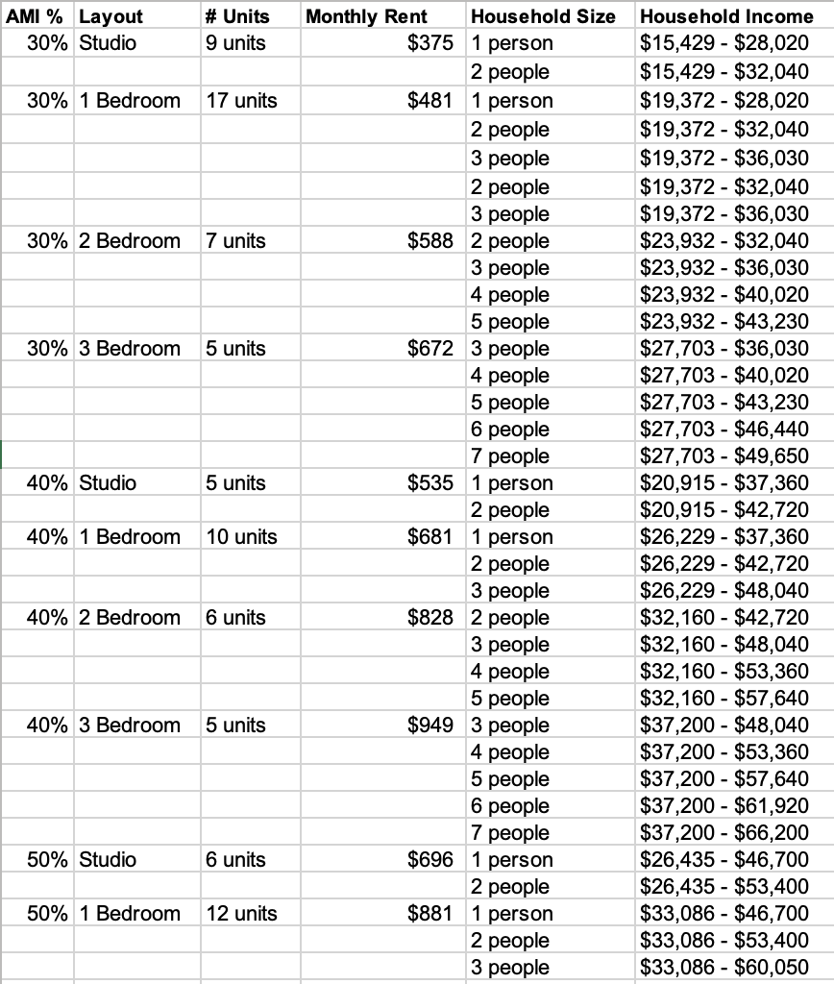

Slide 13
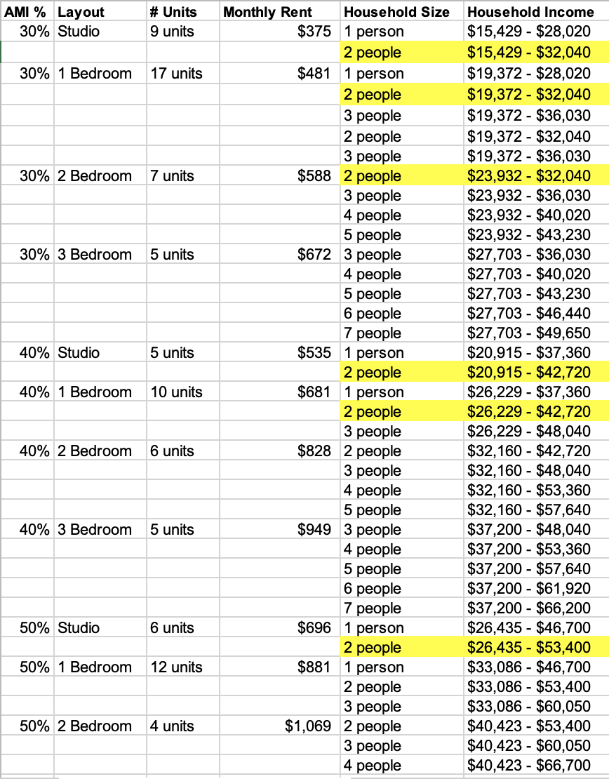

Slide 15
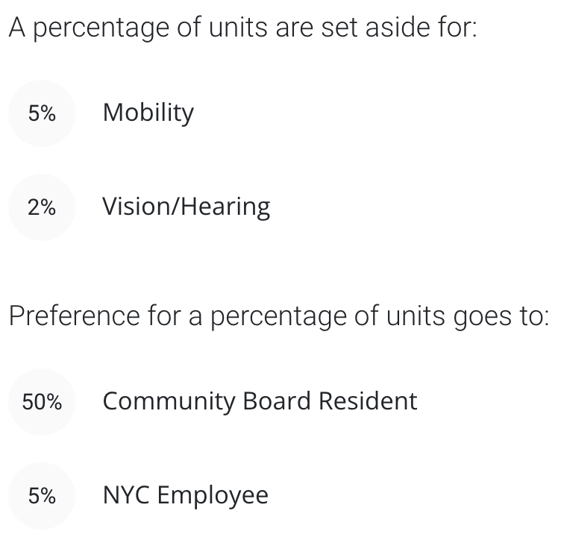

Slide 16
Preferences
Several “preferences:”
7% disability (5% mobility, 2% vision/hearing)
50% community preference
5% municipal employee
According to Siskind:
Applications can have more than one preference, and granting someone with multiple preferences a unit counts against each preference’s goal.

Slide 17
How do they handle this all?

Slide 18
How do they handle this all?
Order applicants by log number.
Satisfy preferences:
Applicants eligible for disability preference considered in log order until 7% of units have been allocated.
Applicants eligible for community preference considered in log order until 50% of units filled with people from community district.
Applicants eligible for municipal employee preference considered in log order until 5% of units filled with municipal employees.
Remaining applicants considered in log order until all units filled.

Slide 19
How do they handle this all?
Order applicants by log number.
Satisfy preferences:
Applicants eligible for disability preference considered in log order until 7% of units have been allocated.
Applicants eligible for community preference considered in log order until 50% of units filled with people from community district.
Applicants eligible for municipal employee preference considered in log order until 5% of units filled with municipal employees.
Remaining applicants considered in log order until all units filled.
Granting someone with multiple preferences a unit counts against each preference’s goal.
If household is eligible for multiple available unit types, it chooses which to claim.

Slide 20
Beveridge (paragraph 60):
unless and until a number of units equal to the percentage assigned to community preference is filled (the default being 50 percent), applicant HHs who are outsiders are generally skipped in line, while insiders are processed.
Siskin:
if a mobility unit placement also qualified for the CP, they would be counted as satisfying one unit in both preferences. The result of this nested preference was that the number of available units in both preferences would be decreased, and the units available in the no preference or open stage would be increased.

Slide 21
What are consequences of using this algorithm?

Slide 22
What are consequences of using this algorithm?
????

Slide 23
A Simple Example
Assume:
All units have same number of bedrooms.
Two non-overlapping target income ranges.
No disability or municipal employee preferences
All applicants are eligible and will accept.

Slide 24
A Simple Example
Assume:
All units have same number of bedrooms.
Two non-overlapping target income ranges.
No disability or municipal employee preferences
All applicants are eligible and will accept.
1000 applicants:
20% from community district
90% low income
Income and community preference are independent.

Slide 25
A Simple Example
Assume:
All units have same number of bedrooms.
Two non-overlapping target income ranges.
No disability or municipal employee preferences
All applicants are eligible and will accept.
1000 applicants:
20% from community district
90% low income
Income and community preference are independent.
 | CP | Not CP
Low Income | 180 | 720
Middle Income | 20 | 80

Slide 26
A Simple Example
Assume:
All units have same number of bedrooms.
Two non-overlapping target income ranges.
No disability or municipal employee preferences
All applicants are eligible and will accept.
1000 applicants:
20% from community district
90% low income
Income and community preference are independent.
100 units
50 low income
50 middle income
 | CP | Not CP
Low Income | 180 | 720
Middle Income | 20 | 80

Slide 27

A Simple Example
Assume:
All units have same number of bedrooms.
Two non-overlapping target income ranges.
No disability or municipal employee preferences
All applicants are eligible and will accept.
$≥$50 from
community
1000 applicants:
20% from community district
90% low income
Income and community preference are independent.
100 units
50 low income
50 middle income
 | CP | Not CP
Low Income | 180 | 720
Middle Income | 20 | 80

Slide 28
A Simple Example
Assume:
All units have same number of bedrooms.
Two non-overlapping target income ranges.
No disability or municipal employee preferences
All applicants are eligible and will accept.
$≥$50 from
community
1000 applicants:
20% from community district
90% low income
Income and community preference are independent.
100 units
50 low income
50 middle income
 | CP | Not CP
Low Income | 180 | 720
Middle Income | 20 | 80

Slide 29
Outcomes from different policies
Applicant Counts
 | CP | Not CP
Low Income | 180 | 720
Middle Income | 20 | 80
No Community Preference
 | CP | Not CP
Low Income | 18 | 72
Middle Income | 2 | 8
No Income Targeting

Slide 30
Outcomes from different policies
Applicant Counts
 | CP | Not CP
Low Income | 180 | 720
Middle Income | 20 | 80
No Community Preference
 | CP | Not CP
Low Income | 18 | 72
Middle Income | 2 | 8
No Income Targeting
 | CP | Not CP
Low Income | 10 | 40
Middle Income | 10 | 40
50% Low Income
50% Middle Income

Slide 31
Outcomes from different policies
Applicant Counts
 | CP | Not CP
Low Income | 180 | 720
Middle Income | 20 | 80
No Community Preference
50% Community Preference
 | CP | Not CP
Low Income | 18 | 72
Middle Income | 2 | 8
 | CP | Not CP
Low Income | 45 | 45
Middle Income | 5 | 5
No Income Targeting
 | CP | Not CP
Low Income | 10 | 40
Middle Income | 10 | 40
50% Low Income
50% Middle Income

Slide 32
Outcomes from different policies
Applicant Counts
 | CP | Not CP
Low Income | 180 | 720
Middle Income | 20 | 80
No Community Preference
50% Community Preference
 | CP | Not CP
Low Income | 18 | 72
Middle Income | 2 | 8
 | CP | Not CP
Low Income | 45 | 45
Middle Income | 5 | 5
No Income Targeting
 | CP | Not CP
Low Income | 10 | 40
Middle Income | 10 | 40
 | CP | Not CP
Low Income | 45 | 5
Middle Income | 10 | 40
50% Low Income
50% Middle Income

Slide 33
Outcomes from different policies
No Community Preference
50% Community Preference
 | CP | Not CP
Low Income | 18 | 72
Middle Income | 2 | 8
 | CP | Not CP
Low Income | 45 | 45
Middle Income | 5 | 5
No Income Targeting
 | CP | Not CP
Low Income | 10 | 40
Middle Income | 10 | 40
 | CP | Not CP
Low Income | 45 | 5
Middle Income | 10 | 40
50% Low Income
50% Middle Income
 | CP | Not CP
Low Income | 45 | 45
Middle Income | 5 | 5

Slide 34
Outcomes from different policies
Applicant Counts
 | CP | Not CP
Low Income | 180 | 720
Middle Income | 20 | 80
No Community Preference
50% Community Preference
 | CP | Not CP
Low Income | 18 | 72
Middle Income | 2 | 8
 | CP | Not CP
Low Income | 45 | 45
Middle Income | 5 | 5
No Income Targeting
 | CP | Not CP
Low Income | 10 | 40
Middle Income | 10 | 40
 | CP | Not CP
Low Income | 45 | 5
Middle Income | 10 | 40
50% Low Income
50% Middle Income

Slide 35
Outcomes from different policies
Applicant Counts
 | CP | Not CP
Low Income | 180 | 720
Middle Income | 20 | 80
No Community Preference
50% Community Preference
 | CP | Not CP
Low Income | 18 | 72
Middle Income | 2 | 8
 | CP | Not CP
Low Income | 45 | 45
Middle Income | 5 | 5
No Income Targeting
 | CP | Not CP
Low Income | 10 | 40
Middle Income | 10 | 40
 | CP | Not CP
Low Income | 45 | 5
Middle Income | 10 | 40
50% Low Income
50% Middle Income

Slide 36
The effect of community preference
No Community Preference
50% Community Preference
 | CP | Not CP
Low Income | 10 | 40
Middle Income | 10 | 40
 | CP | Not CP
Low Income | 45 | 5
Middle Income | 10 | 40

Slide 37
The effect of community preference
No Community Preference
50% Community Preference
Community members get
90% of low-income seats
20% of middle income seats
(same as without CP policy!)
 | CP | Not CP
Low Income | 10 | 40
Middle Income | 10 | 40
 | CP | Not CP
Low Income | 45 | 5
Middle Income | 10 | 40

Slide 38
Why is this happening?
The city does NOT reserve 50% of each type of unit for community members.
Community members (like other applicants) are mostly low income.
They claim most low-income units.
Few low-income units left for applicants from outside the community.

Slide 39
Why is this happening? (more detail)
Low Log Number
High Log Number

Slide 40
Why is this happening? (more detail)
Community Preference
Satisfied
 | CP | Not CP
Low Income | 45 | 0
Middle Income | 5 | 0
First pass: take top 50 community residents.
50/200 = 25%

Slide 41
Why is this happening? (more detail)
Community Preference
Satisfied
 | CP | Not CP
Low Income | 45 | 5
Middle Income | 5 | 0
First pass: take top 50 community residents.
50/200 = 25%
Second pass:
Fill remaining units
5/720 = 0.7%
Low Income Units Fill

Slide 42
Why is this happening? (more detail)
Community Preference
Satisfied
 | CP | Not CP
Low Income | 45 | 0
Middle Income | 5 | 0
 | CP | Not CP
Low Income | 45 | 5
Middle Income | 5 | 0
 | CP | Not CP
Low Income | 45 | 5
Middle Income | 5 | 20
First pass: take top 50 community residents.
50/200 = 25%
Second pass:
Fill remaining units
5/720 = 0.7%
Low Income Units Fill
Start to Accept More CP Members

Slide 43
Why is this happening? (more detail)
Community Preference
Satisfied
 | CP | Not CP
Low Income | 45 | 0
Middle Income | 5 | 0
 | CP | Not CP
Low Income | 45 | 5
Middle Income | 10 | 40
 | CP | Not CP
Low Income | 45 | 5
Middle Income | 5 | 0
 | CP | Not CP
Low Income | 45 | 5
Middle Income | 5 | 20
First pass: take top 50 community residents.
50/200 = 25%
Second pass:
Fill remaining units
5/720 = 0.7%
50/100 = 50%
Low Income Units Fill
Middle Income Units Fill

Slide 44
Why is this happening? (more detail)
Community Preference
Satisfied
 | CP | Not CP
Low Income | 45 | 0
Middle Income | 5 | 0
 | CP | Not CP
Low Income | 45 | 5
Middle Income | 10 | 40
 | CP | Not CP
Low Income | 45 | 5
Middle Income | 5 | 0
 | CP | Not CP
Low Income | 45 | 5
Middle Income | 5 | 20
First pass: take top 50 community residents.
50/200 = 25%
Second pass:
Fill remaining units
5/720 = 0.7%
50/100 = 50%
Low Income Units Fill
Middle Income Units Fill

Slide 45
Is this actually happening?
We considered a stylized example with made-up numbers…
But the same qualitative conclusions hold so long as
Fewer than 50% of applicants qualify for community preference, and
competition is fiercest for low-income units.

Slide 46
From Beveridge’s Analysis
88. Moreover, particular unit-types for which an applicant HH may be eligible are in limited supply. Depending on the sequence in which applications are processed, it may be the case that a unit-type for which an applicant HH is eligible will no longer be available by the time that outsiders are reached (that is, the unit type will be closed out).
89. Of the 892 unit-types for which there were at least one unit awarded to an applicant HH in a lottery, I examined each unit type that had both of the following characteristics:
At least five applicant HHs listed on defendant’s status sheets as having received community preference but not having received a disability set-aside; and
Zero applicant HHs listed on defendant’s status sheets to outsiders who were not the recipient of a disability set-aside.
90. This subset of unit types, the projects they were associated with, their AMI bands, and the number of lottery units awarded to CP awards of than disability in each unit type are listed in Exhibit 8, hereto.
91. As the exhibit shows, there were 61 such unit types across 36 lotteries encompassing 565 units. 86.9 percent of the unit types, and 89.0 percent of the units were unit types at the 60 percent AMI level or below.
92. In other words, there are a substantial number of unit types where HHs who are outsiders not eligible for any preference or set-aside (whose processing is sequenced after CP beneficiary HHs) are closed out (effectively have no chance to compete for the unit type), even though the unit type might have been the only one for which they were eligible. This is the direct result of the rules governing the allocation of units based upon community preference.
93. Note that this tally does not encompass those unit types where zero outsider awards were paired with four or fewer awards to applicant HHs who received community preference but not a disability set aside, and does not include the circumstance of partial exclusion (where the lion’s share of a unit type goes to those with a community preference).

Slide 47
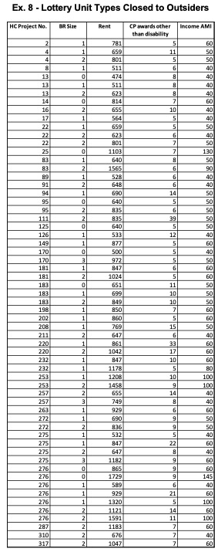

Evidence: types with $≥5$units to insiders, 0 to outsiders.
Almost all very low-income units!

Slide 48
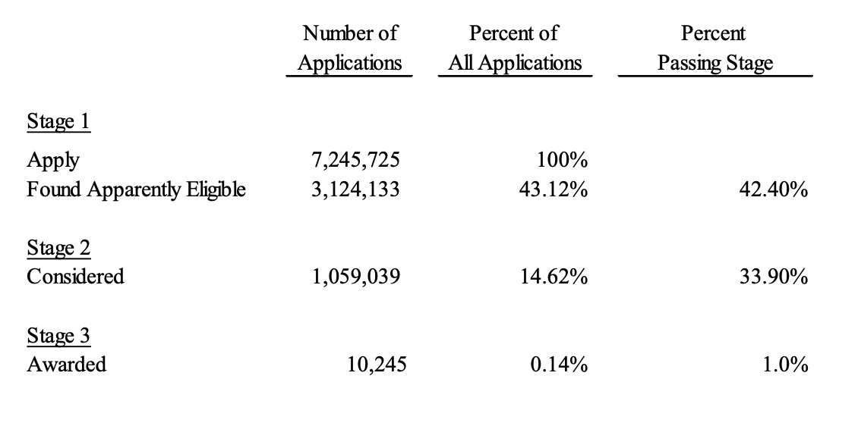
Recall Siskin’s conclusions from Part 2…
I don’t believe that 1/3 of applicants are considered, and only 1% of these are eligible and interested!

Slide 49
Siskin’s Method for Determining Considered Applications
I assumed that people with lottery numbers lower than highest lottery number of the awarded application from that preference list had been considered…
50/200 = 25%
5/720 = 0.7%
50/100 = 50%
His method would conclude 500 households were considered.
In reality, only 100 had chance to match!
Low Income Applicants Skipped

Slide 50
Siskin’s Method for Determining Considered Applications
His analysis does consider unit size: a household is not “considered” if all unit sizes for which it is eligible were allocated before its turn.
However, he makes no reference to income. A household is treated as “considered” even if its income does not qualify it for any remaining units.
Conclusion: this method significantly overestimates considered applicants!

Slide 51
Siskin’s Method for Determining Considered Applications
I assumed that people with lottery numbers lower than highest lottery number of the awarded application from that preference list had been considered…
If… the log number of the application at issue was 1,000, but that application was only eligible for a 3 bedroom unit and… the highest log number that resulted in an award to any 3-bedroom unit was 900, then the application at issue with log number 1,000 would not be a Considered Application, because any eligible units were filled before that log number was reached.
However, if a 3-bedroom unit was awarded to log number 2,000 (rather than 900), log number 1,000 would be a Considered Application, as it was considered for a unit and was not awarded a unit for a reason other than lack of availability, as evidenced by the fact that a higher log number was awarded a 3-bedroom unit.

Slide 52
Community Preference Policy: Summary
Disagreements primarily about definitions (what is meaning of “disparate impact on race”?), rather than math.
Existing policy has unintended consequences: Most or all low-income units go to community residents.
Bonus material: how else could community preference be implemented?
Not clearly stated in nearly 200 pages of reports!

Slide 53
How is Community Preference Implemented?
1000 applicants: 20% from Community District, 80% are not
100 units: 50% reserved for Community District.
Over and above or minimum guarantee?
Pass 1: Take 50 community district applicants with best lottery numbers.
Pass 2: Take 50 applicants with best remaining lottery numbers.
Group Work: how many units will go to Community District members?

Slide 54
Community Preference + Income Reserves
100 units: 50% reserved for Community District,
50% for low income, 50% for middle income.
1000 applicants: 20% from Community District, 80% are not
In each group, 90% low income, 10% middle income
Pass 1: Consider community district members in lottery order. Match each to appropriate income level (skip if no appropriate units exist).
Pass 2: Consider remaining applicants in lottery order. Match each to appropriate income level (skip if no appropriate units exist).
Group Work:
How many low-income units go to Community District members?
How many mid-income units go to Community District members?

Slide 55
NYC Housing
Respecting Priorities
 | CP | Not CP
Low Income | 45 | 5
Middle Income | 10 | 40
 | CP | Not CP
Low Income | 30 | 20
Middle Income | 20 | 30
At least 50 Insiders
At most 50 L
At most 50 M
Each additional OM who applies gets in, crowds out IL and OM, and gives a seat to OL (high priority).
I claim RP easy to explain.
For rejected IL applicants, say ”at most 50 low income, these all have higher priority”
For rejected OM applicants say “at most 50 non CP, these all have higher priority”
For rejected OL applicants say “At least 50 insiders and at most 20 IM, so at least 30 IL. At most 50 L so at most 20 OL. These 20 have higher priority.”
How to explain upper right corner?
We started by filling CP seats. By the time we hit 50, there were only 5 low income spots left!

Slide 56
NYC Housing
Respecting Priorities
 | CP | Not CP
Low Income | 45 | 5
Middle Income | 10 | 40
 | CP | Not CP
Low Income | 30 | 20
Middle Income | 20 | 30
At least 50 Insiders
At most 50 L
At most 50 M
Each additional OM who applies gets in, crowds out IL and OM, and gives a seat to OL (high priority).
I claim RP easy to explain.
For rejected IL applicants, say ”at most 50 low income, these all have higher priority”
For rejected OM applicants say “at most 50 non CP, these all have higher priority”
For rejected OL applicants say “At least 50 insiders and at most 20 IM, so at least 30 IL. At most 50 L so at most 20 OL. These 20 have higher priority.”
 | CP | Not CP
Low Income | 25 | 0.7
Middle Income | 50 | 50
 | CP | Not CP
Low Income | 16.7 | 2.8
Middle Income | 100 | 37.5
How to explain upper right corner?
We started by filling CP seats. By the time we hit 50, there were only 5 low income spots left!

Slide 57
Respecting priorities is not substitutable (not a big deal)
Respecting priorities requires knowing how many of each type are below (this could be a problem).

Slide 58
50% Low Income
50% Middle Income
Other Interpretations
Respecting Priorities
50% Community Preference
 | CP | Not CP
Low Income | 30 | 20
Middle Income | 20 | 30
At least 50 Insiders
At most 50 L
At most 50 M
 | CP | Not CP
Low Income | 10 | 40
Middle Income | 20 | 10
With this interpretation & these numbers, we end up with 20 wasted seats!
At most 50 Outsiders
At most 50 L
At most 50 M
Better interpretation of current feasibility, given non-binary income:
Reserves for income
Minimum quota for neighborhood (not max for non-neighborhood)
 | CP | Not CP
Low Income | 10 | 40
Middle Income | 20 | 30
Not sure exactly what constraints get this for RP (maybe none). But could get it by starting from above and then filling 20 vacancies from lower right.

Slide 59
agencies identify applicant HHs as living in the CD preference area or not, and, accordingly, make available to developers an initial log of lottery applicants subject to lottery sequencing rules (most pertinently, applicant HHs living in the CD preference area are to be processed before any applicant HH resident in New York City who lives outside of the CD preference area until the 50 percent CD preference has been filled).
This is because the first priorities in the processing of lottery applicants by a project’s marketing agent are for units to be awarded to applicant HHs where a member of the HH has: (a) a mobility disability; or (b) a hearing or visual disability. As such, applicant HHs who were denoted both as insiders and as recipients of a disability set-aside unit on the status sheets can be said to have been awarded the unit independent of (not benefitting from) community preference.)

Slide 60
Siskin:
If we assume that everyone who is apparently eligible and considered for an apartment would be interested and actually eligible and would take the lowest cost apartment for which they are eligible…
Looking at the rate of considerations, we see that 33.83% of the apparently eligible applications were considered. When we examine the consideration rate for each race, we see that 31.48% of the white apparently eligible applications were considered while 32.80% of Hispanic and 35.54% of African American apparently eligible applications were considered.
His table 1 claims that the actual percentage of considered who are housed is 1%!
The Fact That Some Applications Without Any Preference Cannot Compete for Any Unit Because All the Units for Which They are Eligible are Awarded Before the No- Preference Applications are Considered is Irrelevant to the Issue of Disparate Impact by Race
Moreover, the fact that all the apartment types for which an application is eligible are filled before the application would be considered is not unique to those without the CP. Households with the CP are considered in lottery number order and, consequently, when their lottery number is reached, all the apartments for which they are apparently eligible may already have been filled, so they are also denied the opportunity to compete.

Slide 61
The preferences are ranked, so that the mobility and hearing/vision preference applications are processed first to meet the intended number of units to be awarded, followed by the community district preference (“CP”), and then the municipal employee preference. The remaining units are open for any application from the City which was not yet processed. Applications can have more than one preference, and granting someone with multiple preferences a unit counts against each preference’s goal. The community preference policy sets a goal of 50% of the available units.

Slide 62
That is, first the apparently eligible applications with the mobility preference (5%), and hearing/vision preference (2%) were selected, followed by the CD preference (50%), and then the municipal employee preference (5%) and the “no preference” (38%) applications.
If an applicant was eligible for more than one type of unit, the applicant was placed into the smallest number of bedrooms available, favoring a lower rent if eligible for multiple units of the same size.
At each preference processing stage, awarded applicants were evaluated to determine if they satisfied other preference categories that had not yet been processed. For example, if a mobility unit placement also qualified for the CP, they would be counted as satisfying one unit in both preferences. The result of this nested preference was that the number of available units in both preferences would be decreased, and the units available in the no preference or open stage would be increased. The exception to the nested preference process was that a unit could not satisfy both a mobility and hearing/vision placement.

Slide 63
A second factor that would impact the likelihood of selection is the project which the application is requesting since the attractiveness of the project may impact the number and type of applications seeking a unit. A third factor is the types of apartments available at the project. That is, there are a variety of types of apartments available, and the mix of applicants for each apartment type varies, which could impact selection. These second and third factors are not random, and the extent to which they will vary by CP status or race is unknown, but they may well be correlated with CP status or race.

Slide 64
From Beveridge:
10. Within a project’s lottery, there are, in the overwhelming percentage of lotteries, multiple “unit types” that are, at least initially, available to be competed for. Each unit type in a lottery is characterized by a unique combination of number of bedrooms, a monthly rent, a minimum income, and a range of permissible HH sizes, with the maximum permissible HH income generally varying by each permissible HH size. Each unit type is also associated with a particular AMI level of household income.

Slide 65
12. Neither HPD nor HDC make any initial threshold judgment about the qualifications of an applicant HH.3 In some respects, the process at this point is unremarkable: those who have wanted to apply have applied; once the lottery application process has ended, the agencies assign random sequence numbers to each application to determine the order in which a developer’s marketing agent is obliged to review them; and several pieces of data about applicant HHs, including, notably, the applicant HH’s self-reported annual HH income and HH-size, are made available to the marketing agent.

Slide 66
15. I was asked for this report to examine data from defendant’s affordable housing lotteries to determine whether the community preference policy operates to create discriminatory effects against one or more racial or ethnic groups. I was also asked to determine whether these effects are reflective of a pattern that perpetuates segregation more (and allows integration less) than what would exist without the policy.

Slide 67
Use this for post about school choice: how to interpret an application?
32. Any hypothesis that New Yorkers are always or mostly interested in remaining in their existing community district is belied by the evidence of lottery participation for those seeking affordable housing.

