Slide 1
Do “Community Preference” Policies Violate the Fair Housing Act?
Part 2: Examining the City’s Defense
Nick Arnosti (not a legal scholar)

Slide 2
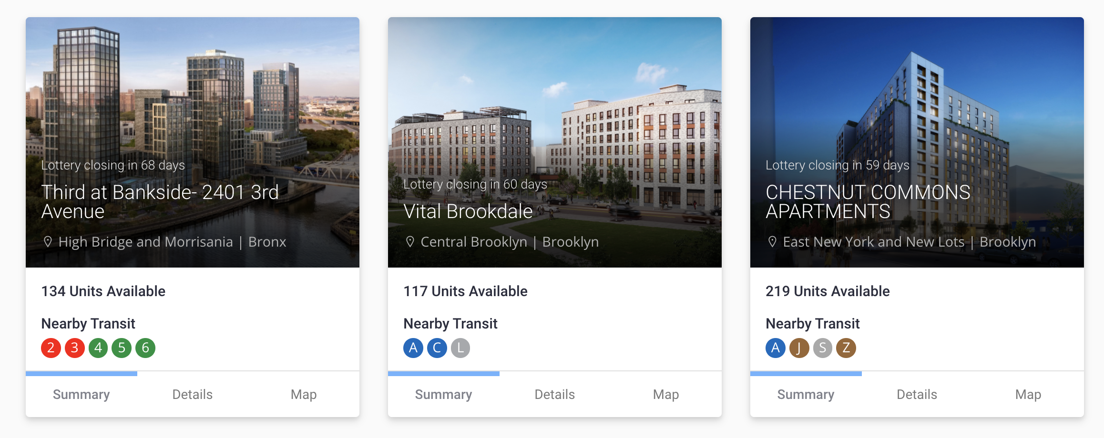
New York Affordable Housing Lotteries

Slide 3
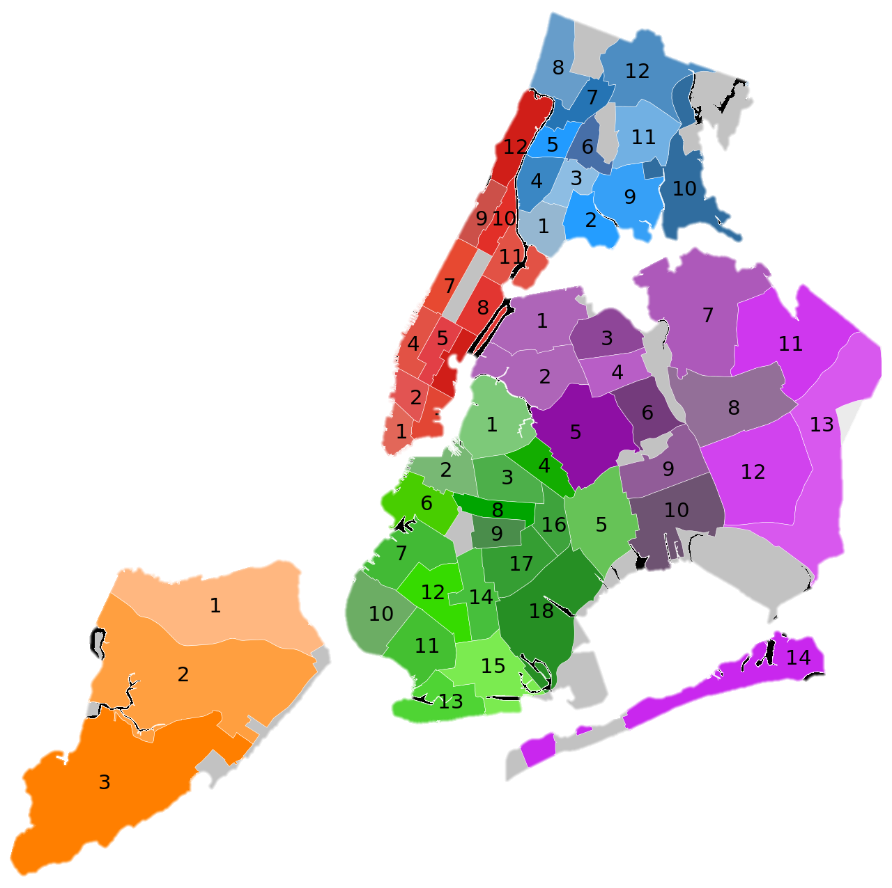
Community Preference Policy
Community Preference is a longstanding NYC policy that reserves 50% of units in most subsidized affordable housing developments for residents of the local Community District.
Lawsuit!
Plaintiffs claim that the policy has racially discriminatory impacts and perpetuates the harmful legacy of segregation.
NYC has 59 Community Districts

Slide 4
How to establish “disparate impact on the basis of race”?
Data analysis: 10,245 units in 168 lotteries from 2012-2018.
Plaintiffs hired Andrew Beveridge to make the case.
The city hired Bernard Siskin to rebut.
I offer my own take.
Part 1
Part 2
Part 3

Slide 5
How to establish “disparate impact on the basis of race”?
Data analysis: 10,245 units in 168 lotteries from 2012-2018.
Plaintiffs hired Andrew Beveridge to make the case.
The city hired Bernard Siskin to rebut.
I offer my own take.
Part 1
Part 2
Part 3

Slide 6
How to establish “disparate impact on the basis of race”?
Data analysis: 10,245 units in 168 lotteries from 2012-2018.
Plaintiffs hired Andrew Beveridge to make the case.
The city hired Bernard Siskin to rebut.
I offer my own take.
Part 1
Part 2
Part 3

Slide 7
Recap: My Critique of Beveridge’s Report
To study a policy’s impact, must compare outcomes with and without it!
Beveridge fails to do this.

Slide 8


Recap: My Critique of Beveridge’s Report
To study a policy’s impact, must compare outcomes with and without it!
Beveridge fails to do this.
 | Incorporates Outcomes | Clear what would happen without CP
Table 1
Table 2
Table 3
Table 4
Table 5
Table 6
Table 7
Table 8

Slide 9
Recap: My Critique of Beveridge’s Report
To study a policy’s impact, must compare outcomes with and without it!
Beveridge fails to do this.
 | Incorporates Outcomes | Clear what would happen without CP
Table 1
Table 2
Table 3
Table 4
Table 5
Table 6
Table 7
Table 8

Slide 10
Recap: My Critique of Beveridge’s Report
To study a policy’s impact, must compare outcomes with and without it!
Beveridge fails to do this.
 | Incorporates Outcomes | Clear what would happen without CP
Table 1
Table 2
Table 3
Table 4
Table 5
Table 6
Table 7
Table 8

Slide 11
My Critique of Beveridge’s Report
To study a policy’s impact, must compare outcomes with and without it!
Beveridge fails to do this.
 | Incorporates Outcomes | Clear what would happen without CP
Table 1
Table 2
Table 3
Table 4
Table 5
Table 6
Table 7
Table 8
Siskin’s rebuttal:
Dr. Beveridge never measures the degree of segregation resulting from the CP policy, nor the degree of segregation that would result if the CP policy were eliminated.

Slide 12
My Critique of Siskin’s Report
To study a policy’s impact, must compare outcomes with and without it!
Siskin does this, but chooses the wrong outcomes!
(Also some questions about his methods.)

Slide 13
Siskin’s Analysis
I have conducted my analysis in three ways...
First, I demonstrate that African Americans and Hispanics are overrepresented in the City’s affordable housing units as compared to their representation among low income New York City residents.
The second analysis compares lottery results with the CP policy and without the CP policy.
The third analysis examines… the Consideration Stage, [which] is the only stage where the CP policy has an impact.

Slide 14
Siskin’s First Point is Irrelevant
The City’s affordable housing projects overwhelmingly serve people of color, even in majority white areas.
African Americans and Hispanics are awarded affordable housing through the City’s housing lottery in disproportionate numbers in their favor compared to their representation among New Yorker City residents with incomes [that] would make them eligible for the City’s affordable housing lotteries.

Slide 15
Siskin’s First Point is Irrelevant
The City’s affordable housing projects overwhelmingly serve people of color, even in majority white areas.
African Americans and Hispanics are awarded affordable housing through the City’s housing lottery in disproportionate numbers in their favor compared to their representation among New Yorker City residents with incomes [that] would make them eligible for the City’s affordable housing lotteries.
This has nothing to do with the effect of Community Preference.

Slide 16
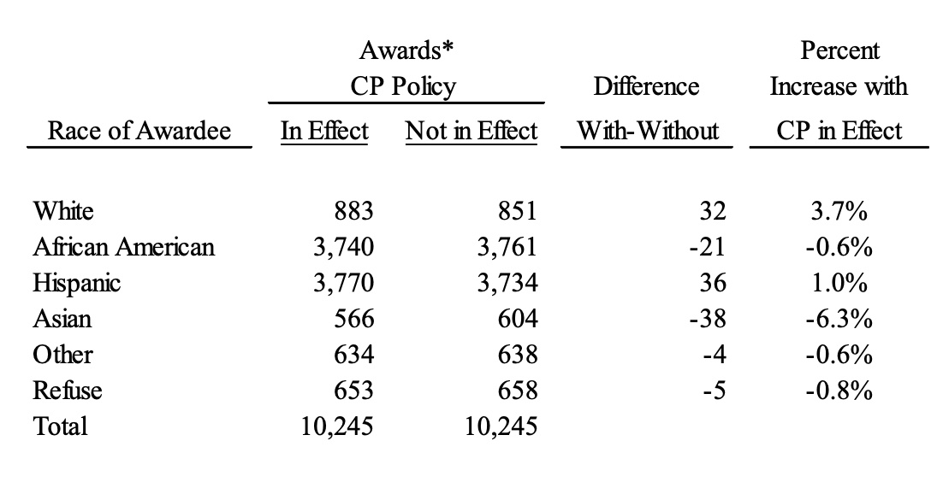
Siskin’s Second Point, Part 1: CP has Little Effect on Race of Awardees City-Wide
“The CP policy applies citywide…. And thus the analysis should have been done citywide.”

Slide 17
Siskin’s Second Point, Part 1: CP has Little Effect on Race of Awardees City-Wide
“The CP policy applies citywide…. And thus the analysis should have been done citywide.”
Cannot address plaintiff’s claim that CP promotes segregation.
Many illegal policies maintain city-wide racial composition of awardees. (Example: specify where each race can live).

Slide 18
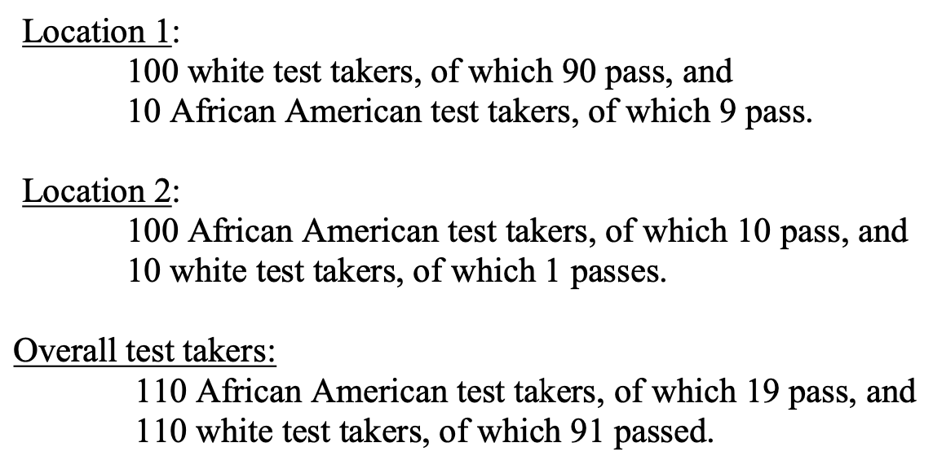
Is City-Wide Analysis Reasonable?
Siskin argues ‘yes’, points out that local measures and aggregate measures may tell different stories.
90% pass rate
10% pass rate
Whites much more likely to pass
Simpson’s Paradox!

Slide 19
Is City-Wide Analysis Reasonable?
Cannot address plaintiff’s claim that CP promotes segregation.
Many illegal policies maintain city-wide racial composition of awardees. (Example: specify where each race can live).

Slide 20
How to measure segregation?
Siskin’s Complaint:
Dr. Beveridge never measures the degree of segregation resulting from the CP policy, nor the degree of segregation that would result if the CP policy were eliminated.

Slide 21
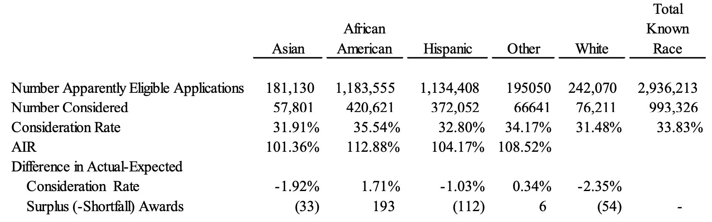
Analyzing City-Wide Effect of CP on Consideration Chance, by Race
Conclusion: with CP policy, applicants of different races are considered at similar rates.

Slide 22
Siskin’s Second Point, Part 2: CP has Little Effect on City-Wide Measures of Segregation
“even if one were to select awardees with the goal of increasing (or decreasing) the Dissimilarity Index, the result would have a small impact on the Dissimilarity Index between African Americans and whites. This is primarily due to the fact that the housing lottery units make up only a very small portion of the housing stock in New York City.”
Looking at city-wide measures of segregation is not helpful.
Even extreme discrimination would not move the needle.

Slide 23
Siskin’s Second Point, Part 2: CP has Little Effect on City-Wide Measures of Segregation
“even if one were to select awardees with the goal of increasing (or decreasing) the Dissimilarity Index, the result would have a small impact on the Dissimilarity Index between African Americans and whites. This is primarily due to the fact that the housing lottery units make up only a very small portion of the housing stock in New York City.”
Looking at city-wide measures of segregation is not helpful.
Even extreme discrimination would not move the needle.

Slide 24
Siskin’s Third Point: Look at Considered Applicants, not Awarded Applicants
Applicants
Stage 1
Apparently Eligible
Stage 2
Considered
Stage 3
Offered
Awarded

Slide 25
Siskin’s Third Point: Look at Considered Applicants, not Awarded Applicants
Applicants
CP affects who is considered (Stage 2)
Should look at who would be considered, with and without CP.
Stage 1
Apparently Eligible
Stage 2
Considered
Stage 3
Offered
Awarded

Slide 26
Siskin’s Description
Applicants
CP affects who is considered (Stage 2)
Should look at who would be considered, with and without CP.
Stage 1
Apparently Eligible
Stage 2
Considered
Concerns:
We don’t observe who was considered.
Some apparently ineligible households were considered (844 were awarded).
Even more difficult to know who would have been considered.
Stage 3
Offered
Awarded

Slide 27
Siskin’s Description
Applicants
Claim:
Community Preference only affects Stage 2.
Concerns:
Some apparently ineligible households were considered (844 were awarded).
We don’t observe who was considered.
Who was considered.
Why considered applicants were not awarded.
Which applicants would pass Stage 3 if considered.
Stage 1
Apparently Eligible
Stage 2
Considered
Stage 3
Offered
Awarded

Slide 28
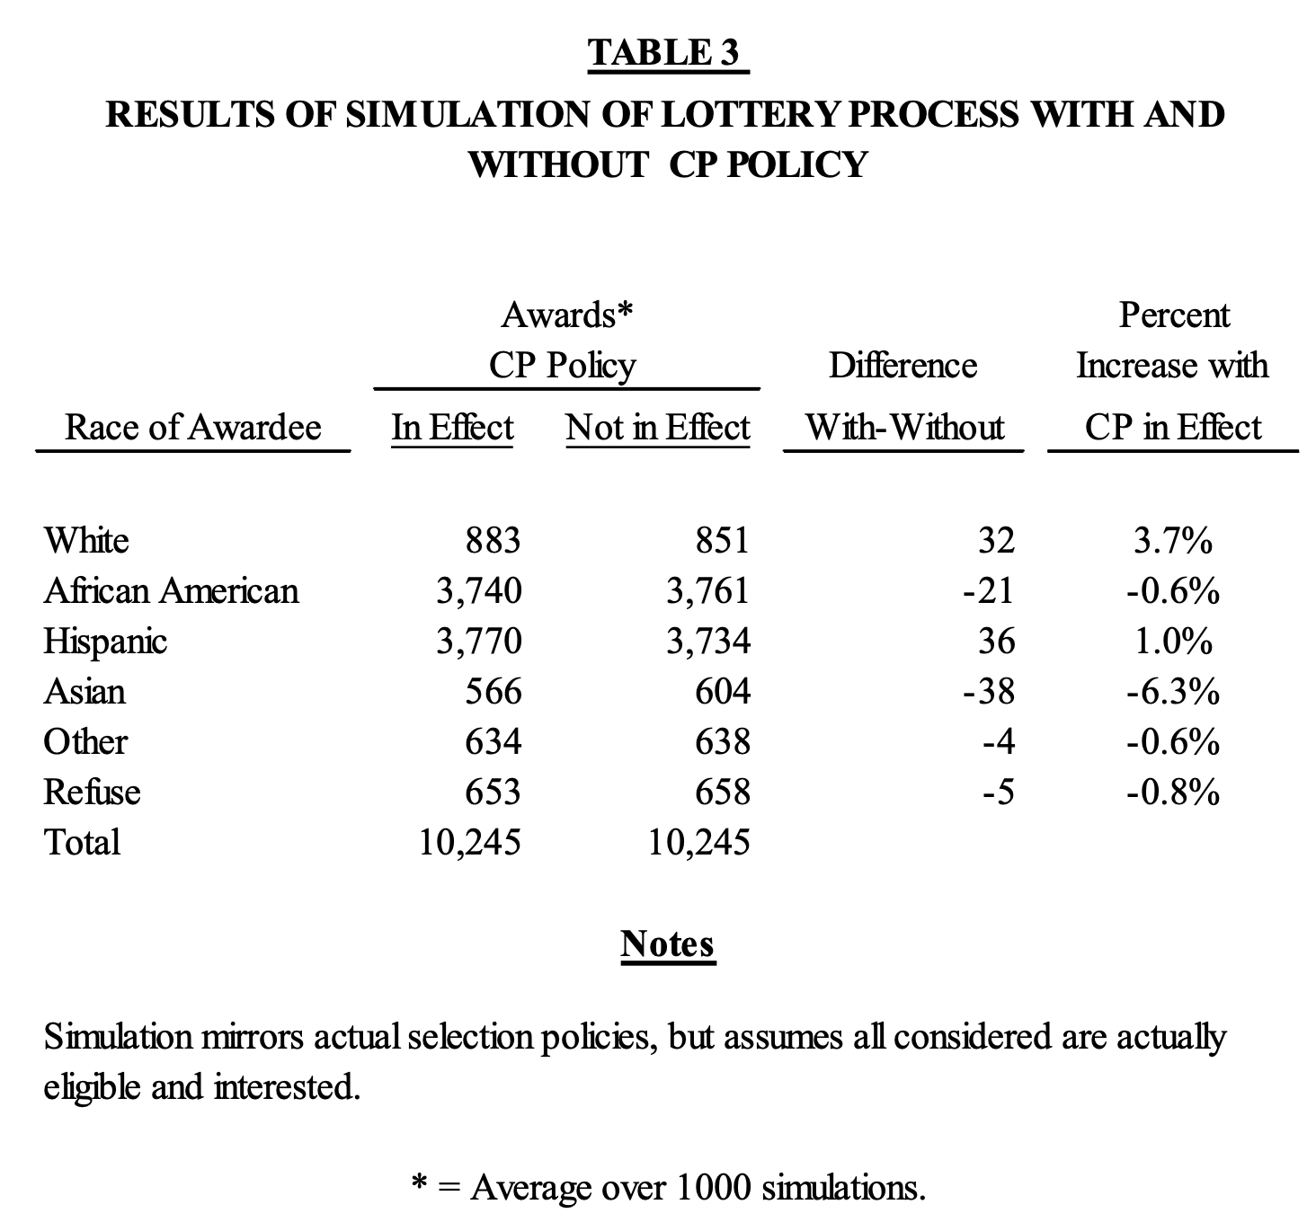

Slide 29
How to Determine Considered Applicants?
We observe:
Who is eligible for community preference
Which “apartment types” applicants are eligible for
Who was awarded
Lottery numbers
High-Level Idea: if an apartment I was eligible for was allocated to someone with a worse lottery number, then I was considered.

Slide 30
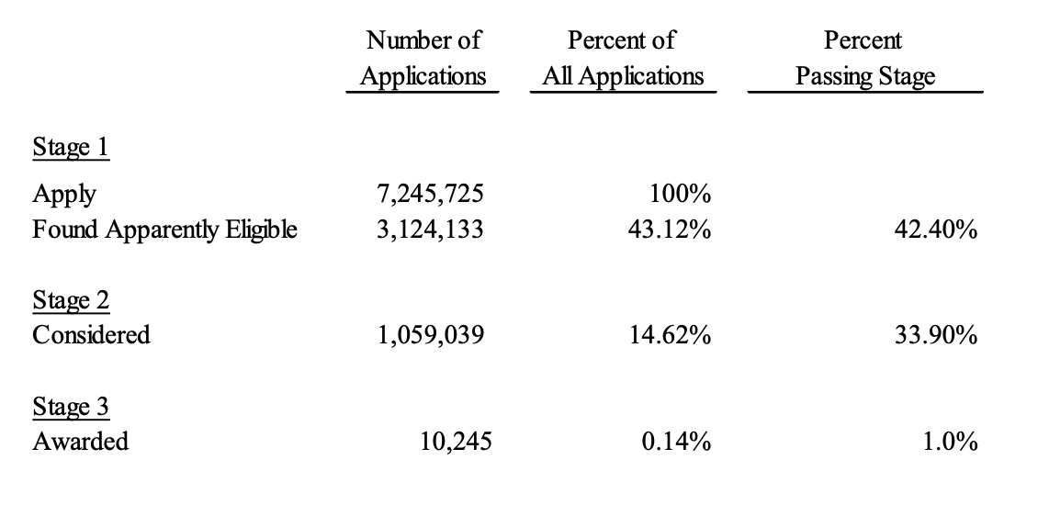
Some Suspicious Findings
Nevertheless, in simulations, Siskin assumes 100% of considered applicants are awarded!

Slide 31
Some Suspicious Findings
I don’t believe that 1/3 of applicants are considered, and only 1% of these are eligible and interested.

Slide 32
Coming Up: Part 3
Solving the mystery: what could explain high ‘considered’ rate?
A key missing feature: affordability at different income levels.

Slide 33
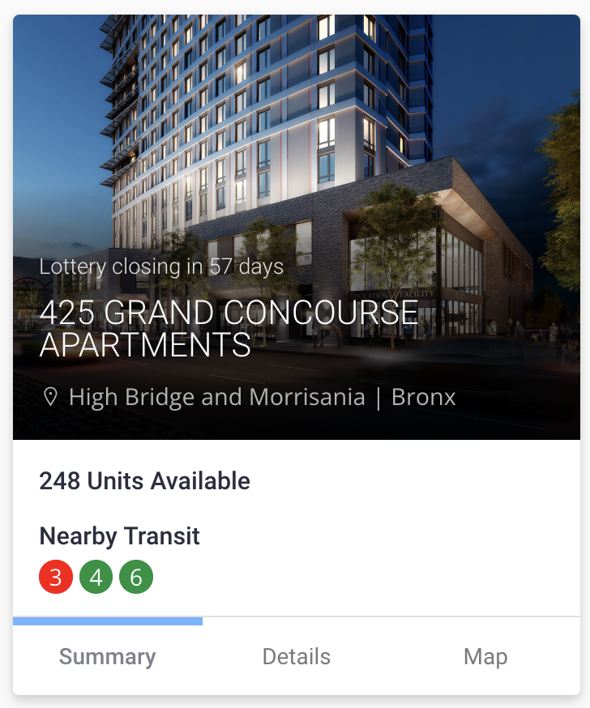
Coming Up: Part 3
Solving the mystery: what could explain high ‘considered’ rate?
A key missing feature: affordability at different income levels.
AMI % | Layout | # Units | Monthly Rent | Household Size | Household Income
 |  |  |  | 1 person | $19,303 - $25,080
30% | 1 Bedroom | 9 units | $465 | 2 people | $19,303 - $28,650
 |  |  |  | 3 people | $19,303 - $32,220
 |  |  |  | 1 person | $46,732 - $58,520
70% | 1 Bedroom | 18 units | $1,265 | 2 people | $46,732 - $66,850
 |  |  |  | 3 people | $46,732 - $75,180
 |  |  |  | 1 person | $69,395 - $108,680
130% | 1 Bedroom | 23 units | $1,926 | 2 people | $69,395 - $124,150
 |  |  |  | 3 people | $69,395 - $139,620

Slide 34
https://housingconnect.nyc.gov/PublicWeb/details/2684

Slide 35
Multi-Stage Pipeline
Applicants
Considered?
Community Preference affects who is considered.
Outsiders could be less likely to be eligible.
Outsiders could be less likely to accept an offer.
Considered
Found Eligible?
Offered
Still Interested?
Housed

Slide 36
Analysis of “Apparently Eligible” applicants
Challenge:
Not all applicants are eligible.
We don’t observe which applicants are eligible.
Proposed Solution:
Determine “apparently eligibility” from self-reported income, household data.
Analyze only apparently eligible applicants.
Concerns:
Many apparently eligible applicants are not eligible.
Some apparently ineligible applicants are eligible (and housed). 844 units (out of 10,245) awarded to “apparently ineligible” applicants.

