Slide 2
Four Racial Groups (disjoint)

Slide 3
CD Typologies

Slide 4
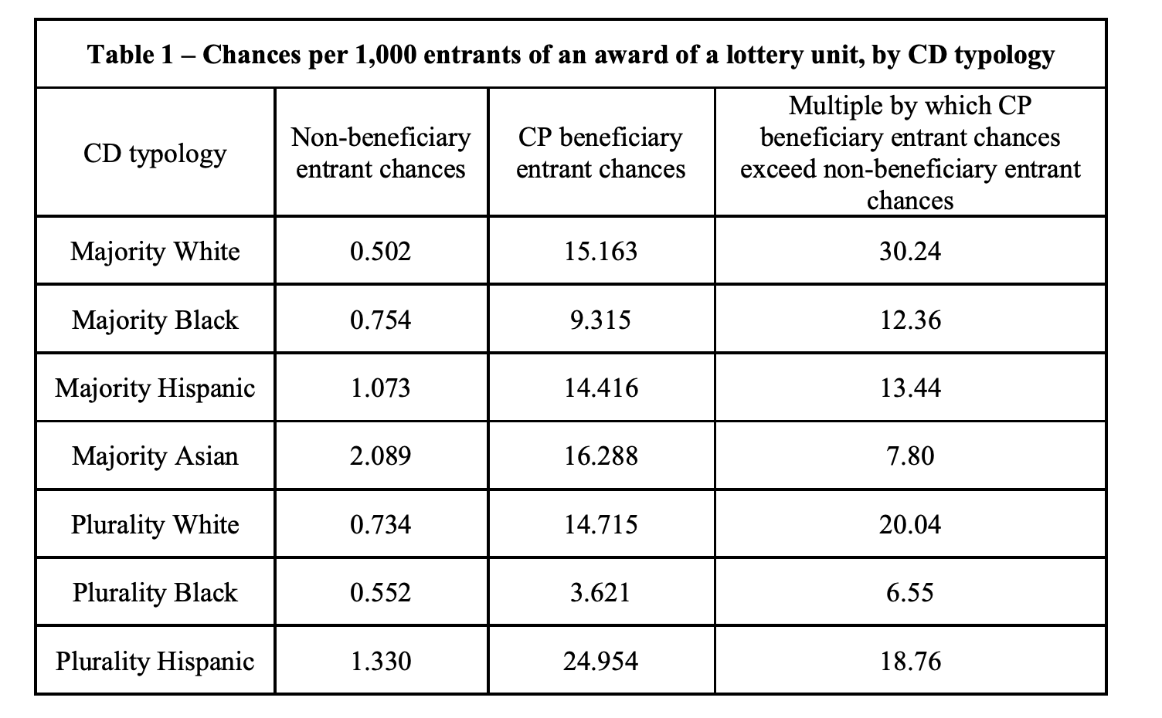
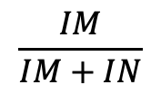
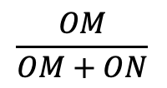
Note: no analysis of race.
Also: obvious that CP beneficiary entrant chances are higher, question is by how much.
Finally: These are bad estimates.
$$\frac{OM}{OM+ON}$$
$$\frac{IM}{IM+IN}$$
How much more likely to receive housing?
How much more likely to receive offer?

Slide 5
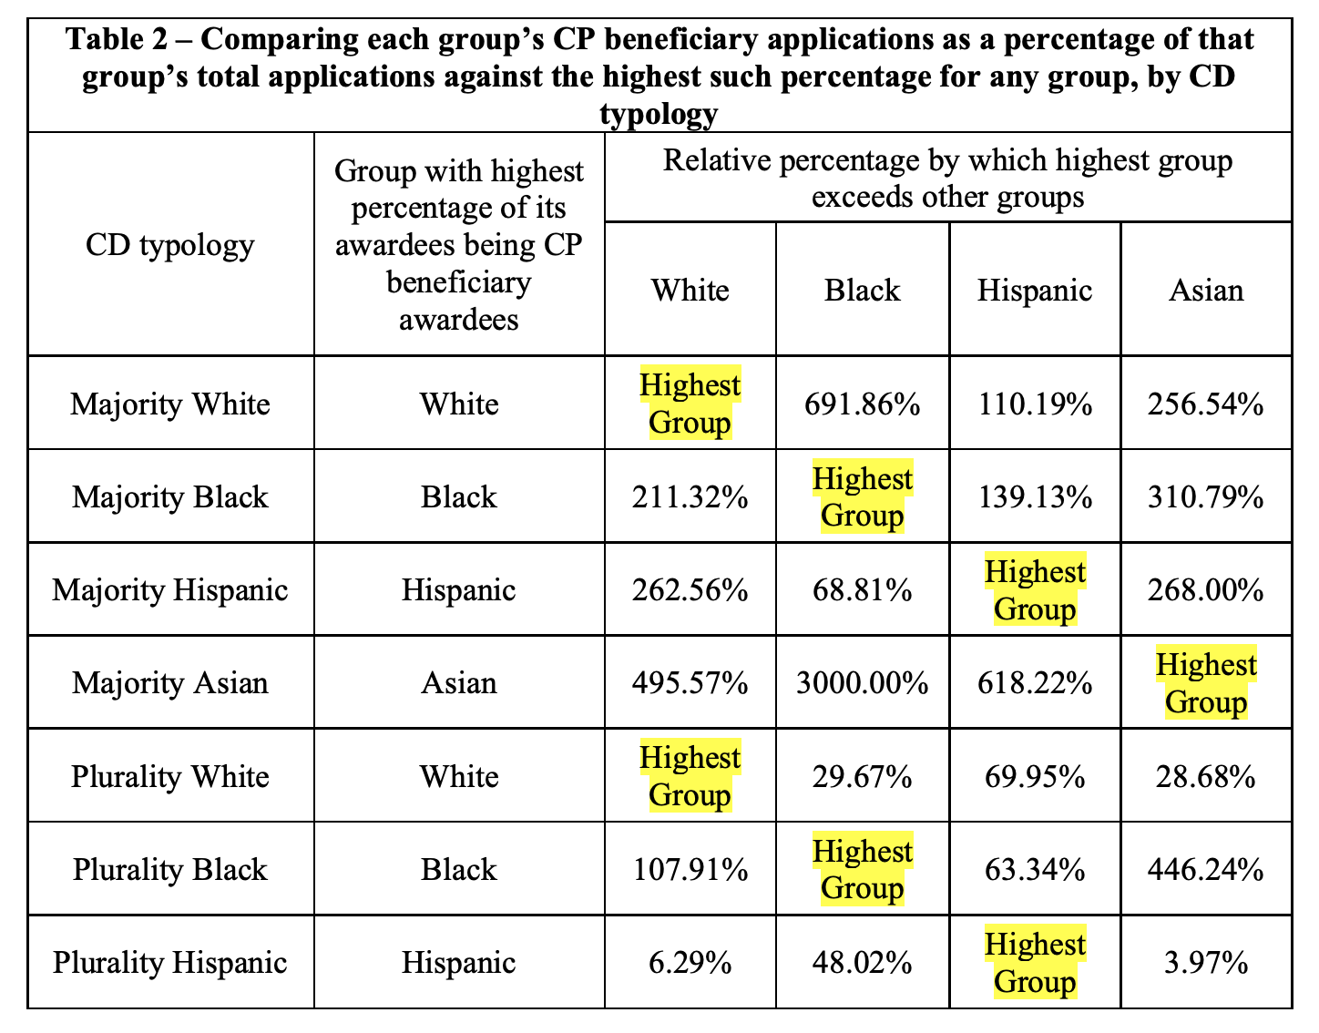
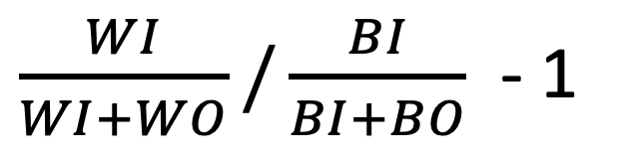
$\frac{WI}{WI+WO}/\frac{BI}{BI+BO}$ - 1
6.86%
0.86%

Slide 6
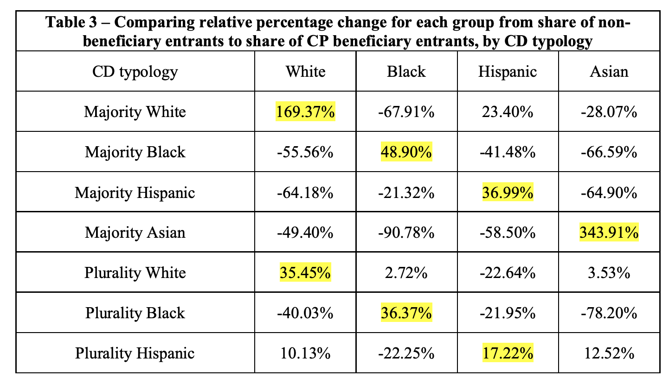

“My second method of assessing CP disparate impact”
$\frac{WI}{WI+BI+AI+HI}$/$\frac{WO}{WO+BO+AO+HO}$ - 1
26.6% 9.9%

Slide 7
No table shows disparate impact: must be combined.
No attempt to determine counter-factual.

