Slide 1
NYC
Examining the Plaintiff Analysis

Slide 2
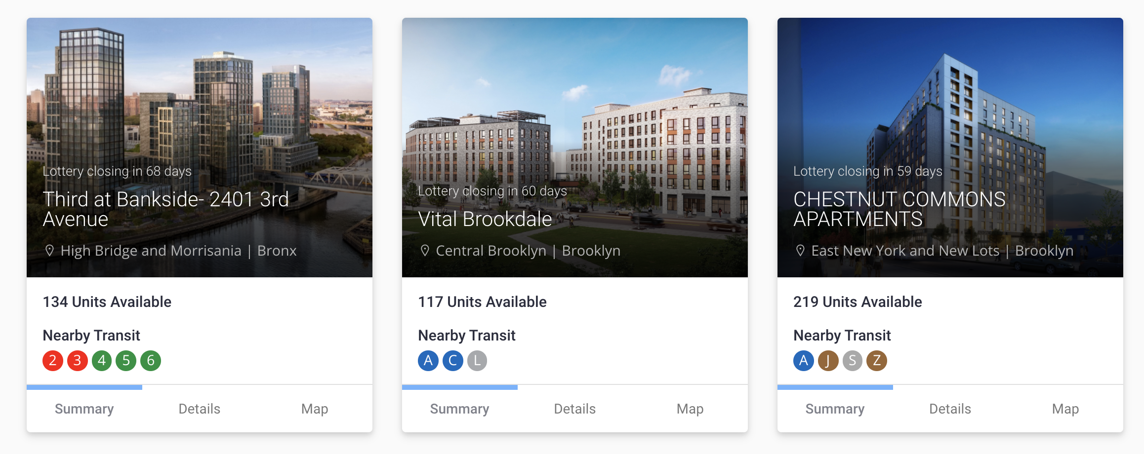
New York Affordable Housing Lotteries

Slide 3
Community Preference Policy
Community Preference is a longstanding NYC policy that reserves 50% of units in most subsidized affordable housing developments for residents of the local Community District.

Slide 4
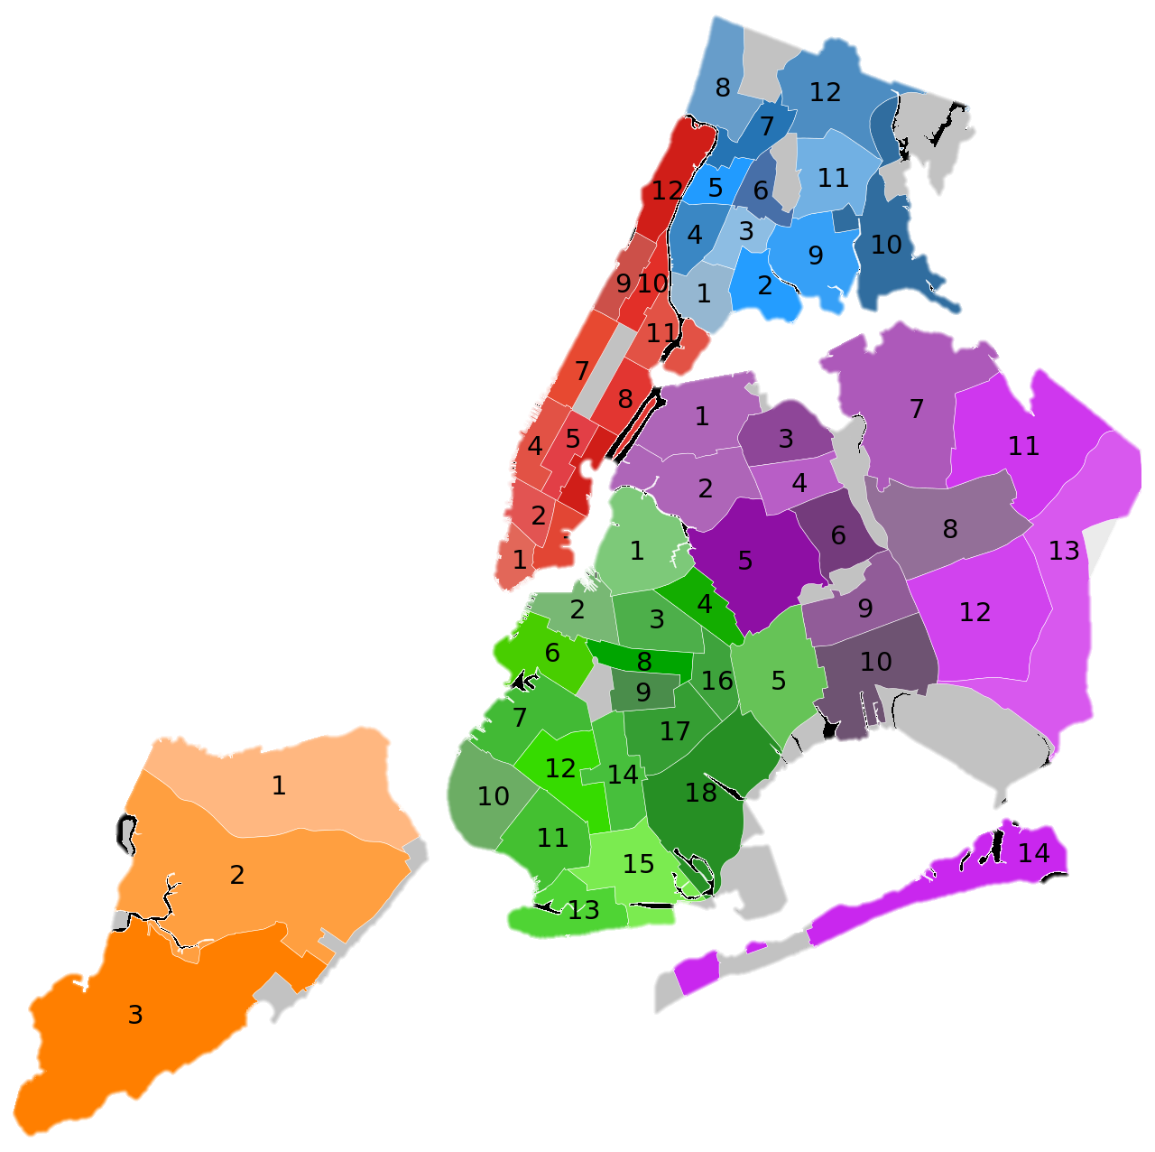
Community Preference Policy
Community Preference is a longstanding NYC policy that reserves 50% of units in most subsidized affordable housing developments for residents of the local Community District.
NYC has 59 Community Districts

Slide 5
Community Preference Policy
Community Preference is a longstanding NYC policy that reserves 50% of units in most subsidized affordable housing developments for residents of the local Community District.
Lawsuit!
Plaintiffs claim that the policy has racially discriminatory impacts and perpetuates the harmful legacy of segregation.
NYC has 59 Community Districts

Slide 6
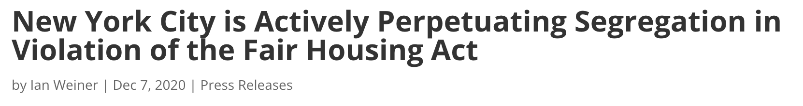
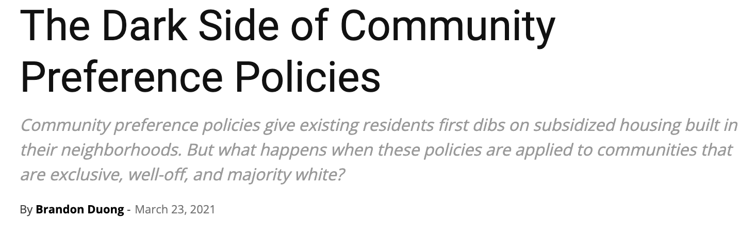
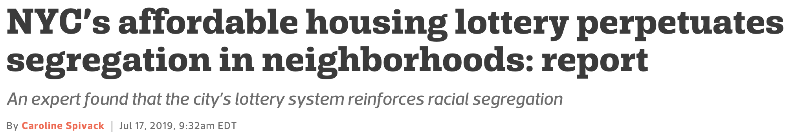

Slide 7
How to establish “disparate impact on the basis of race”?
Plaintiffs hired Andrew Beveridge to make the case.
The city hired Bernard Siskin to rebut.
I offer my own take.
Part 1
Part 2
Part 3

Slide 8
Part 1: Beveridge’s Report
Analyzes data from 168 lotteries from 2012-2018.
Total units allocated: 10,245.
68 pages long (22 of them are Beveridge’s CV)
My goal: simplify.
Focus on key points, not comprehensive.
Omit some details (i.e. disability set-asides).

Slide 9
How to study disparate impact of CP on race? Compare outcomes by race, with and without CP

Slide 10
How to study disparate impact of CP on race? Compare outcomes by race, with and without CP
Difficult Questions:
Which outcomes to compare?
How to estimate outcomes without CP?
.

Slide 11
How to study disparate impact of CP on race? Compare outcomes by race, with and without CP
Difficult Questions:
Which outcomes to compare?
How to estimate outcomes without CP?
Beveridge’s analyses don’t even attempt to do this!
Some don’t incorporate outcomes.
Some don’t incorporate race.
None address would happen without the policy.

Slide 12
How to study disparate impact of CP on race? Compare outcomes by race, with and without CP
 | Incorporates Outcomes | Incorporates Applicant Race | Clear what would happen without CP
Table 1
Table 2
Table 3
Table 4
Table 5
Table 6
Table 7
Table 8

Slide 13


How to study disparate impact of CP on race? Compare outcomes by race, with and without CP
 | Incorporates Outcomes | Incorporates Applicant Race | Clear what would happen without CP
Table 1
Table 2
Table 3
Table 4
Table 5
Table 6
Table 7
Table 8

Slide 14

The Plaintiff’s Argument
Community Preference (CP) significantly advantages insiders.
+
Insiders are more likely to belong to the Community District’s majority race.
Community Preference increases the number of housed applicants who belong to the CD’s majority race.
$$⇒$$

Slide 15
The Plaintiff’s Argument
Community Preference (CP) significantly advantages insiders.
+
Insiders are more likely to belong to the Community District’s majority race.
Community Preference increases the number of housed applicants who belong to the CD’s majority race.
Tables 1, 4
Tables 2, 3, 5, 6
No analysis
$$⇒$$

Slide 16
Beveridge’s Units of Analysis
Applicants classified into 4 (mutually exclusive) racial groups:
White, Black, Hispanic, Asian.
In addition, classified as “Insider” (from CD) or “Outsider” (not from CD)
Community Districts classified into 7 “typologies”:
Majority White, Black, Hispanic, Asian
Plurality White, Black, Hispanic

Slide 17
Beveridge’s Units of Analysis
 |  | White | Black | Hispanic | Asian
Majority | White
 | Black
 | Hispanic
 | Asian
Plurality | White
 | Black
 | Hispanic

Slide 18
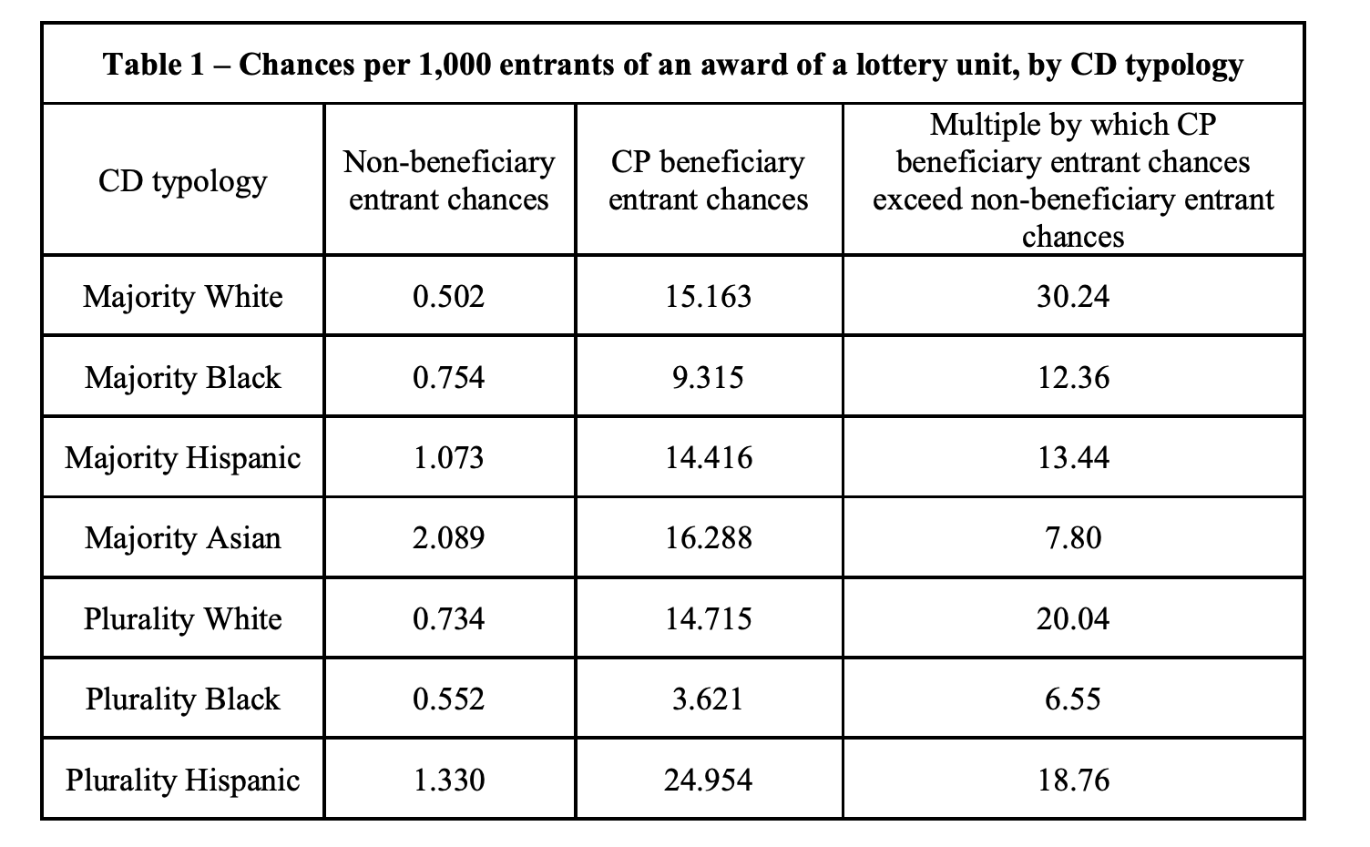

Slide 19



$$\frac{Outsiders Housed}{Outsiders Applied}$$
$$\frac{Insiders Housed}{Insiders Applied}$$
$${\frac{Insiders Housed}{Insiders Applied}}/{\frac{Outsiders Housed}{Outsiders Applied}}$$

Slide 20
$$\frac{Outsiders Housed}{Outsiders Applied}$$
$$\frac{Insiders Housed}{Insiders Applied}$$
$${\frac{Insiders Housed}{Insiders Applied}}/{\frac{Outsiders Housed}{Outsiders Applied}}$$
Intuitive meaning: “How much advantage do insiders get?”
Observations:
No incorporation of applicant race.
Not clear what numbers would be without CP.

Slide 21
Multi-Stage Pipeline
Applicants
Considered?
Community Preference affects who is considered.
Outsiders could be less likely to be eligible.
Outsiders could be less likely to accept an offer.
Considered
Found Eligible?
Offered
Still Interested?
Housed

Slide 22
$$\frac{Outsiders Housed}{Outsiders Applied}$$
$$\frac{Insiders Housed}{Insiders Applied}$$
$${\frac{Insiders Housed}{Insiders Applied}}/{\frac{Outsiders Housed}{Outsiders Applied}}$$
Without policy, would insiders still be housed at significantly higher rates?

Slide 23
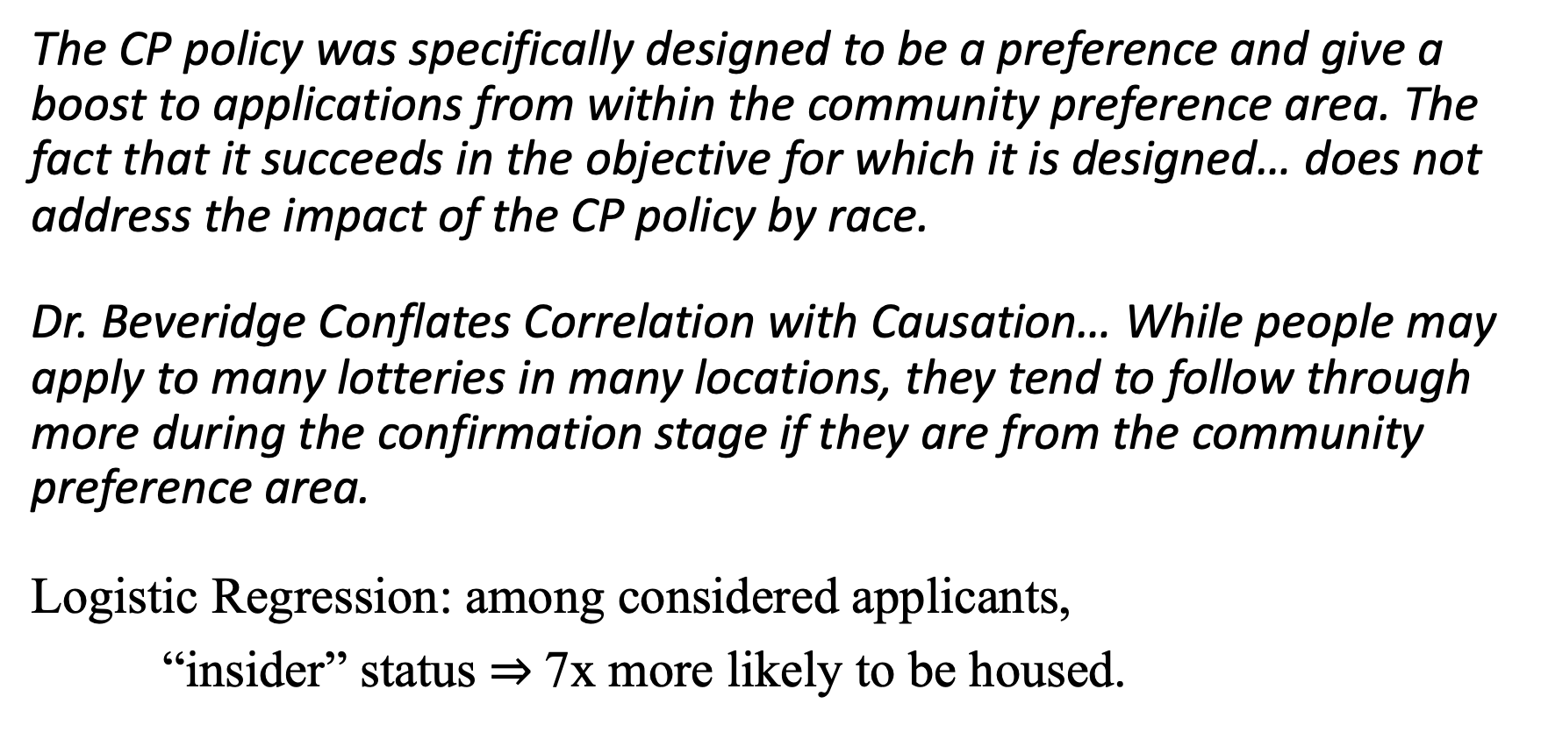
Siskin’s Rebuttal to Table 1
The CP policy was specifically designed to be a preference and give a boost to applications from within the community preference area. The fact that it succeeds in the objective for which it is designed… does not address the impact of the CP policy by race.
Dr. Beveridge Conflates Correlation with Causation… While people may apply to many lotteries in many locations, they tend to follow through more during the confirmation stage if they are from the community preference area.
Logistic Regression: among considered applicants,
“insider” status $⇒$7x more likely to be housed.

Slide 24
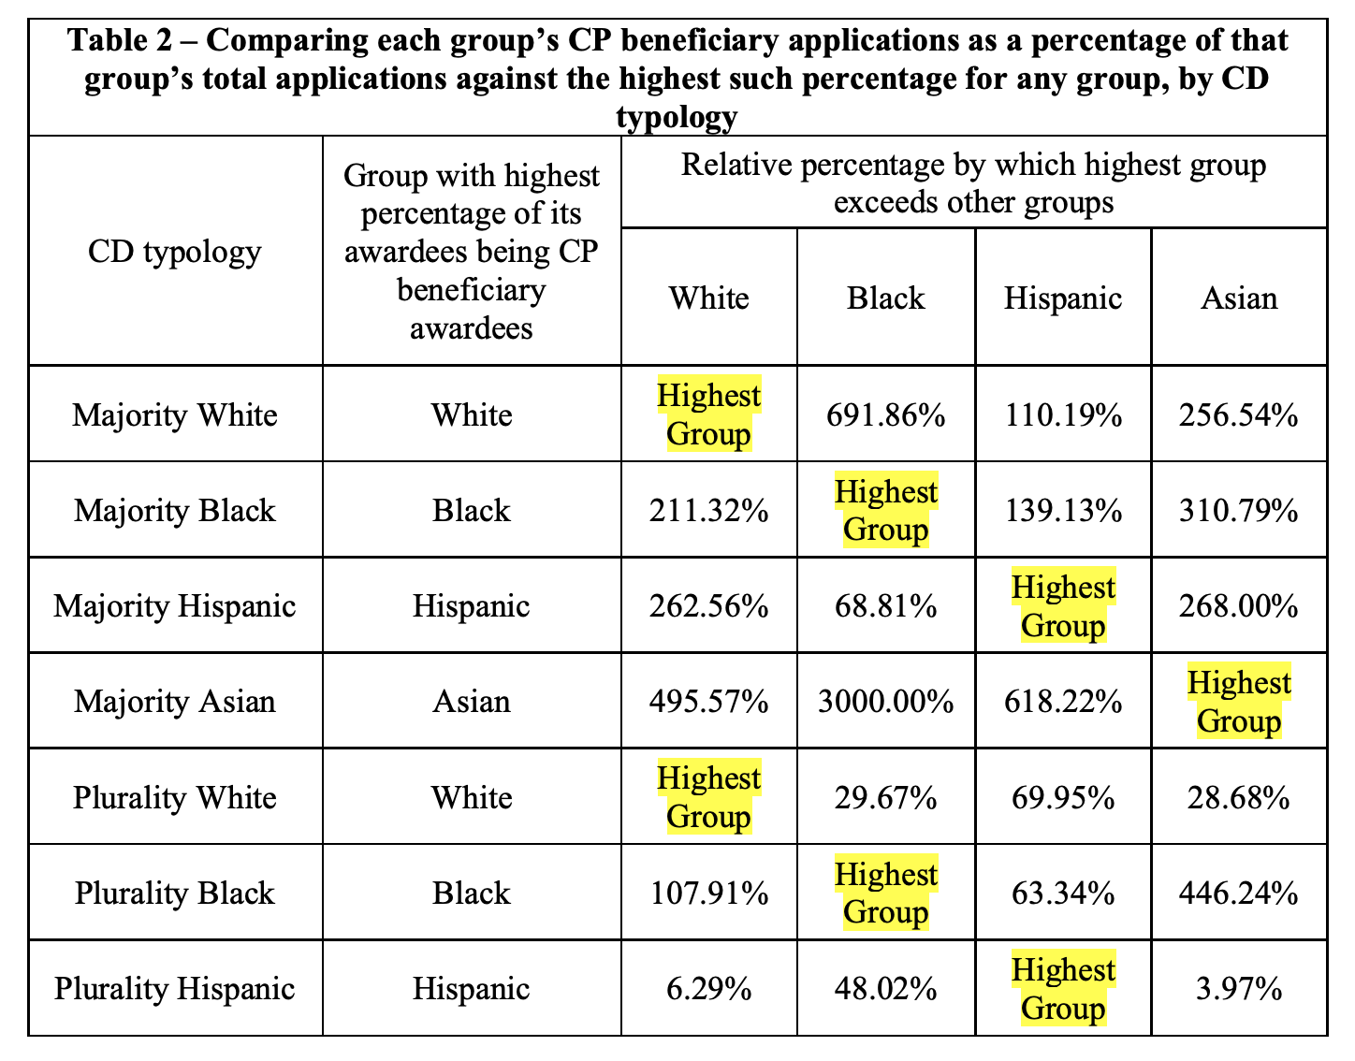

On to Table 2…
6.86%
0.86%
$\frac{White Insiders}{White Applicants}/\frac{Black Insiders}{Black Applicants}$ - 1

Slide 25
On to Table 2…
6.86%
0.86%
$\frac{White Insiders}{White Applicants}/\frac{Black Insiders}{Black Applicants}$ - 1
Interpretation: in majority white districts, white applicants are nearly 8x more likely to be insiders than black applicants.

Slide 26
On to Table 2…
6.86%
0.86%
$\frac{White Insiders}{White Applicants}/\frac{Black Insiders}{Black Applicants}$ - 1
Interpretation: in majority white districts, white applicants are nearly 8x more likely to be insiders than black applicants.
Observations:
Confusing way to present data!
1. No incorporation of outcomes
Numbers would be identical without CP.

Slide 27
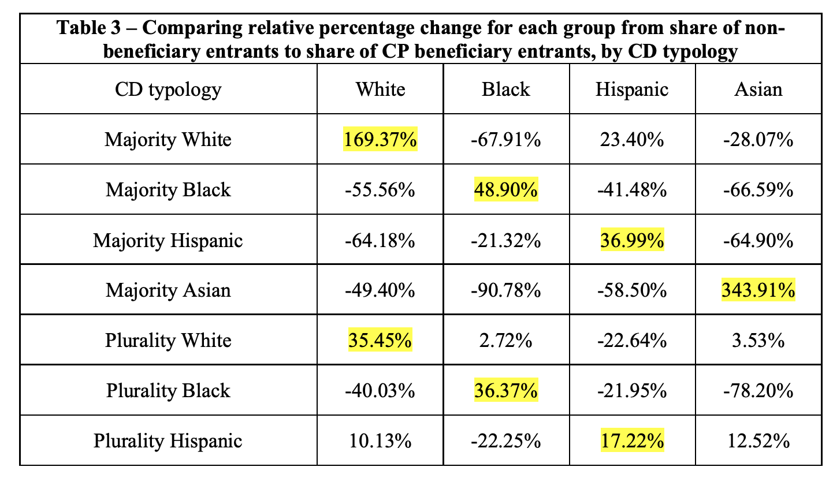

Beveridge’s “second method of assessing CP disparate impact”
26.6% 9.9%
$\frac{White Insiders}{All Insiders}$ / $\frac{White Outsiders}{All Outsiders}$ - 1

Slide 28
Beveridge’s “second method of assessing CP disparate impact”
26.6% 9.9%
$\frac{White Insiders}{All Insiders}$ / $\frac{White Outsiders}{All Outsiders}$ - 1
Interpretation: in majority white districts, insiders are 2.7x more likely than outsiders to be white.

Slide 29
Beveridge’s “second method of assessing CP disparate impact”
26.6% 9.9%
$\frac{White Insiders}{All Insiders}$ / $\frac{White Outsiders}{All Outsiders}$ - 1
Interpretation: in majority white districts, insiders are 2.7x more likely than outsiders to be white.
Observations:
Confusing way to present data!
1. No incorporation of outcomes
Numbers would be identical without CP.

Slide 30
Analysis of “Apparently Eligible” applicants
Challenge:
Not all applicants are eligible.
We don’t observe which applicants are eligible.
Proposed Solution:
Determine “apparently eligibility” from self-reported income, household data.
Analyze only apparently eligible applicants.
Concerns:
Many apparently eligible applicants are not eligible.
Some apparently ineligible applicants are eligible (and housed). 844 units (out of 10,245) awarded to “apparently ineligible” applicants.

Slide 31
Analysis of “Apparently Eligible” applicants
Challenge:
Not all applicants are eligible.
We don’t observe which applicants are eligible.
Proposed Solution:
Determine “apparently eligibility” from self-reported income, household data.
Analyze only apparently eligible applicants.
Concerns:
Many apparently eligible applicants are not eligible.
Some apparently ineligible applicants are eligible (and housed). 844 units (out of 10,245) awarded to “apparently ineligible” applicants.

Slide 32
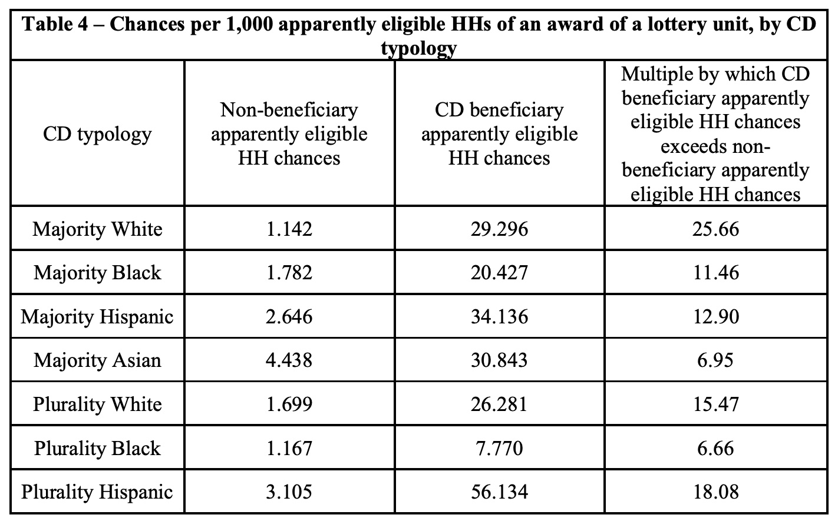
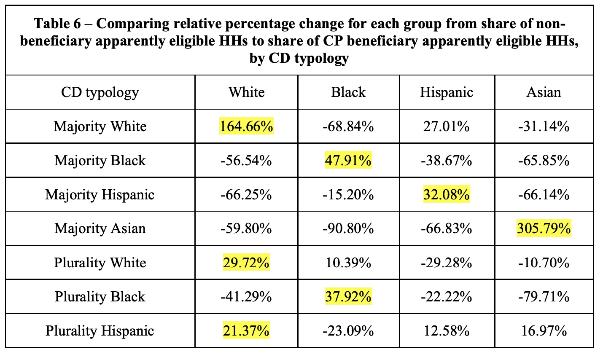
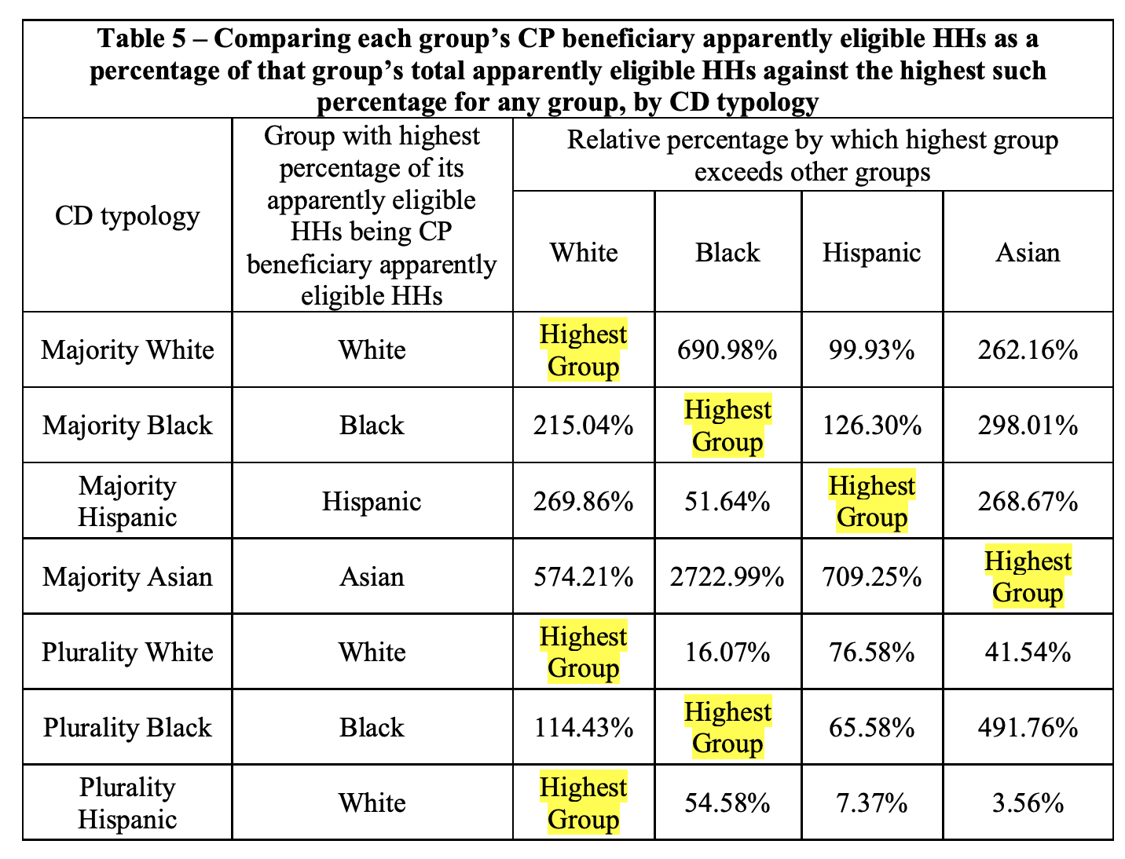
Tables 4, 5, 6: same critiques as for Tables 1, 2, 3
No analysis of race.
Unclear what would happen without CP.
No analysis of outcomes.
Would be identical without CP.
No analysis of outcomes.
Would be identical without CP.

Slide 33
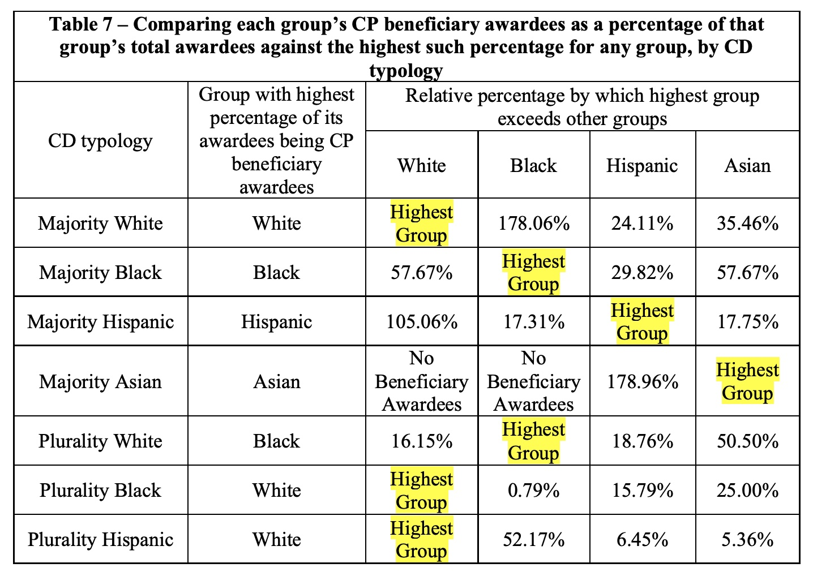

Table 7…
$${\frac{White Insiders Housed}{White Applicants Housed}}/{\frac{Black Insiders Housed}{Black Applicants Housed}}−1$$

Slide 34
Table 7…
$${\frac{White Insiders Housed}{White Applicants Housed}}/{\frac{Black Insiders Housed}{Black Applicants Housed}}−1$$
Interpretation: in majority white districts, housed white applicants are 2.8x more likely to be insiders than housed black applicants.

Slide 35
Table 7…
$${\frac{White Insiders Housed}{White Applicants Housed}}/{\frac{Black Insiders Housed}{Black Applicants Housed}}−1$$
Interpretation: in majority white districts, housed white applicants are 2.8x more likely to be insiders than housed black applicants.
+ Considers outcomes
by race.
Unclear what would
result without CP.
Base rates: white applicants more likely to be insiders in majority white districts!

Slide 36
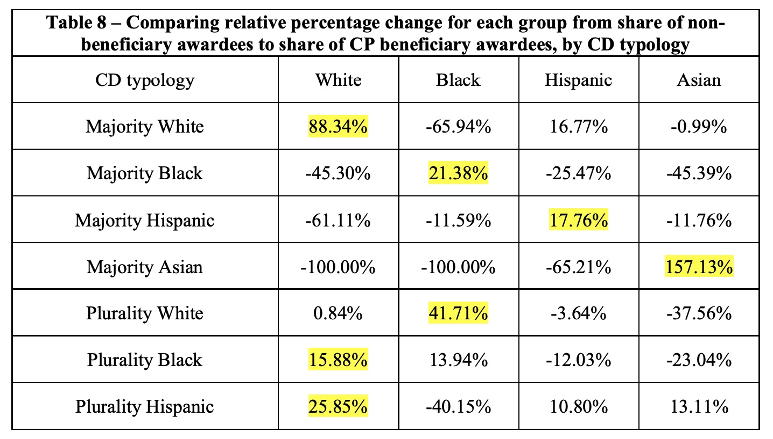
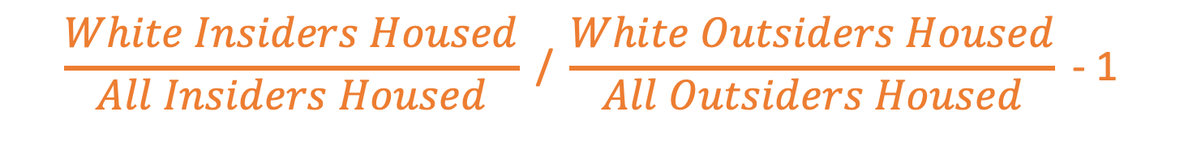
Table 8…
$$\frac{White Insiders Housed}{All Insiders Housed}\text{ / }\frac{White Outsiders Housed}{All Outsiders Housed}\text{ − 1}$$

Slide 37
Table 8…
$$\frac{White Insiders Housed}{All Insiders Housed}\text{ / }\frac{White Outsiders Housed}{All Outsiders Housed}\text{ − 1}$$
Interpretation: in majority white districts, housed insiders are 1.9x more likely to be white (and 66% less likely to be black) as housed outsiders.

Slide 38
Table 8…
$$\frac{White Insiders Housed}{All Insiders Housed}\text{ / }\frac{White Outsiders Housed}{All Outsiders Housed}\text{ − 1}$$
Interpretation: in majority white districts, housed insiders are 1.9x more likely to be white (and 66% less likely to be black) as housed outsiders.
+ Considers outcomes
by race.
Unclear what would
result without CP.
Base rates: white applicants more likely to be insiders in majority white districts!

Slide 39
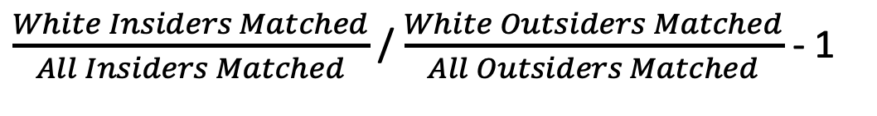
$\frac{White Insiders Matched}{All Insiders Matched}$ / $\frac{White Outsiders Matched}{All Outsiders Matched}$ - 1
Same concern as Table 7:
This number reflects whether applicants of each race tend to be insiders or outsiders.
No comparison of what would happen with vs without policy.
What would these numbers be without community preference?

Slide 40
CD Typologies

Slide 41
I have conducted my analysis in three ways, each of which demonstrate that the CP policy does not have a disparate impact on any race. First, I demonstrate that African Americans and Hispanics are overrepresented in the City’s affordable housing units as compared to their representation among low income New York City residents. The second analysis compares lottery results with the CP policy and without the CP policy. The third analysis examines the stage of the Lottery Process that determines which applications will be able to compete for a unit by demonstrating their actual eligibility and interest in a unit. This stage of the Lottery Process, referred to as the Consideration Stage, is the only stage where the CP policy has an impact on who can compete for affordable housing. My analyses demonstrate that there is no meaningful disparate impact.

Slide 42
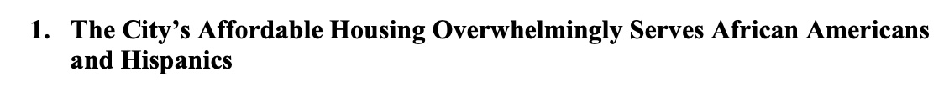
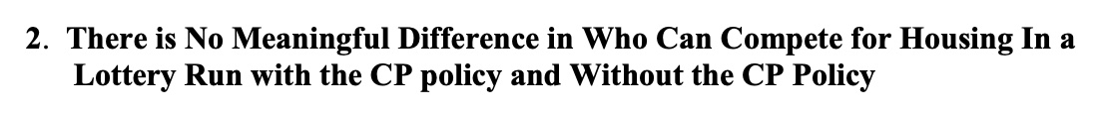
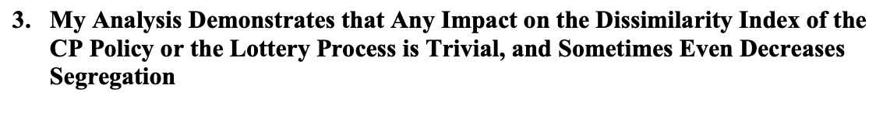
Siskin’s Report
“Kitchen Sink” approach

Slide 43
“even if one were to select awardees with the goal of increasing (or decreasing) the Dissimilarity Index the result would have a small impact on the Dissimilarity Index between African Americans and whites. This is primarily due to the fact that the housing lottery units make up only a very small portion of the housing stock in New York City.”

Slide 44
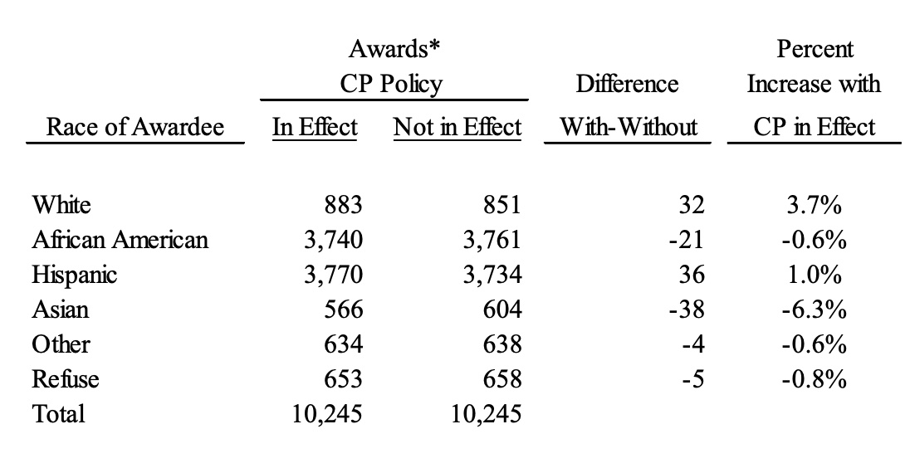
Simulation Results

Slide 45
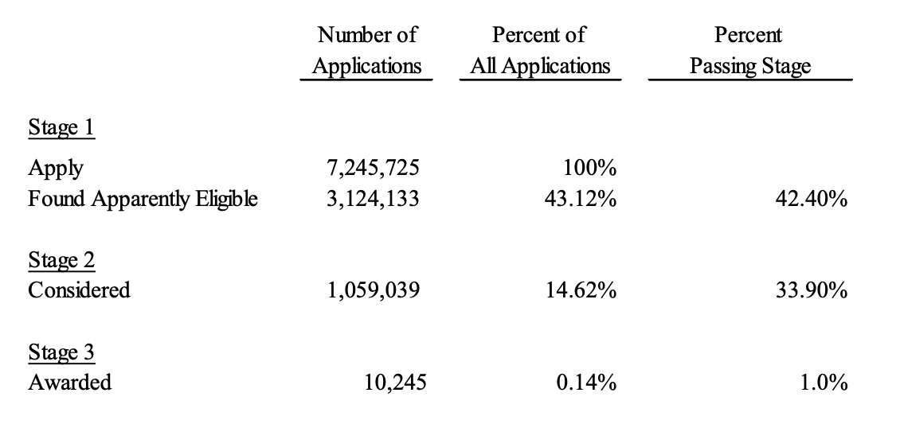

Slide 46
Income Levels
Missing from both analyses!

