Slide 1
Engineering Systems for Allocating Public Goods
Lecture 3: Top Trading Cycles + Fairness

Slide 2


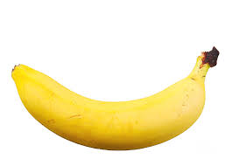

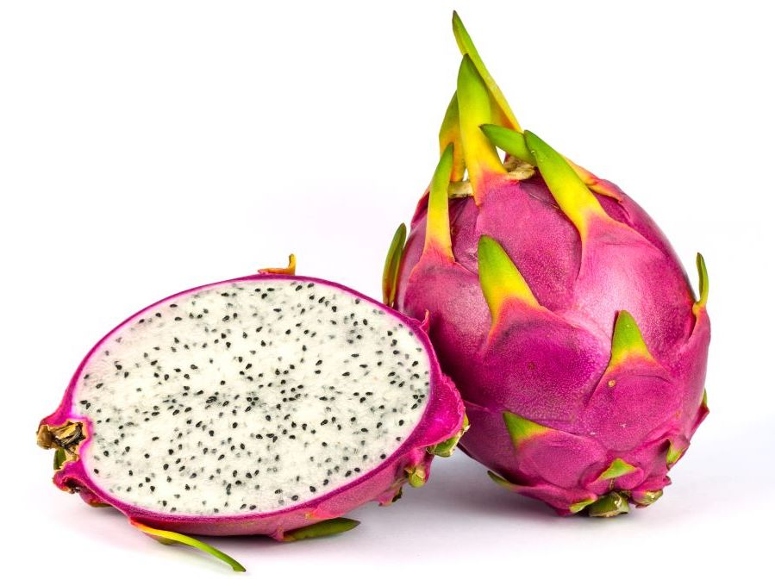
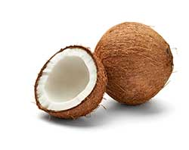
Warm Up
1 | 2 | 3 | 4
Consider the allocation ABCD. Is it
Pareto Efficient?
Individually Rational?
Core?
Consider the allocation DABC. Is it
Pareto Efficient?
Individually Rational?
Core?
What are the core allocation?
ABDC

Slide 3
Key Concepts
An allocation is blocked by a coalition of agents if that coalition can deviate and implement a solution that
they all like at least as much, and
some of them like better.
Pareto Efficient = Not blocked by the coalition of all agents
Individually Rational = Not blocked by any single agent
Core = Not blocked by any coalition

Slide 4
Extra Credit
Lots of you attempted it!
Consider the following algorithm for board game trades:
1. Start with the initial allocation, and look for mutually beneficial pairwise swaps.
a) If there are no such swaps, terminate and produce the current allocation.
b) If there is one mutually beneficial pairwise swap, execute it.
c) If there are multiple mutually beneficial pairwise swaps, execute the one that improves the total sum of ranks the most. Break ties in favor of low-index agents.
2. Repeat step 1, with treating the current allocation as the "new" initial allocation.
Is outcome always Individually Rational?
Is outcome always Pareto Efficient?
Is this mechanism Truthful?
Proof by counter example
Agent 1 : A > B > C
Agent 2: B > C > A
Agent 3: C > A > B
The best allocation is ABC where everyone gets their top choice. But if we start with BCA then no one can make a mutually beneficial trade.

Slide 5
Extra Credit
Lots of you attempted it!
Consider the following algorithm for board game trades:
1. Start with the initial allocation, and look for mutually beneficial pairwise swaps.
a) If there are no such swaps, terminate and produce the current allocation.
b) If there is one mutually beneficial pairwise swap, execute it.
c) If there are multiple mutually beneficial pairwise swaps, execute the one that improves the total sum of ranks the most. Break ties in favor of low-index agents.
2. Repeat step 1, with treating the current allocation as the "new" initial allocation.
Is outcome always Individually Rational?
Is outcome always Pareto Efficient?
Is this mechanism Truthful?
Proof by counter example
Agent 1 : A > B > C
Agent 2: B > C > A
Agent 3: C > A > B
Take the above assignment as the true preferences. Now suppose that Agent 1 reports instead
Agent 1: A > C > B
This allows a trade to happen between agent 1 and 2 resulting in CBA. Then a trade between agent 1 and 3 resulting in ABC which is better than the honest report.

Slide 6
Questions from Last Class
Is there always an allocation in the core?
Can there be more than one allocation in the core?
How can we find an allocation in the core?
Can we find this allocation in a way that is truthful?

Slide 7
Plan for Today
Top Trading Cycles Algorithm
Defining “fairness”

Slide 8




Top Trading Cycles
Observation: if a group can trade with each other and all get their favorite game, then if you recommend anything else, they will ignore you.
Algorithm:
Each person “points” to their favorite remaining game.
Everyone that is part of a “loop” gets the game they are pointing to.
Return to Step 1.
1: A > C > B
3: A > B > C
Note: People can point to their own game.
Question: Is there always a loop?
2: B > A > C

Slide 9
Top Trading Cycles Practice
1 | 2 | 3 | 4
1 | 2 | 3 | 4
1 | 2 | 3 | 4
Group Work:
Suppose we start from the allocation shown, and apply Top Trading Cycles.
What cycle clears first?
What is our final allocation?
Notes:
Analyzing TTC-RE:
Initial allocations that lead to final allocation of DABC: 2 starts with A or 1 starts with D (10), CBAD, BCDA.
Initial allocations that lead to final allocation of ADBC: 2 starts with D (6): ADBC, ADCB, BDAC, CDAB, CDBA, BDCA.
Initial allocations that lead to final allocation of ABCD: ABCD
Initial allocations that lead to final allocation of ACBD: ACBD, BCAD
Initial allocations that lead to final allocation of ABDC: ABDC, ACDB, CBDA
Note that whoever gets the apple always ends up with their first choice.

Slide 10
Top Trading Cycles Practice
Group Work: If we start from the allocation shown, and apply Top Trading Cycles,
What cycle clears first?
What is our final allocation?
1 | 2 | 3 | 4 | 5 | 6 | 7 | 8 | 9
B | C | G | B | G | H | H | B | B
A | G | C | I | B | C | C | A | A
I | B | E | H | F | E | D | I | G
H | I | H | G | D | F | F | H | D
D | F | I | D | I | I | E | F | C
F | D | D | F | H | D | G | D | F
G | A | F | E | C | G | A | C | I
C | E | B | C | E | B | B | E | E
E | H | A | A | A | A | I | G | H
1 | 2 | 3 | 4 | 5 | 6 | 7 | 8 | 9
B | C | G | B | G | H | H | B | B
A | G | C | I | B | C | C | A | A
I | B | E | H | F | E | D | I | G
H | I | H | G | D | F | F | H | D
D | F | I | D | I | I | E | F | C
F | D | D | F | H | D | G | D | F
G | A | F | E | C | G | A | C | I
C | E | B | C | E | B | B | E | E
E | H | A | A | A | A | I | G | H
Initial Allocation
Final Allocation
2 and 3 swap, 5 and 6 swap, 4 and 7 swap

Slide 11
Top Trading Cycles Practice
1 | 2 | 3 | 4 | 5 | 6 | 7 | 8 | 9
B | C | G | B | G | H | H | B | B
A | G | C | I | B | C | C | A | A
I | B | E | H | F | E | D | I | G
H | I | H | G | D | F | F | H | D
D | F | I | D | I | I | E | F | C
F | D | D | F | H | D | G | D | F
G | A | F | E | C | G | A | C | I
C | E | B | C | E | B | B | E | E
E | H | A | A | A | A | I | G | H
Group Work:
Reset to this initial state.
Repeat top trading cycles, but now you can point to anyone.
Try to get a better object than last time. Can you?
2 and 3 swap, 5 and 6 swap, 4 and 7 swap

Slide 12
Top Trading Cycles Practice
Group Work: If we start from the allocation shown, and apply Top Trading Cycles,
What cycle clears first?
What is our final allocation?
1 | 2 | 3 | 4 | 5 | 6 | 7 | 8 | 9
H | G | G | B | C | C | A | E | C
E | E | A | H | E | I | C | I | F
F | I | I | C | H | G | I | H | D
C | F | D | G | D | A | B | A | A
B | H | H | A | A | D | D | B | I
I | D | F | D | I | E | E | F | G
D | A | B | F | F | H | H | G | B
G | B | C | E | G | F | F | D | H
A | C | E | I | B | B | G | C | E
1 | 2 | 3 | 4 | 5 | 6 | 7 | 8 | 9
H | G | G | B | C | C | A | E | C
E | E | A | H | E | I | C | I | F
F | I | I | C | H | G | I | H | D
C | F | D | G | D | A | B | A | A
B | H | H | A | A | D | D | B | I
I | D | F | D | I | E | E | F | G
D | A | B | F | F | H | H | G | B
G | B | C | E | G | F | F | D | H
A | C | E | I | B | B | G | C | E
Initial Allocation
Final Allocation
3, 4, 5, 7 swap, 6 keeps, 1 and 2 swap

Slide 13
Top Trading Cycles Practice
Group Work: If we start from the allocation shown, and apply Top Trading Cycles,
What cycle clears first?
What is our final allocation?
1 | 2 | 3 | 4 | 5 | 6 | 7
E | C | F | B | B | F | G
F | D | E | C | A | E | B
D | G | G | E | D | D | C
B | A | D | A | G | A | A
A | F | A | D | F | B | D
C | B | B | F | C | G | E
G | E | C | G | E | C | F
1 | 2 | 3 | 4 | 5 | 6 | 7
E | C | F | B | B | F | G
F | D | E | C | A | E | B
D | G | G | E | D | D | C
B | A | D | A | G | A | A
A | F | A | D | F | B | D
C | B | B | F | C | G | E
G | E | C | G | E | C | F
Initial Allocation
Final Allocation
2 and 3 swap, 5 and 6 swap, 4 and 7 swap

Slide 14
Top Trading Cycles Practice
1 | 2 | 3 | 4 | 5 | 6 | 7
E | C | F | B | B | F | G
F | D | E | C | A | E | B
D | G | G | E | D | D | C
B | A | D | A | G | A | A
A | F | A | D | F | B | D
C | B | B | F | C | G | E
G | E | C | G | E | C | F
Group Work:
Reset to this initial state.
Repeat top trading cycles, but now you can point to anyone.
Try to get a better object than last time. Can you?
2 and 3 swap, 5 and 6 swap, 4 and 7 swap

Slide 15
Top Trading Cycles Practice
Group Work: If we start from the allocation shown, and apply Top Trading Cycles,
What cycle clears first?
What is our final allocation?
1’ | 2’ | 3’ | 4’ | 5’ | 6’ | 7’
F | E | C | D | B | F | E
B | D | E | E | F | D | B
C | G | B | C | C | G | C
E | B | D | F | A | A | F
A | A | F | A | D | E | A
D | F | A | B | G | C | G
G | C | G | G | E | B | D
1’ | 2’ | 3’ | 4’ | 5’ | 6’ | 7’
F | E | C | D | B | F | E
B | D | E | E | F | D | B
C | G | B | C | C | G | C
E | B | D | F | A | A | F
A | A | F | A | D | E | A
D | F | A | B | G | C | G
G | C | G | G | E | B | D
Initial Allocation
Final Allocation
3, 4, 5, 7 swap, 6 keeps, 1 and 2 swap

Slide 16
1 | 2 | 3 | 4 | 5 | 6 | 7
E | C | F | B | B | F | G
F | D | E | C | A | E | B
D | G | G | E | D | D | C
B | A | D | A | G | A | A
A | F | A | D | F | B | D
C | B | B | F | C | G | E
G | E | C | G | E | C | F
1’ | 2’ | 3’ | 4’ | 5’ | 6’ | 7’
F | E | C | D | B | F | E
B | D | E | E | F | D | B
C | G | B | C | C | G | C
E | B | D | F | A | A | F
A | A | F | A | D | E | A
D | F | A | B | G | C | G
G | C | G | G | E | B | D

Slide 17
Top Trading Cycles Practice
1 | 2 | 3 | 4 | 5 | 6 | 7 | 8
D | B | G | H | B | A | D | C
G | D | F | D | C | E | F | E
B | C | A | E | G | G | A | D
E | F | C | A | E | H | G | G
F | G | E | G | F | C | B | B
C | E | H | B | A | F | C | F
H | H | D | C | H | B | H | A
A | A | B | F | D | D | E | H
Group Work:
Suppose we start from the allocation shown, and apply Top Trading Cycles.
What cycle clears first?
What is our final allocation?

Slide 18
Initial Pointing
2E
3A
1H
4D
8C
5G
7B
6F

Slide 19
After removing initial cycles
2E
3A
1D
4H
8C
5G
7B
6F

Slide 20
After two rounds of removing cycles
2E
3G
1D
4H
8C
5B
7F
6A

Slide 21
Final Allocation
1 | 2 | 3 | 4 | 5 | 6 | 7 | 8
D | B | G | H | B | A | D | C
G | D | F | D | C | E | F | E
B | C | A | E | G | G | A | D
E | F | C | A | E | H | G | G
F | G | E | G | F | C | B | B
C | E | H | B | A | F | C | F
H | H | D | C | H | B | H | A
A | A | B | F | D | D | E | H

Slide 22
Top Trading Cycles Incentives
1 | 2 | 3 | 4 | 5 | 6 | 7 | 8
D | B | G | H | B | A | D | C
G | D | F | D | C | E | F | E
B | C | A | E | G | G | A | D
E | F | C | A | E | H | G | G
F | G | E | G | F | C | B | B
C | E | H | B | A | F | C | F
H | H | D | C | H | B | H | A
A | A | B | F | D | D | E | H
Group Work:
Reset to this initial state.
Repeat top trading cycles, but now you can point to anyone.
Try to get a better object than last time. Can you?

Slide 23
1 | 2 | 3 | 4 | 5 | 6 | 7 | 8
D | B | G | H | B | A | D | C
G | D | F | D | C | E | F | E
B | C | A | E | G | G | A | D
E | F | C | A | E | H | G | G
F | G | E | G | F | C | B | B
C | E | H | B | A | F | C | F
H | H | D | C | H | B | H | A
A | A | B | F | D | D | E | H

Slide 24
2G
3E
1F
4C
8B
5A
7H
6D

Slide 25
2G
3E
1F
4H
8C
5B
7D
6A

Slide 26
2F
3E
1G
4H
8C
5B
7D
6A

Slide 27
1 | 2 | 3 | 4 | 5 | 6 | 7 | 8
D | B | G | H | B | A | D | C
G | D | F | D | C | E | F | E
B | C | A | E | G | G | A | D
E | F | C | A | E | H | G | G
F | G | E | G | F | C | B | B
C | E | H | B | A | F | C | F
H | H | D | C | H | B | H | A
A | A | B | F | D | D | E | H

Slide 28
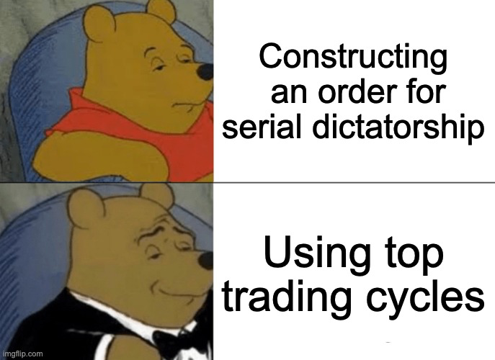
Checking if an Allocation is PE
Before: see if there is some order for serial dictatorship that produces it.
Now: run TTC from this allocation, see if we get the same allocation back.

Slide 29
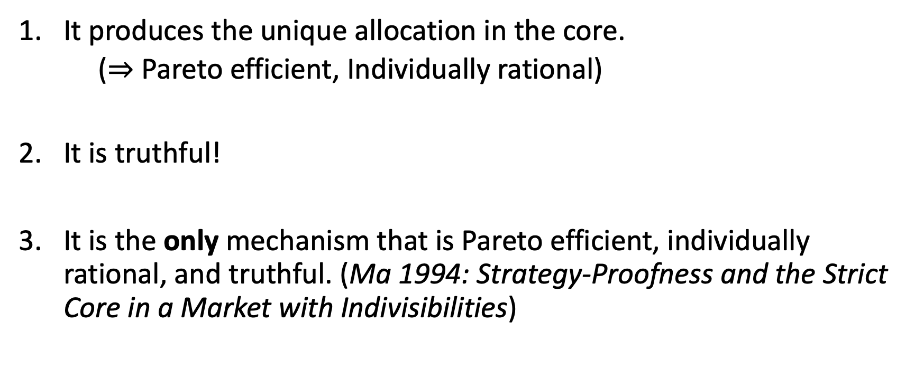
Nice Features of Top Trading Cycles
It produces the unique allocation in the core.
($⇒$ Pareto efficient, Individually rational)
It is truthful!
It is the only mechanism that is Pareto efficient, individually rational, and truthful. (Ma 1994: Strategy-Proofness and the Strict Core in a Market with Indivisibilities)
A core allocation always exists!

Slide 30
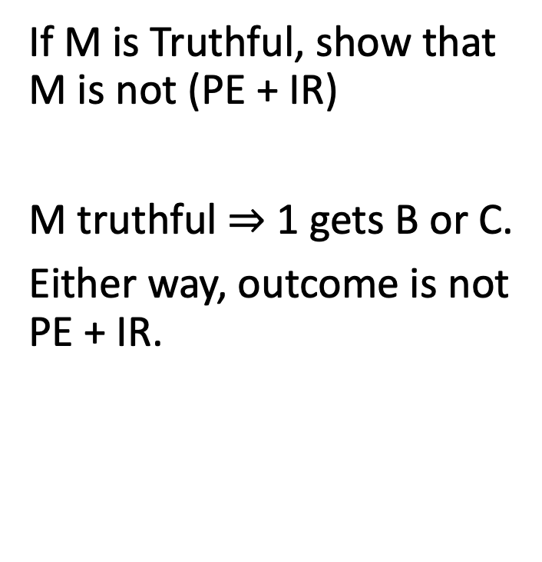
On this profile, mechanism M recommends CBA:
If M is Pareto Efficient + Individually Rational, show that M is not Truthful
1 | 2 | 3
1 | 2 | 3
If M is Truthful, show that M is not (PE + IR)
M truthful $⇒$ 1 gets B or C.
Either way, outcome is not PE + IR.

Slide 31
An Amazing Fact!
1 | 2 | 3 | 4
Suppose that on this instance, we wish to recommend DABC.
Then either
Our mechanism is not truthful.
OR
On some other instance, it fails to select a PE + IR allocation.

Slide 32
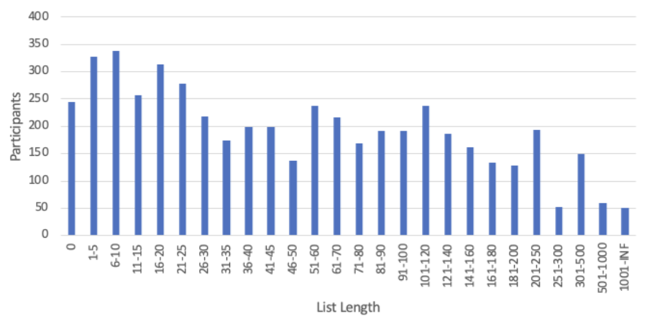
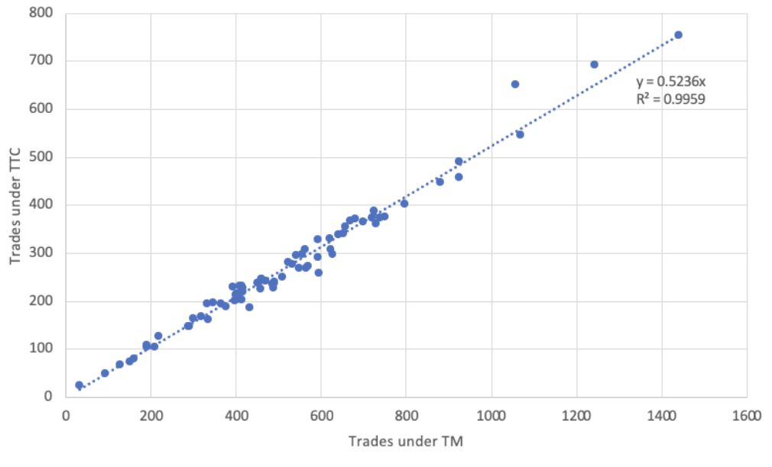
Board game trades use Trade Maximizer. Should they switch to Top Trading Cycles?
Data from 82 math trades from 2016-2022
65 of them involve > 4,000 games.

Slide 33
What if people bring multiple games?
Not sure this is worth going into. (Relevant for application, but not as relevant for future of course.)
Could also ask, what if we have fewer games than people (Less relevant for application, more relevant for future of course.)

Slide 34
Could We Use Top Trading Cycles When Nobody Owns Anything?

Slide 35
Making “Fair” Versions of Serial Dictatorship and Top Trading Cycles
Serial Dictatorship is not fair:
the person who goes first gets an advantage!
Top Trading Cycles from an arbitrary endowment is also not fair:
someone might start with the “best” object!
How could we make these fair?
Random Serial Dictatorship (RSD): have people choose in a random order.
Top Trading Cycles from Random Endowments (TTC-RE): give items randomly, then run TTC.

Slide 36
Top Trading Cycles HW Problem
1 | 2 | 3 | 4 | 5 | 6 | 7 | 8
D | B | G | H | B | A | D | C
G | D | F | D | C | E | F | E
B | C | A | E | G | G | A | D
E | F | C | A | E | H | G | G
F | G | E | G | F | C | B | B
C | E | H | B | A | F | C | F
H | H | D | C | H | B | H | A
A | A | B | F | D | D | E | H

Slide 37
2G
3E
1F
4C
8B
5A
7H
6D

Slide 38
2G
3E
1F
4H
8C
5B
7D
6A

Slide 39
2F
3E
1G
4H
8C
5B
7D
6A

Slide 40
Final Allocation
1 | 2 | 3 | 4 | 5 | 6 | 7 | 8
D | B | G | H | B | A | D | C
G | D | F | D | C | E | F | E
B | C | A | E | G | G | A | D
E | F | C | A | E | H | G | G
F | G | E | G | F | C | B | B
C | E | H | B | A | F | C | F
H | H | D | C | H | B | H | A
A | A | B | F | D | D | E | H

Slide 41
Top Trading Cycles: Dynamic vs Direct Implementations

Slide 42
Allocations vs Mechanisms
The following are properties of allocations:
Pareto efficient.
Individually rational.
Core.
Can an allocation be truthful? No.
Truthfulness depends on what would have happened with different preferences. In other words, truthfulness is a property of a mechanism.
We say that a mechanism is {Pareto efficient, individually rational, core} if it always selects an allocation with these properties.

Slide 43
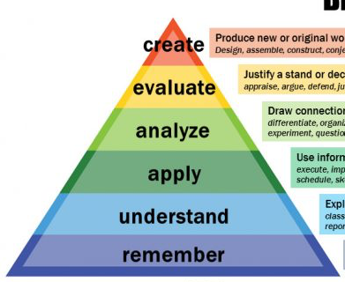
Answering Essay Questions
Tell me which properties you think are most important, and why!
Name an algorithm, and state its properties.

Slide 44
Two Settings
Designer controls all items
Algorithm: Serial Dictatorship
Every order of agents is Pareto efficient and truthful.
Can find any Pareto efficient allocation (with some order).
Could we use Top Trading Cycles?
Each item owned by an agent
Algorithm: Top Trading Cycles
Pareto efficient, truthful, and individually rational.
Finds the unique core allocation.
Could we use Serial Dictatorship?

Slide 45
Today’s Goal: Define Fairness
Intuitive definition: treat people equally!
This generally requires randomization.

Slide 46
How To Define Fairness?
“Treat People Equally” Could Mean:
Equal Allocation. People have the same chance of receiving each item
Equal Rank Distribution. People have identical chance of receiving their first, second, third choice…
Symmetry. (Defined on next slides.)
Other Definitions of Fairness (not discussed today):
Equal treatment of equals
Envy-Free
Notes:
Another option: Envy Free. However, to even define it we need agents to be able to compare randomized bundles (or describe how they do this). In addition, depending on how this is defined, RSD is not envy-free (see paper by Alex Nesterov).

Slide 47
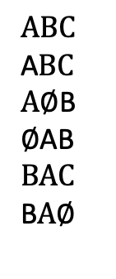
1 | 2 | 3
A | A | C
B | B | B
C | C | A
1/3
1/3
1/3
1/2
1/3
0
1 | 2 | 3
1/2 | 1/2 | 1
1/2 | 1/2 | 0
0 | 0 | 0
Choose a completely random allocation
(My initial method)
ABC
ACB
BAC
BCA
CAB
CBA
$$ABC$$
A$BC$
$A∅$B
$∅$AB
$$BAC$$
B$A∅$

Slide 48
Random Mechanisms
A random mechanism is a probability distribution over deterministic mechanisms.
A random mechanism is Pareto efficient if all of the deterministic mechanisms which it might choose are Pareto efficient.
A random mechanism is truthful (strategy-proof) if all of the deterministic mechanisms which it might choose are truthful.
There are other ways to define efficiency and truthfulness for random mechanisms, but today we will focus on the definitions above.

Slide 49
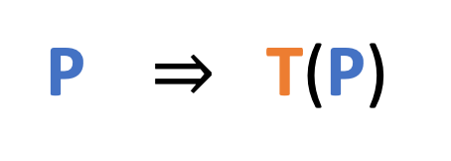
Transposing Preferences
A transposition is a swap of two positions.
1 | 2 | 3 | 4
We can apply transposition T to any preference profile P:
1 | 2 | 3 | 4
1 | 2 | 3 | 4
P $⇒$ T(P)

Slide 50
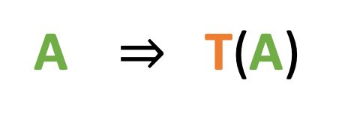
Transposing Allocations
A transposition is a swap of two positions.
1 | 2 | 3 | 4
We can also apply transposition T to any allocation A:
1 | 2 | 3 | 4
1 | 2 | 3 | 4
A $⇒$ T(A)

Slide 51
Defining Symmetry
A random mechanism M is symmetric if for any
Preference profile P, Allocation A, and Transposition T:
Prob(M(P) = A) = Prob(M(T(P)) = T(A)).
Intuition:
We are not systematically favoring one agent over another.
Swapping two agent’s preferences should just swap the final allocation.
Note: An equivalent definition says that this must hold for any permutation (possibly involving more than two agents).

Slide 52
How to design symmetric mechanisms?
Best Approach: Create deterministic mechanisms with different “roles”, and assign agents randomly to roles.

Slide 53
Top Trading Cycles from Random Endowments
Start from a uniformly random allocation.
Apply top trading cycles.

Slide 54
Random Serial Dictatorship
Place people in a uniform random order.
Apply serial dictatorship.

Slide 55
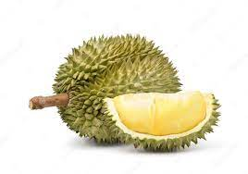
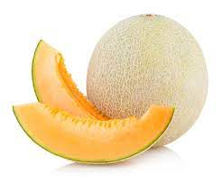
A New Mechanism
Give Apple, Banana, and Durian to Role 1.
Give the Cantaloupe to Role 4.
Roles 1 and 4 play TTC.
Once Role 1 matches, pass their excess fruit to Role 2. Have Roles 2 and 4 play TTC.
Once Role 2 matches, pass their excess fruit to Role 3. Have Roles 3 and 4 play TTC.
1 | 2 | 3 | 4
Group Work:
If we assign agents randomly to roles
What are the possible final assignments?
What is the probability of each?

Slide 56
Summary
All known mechanisms which are Pareto efficient, strategy-proof and symmetric are equivalent to Random Serial Dictatorship!
Despite (and sometimes because of) its simplicity, Random Serial Dictatorship is a reasonable solution in many cases.

Slide 57
Session 3 Study Guide
Concepts
Random Mechanism
Transposition
Symmetry
Algorithms
TTC
TTC-RE
RSD
Facts
Top Trading Cycles gives the unique allocation in the core
Top Trading Cycles is PE, SP, IR.
Top Trading Cycles is the only algorithm with these properties.
TTC-RE Pareto efficient, truthful and symmetric.
RSD is Pareto efficient, truthful and symmetric.
Notes:
Probably good to cover SD in first class, to split these ideas up.

Slide 58
Coming Up
Concept Check (due tomorrow at midnight)
Reflection and Critical Thinking (due next Monday at midnight)

