Slide 1
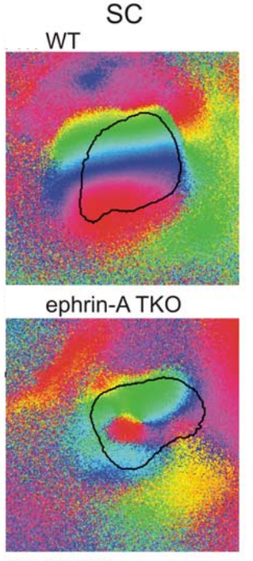
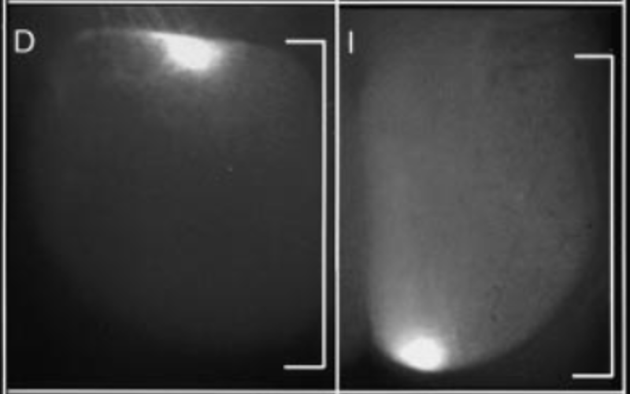
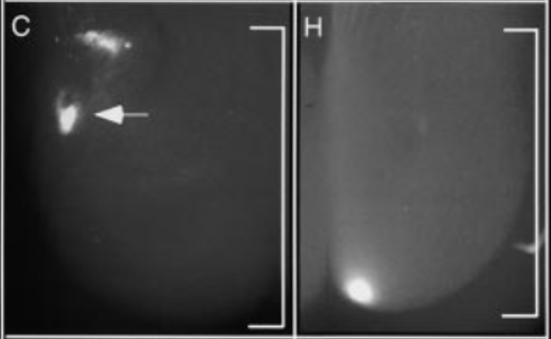
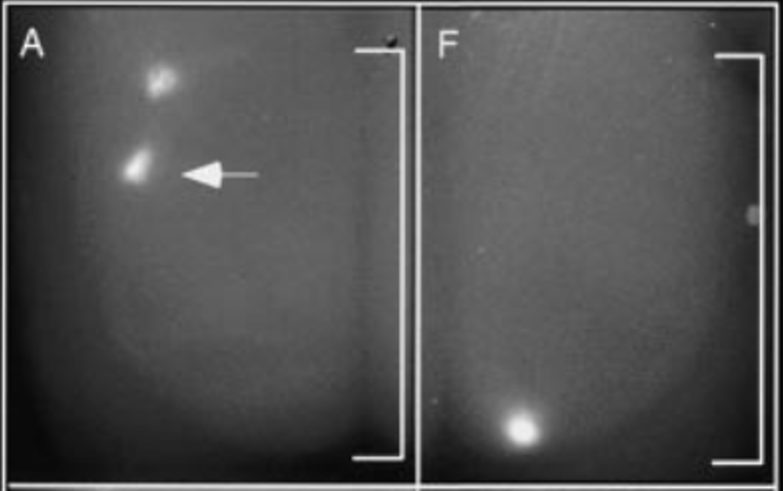
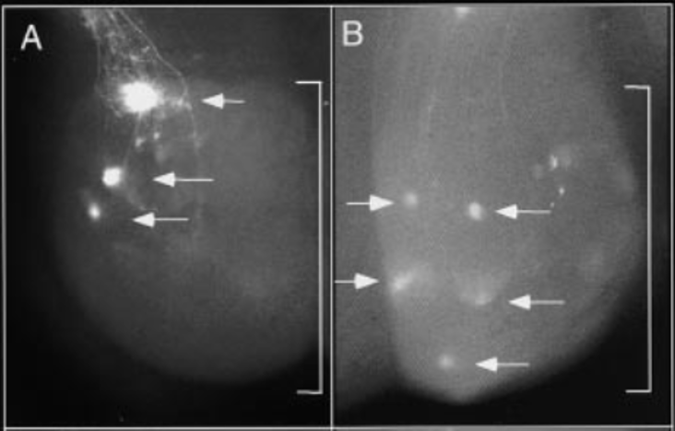
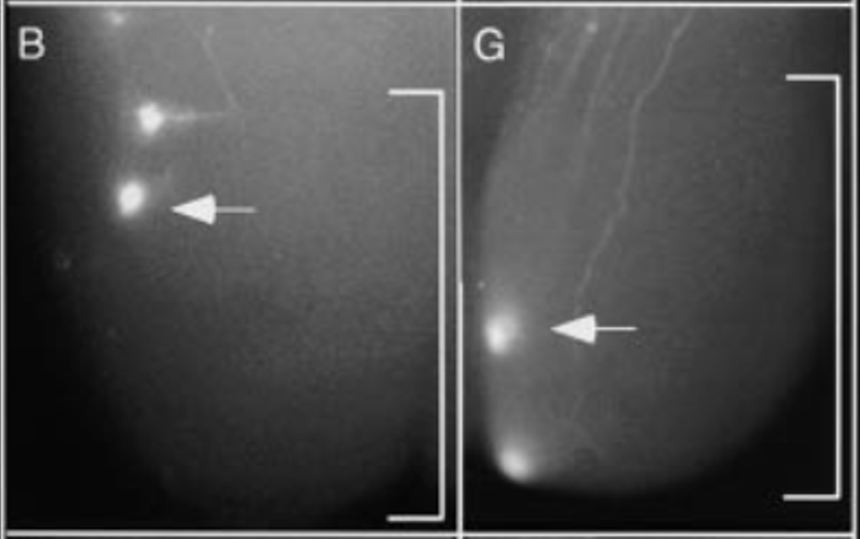
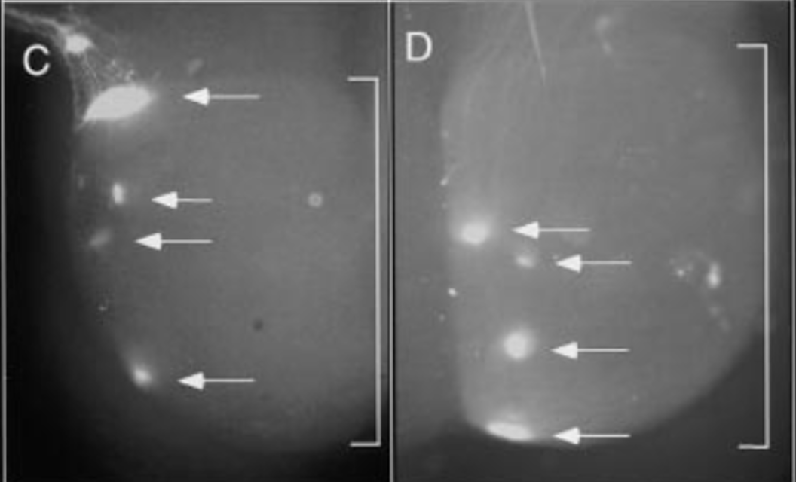









$$Temporal$$
$$Nasal$$
$$Temporal$$
$$Nasal$$
A
B
G
H
M
$$WT$$
$${A2^{+/−}A5}^{+/−}$$
C
D
I
J
$${A2}^{−/−}$$
$${A2^{−/−}A5}^{−/−}$$
N
E
F
K
L
$${A5}^{−/−}$$
$${A2^{−/−}A5}^{−/−}$$

