Slide 1
Predicting Diabetes Rates
Nick Henderson

Slide 2

Diabetes in the United States
Over 34 million Americans have diabetes (in 2018)
~ 10% of the population
Estimated total cost of $327 billion in 2017
$237 billion medical costs
$90 billion reduced productivity
Diabetes is impacted by lifestyle, diet, exercise, obesity etc.
What can we learn about the factors that impact diabetes rates?
Can we predict diabetes rates?
Stats from: https://www.diabetes.org/resources/statistics/statistics-about-diabetes

Slide 3
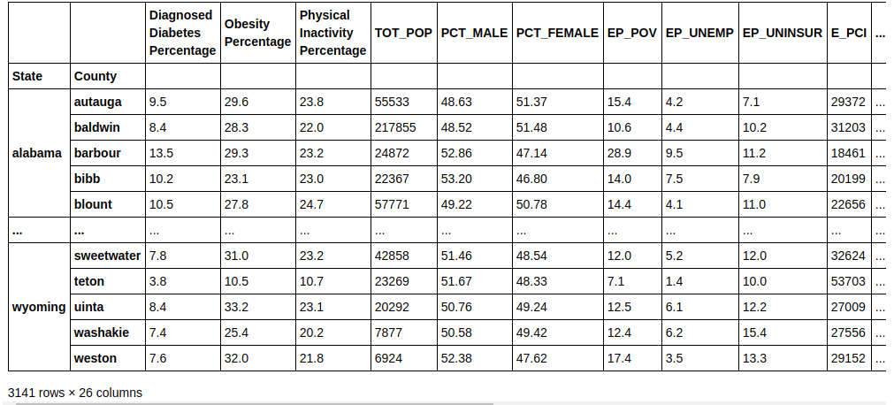
Setup & Data
Collect county-level data for diabetes rates in all US counties
Collect county-level data for socioeconomics, health, and demographics
Join datasets
Model diabetes rates using the other features in the dataset
Final Dataframe after selecting features:
Diabetes/obesity/physical activity rates: https://gis.cdc.gov/grasp/diabetes/DiabetesAtlas.html#
Socioeconomic data: https://www.atsdr.cdc.gov/placeandhealth/svi/data_documentation_download.html
Race/Demographics: https://www2.census.gov/programs-surveys/popest/datasets/2010-2019/counties/asrh/cc-est2019-alldata.csv

Slide 4
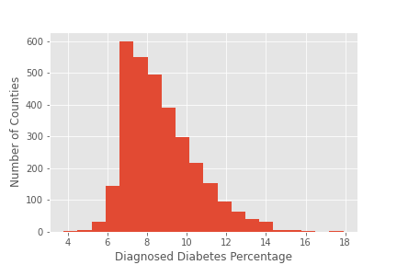
Diabetes rates overview
Minimum Rate : 3.8%
Maximum Rate : 17.9%
Mean Rate: 8.7%
Standard Deviation: 1.8%
Which Counties have the highest and lowest diabetes rates?

Slide 5
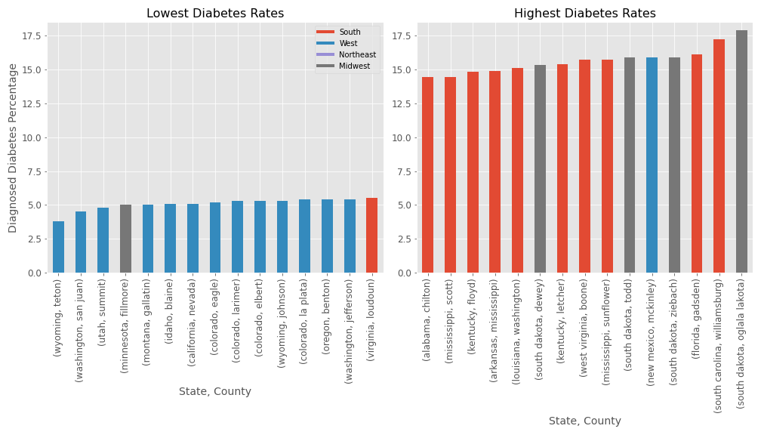
Top/Bottom Counties with Region
Does this pattern hold for the whole list of counties?

Slide 6
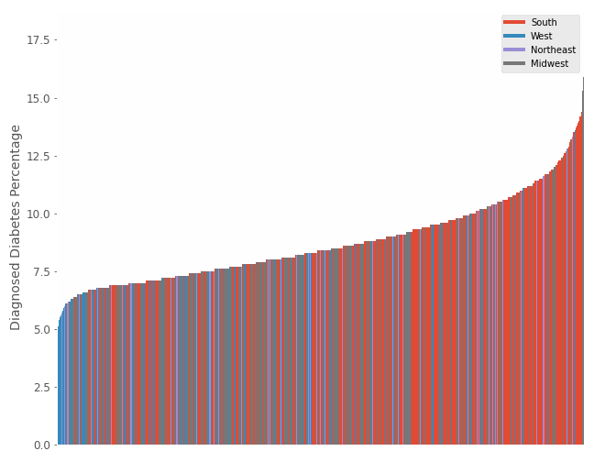
Diabetes in all counties by region
South Mean : 9.33%
Midwest Mean : 8.29%
Northeast Mean: 8.65%
West Mean: 7.92%

Slide 7
Developing Model
Error Metric: Root Mean Square Error
Baseline model: Mean diabetes rate
Baseline performance: RMSE = 1.8 (i.e. 1.8% diabetes) = S.D. of diabetes rates
Model: Poisson Regression

Slide 8
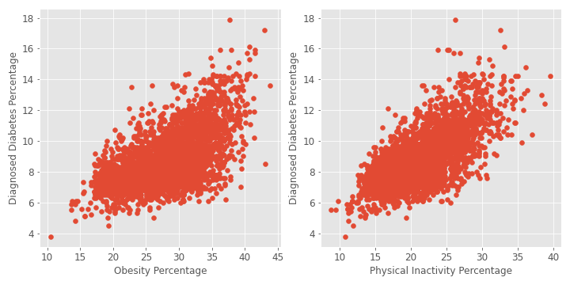
Developing Model - Simple Poisson regression
Features: Physical Inactivity Percentage, Obesity Percentage

Slide 9
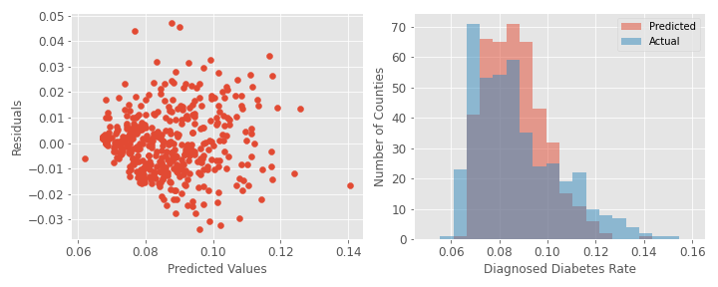
Developing Model - Simple Poisson regression
Features: Physical Inactivity Percentage, Obesity Percentage
RMSE from KFolds(6): 1.21% (baseline was 1.8%)

Slide 10
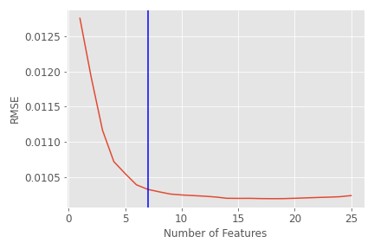
Optimizing Model - Poisson regression
Wrote a function tests every feature and adds the best one to the model (feature that minimizes error)
Started with 0 features, and looped function to sequentially add the best features one-by-one

Slide 11
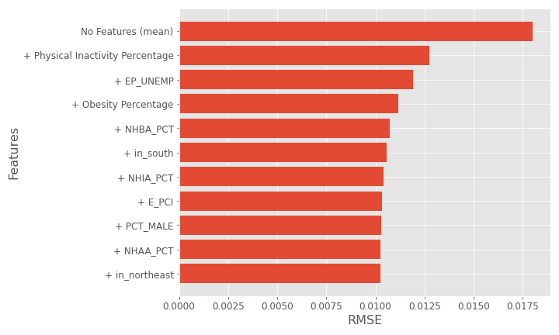
Optimizing Model - Poisson regression
Top Features:

Slide 12
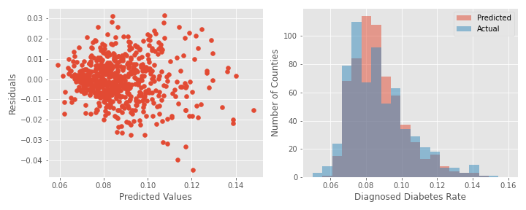
Final Model - Poisson regression
Features:
Physical Inactivity Percentage
Estimated Percent Unemployed
Obesity Percentage
Non-hispanic black alone percentage
In south (dummy variable)
Non-hispanic american indian and alaskan native alone percentage
Estimated per capita income
RMSE on Test Data: 1.06% (baseline = 1.8%)

Slide 13
Conclusions / Future Directions
Southern counties have higher diabetes rates
Diabetes rates are related more strongly to employment status than income
I.e. having a job matters more than making a lot of money (in this very specific model context)
Physical inactivity is a stronger predictor than obesity
Future Directions
More lifestyle features
More feature engineering
More features + Dimension Reduction
Testing model outside of US
Predicting healthcare costs associated with diabetes

