Slide 1
Modelleren en Systeemontwerp
Introduction

Slide 2
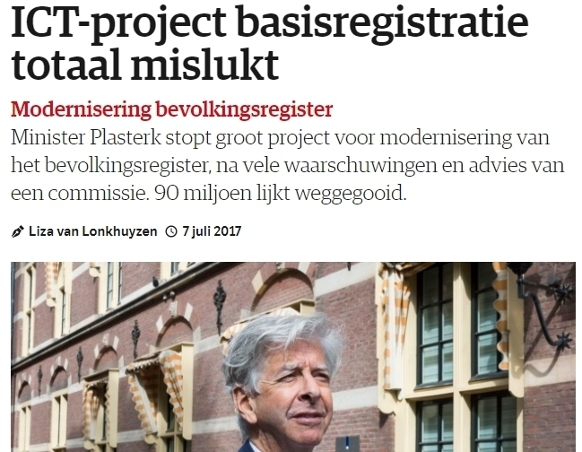
Bron: nrc.nl

Slide 3

Bron: nrc.nl

Slide 4
Introduction
Why do ICT projects fail so often?
Bad programmers?
Bad management?
Bad …?

Slide 5
Introduction
So you have done some programming…

Slide 6
Levels of abstraction
You already know how to write individual lines of code:
for (i = 0; i < n; i++)
Code is organized into methods:
public bool isEmpty()
Methods are organized into classes:
public class Student

Slide 7
Beyond the for-loop
In this course you will learn how to design great software:
that is clearly structured
that is easy to modify and maintain
that makes your customers happy...
...which is not that obvious

Slide 8
Introduction
Which phases can we identify in an ICT-project?
…and where could/will things go wrong?

Slide 9
Phases
CODING AND DEBUGGING

Slide 10
PHASES
Client: “I want a way to easily access and analyze all our interactions with our customers.”
You: “Done! I launched a Kubernetes cluster running a Redis Docker image containing all your customer data. It’s very easy-to-use, you can simply send HTTP post requests with a SHA256 secure JSON web token in the header.”
Client: “You’re fired.”

Slide 11
Phases
DESIGN
CODING AND DEBUGGING

Slide 12
PHASES
REQUIREMENTS ANALYSIS
DESIGN
CODING AND DEBUGGING

Slide 13

Phases
But once I’ve finished coding something, I'm done. Right?

Slide 14
Phases
CODING AND DEBUGGING
TESTING AND VERIFICATION

Slide 15
PHASES
CODING AND DEBUGGING
TESTING AND VERIFICATION
MAINTENANCE

Slide 16
Software construction
There is much more to software construction than just programming
And it is hard to overestimate the volume and importance of maintenance

Slide 17
MSO
This course assumes you know about for-loops, assignments, methods, and objects
We will teach you to apply this knowledge to organize code into great software that makes your customers happy

Slide 18
Topics
MSO is a course that used to be shared by Information Science and Computer Science students
What should this course cover?
Technical? Sociological? Programming? Modeling?
Object oriented analysis and design!

Slide 19
Object-oriented analysis
Before you start designing software, you need to determine what to build
Analysis is the process of discovering, documenting and maintaining the requirements of a software system
Figuring out what the problem is
What does the customer want?
How can I translate a customer's wishes to a software design?
By the way, who is the customer?

Slide 20
Analysis: Who are the stakeholders?
Who is the customer in the case of the bevolkingsregister?
The clerk?
The citizen?
The municipal authorities?
The national government?
...?

Slide 21
Object-oriented design
How should I organize code into classes?
Which classes are related?
How are classes related?
What are the properties of a good design?

Slide 22
Analysis and Design
This course teaches both analysis and design.
Analysis is a soft skill: talking to customers and figuring out what they want
Design is more technical: figuring out the right high-level structure of your code

Slide 23
The world is not black and white
Sometimes there is no client (for example if you are your own client)
Design is more than just structuring your code:
Interaction design
Branding
Visual design: fonts, colors, spacing, animations

Slide 24
COURSE WEEK PLANNING
Monday:
Tutorial/lab 13-15
”Lecture” 15-17
Thursday:
Tutorial/lab 9-11

Slide 25
Course organization
Lecture? What lectures!?
Clips!
Watch them when you want
Watch them again and again
Go back a minute and watch again
Watch them slowly
Watch them quickly

Slide 26
Course organization
Still questions after watching clips?
Mail your questions to me latest Thursday evening
. . . so we can discuss your questions on Monday
Take care of the subject format when emailing:
[INFOMSO questions week XX]

Slide 27
Course organization
What do we do on Monday?
First we will discuss your questions about the topics of last week
might lead to an in-depth treatment of the more advanced issues
Next we will do some quizzes
that give you feedback about your level of understanding
This approach can be very fruitful when you are actively participating
but is far less effective when you don't

Slide 28
Assignments
There are four assignments that you must submit
Each assignment will be marked on the scale: A-B-D-F
If you score AABB or better, you will receive an extra 0.5 on your final project
If you have no F's, but you score BBDD or worse, you will lose 0.5 on your final project
If you fail two assignments (F), you will fail the course
If you fail one assignment, you will be given the opportunity to complete a remedial assignment (herkansing), provided your final mark (rounded) for the whole course is at least a 6

Slide 29
Final mark
One midterm exam (20%)
Final exam (50%)
Design project (30%)

Slide 30
MAterial
Shalloway and Trott, Design Patterns Explained, 2nd edition, Addison Wesley
Code uses Java (but there is almost no code in the book)
C# code available from the book's website
Larman, Applying UML and patterns, Prentice Hall (slides and schedule refer to the second edition)
Online resources
Clips, slides, example code

Slide 31
WHO?
Lecturer: Arjan Egges
j.egges@uu.nl
Tutorial/lab assistants:
Beau Mahler
Werre Timmer
Yorick Kooij

Slide 32
How much code?
This course will not require a lot of coding . . .
. . . but we will study programs
We will look at what code does and how it is structured, without worrying too much about how it is implemented exactly
`Is this program well designed?' as opposed to `The loop on line 325 of the Foo class is wrong'

Slide 33
Course outline
First two weeks: focus on the analysis and design process, including UML
Later sessions: it is a good thing to learn from your failures
But it is better to learn from other peoples failures: focus on design patterns

Slide 34
Next week
Lecture on Monday will be given by Hans Philippi
Any questions about this week’s material should be sent to him instead of me: H.Philippi@uu.nl.

Slide 35
References
The following references may be helpful to refresh or extend your knowledge of C#:
https://www.tutorialspoint.com/csharp/
topics: inheritance, polymorphism, interfaces
http://csharp.net-tutorials.com/
topics: inheritance, abstract classes

