Slide 1
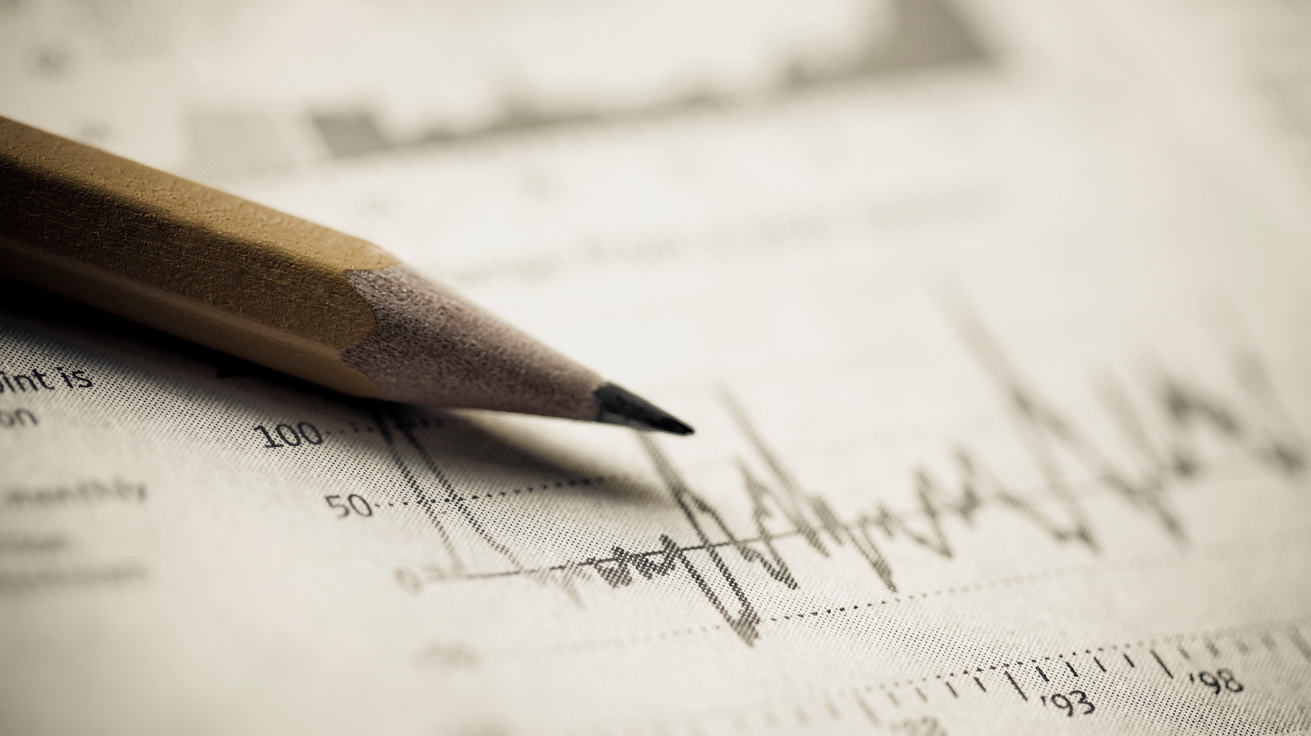
AI with Matlab
Mathemagicians Nick Liouliakis Catherine Papadopoulou

Slide 2

The Problem
Create a fitness tracker based on data from sensors available on a smartphone.
The available data were:
Acceleration
Orientation
Angular Velocity
Position
For our application, we used:
Acceleration
Position

Slide 3
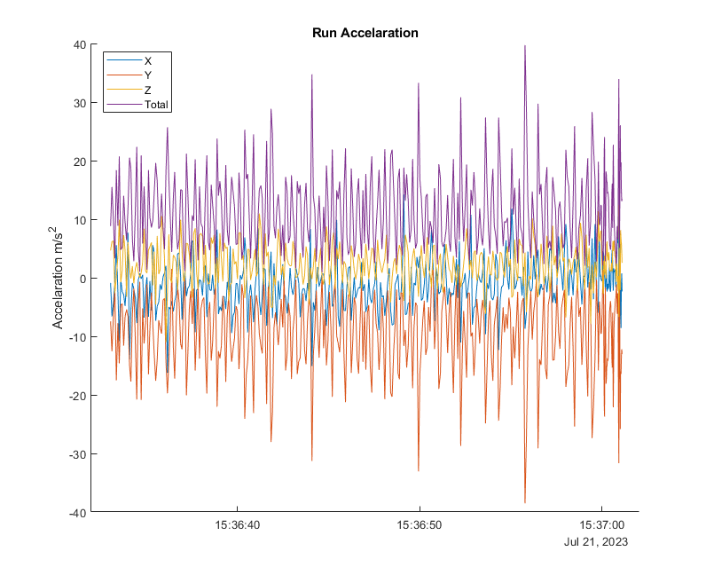
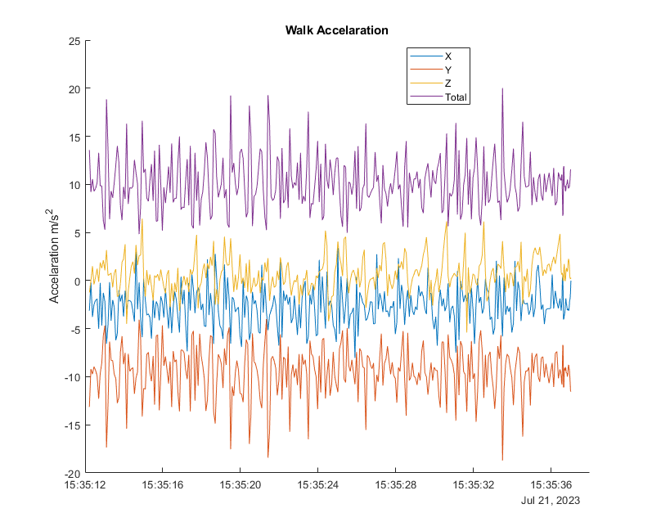
Exploratory data analysis and visualization

Slide 4
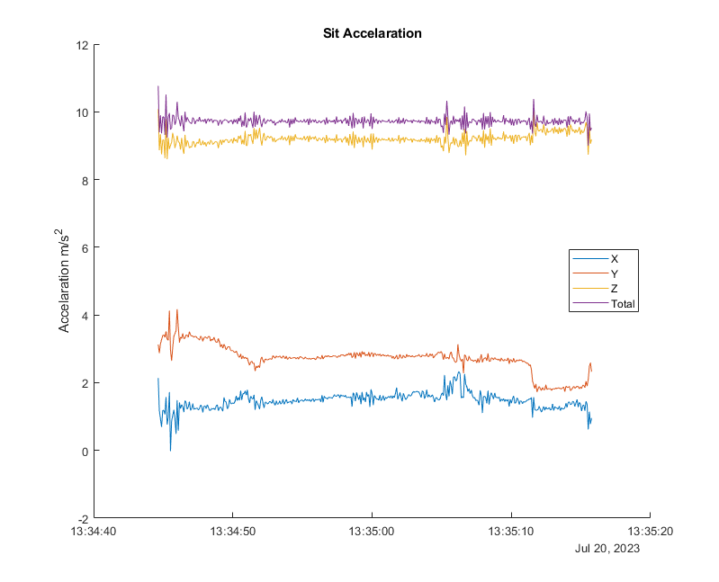
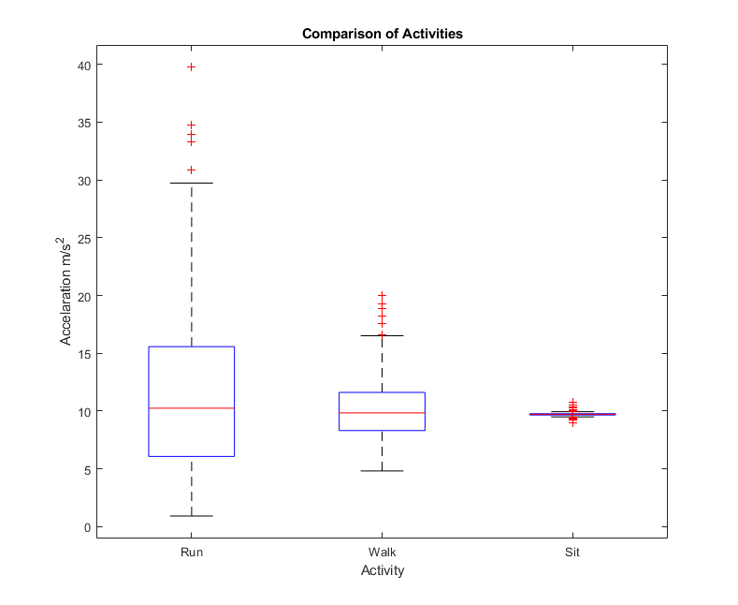
Exploratory data analysis and visualization

Slide 5
Data preprocessing
One of the main goals of our fitness tracker is to be able to distinguish whether the user was sitting, walking or running.
In to order to feed the data to the Classification Learner, the moving statistics are calculated. This is necessary in order to categorize the different time intervals.
Specifically, we used the following moving statistics with a moving window of 60 samples:
Moving Average
Moving Min
Moving Max
Moving Median
Moving Standard Deviation
Moving Median Absolute Deviation

Slide 6
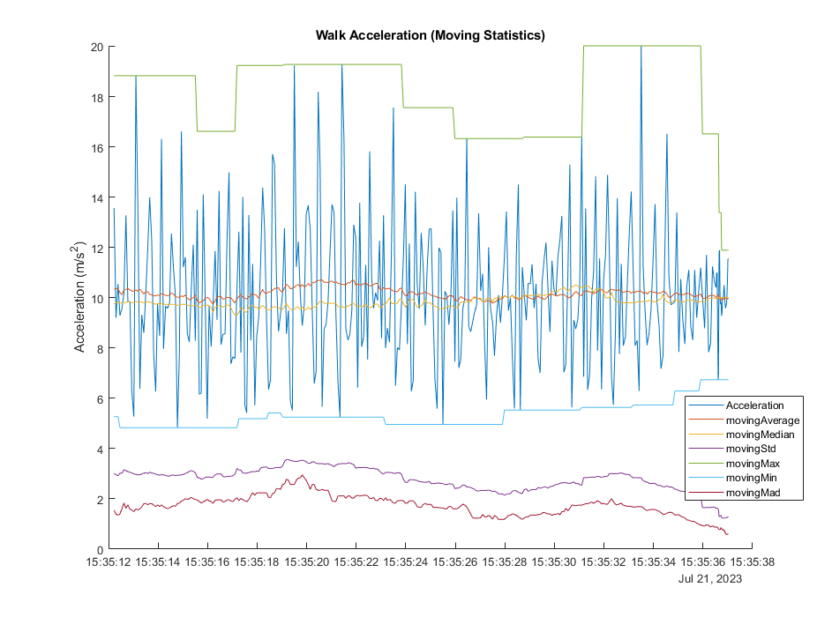
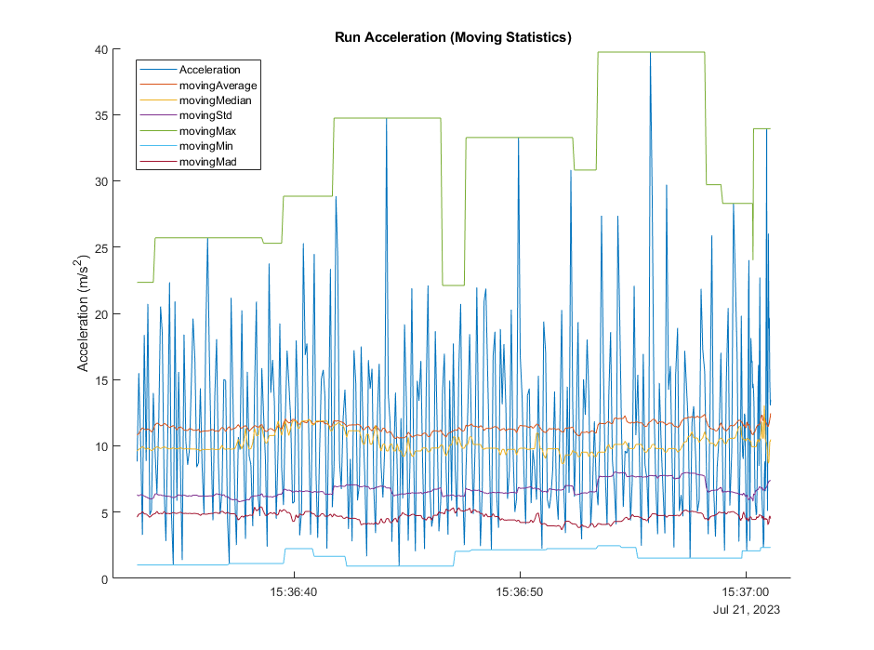
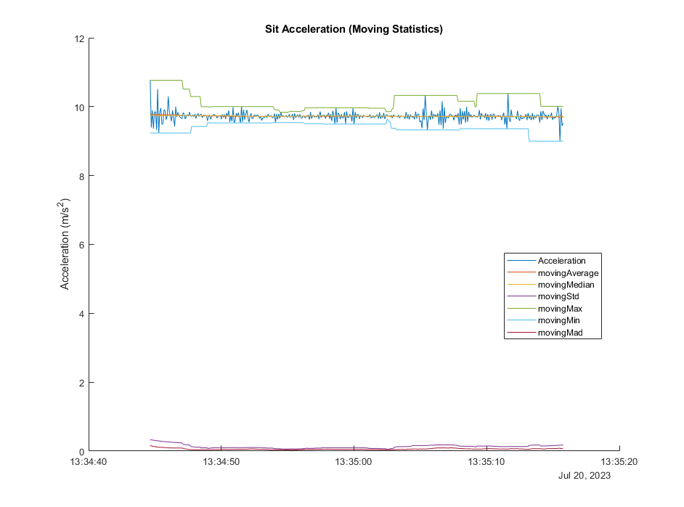

Slide 7
Training the Model
For estimating whether the user is sitting, walking or running, we developed a Classification model.
We tried all Quick-To-Train models. We used a test set and 10-fold cross-validation for validating all models.
Most of them had almost perfect accuracy for both testing and validation.
For training, we used both the provided datasets and datasets we recorded ourselves.
For the acceleration, after trial and error, we ended up calculating the magnitude of the acceleration vector first and then applying the moving statistics.
Important note: The accelerometer must record data with a frequency of 10 Hz.

Slide 9
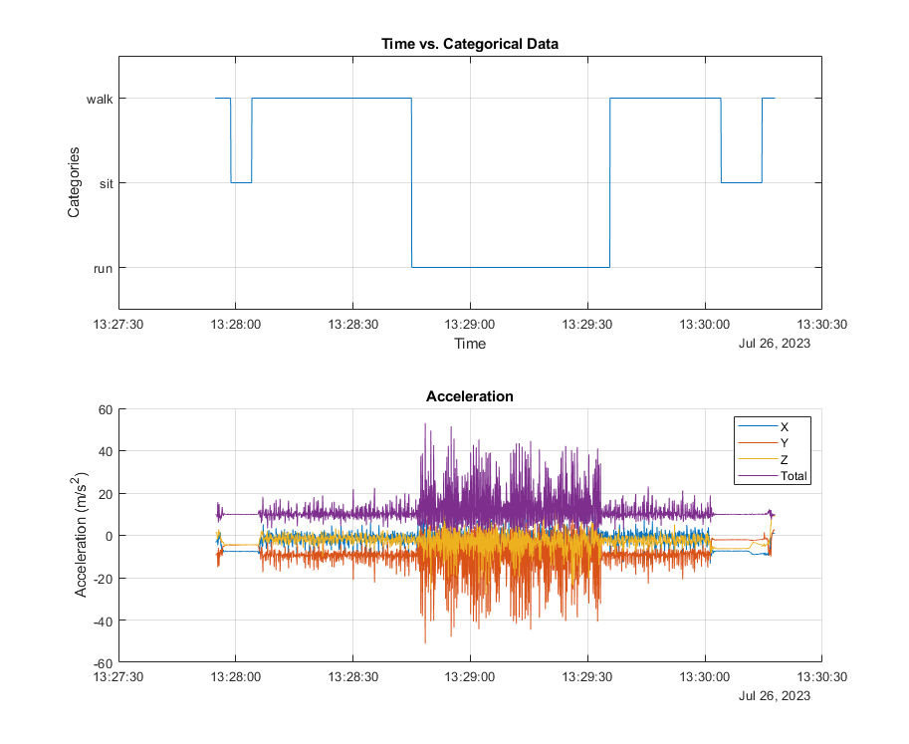
Results

Slide 10
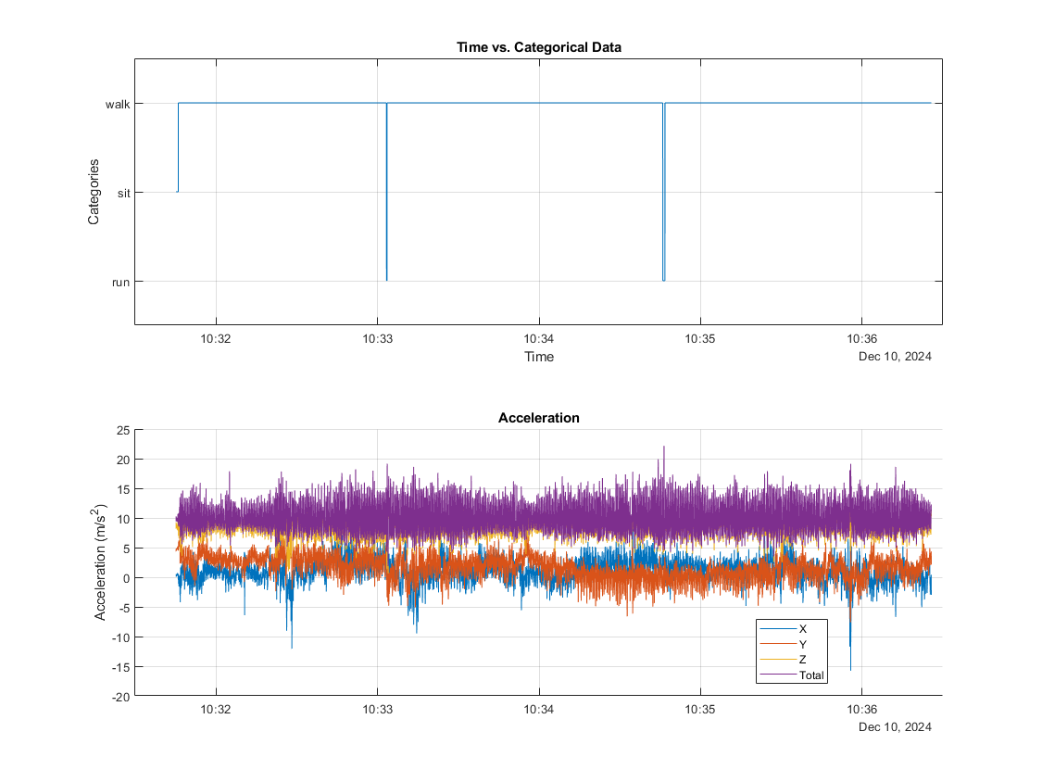
Results

Slide 11
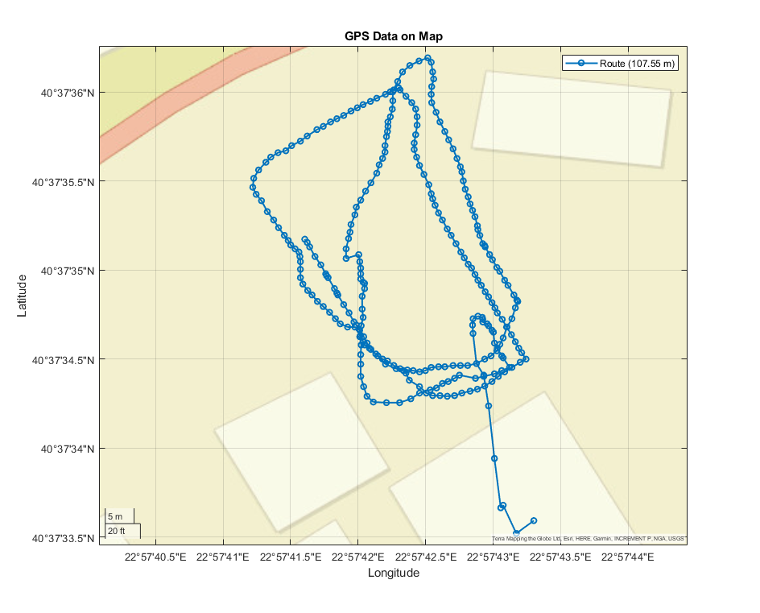
Extra Features
We utilized the GPS data for calculating the distance travelled by the user.
In order to transform latitude and longitude measurements to distance, the World Geodetic System 1984 was used.
In addition, we created a plot that visualizes the route of the user on a map.

