Slide 1
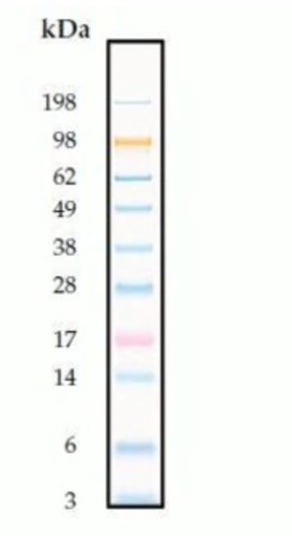
Vinculin
Myc-N
IDH1
PSA

