Slide 1
InterviewIQ
A Smart Interview Preparation Bot
By Anag Devnani & Alok Aeri

Slide 2
Technologies Used
Python
Streamlit
Gemini 3 Flash API
Streamlit Community Cloud

Slide 3
Project Structure
interview-bot/
├── app.py # Main app — all 5 steps
├── config.py # Constants + all prompt templates
├── requirements.txt
├── .streamlit/secrets.toml # API key (gitignored)
└── modules/
├── parser.py # PDF + DOCX parsing
├── gemini_client.py # Gemini API wrapper
├── session.py # Session state helpers
└── charts.py # Plotly dashboard charts

Slide 4
Key Features
Resume-aware dynamic question generation..
Variable Difficulty Settings: 3 Levels + AI Calibration.
Interviewer Persona Simulation (Friendly / Tough / Stress).
STAR method detector for behavioural questions.
Hint + Skip with score penalties.
Full radar chart + score / confidence dashboard.

Slide 5
STAR Method
The STAR method is a structured, four-part interviewing technique used to answer behavioral questions.
Situation
Task
Action
Result
It helps provide concise, evidence-based answers that highlight their skills, achievements, and impact.

Slide 6
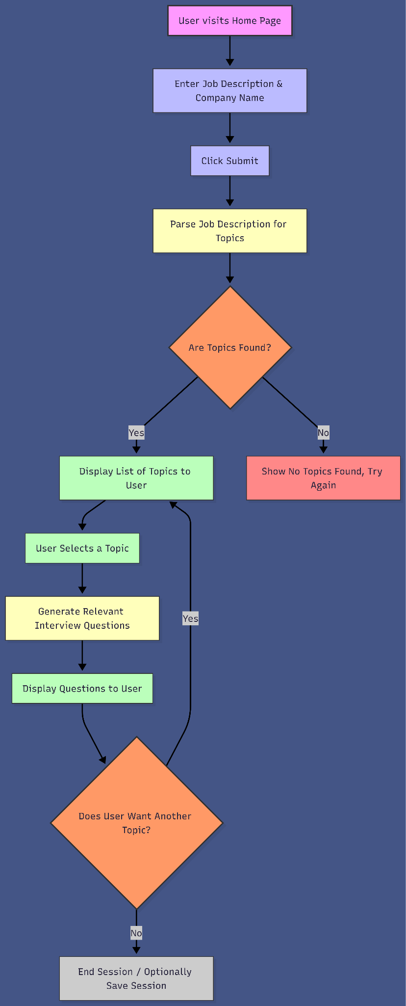
How it works:
User enters job description and company name.
On submit, the system parses text for relevant skills/topics.
If topics are found:
Displays them.
Lets the user pick a topic.
Generates interview questions for that topic.
User can continue exploring other topics or end the session.
If no topics are found, shows a friendly error and asks to retry.

Slide 7
Thank You

