Slide 1
Software Engineering Tools
JD Kilgallin
CPSC:480
09/07/22
GitHub docs
Finding the right tool is often half the battle –Andy Rooney

Slide 2
Notes
Missing a quiz due to communicable illness symptoms; updated policy
If you're not able to take the quiz that day at all, I need a doctor's note.
If you just don't want to get others sick, email me at least one hour before and plan to take the quiz at home, on-camera, via Microsoft Teams (or Panopto, tbd) at exactly 5:15.
BrightSpace submissions are open for project 1, GitHub username, and project 2 (first group project) teams. Include job descriptions and GitHub link + summary of contents in submission.
Project 1 – What can go in a portfolio?
No standard projects like CS II. If you're not sure about a project, email me.
Nothing obscene, discriminatory, or defamatory (read GitHub ToS).
Nothing that violates a patent or trademark.
If you have a robust portfolio, you can consider omitting your weakest work.

Slide 3
What if I don't have anything for a portfolio?
Option A – Make something! Practice a new language or framework and solve a small problem:
Something from LeetCode or other interview question database.
Small GUI or CLI game or utility (e.g. tic tac toe, wordle, calculator, dice roller)
Intermediate math problem (combinatorics, RSA key generator, calculus).
More examples forthcoming – stay tuned.
Option B – Find an open source project with an open issue and contribute a fix or enhancement. Fork the project and send a PR.
Option C – Identify three projects that you would like to have in your portfolio by the end of the year. Submit a detailed report on each stating exactly what the project would be, how you would build it, & what skills you need to gain/obstacles you need to overcome. A or B should be easier.

Slide 4
Learning Objectives
Types of tools involved in software engineering
Features of project management tools
Features of development tools
Features of testing tools
Features of tools for builds, releases, and version control
Using Git
Using GitHub
Using Markdown

Slide 5
Software engineering tools
Almost entirely consists of other software, including:
General-purpose software (e.g. web browser, Word, Adobe Acrobat)
Business software (e.g. Excel, SalesForce, learning management system)
Communication software (e.g. Outlook, Slack, Zoom)
Engineering/project software (e.g. Trello, Microsoft Visio)
Systems administration/operation software (e.g. VMWare, PuTTY, kubectl)
Developer software (e.g. Visual Studio, notepad++, gcc, git)
Domain-specific software (e.g. Postman/Fiddler for Internet systems)
Company software (most companies "dogfood" whatever they sell)
Hardware – desktop, laptop, multiple monitors, high-end keyboard
Whiteboard, smartphone, books, chair/desk, coffee/snacks

Slide 6
Project management tools
Track the work curently in progress, completed, and still to be started.
Hierarchical structure of projects, features, items, and tasks.
Title, description, priorities, history, product/area, target product versions/dates, time estimate, supporting files, comments.
Current status, personnel assignment, and definition of done.
Bug reports, root cause analysis, severity and impact notes, criteria for fix.
Links to parent/child items, progress-blocked-by, duplicates, related items.
May incorporate source code, code reviews, test cases, and relationship between code checkins/authors, tests/signoff, bugs, original work items.
Common tools include Trello, Azure DevOps, JIRA, Bugzilla.

Slide 7
Integrated Development Environment (IDE)
Editor – syntax highlighting, error detection, auto-complete, navigation.
Solution Explorer – View and manage project components & relationships.
Package manager – Find/add/update needed libraries, other dependencies.
Compiler – Build the project locally for target architecture & framework.
Debugger – Execute the built project with ability to pause, examine state.
Source control – Pull and push changes from central location/other devs.
Plugins, automation, GUI designers, endless bells and whistles.
Examples: Android Studio, Atom, BlueJ, Eclipse, Idle, IntelliJ, Light Table, NetBeans, Visual Studio, Visual Studio Code, Xamarin, XCode.

Slide 8
Command-line development
A shell is an interface to a system. As with other software, can either use a Command-Line Interface (CLI) or Graphical User Interface (GUI). Major CLI shells are PowerShell on Windows and GNU Bash cross-platform.
Command-line systems have a higher learning curve, but are very expressive, easy to use remotely (even over slow connections), easy to compose and integrate, and amenable to scripting automated processes.
Lack of mouseclicks/moving hands can greatly speed activity, especially in combination with expressive tools and automated scripts.
Free and Open-Source Software toolchains frequently emphasize CLI use.
Popular command-line code editors include vim, emacs, and "alternatives".

Slide 9
Virtualization
A system optimized for software development is different than a system optimized for general business use.
May require different operating system or other system software.
Developer needs administrator privileges, maybe even domain admin.
May need to perform unsafe operations that could risk equipment and data.
May need network communications that corporate IT would typically restrict.
May need to restart frequently or revert to older system snapshots.
Hard use may lead to system instability and an eventual need to start over.
May need multiple systems for different components or test scenarios.
May need to preserve environment across multiple devices.
Solution is to run a computer within a computer – a virtual machine
Host system runs business applications, plus e.g. VMWare or Hyper-V
VM can be run in a sandbox and moved to a different host system.

Slide 10
Accessing foreign systems
Dev tools and software being developed can't always be run locally.
Secure Shell Protocol (SSH) allows access to CLI shell on remote system
Remote Desktop Protocol (RDP) allows GUI shell on remote system.
File Transfer Protocol (FTP) allows up/download on arbitrary systems
May even want an entire local copy of a remote machine, but VM files are large and potentially difficult to deploy/configure, and may violate software licenses.
Containerized applications and infrastructure-as-code allow this – container uses host OS kernel & includes minimal necessary software

Slide 11
Information tools for development
Don't reinvent the wheel
Every major language has an extensive set of libraries to accomplish any kind of common task.
Package managers make installation easy, e.g. npm, pip, NuGet, Maven, Go.
Good libraries will have documentation and usage samples.
Stackoverflow has solution patterns for most common problems, including usage of library code.
Build a suite of utilities you find yourself reusing (e.g. wrapping web calls).
Understand your application
Get familiar with debugging all parts of your software and how to examine program state and control flow.
Logging is an art, and you are the primary patron.
A profiler is like a debugger, but focused on analyzing where the program spends most of its CPU/memory/disk IO/network resources.

Slide 12
Testing tools
Unit tests (should) cover individual code paths of a single method.
Integration tests cover interactions between methods/components.
End-to-end tests cover all steps of realistic user activities.
Mock components are used to simulate functionality of components not under test (e.g. returning data from a database or web service).
Developers usually write unit tests with code, QA Engineers do the rest.
Test software may be part of IDE, version control, standalone (e.g. Selenium), developed in-house for specific needs, or a combination.
Selected tests may run automatically each checkin, full set daily w/report.
Some tools test GUI components by emulating mouse motion/clicks.
Some tools allow static analysis (search for common bugs or vulnerabilities like SQL injection). May use external assessment firm specializing in this.

Slide 13
Software Configuration Management (SCM)
Actually pre-dates software! Programs using wired plugboards (e.g. ENIAC) need record of cable configuration and a log of changes to it.
SCM systems primarily track revisions to source code. "Version control", "source control", and "repository" may be interchanged, but technically those only refer to one component of SCM.
SCM is the primary means of collaboration between coders.
Modern SCM incorporates code reviews, automated builds, test execution, checkin signoff procedures, defect tracking, etc.
SCM systems track released versions, so that prior releases are accessible, and critical patches can be applied to very old versions.

Slide 14
Version Control/SCM
First tool Source Code Control System (SCCS) 1972 for UNIX.
Revision Control System (RCS) 1982 from Purdue, now part of GNU.
Concurrent Versions System (CVS) 1986 on top of RCS. Still in use.
Subversion (SVN) developed to address unfixable issues with CVS.
Perforce used in large-scale projects, incl Microsoft, Google, SAP.
Git developed for Linux; distributed, scalable, non-linear development
GitHub is a popular online host for Git repositories & related content.
DockerHub is a registry of versioned containers for DevOps and Go.
Some tools like Azure DevOps offer both SCM & project management.

Slide 15
Git – repositories
SCM system built to record changes to files. Allows users to merge simultaneous changes, revert changes, recover old versions, see who changed something and when, compare files at different times, etc.
A repository is a directory/folder representing a project and tracks changes to files and subdirectories. Always has a ".git" directory.
A repository can exist solely on one machine, or it can be shared, in which case multiple copies can be cloned from the origin copy.
While git can be used without a central repository, typically each developer working on a single project will clone a copy from a central source hosted and managed by the company or product owner.
Git is very complex and we will cover only a subset of features, commands, and options needed to support core use cases.

Slide 16
Git – commits
A working tree is a local copy of a git repository where changes are made. Changed files are staged for a tracked update, and staged files are committed, creating a new local snapshot of the repository.
New snapshots are pushed to origin, and others' changes are pulled. Any remote changes must be pulled/merged before yours can be pushed.
Git stores each commit with a snapshot of changed files, metadata like author and message/title, and pointer to parent commit(s).
A commit is identified by a hash of the snapshot. You can always checkout a commit to restore the local copy to a previous state.
A tag can be created that serves as a static pointer to a specific commit. The main use is to tag a release with the version number.

Slide 17
Git – branches
A branch is a pointer to a commit that moves with new commits. "master" or "main" is the default branch.
HEAD is a local pointer to the commit you're currently working from and moves when you switch branches.
Branches, like repositories, can be local-only or shared.
Branches are created to develop specific features, releases, bug fixes, experiments, personal notes, or other reasons.
Branches or clones can be merged, creating a new commit. Conflicting changes must be resolved. Many tools can (partially) automate this.

Slide 18
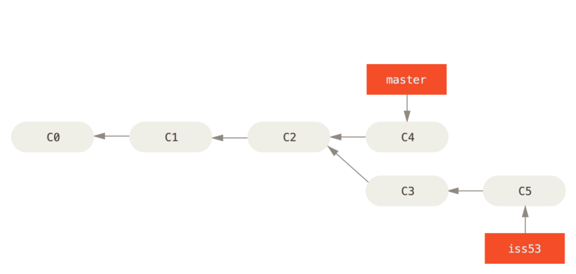

Slide 19
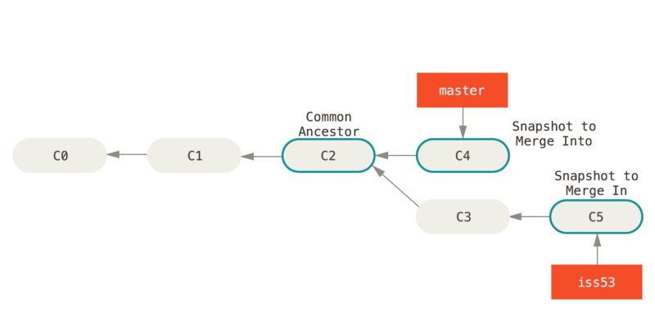

Slide 20
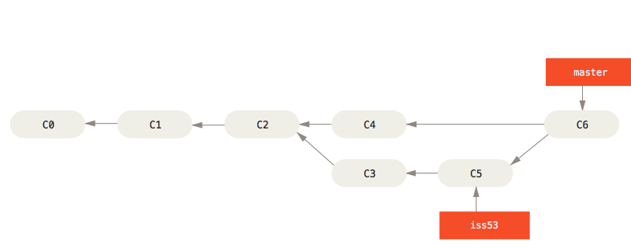

Slide 21
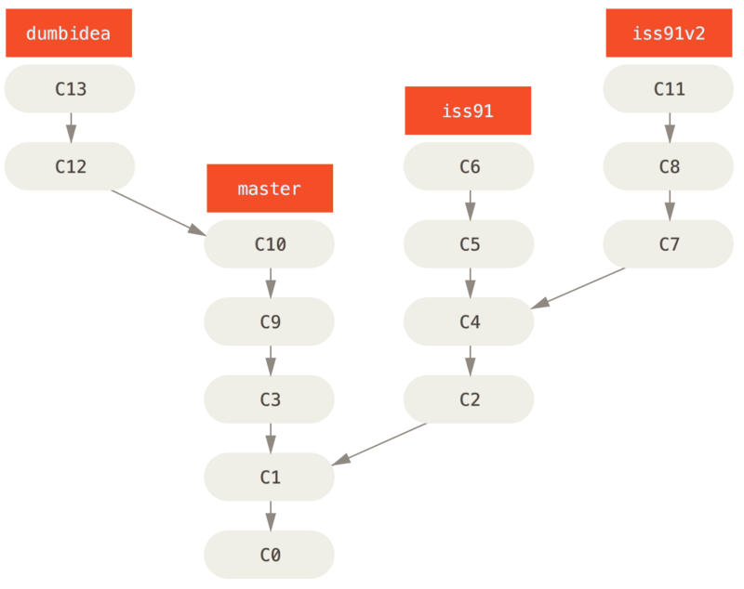

Slide 22
Git – forks and pull requests
A fork is a new repository with a reference to the original repository. This is different from a branch in that ownership and permissions are managed by the person forking, and not the original repo owner.
A pull request is a request to merge changes from a branch or a fork into another, usually the original main branch. These must be approved by someone authorized to modify the destination repo.
Most OSS limits who can push, or approve pull requests, so changes are made by forking, then issuing a pull request with desired changes.
Even within a single repo, common practice is for development to happen in a separate branch, and code reviews are done via pull request to main.

Slide 23
Git – basic usage
Git is usually used from the command line (mainly Linux/bash), but GUIs exist. Commands must be run from within a repository directory.
git init – create a new local repo from current directory
git clone <URL> – create local copy of repository accessible at URL.
git status – Show tracked-vs-untracked & modified-vs-unmodified files
git add * – Stage all untracked files for commit
git commit -a -m "Commit message here" – Create local snapshot with newly-tracked files & modified/deleted files previously tracked.
git pull – Download new commits that were pushed to central host.
git push – Upload local commit(s) to central repository host
git log – See commit history

Slide 24
Git – more usage
git branch foo – Create new branch named foo.
git branch – Show existing branches and the active branch.
git checkout foo – Switch HEAD and local directory contents to last commit in foo branch. git checkout main to switch to main branch.
git checkout – Revert local repo to last commit in current branch.
git diff – Compare files between two commits, tags, branches, or current state. Many different options.
git merge foo – Merge commits in foo branch into active branch.
git mv oldFilename newFilename – Rename file and preserve tracking.
git <command> --help – Show usage of command. See References slide for more guides from GitHub, Atlassian, & official Pro Git book.

Slide 25
GitHub
Model is one account per user, multiple repositories per account.
Free public and private repos. Anyone can clone or fork public repos, but owner limits who can push changes, issue pull requests, do other tasks.
Repos (and accounts) can also be associated with an organization. Organizations can centrally manage accounts, groups, permissions, etc
GitHub allows for online documentation in Markdown & even online edits.
A release can be issued from a particular commit in a repository to make a versioned binary package.
GitHub Actions allow automation to occur for checkin, release, etc.
GitHub Issues allows for some project management and defect tracking.

Slide 26
Markdown
Lightweight, easy-to-use markup language for text formatting.
More concise and easy to write than alternatives like HTML
Variants supported in Reddit, Teams, Discord, wikis, Stackoverflow
Not well standardized, but basic features common in most places.
May hijack attempts to write plain text (e.g. underscores, line breaks)
Many tools let you see a preview or auto-replace with formatted text.
Supports font and paragraph formatting; structures like lists, bullets, and tables; graphical content like diagrams, images, equations, and emoji; links and references; etc.

Slide 27
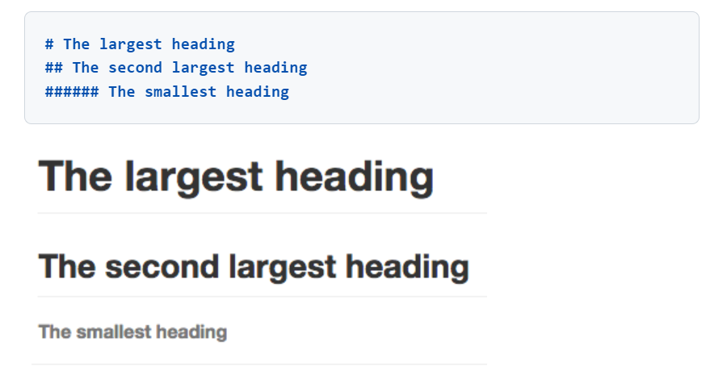

Slide 28
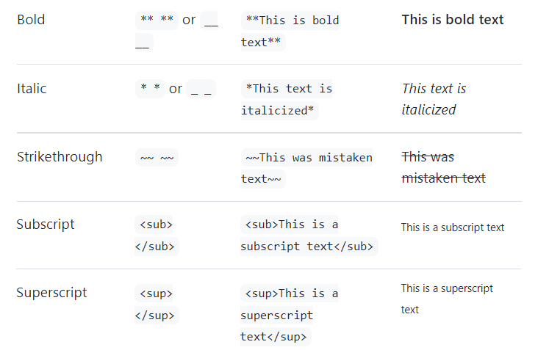

Slide 29
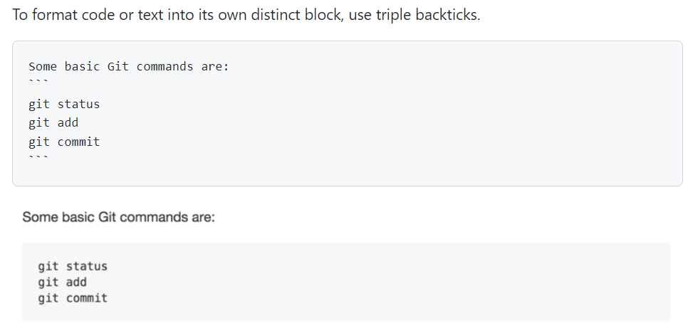

Slide 30
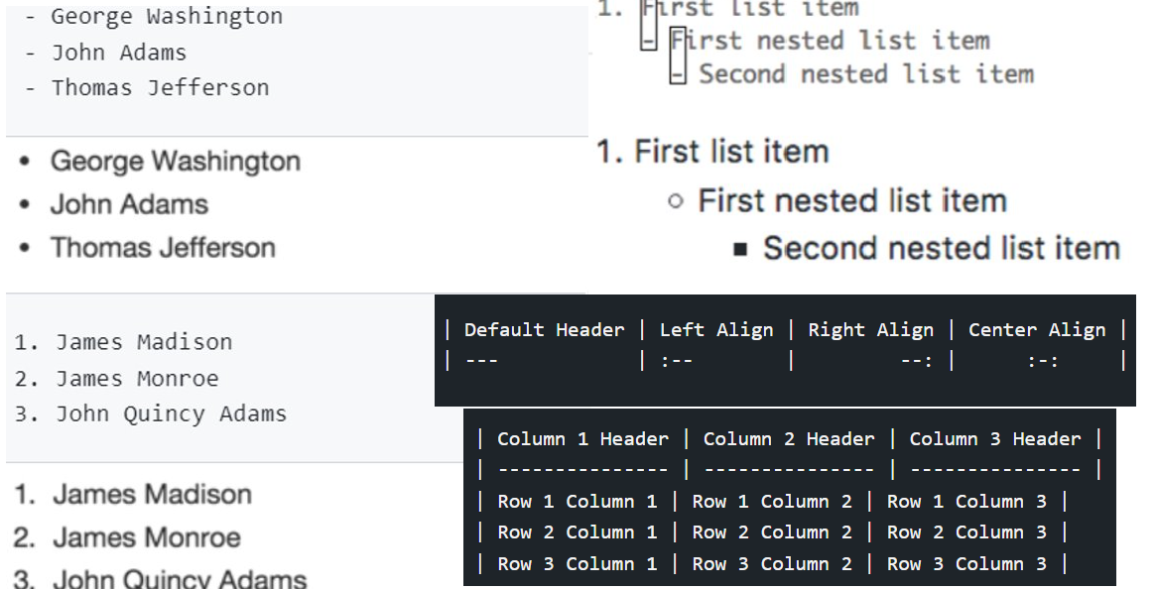

Slide 31
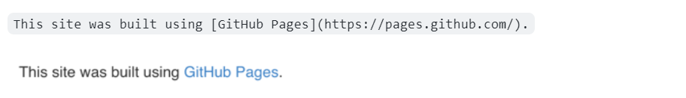
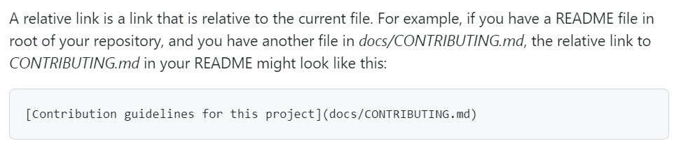
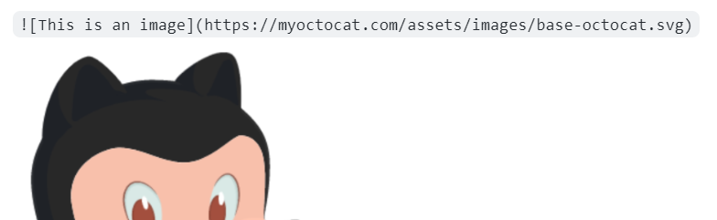

Slide 32
Markdown – not shown
Paragraph and line break formatting
Automated table of contents
Quotation blocks
Relative links
Color
@Mentions
Emoji
Escape sequences
Diagrams
LaTeX (typesetting equations)
Footnotes
More!

Slide 33
Git/GitHub "Hello World"
Create a repo in GitHub.
Clone a local copy
Make a change (Add README in markdown)
Commit the change
Push the change to GitHub
View the change in GitHub

Slide 34
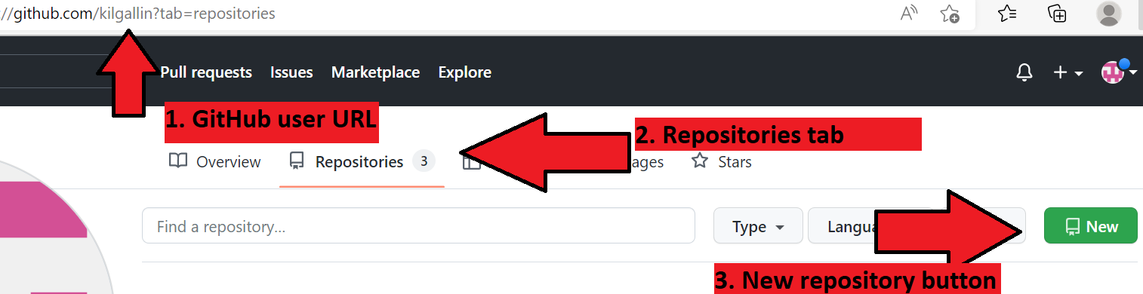
Access GitHub.com in a browser (There will be a "New" shortcut here)
Click user icon and go to "Your profile". You can also use direct URL (1)
Go to "Repositories" (2) & click "New" (3), or use homepage shortcut.
Enter a repository name and description and click "Create repository"
Copy URL, paste into "git clone" command, & change to new directory
Run git commands to commit and push markdown in README.md.
Follow directions on "git push" to enter name, email, GitHub creds.
Navigate to repository in browser or paste URL again.

Slide 35
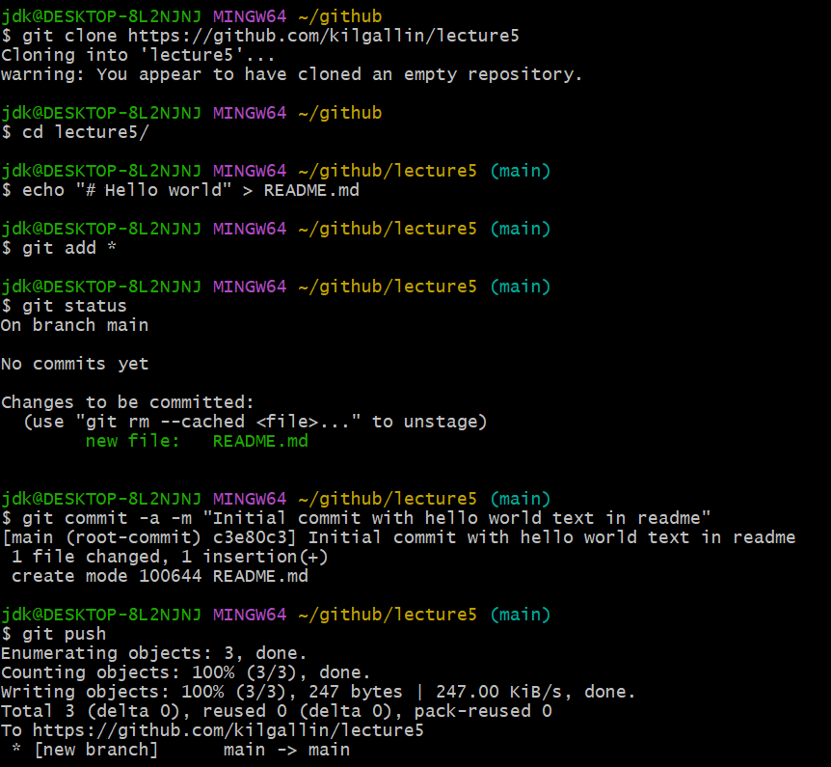

Slide 36
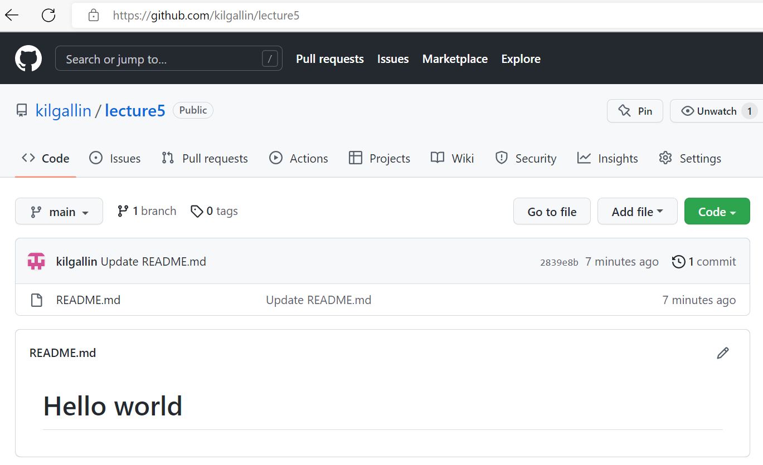

Slide 37
References
GitHub ToS
History of software configuration management - Wikipedia
Download Git
The Linux command line for beginners
Setting up a repository | Atlassian Git Tutorial
Saving changes | Atlassian Git Tutorial
Set up Git - GitHub Docs
Hello World - GitHub Docs
Basic writing and formatting syntax - GitHub Docs
Official book: Pro Git, 2nd edition. Scott Chacon & Ben Straub. 2014. Apress.
Bring a laptop to next lecture with Git installed, & create GitHub account.

