Slide 1

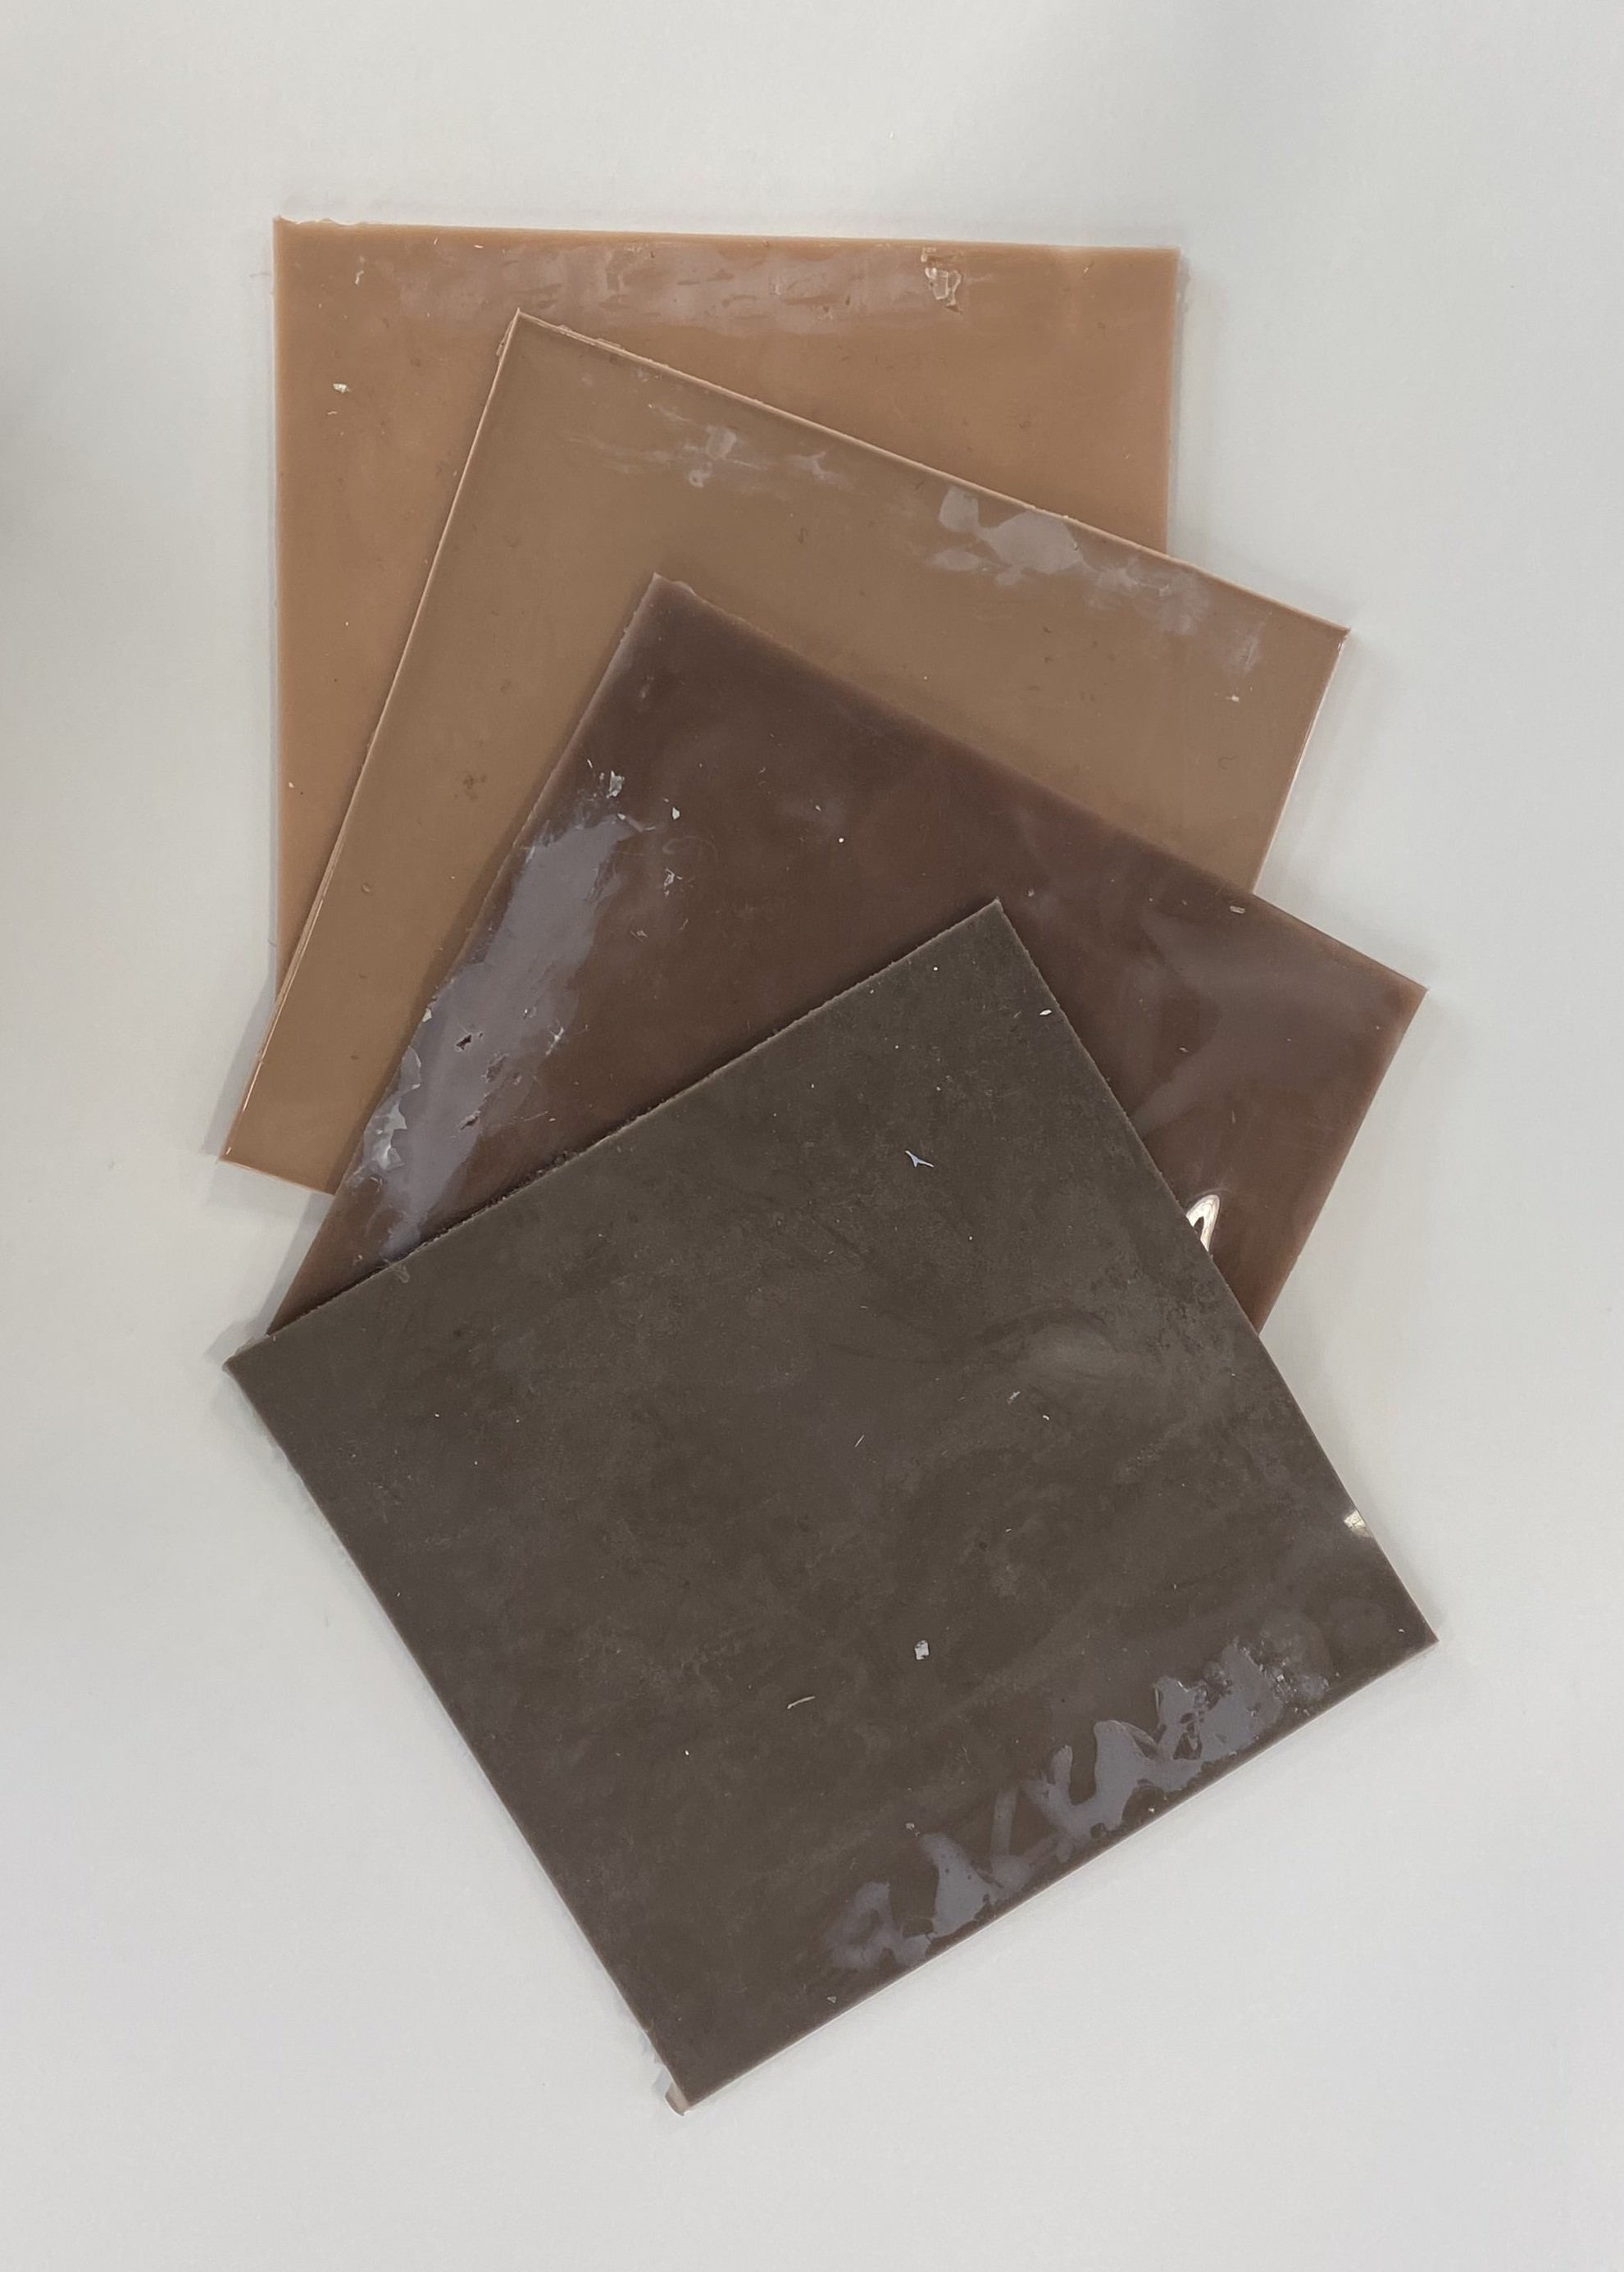
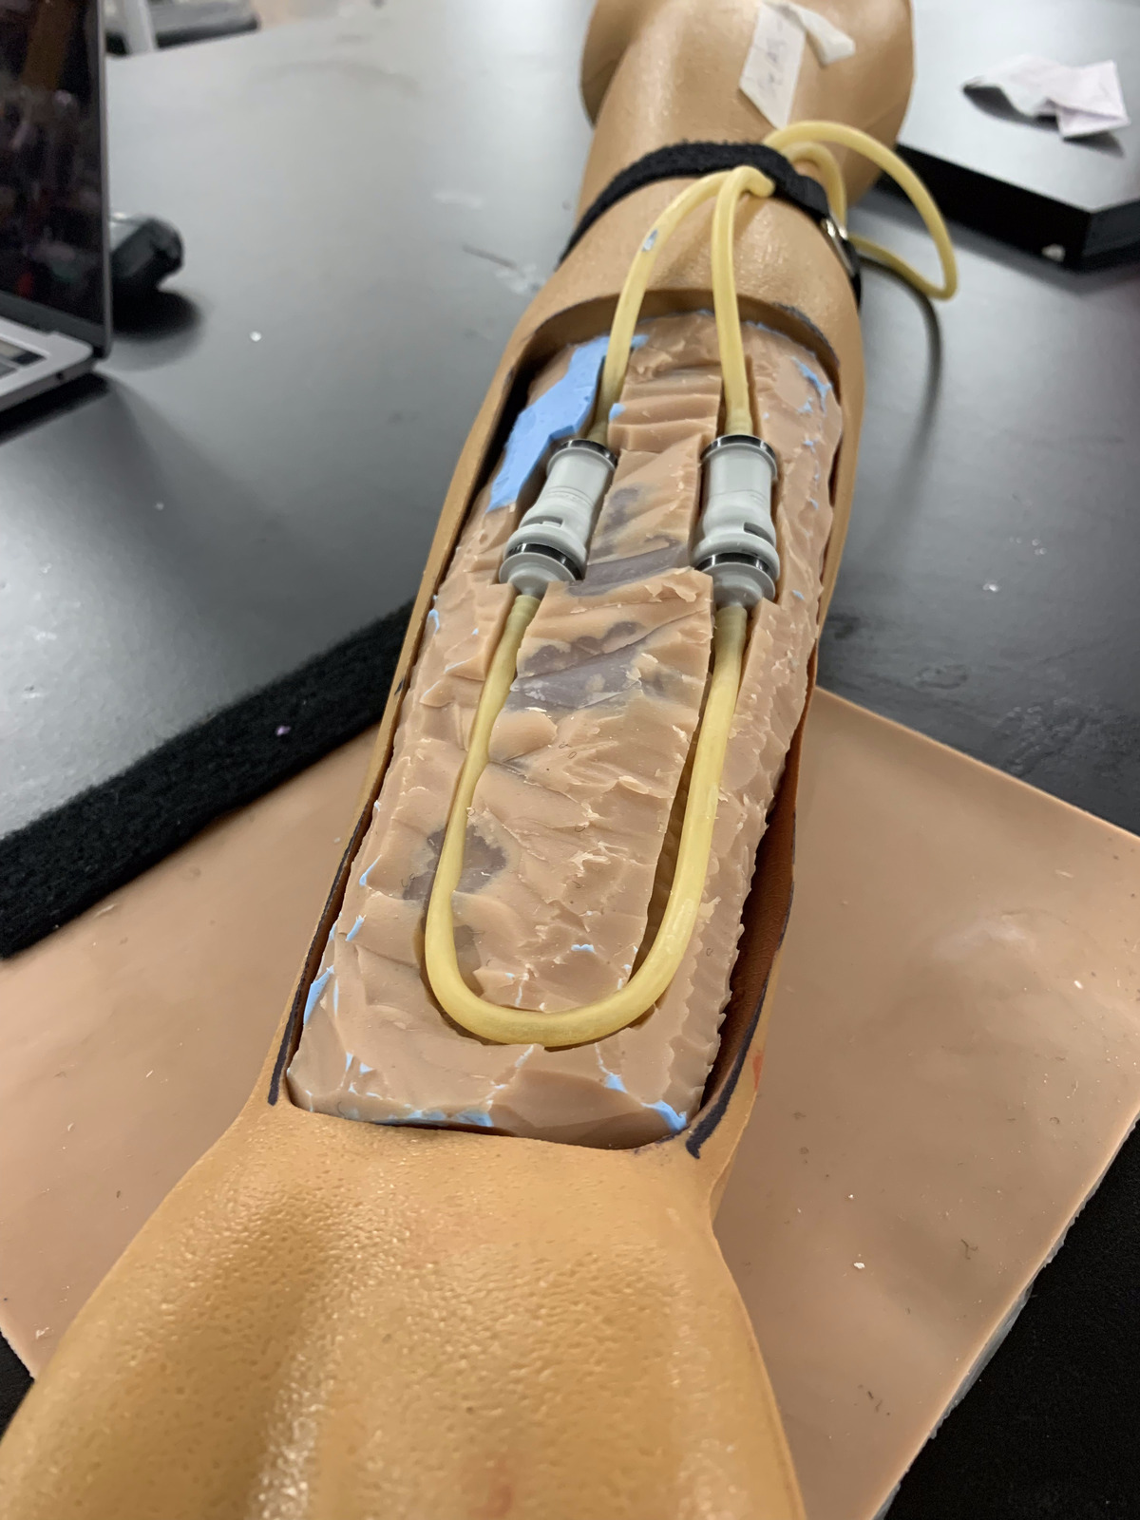
CT and PET Scan Simulator, with Phantom Generation From Images of Sliced Brain Nicholas Trigger, James Bradley BME 303: Modern Diagnostic & Imaging Systems
Design Problem Statement
Final Design Solution
Medical students need an effective, reusable manikin to practice pulsatile arterial line insertion.
Arterial line insertion involves puncturing a catheter into the radial artery to monitor the blood pressure of inpatients. Our client was looking for a cheaper, better way to practice arterial line punctures.
Existing ALPT devices have two critical issues which make them poor training devices:
Final ALPT Prototype
Fig 3 (left) components:
A – Artificial arm with cutout from SimLab
B – Dragon Skin wrap
C – Medical tubing
D – Pump, electronics, and reservoir
Fig. 4 – Dragon Skin silicon wraps in different skin tones
Fig. 5 – Inside of final arm
Key Learnings
Planning is key; delegate work, so multiple people can work on different tasks concurrently.
Super glue is not an adhesive to silicone.
Creating and coding a circuit can be very difficult – this task can be made easier through careful planning.
Use mold release spray to ensure proper separation of mold and cast.
Conclusion and Future Plans
Design Criteria and Testing
We were able to create a replaceable insert cover made of Dragon Skin silicon which adhered to our design criteria.
Our pump can vary the pulse and blood pressure to simulate a realistic pulse.
Our product can be easily set up and used by an individual.
In the future, we would like to wirelessly control the device.
We are currently and will continue to test our design with professionals
References
Will Inigo, Teaching Assistant
Dr. Ben Cooke, Professor
Dr. Michael Rizk, Professor
Chris Bingham, Technical Mentor
Carlos Falcon, Client
Katie Spencer, Writing Consultant

