Slide 1
What makes a book bestseller

Slide 2
Contents
Identify most popular categories!
04
06
What is the price strategy of the bestsellers?
Which month is the most popular regarding the release date

Slide 3
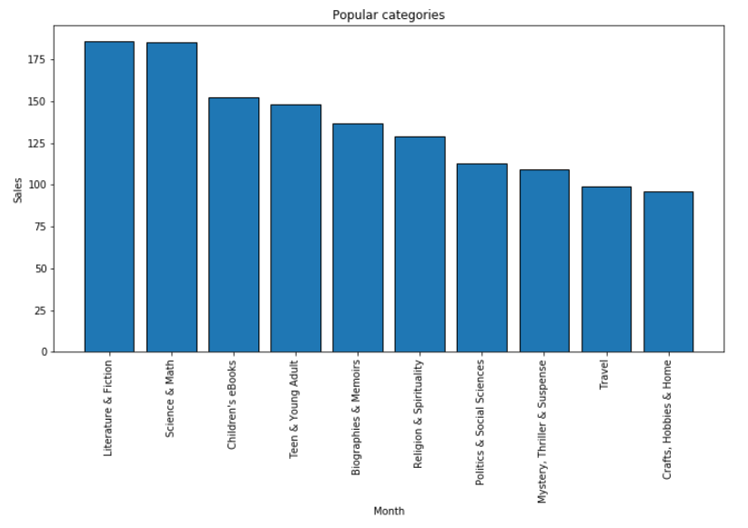
The categories of the bestsellers
You can enter a subtitle here if you need it

Slide 4
Best sellers
Top 5 categories
1. Literature & Fiction 2. Science & Math
3. Children's eBooks
4. Teen & Young Adult
5. Biographies & Memoirs

Slide 5
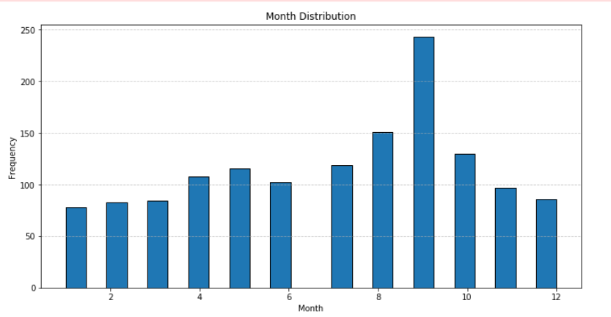
Which month is it most likely for someone to buy a book?
There is a high probability that a best seller will be released in August, September, October

Slide 6
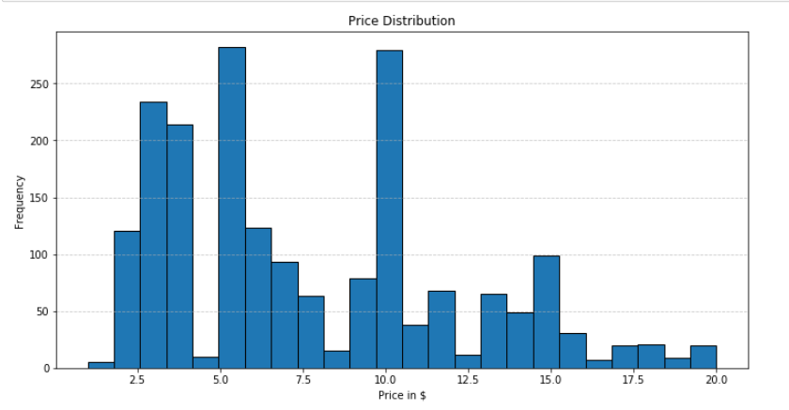
Price distribution
Books found in the Best Sellers lists are most frequently priced between 3 and 10 dollars

Slide 7
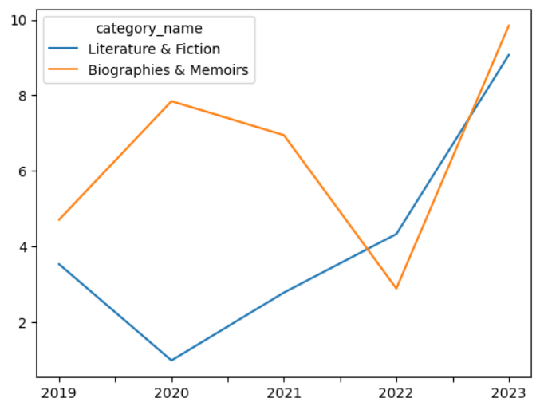
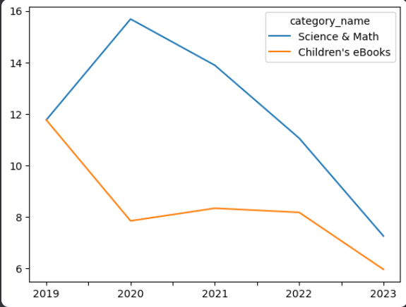
What is the trend of the popular categories during the last 5 years
Science & Math" and "Children's eBooks" categories seem to follow a declining trend
Literature & Fiction" and "Biographies & Memoirs" categories seem to follow an upward trend

Slide 8
Recommendations
The best release window for a book to make the best sellers list is between August and October
The safest categories are:
Literature & Fiction
Biographies & Memoirs
The price range should be between 4 $ and 10 $

Slide 9
Thank you
Nikolaos Tsakalas
Athanasios Alexandrakis

