Slide 1
Please help!
COMP1927 - Assignment 2, Part B
Fury of Dracula - The Hunt
Team Members:
Danilo Scodellaro
Ambrose Hill
Nick Leung
Christine Zheng
OpenLearning Group:
DanAmbroseNick Christine
Lab Group:
Wednesday 18 Drum, with Sarah

Slide 2
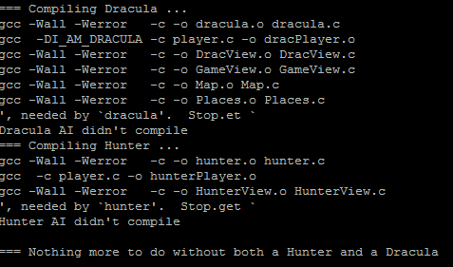
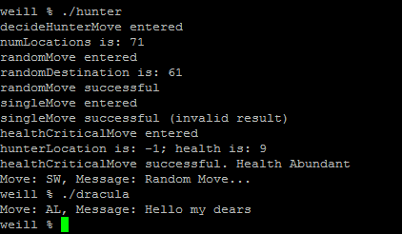
What’s the problem?
Our AI is currently not compiling for dryrun or the competition (give)
It is however compiling locally
And the programs seems to work as desired
The error message is less than helpful
And yet the run normally from where we can see
Various Debug information printed by hunter.c

Slide 3
How did it start?
Dracula.c shouldn’t be the issue. It ran fine originally
Hunter.c ran fine until we incorporated code from Queue.c.
Hunter.c calls the shortestPath() function, from the Map ADT in lab9. This modified Map.c (and Map.h) in turn utilise Queue.c (and Queue.h), as well as Item.h
All of these files have been modified to work with the assignment (well, we think so anyway)
We’ve tinkered a lot to try and get things to work but no success thus far

Slide 4
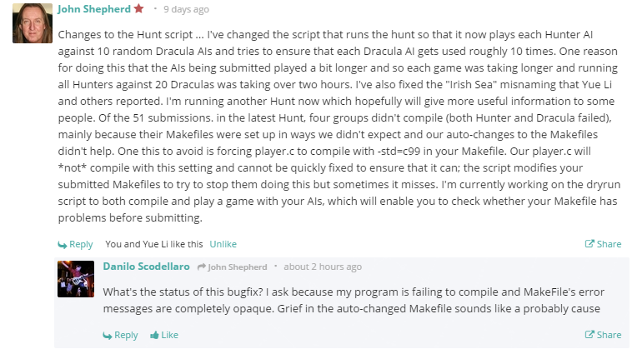
OpenLearning Communication
A possible explanation?

Slide 5
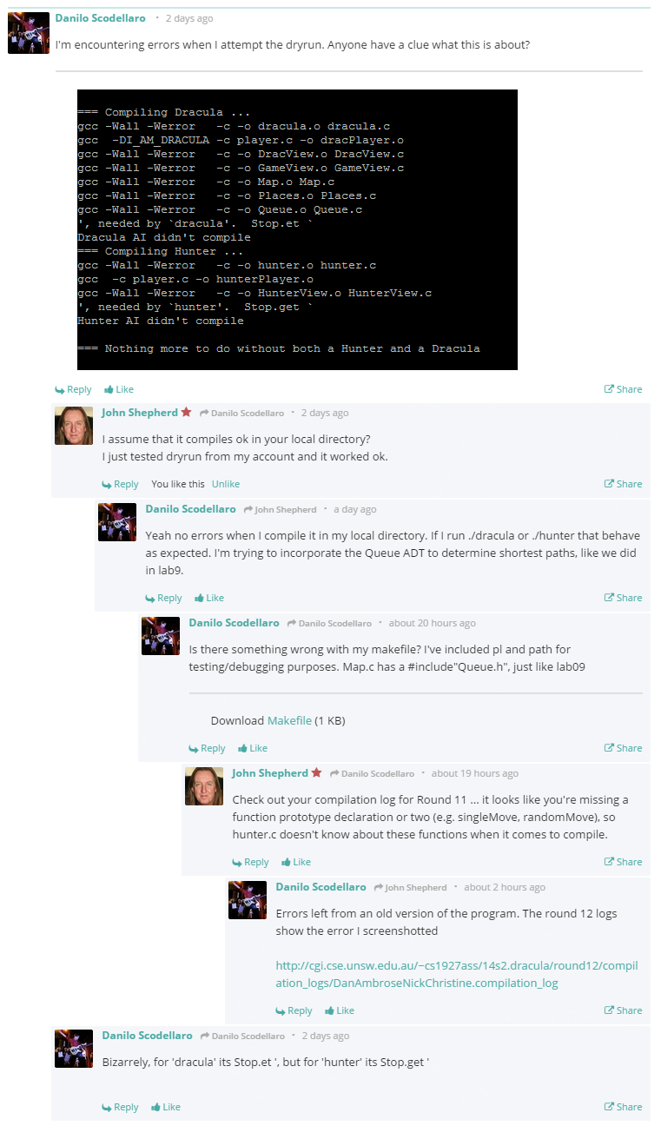
First call for help

Slide 6
Links
Compilation log showing Makefile issue (same as shown on dryrun)
http://cgi.cse.unsw.edu.au/~cs1927ass/14s2.dracula/round12/compilation_logs/DanAmbroseNickChristine.compilation_log
All files in directory:
https://www.cubbyusercontent.com/pl/main/_da9a51bde6184ea3bc587fd69e379c26
I can provide access to the GitHub repo if you give me your username (it’s a private repo)
Command used to compile
“~cs1927/bin/dryrun ass2b Makefile *.c *.h”
Command used to submit
“give cs1927 ass2b Makefile *.c *.h”
Commands used to test hunter and Dracula locally
“./dracula”
“./hunter”

