Slide 1
Harness Installation Instructions
Version 2
October 30, 2016

Slide 2
Version Log
Version | Date | Description
1.0 | 10/2/2016 | Initial version
2.0 | 10/30/2016 | Fixed order of thermocouple hookup on Arduino Mega Shield page Swapped order of RTD board cable 1 & 2 on Arduino Mega Shield page

Slide 3
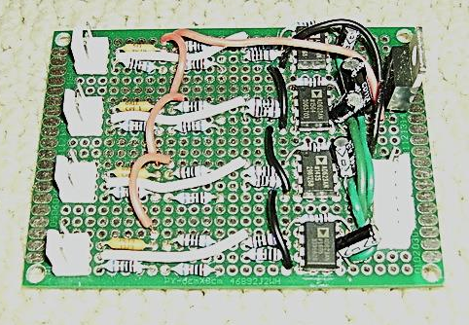
RTD Boards
Top of cabinet
HLT BP: 3 wire RTD
HLT OP: 3 wire RTD
MLT BP: 3 wire RTD
Top RTD
Board Cable 1
MLT OP: 3 wire RTD
Top Board
BK BP: 3 wire RTD
BK OP: 3 wire RTD
SPARE: 3 wire RTD
Bottom RTD
Board Cable 2
SPARE: 3 wire RTD
Bottom Board
Bottom of cabinet

Slide 4
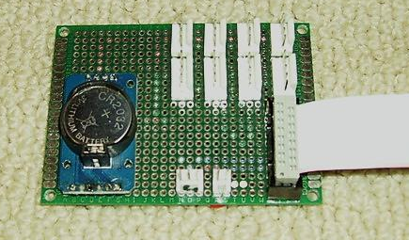
Front Panel Connection Board
Main
#1
HLT
#2
HLT
#2
HLT
#2
Side closest to
cabinet hinge
Displays (4 pin)
Encoders (5 pin)
Ribbon cable to
Arduino Mega Shield
Red stripe
Pump
Monitor
5V from
Front Panel

Slide 5
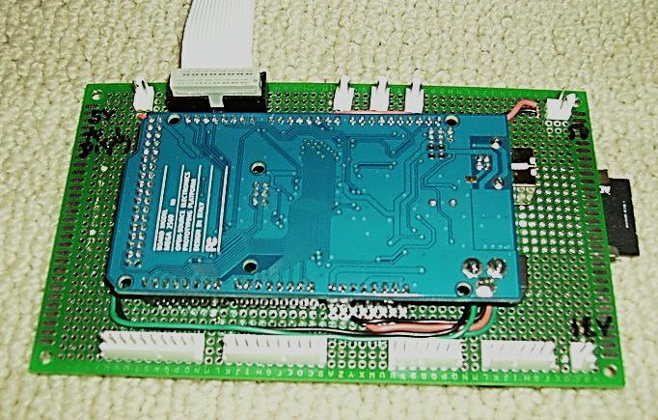
Arduino Mega Shield
5V to
Front Panel
Ribbon cable to
Arduino Mega Shield
Red
stripe
BK
TC
MLT
TC
HLT
TC
5V from Step Down
Voltage Converter
Black Wire
Top Relay
Board Cable 1
Bottom Relay
Board Cable 2
Bottom RTD
Board Cable 2
Top RTD
Board Cable 1
12V from Linear
Power Supply

Slide 6
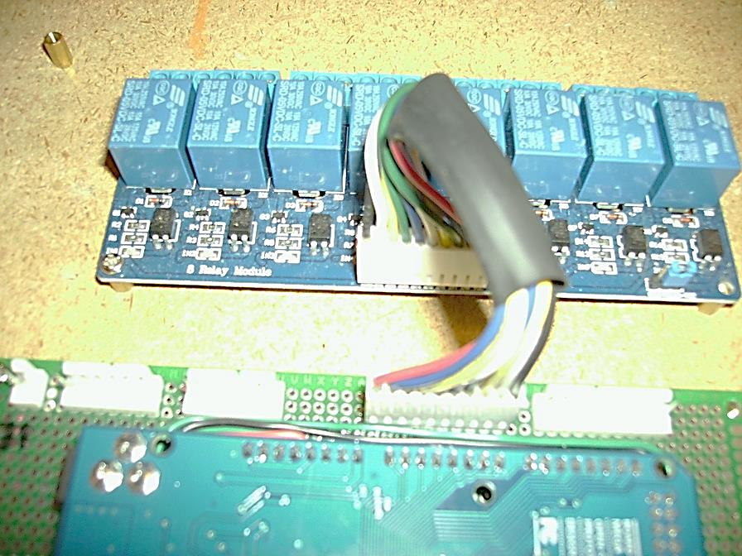
Arduino Shield/Relay Board
Black Wire
WARNING:
Relay Board
Connection
is Not Keyed
Black Wire

Slide 7
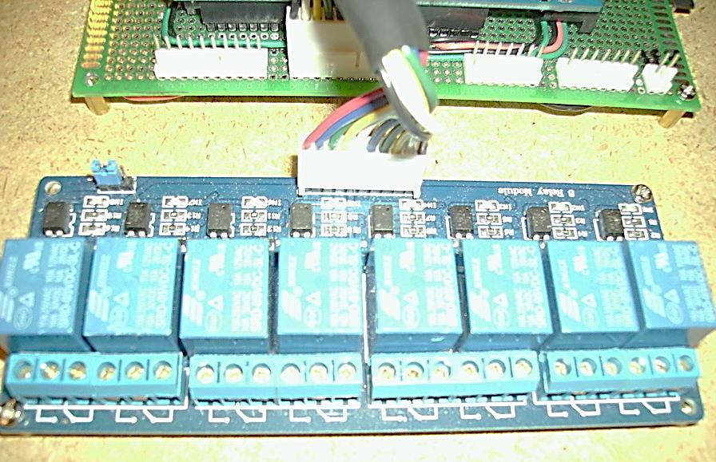
Arduino Shield/Relay Board
Black Wire
Black Wire
WARNING:
Relay Board
Connection
is Not Keyed

