Slide 1
Devops UNIT-III

Slide 2
USING ANSIBLE TO MANAGE PASSWORDS, USERS, AND GROUPS
Users and passwords are the building blocks of identity management
Groups allow you to manage a collection of users and control access to files, directories, and commands.

Slide 3
Enforcing Complex Passwords
users decide what a strong password
enforce complex passwords on every host that users can access.
use code to enforce strong passwords for all users to achieve automation
To do this, use an Ansible task to install a plug-in for Pluggable Authentication Modules (PAM), which is a user authentication framework that most Linux distributions employ
The plug-in to provide complex passwords is called pam_pwquality. This module validates passwords based on criteria you set.

Slide 4
Installing libpam-pwquality
The pwquality PAM module is available in the Ubuntu software repository under the name libpam-pwquality
use the Ansible tasks to install and configure this package
the goal is to automate everything and tasks provide the mechanism to carry out administrative work.
These tasks are located in the repository Navigate to the ansible/ directory and open the pam_pwquality.yml file in the editor
This file contains two tasks:
Install libpam-pwquality and Configure pam_pwquality
first task uses the Ansible package module to install libpam-pwquality on the VM

Slide 5
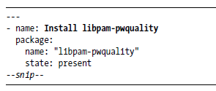
.

Slide 6
Each Ansible task should start with a name declaration that defines its goal.
In this case, the name is Install libpam-pwquality.
Next, the Ansible package module performs the software installation.
The package module requires to set two parameters: name and state
package name (found in the Ubuntu repository) should be libpam-pwquality, and the state should be present.
To remove a package, set the state to absent.
This is a good example of declarative instruction, since you are telling Ansible to make sure this package is installed

Slide 7
Ansible modules perform common actions on an OS, such as enabling a firewall, managing users, or installing software.
Ansible allows your actions to be idempotent, which means you can do a specific action over and over again and the result will be the same as it was the last time you executed the action.
Because of this, you should automate all you can! You’ll save time and avoid mistakes caused by manual fatigue.
Imagine if you had to configure 1,000 machines a day. It would be almost impossible without automation!

Slide 8
Configuring pam_pwquality to Enforce a Stricter Password Policy
On a default Ubuntu system, It requires a minimum password length of six characters and executes only some basic complexity checks.
To enforce more complexity, need to configure pam_pwquality to set a stricter password policy
A file named /etc/pam.d/common-password handles configuration of the pam_pwquality module.
This file is where the Ansible task makes the necessary changes to validate passwords.
All you need to do is change one line in that file.
A common way to edit a line using Ansible is with the lineinfile module, which allows you to change a line in a file or check whether a line exists

Slide 9
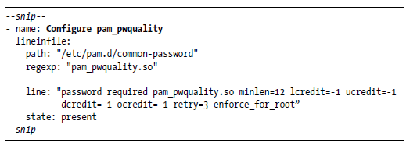
Ansible

Slide 10
the task starts with a name, Configure pam_pwquality, that describes its intent.
Then it tells Ansible to use the lineinfile module to edit the PAM password file. The lineinfile module requires the path of the file to which you want to make changes.
In this case, it is the PAM password file /etc/pam.d/common-password. Use a regular expression, or regexp, to find the line in the file you want to change.
The regular expression locates the line that has pam_pwquality.so in it and replaces it with a new line. The replacement line parameter contains the pwquality configuration changes, which enforce more complexity.
The options provided above enforce the following:
• A minimum password length of 12 characters
• One lowercase letter
• One uppercase letter

Slide 11
Key Ansible Concepts
• One numeric character
• One nonalphanumeric character
• Three retries
• Disable root override
Adding these requirements will strengthen Ubuntu’s default password policy.
Any new passwords will need to meet or exceed these requirements, which will make brute-forcing user passwords a bit harder for attackers.

Slide 12
Linux User Types
Linux, users come in three types: normal, system, and root.
a normal user as a human account
Every normal user is typically associated with a password, a group, and a username.
a system user as a nonhuman account, such as the user Nginx runs as.
a system user is almost identical to a normal user, but it is located in a different user ID (UID) range for compartmental reasons.
A root user (or superuser) account has unrestricted access to the operating system. You can tell the root user by its UID, which is always zero.

Slide 13
Getting Started with the Ansible User Module
Ansible comes with the user module, which makes managing users very easy.
It handles all the messy details for accounts, like shells, keys, groups, and home directories. You’ll use the user module to create a new user
Open the user_and_group.yml file located in the ansible/ directory.
This file contains the following five tasks:
1. Ensure group developers exists.
2. Create the user bender.
3. Assign bender to the developers group.
4. Create a directory named engineering.
5. Create a file in the engineering directory.

Slide 14
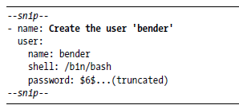
These tasks will create a group and a user, assign a user to a group, and create a shared directory and file.
The user module has many options, but only the name parameter is required. In this example, the name is set to bender.
Setting a user’s password at provision time can be useful, so set the optional password parameter field to a known password hash
The password value, beginning with $6, is a cryptic hash that Linux supports.

Slide 15
Generating a Complex Password
many different methods to generate a password to match the complexity you set in pam_pwquality.
password hash that matches this threshold to save timea
combination of two command line applications, pwgen and mkpasswd, to create the complex password.
The pwgen command can generate secure passwords,
the mkpasswd command can generate passwords using different hashing
algorithms.
The pwgen application is provided by the pwgen package,
the mkpasswd application is provided by a package named whois.
Together, these tools can generate the hash that Ansible and Linux expect.

Slide 16

Linux stores password hashes in a file called shadow.
On an Ubuntu system, the password hashing algorithm is SHA-512 by default.
To create your own SHA-512 hash for Ansible’s user module, use the commands below on an Ubuntu host:

Slide 17
Since these packages are not installed by default, you’ll need to install them first with the APT package manager.
The pwgen command generates a complex password that matches what you need to satisfy pwquality and saves it into a variable called pass.
Next, the contents of the variable pass are piped into mkpasswd to be hashed using the sha-512 algorithm.
The final output should contain two lines.
The first line contains the SHA-512 hash, and the second line contains the new password.
You can take the hash string and set the password value in the user creation task to change it.

Slide 18
Linux Groups
Linux groups allow you to manage multiple users on a host.
Creating groups is also an efficient way to limit access to resources on a host.
It is much easier to administer changes to a group than to hundreds of users individually
Ansible task to create a group called developers that you will use to limit access to a directory and a file.

Slide 19
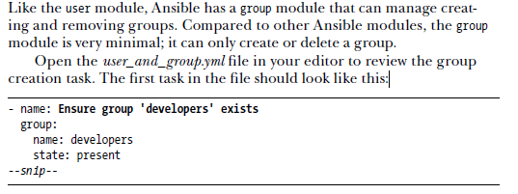
Getting Started with the Ansible Group Module

Slide 20
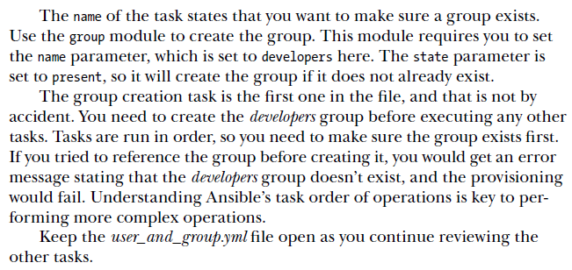

Slide 21
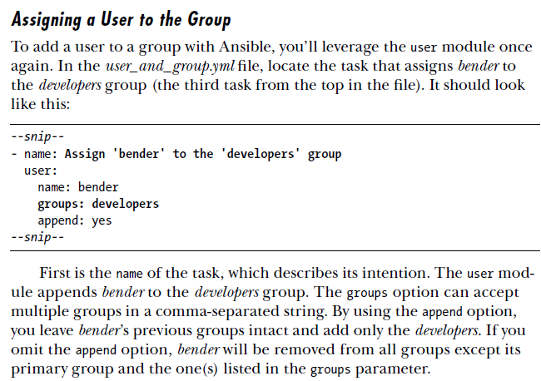

Slide 22
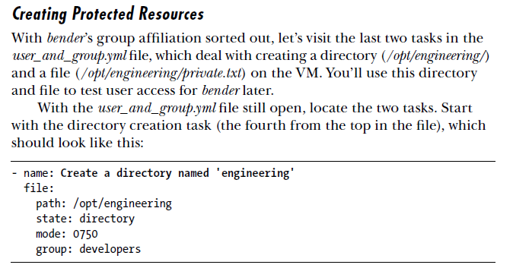

Slide 23
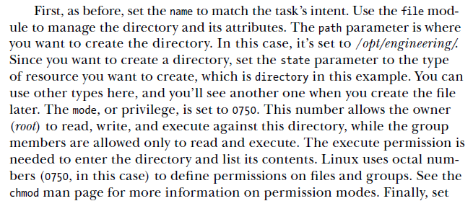

Slide 24
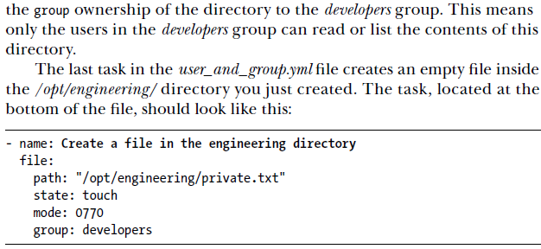
Summary

Slide 25
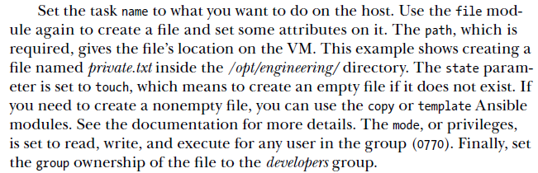

Slide 26
USING ANSIBLE TO CONFIGURE SSH
SSH is a protocol and tool that provides command line access to a remote host from your own machine.
If you are managing a remote host or a fleet of remote hosts, the most common way to access them is over SSH.
Most servers are likely to be headless, so the easiest way to access them is from a terminal.
Since SSH opens access to a host, misconfiguration or default installations can lead to unauthorized access.

Slide 27
USING ANSIBLE TO CONFIGURE SSH
how to use Ansible to secure SSH access to your VM
This can be done by disabling password access over SSH, requiring
public key authentication over SSH, and enabling two-factor authentication (2FA) over SSH

Slide 28
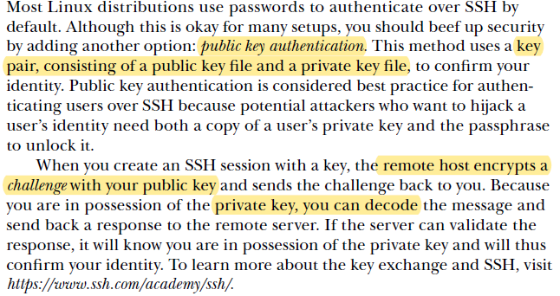
Understanding and Activating Public Key Authentication

Slide 29
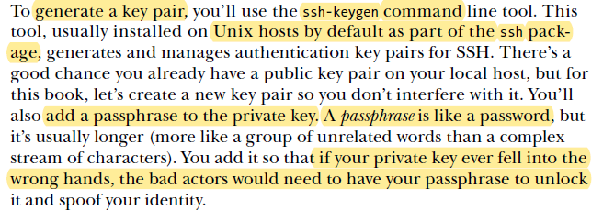
Generating a Public Key Pair

Slide 30


command to generate a new key pair

Slide 31
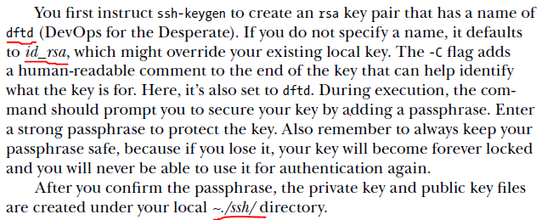

Slide 32
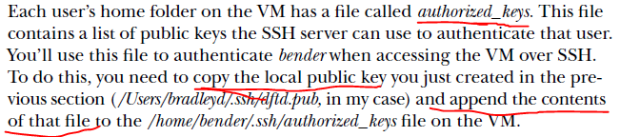
Using Ansible to Get Your Public Key on the VM

Slide 33
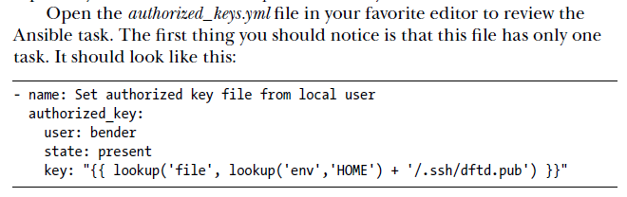

Slide 34
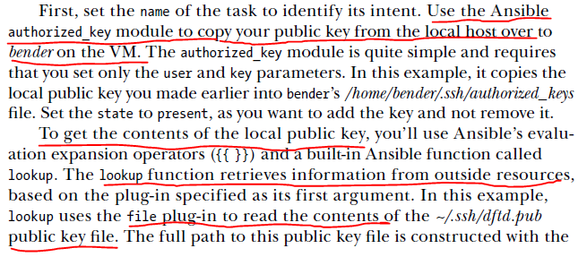

Slide 35
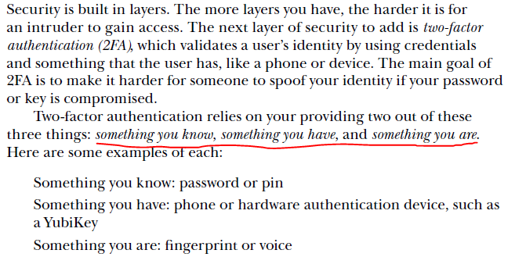
Adding Two-Factor Authentication

Slide 36
