Slide 1
Advanced Algorithms and Graph Mining
Niccolò Guiducci
Firenze, 5 Giugno 2023

Slide 2
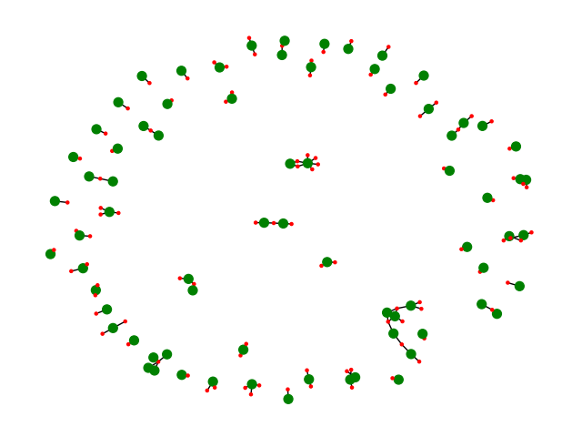
Goals
Generate an author-publication bipartite graph from DBLP dataset
Calculate the average number of publication over a period of time
Find the most used words in the publications titles of Connected Components
Find the pair of publications that shares the largest number of authors
Build the author graph and find the most collaborative pair
«A Multi-factor Paging Experiment: I»
and
«A Multi-factor Paging Experiment: II»
is the pair with more common authors: 2

Slide 3
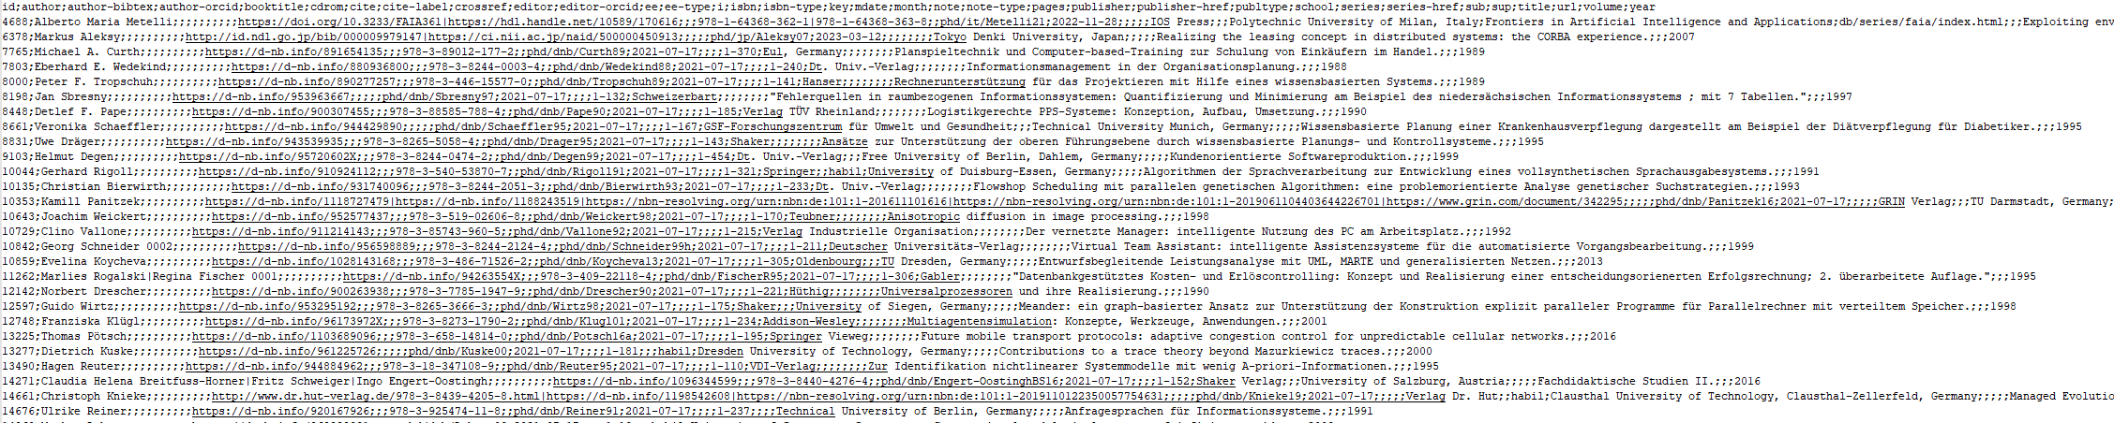
Introduction
The DBLP Dataset
The DBLP (Digital Bibliography & Library Project) dataset is a comprehensive bibliographic database of computer science research papers and proceedings
It contains over 5 million records, including articles, conference papers, and book chapters
Each record includes metadata such as the title, author(s), publication venue, and publication year.
Data are subdivided in some .csv files

Slide 4
Machine Specifics
All the following tests were executed on a computer with the following specifics:
OS: Microsoft Windows 10 Pro
CPU: 11° Gen Intel(R) Core(TM) i9-11900KF @3.5GHz(TBoost 5.1GHz) Octa-Core
GPU: GeForce RTX 3070Ti
RAM: 32GB DDR4 @3600 MHz
MOBO: Asus PRIME Z490-A

Slide 5
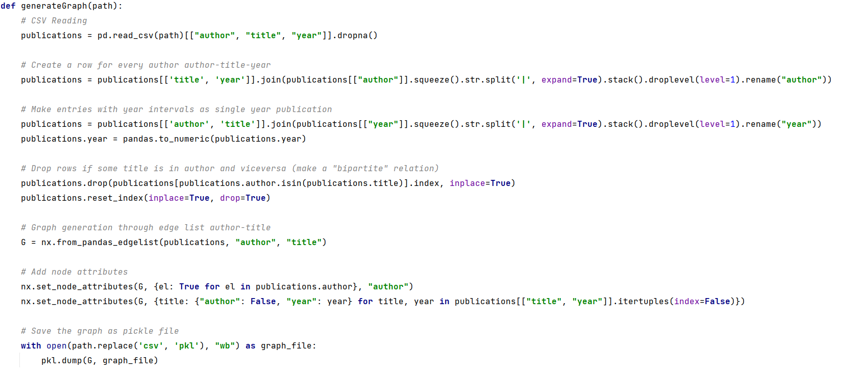
Build Author - Publication Graph
Extract the data – Pandas and NetworkX

Slide 6
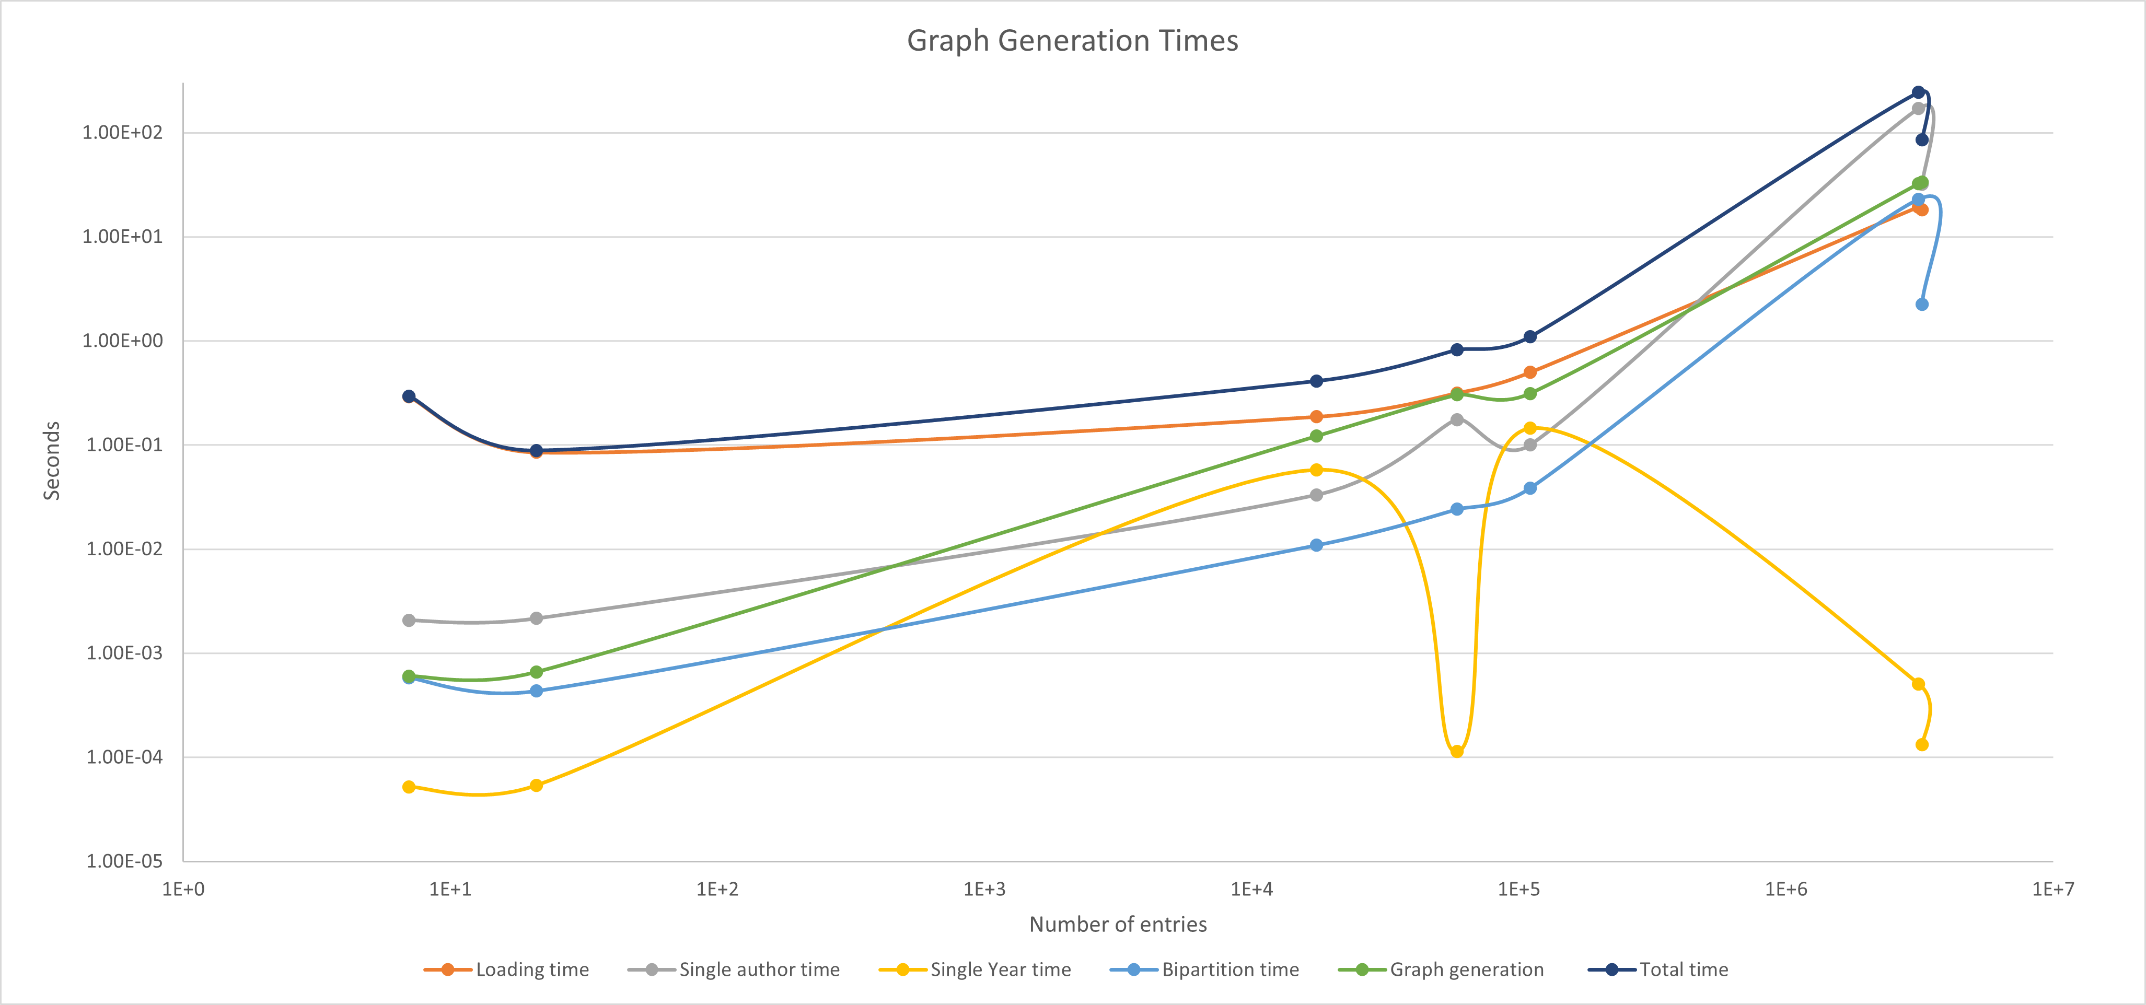
Build Author-Publication Graph
Graph Generation Times

Slide 7
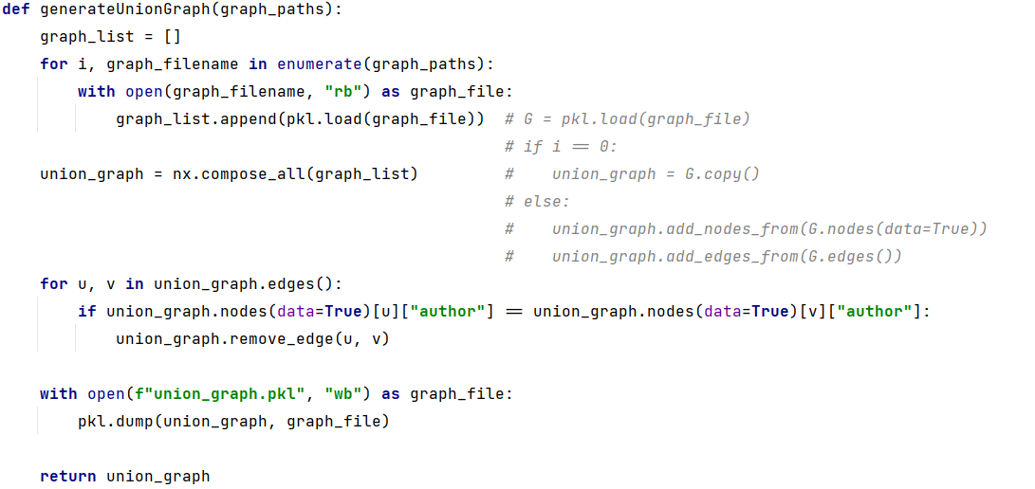
Build Union Graph
Compose Graphs - NetworkX
Union Graph has 9,646,543 nodes and 20,453,885 edges

Slide 8
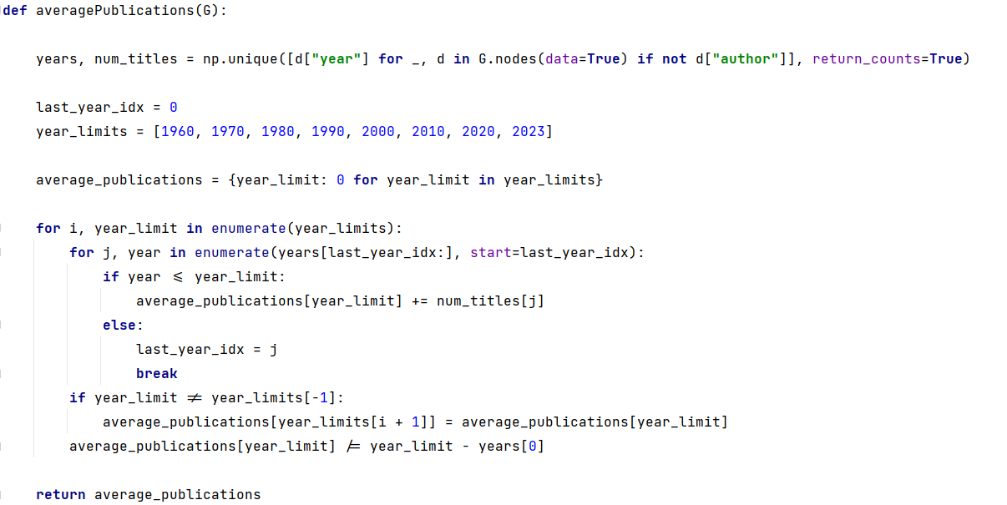
QUESTION 1
Average number of publications per year*?
Key Idea:
Create a list of publication «years» iterating over bipartite graph nodes
Count publication per year
Calculate averages per year-range
*Considering only the publications up to year x with x in {1960,1970,1980,1990,2000,2010,2020,2023}

Slide 9
QUESTION 1
Average number of publications per year*?
*Considering only the publications up to year x with x in {1960,1970,1980,1990,2000,2010,2020,2023}

Slide 10
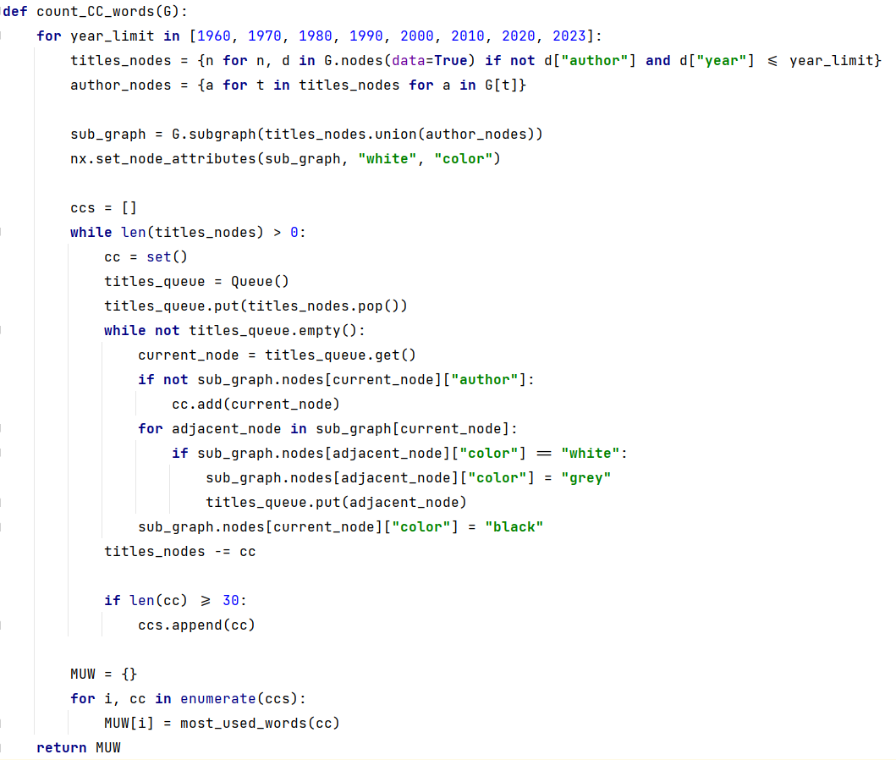
QUESTION 2
Compute the connected components and report for each component the most used words in the titles*
Key Idea:
Select the subgraph that satisfy costraints
Perform a CC search by a BFS
Extract most used words per CC
* Containing at least 30 publications

Slide 11
QUESTION 2
CCs Search – Execution Times*
* Charts refer to execution on the Union Graph

Slide 12
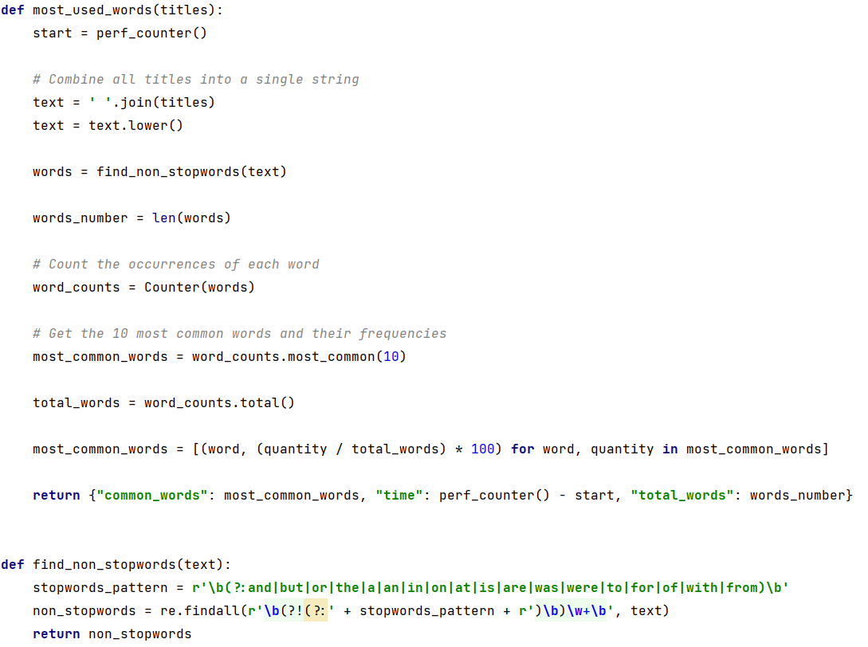
QUESTION 2
Find Most Used Words - Functions

Slide 13
QUESTION 2
Find Most Used Words – Execution Time*
* Charts refer to execution on the Union Graph

Slide 14
QUESTION 2
Most Used Words – On the first CC
Year limit | Top1 | Top2 | Top3
1960 | Computer(4.03%) | Programming(2.82%) | Processing(2.2%)
1970 | Computer(1.31%) | System(0.99%) | Algorithm(0.97%)
1980 | Computer(1.18%) | System(1.117%) | Systems(1.116%)
1990 | Systems(1.08%) | System(1.04%) | Data(0.65%)
2000 | Systems(0.99%) | Based(0.94%) | Using(0.91%)
2010 | Based(1.42%) | Using(1.05%) | Systems(0.84%)
2020 | Based(1.64%) | Using(1.09%) | Systems(0.7%)
2023 | Based(1.69%) | Using(1.08%) | Learning(0.67%)
* Charts refer to execution on the Union Graph

Slide 15
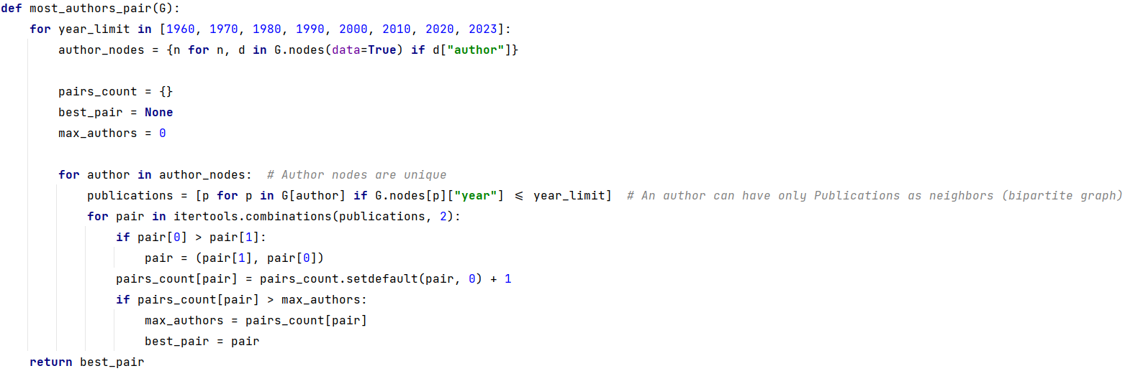
QUESTION 3
Find the pair of publications that shares the largest number of authors
Key Idea:
Iterate over author nodes
Calculate pair combinations of author neighbors publications
Store and count how many times a pair is find
TOO MUCH MEMORY required for big graphs!

Slide 16
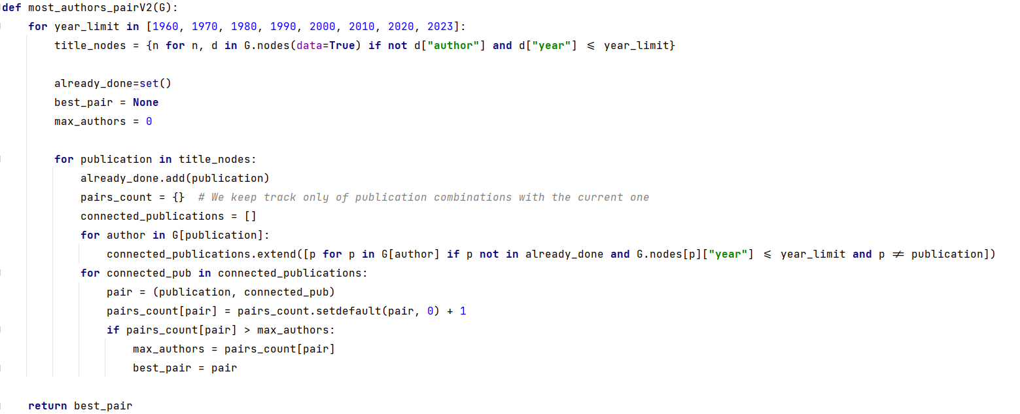
QUESTION 3 – V2
Find the pair of publications that shares the largest number of authors
Key Idea:
Iterate over publication nodes
Calculate combinations over second-order neighbors (that are other publications)
Store and count only few pairs at a time (a specific pair can be seen only during a specific iteration)
V1 function is faster but requires more memory (>25GB)!

Slide 17
QUESTION 3 – V2
Union Graph – Execution Times
* Charts refer to execution on the Union Graph

Slide 18
QUESTION 3 – V2
Union Graph – Results
Year limit | Title 1 | Title 2 | Common Authors
1960 | The Problem of Programming Communication…(Part 1). | The Problem of Programming Communication…(Part 2). | 6
1970 | Revised report on the algorithmic language ALGOL 60. | Revised report on the algorithm language ALGOL 60. | 13
1980 | Revised report on the algorithmic language ALGOL 60. | Revised report on the algorithm language ALGOL 60. | 13
1990 | Experiments with the Tangora 20,000 word speech recognizer | An IBM PC based large-vocabulary isolated-utterance speech recognizer | 17
2000 | ℋ | H | 30
2010 | Preface | Editorial | 496
2020 | Preface | Editorial | 496
2023 | Preface | Editorial | 496
* Charts refer to execution on the Union Graph

Slide 19
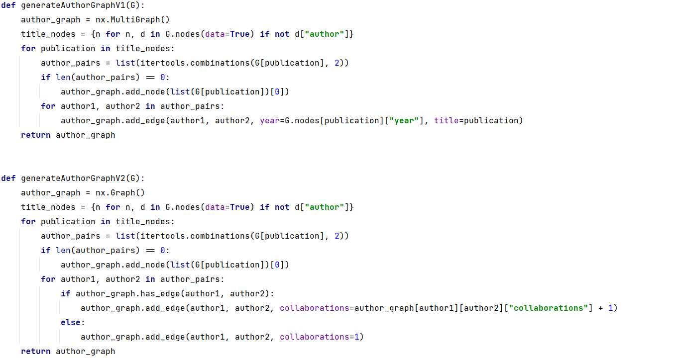
Build Author - Author Graph

Slide 20
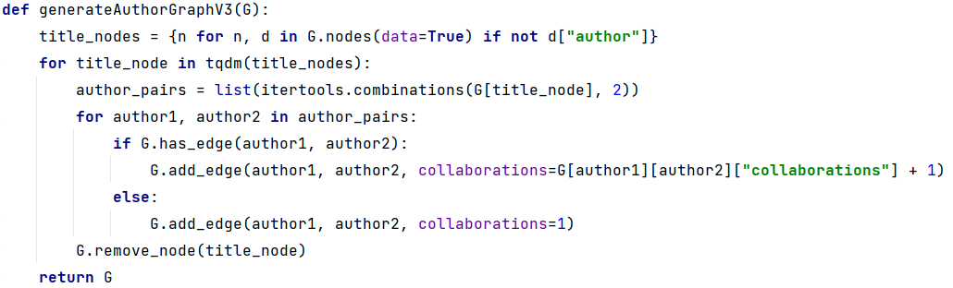
Build Author - Author Graph
 | Time(minutes) | Memory(RAM) | Nodes | Edges
AuthorGraphV1 | >20 | >30GB (out of RAM) | 3324487 | 67559024
AuthorGraphV2 | 2:11 | ~25GB | 3324487 | 51423655
AuthorGraphV3 | 2:17 | ~16GB | 3324487 | 51423655

Slide 21
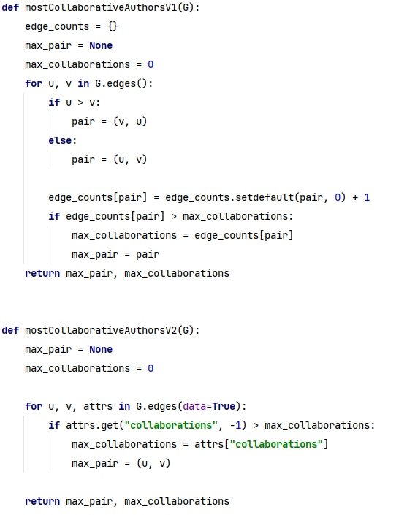
QUESTION 4
Find the most collaborative pair of authors
Key Idea to use with Author Graph V1 (MultiGraph):
Iterate over edges
Each edge is a collaboration
Count number of edges between authors
TOO MUCH MEMORY required for big graphs!
Key Idea to use with Author Graph V2:
Iterate over edges
Find the edge with max «collaboration» attribute

Slide 22
QUESTION 4
Results
 | Time(seconds) | Author 1 | Author 2 | Collaborations
AuthorGraphV1 | Out RAM | - | - | -
AuthorGraphV2 | 26.15 | Makoto Takizawa 0001 | Tomoya Enokido | 512
AuthorGraphV3 | 26.99 | Makoto Takizawa 0001 | Tomoya Enokido | 512

Slide 23
Advanced Algorithms and Graph Mining
Niccolò Guiducci
Firenze, 5 Giugno 2023

