Slide 1
ALGORITMI E PROGRAMMAZIONE PER L'ANALISI
DEI DATI
Niccolò Guiducci
Firenze, 5 Giugno 2023

Slide 2
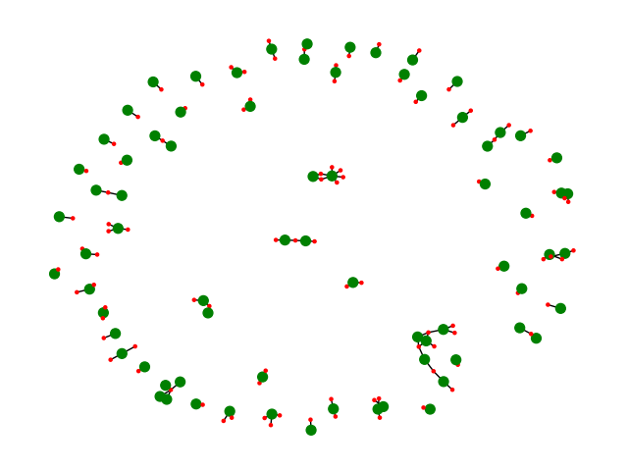
Goals
Generate an author-publication bipartite graph from DBLP dataset
Calculate the average number of publication over a period of time
Find the most used words in the publications titles of Connected Components
Find the pair of publications that shares the largest number of authors
Build the author graph
«A Multi-factor Paging Experiment: I»
and
«A Multi-factor Paging Experiment: II»
is the pair with more common authors: 2

Slide 3
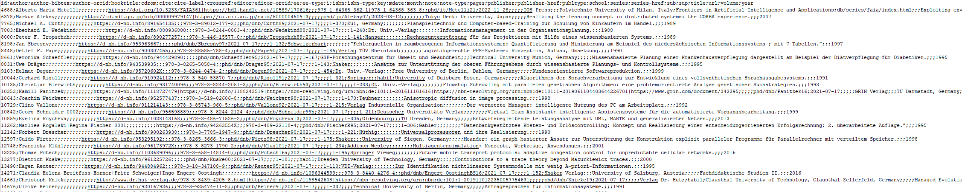
Introduction
The DBPL Dataset
The DBLP (Digital Bibliography & Library Project) dataset is a comprehensive bibliographic database of computer science research papers and proceedings
It contains over 5 million records, including articles, conference papers, and book chapters
Each record includes metadata such as the title, author(s), publication venue, and publication year.
Data are subdivided in some .csv files

Slide 4
Machine Specifics
All the following tests were executed on a computer with the following specifics:
OS: Microsoft Windows 10 Pro
CPU: 11° Gen Intel(R) Core(TM) i9-11900KF @3.5GHz(TBoost 5.1GHz) Octa-Core
GPU: GeForce RTX 3070Ti
RAM: 32GB DDR4 @3600 MHz
MOBO: Asus PRIME Z490-A

Slide 5
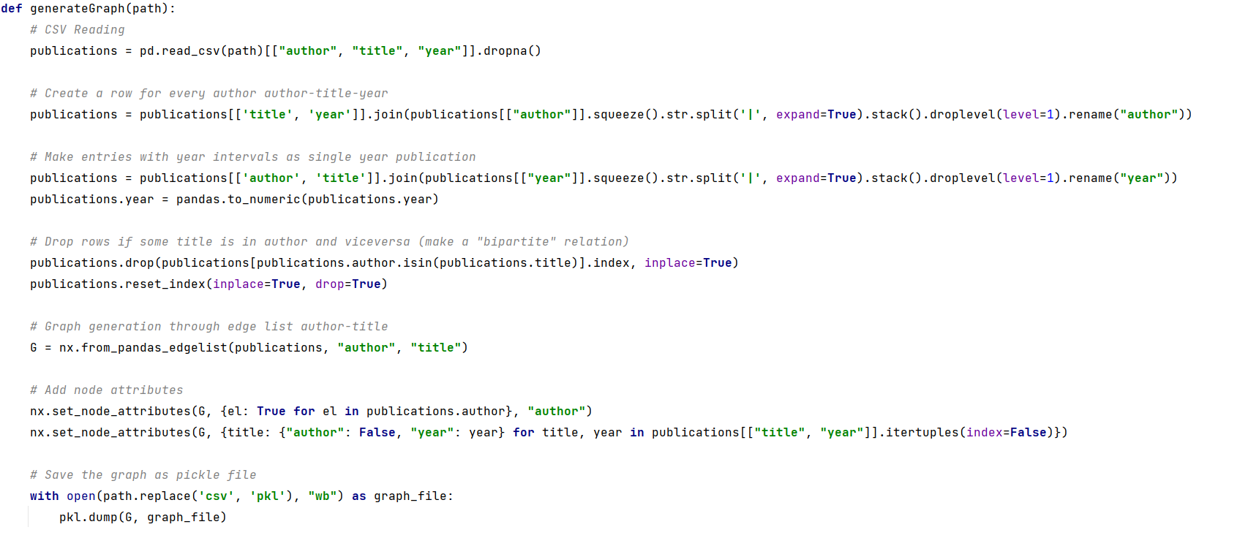
Build Author - Publication Graph
Extract the data – Pandas and NetworkX

Slide 6
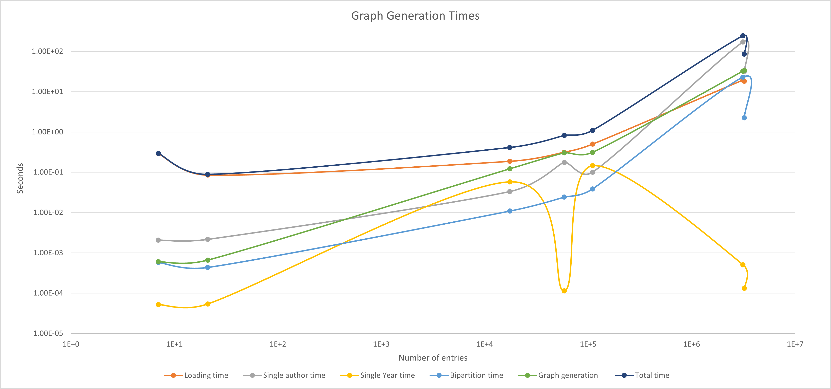
Build Author-Publication Graph
Graph Generation Times

Slide 7
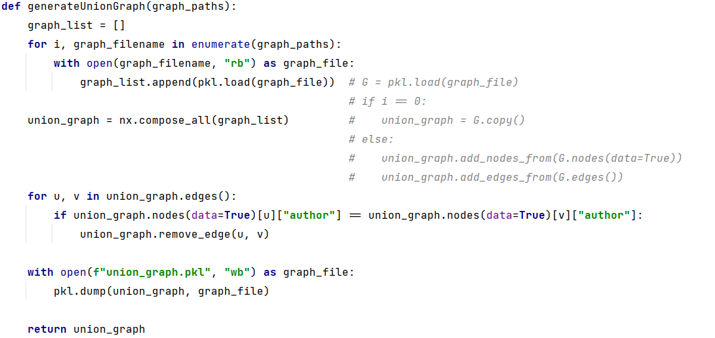
Build Union Graph
Compose Graphs - NetworkX
Union Graph has 9,646,543 nodes and 20,453,885 edges

Slide 8
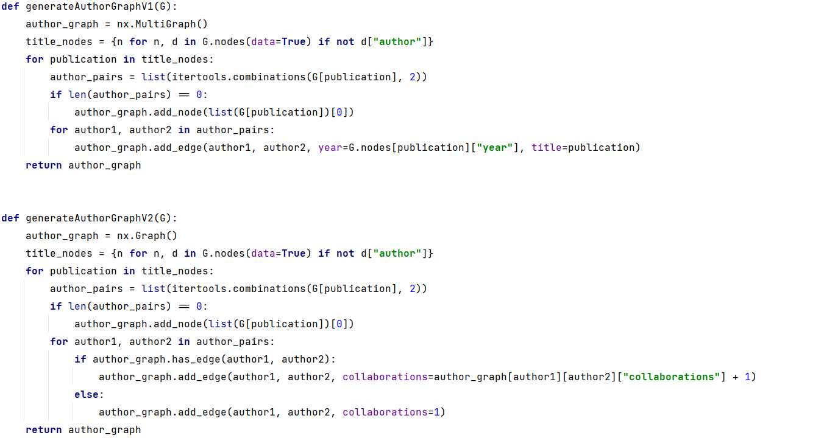
Build Author - Author Graph

Slide 9
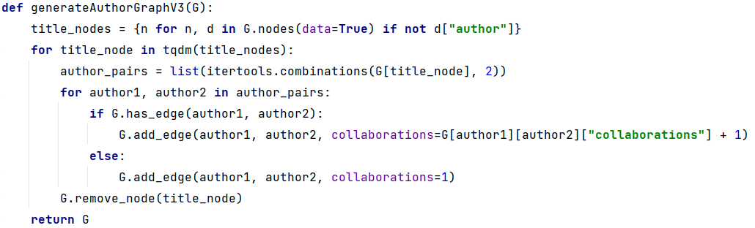
Build Author - Author Graph
 | Time(minutes) | Memory(RAM) | Nodes | Edges
AuthorGraphV1 | >20 | >30GB (out of RAM) | 3324487 | 67559024
AuthorGraphV2 | 2:11 | ~25GB | 3324487 | 51423655
AuthorGraphV3 | 2:17 | ~16GB | 3324487 | 51423655

Slide 10
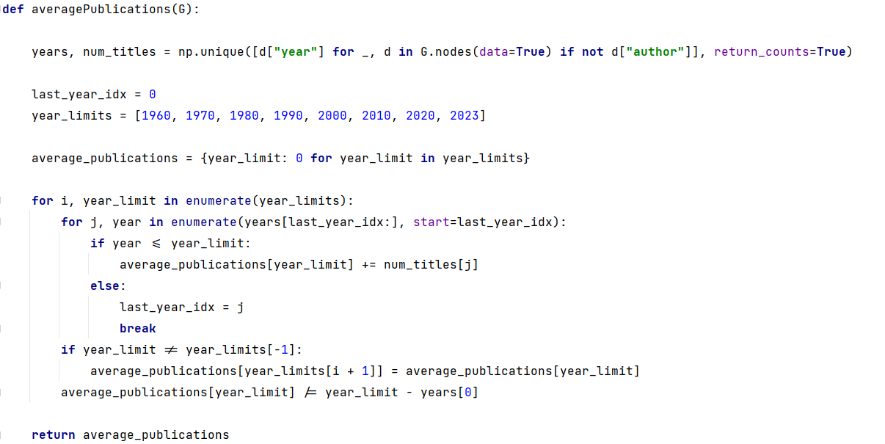
QUESTION 1
Average number of publications per year*?
Key Idea:
Create a list of publication «years» iterating over bipartite graphs nodes
Count publication per year
Calculate averages per year-range
*Considering only the publications up to year x with x in {1960,1970,1980,1990,2000,2010,2020,2023}

Slide 11
QUESTION 1
Average number of publications per year*?
*Considering only the publications up to year x with x in {1960,1970,1980,1990,2000,2010,2020,2023}

Slide 12
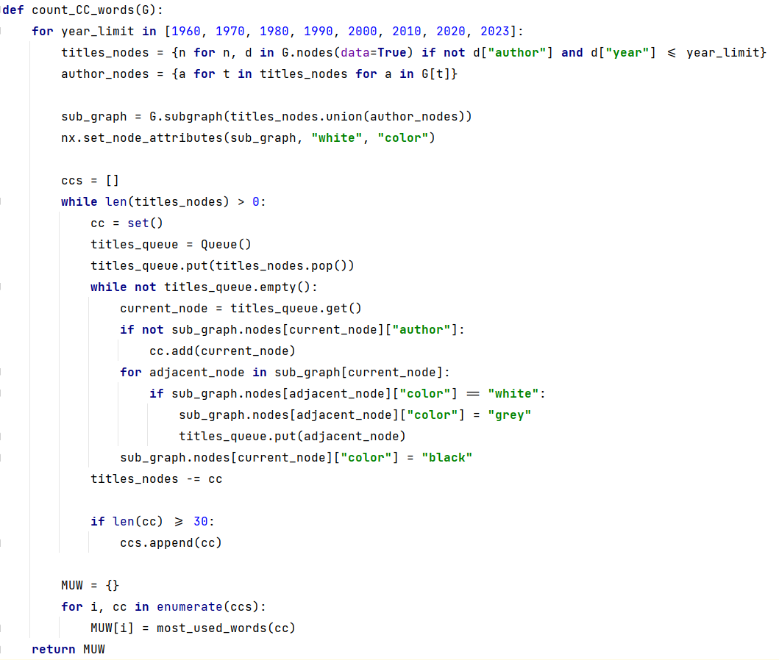
QUESTION 2
Compute the connected components and report for each component the most used words in the titles*
Key Idea:
Select the subgraph that satisfy costraints
Perform a CC search by a BFS
Extract most used words per CC
* Containing at least 30 publications

Slide 13
QUESTION 2
Compute the connected components and report for each component the most used words in the titles*
* Containing at least 30 publications

Slide 14
ALGORITMI E PROGRAMMAZIONE PER L'ANALISI
DEI DATI
Niccolò Guiducci
Firenze, 5 Giugno 2023

