Slide 1


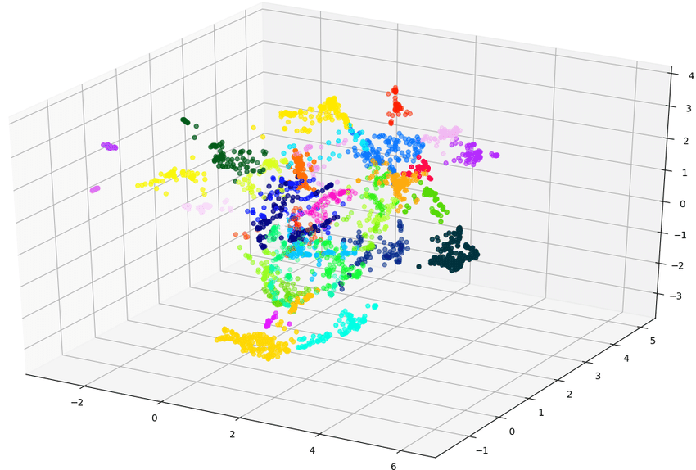





Chunking
index
1
code block
3
Azure Search Vector
Web UI
Embedding
2
Azure Open AI
Embedding

Slide 2
Azure Open AI
GPT
4
prompt
5
3
Vector Search
Azure Search Vector
Web UI
code block
1
2
Embedding
Azure Open AI
Embedding

