Slide 1
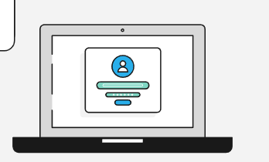
Chain Of Product
Network and Computer Security
Afonso Rosa 106700
Lourenço Calhau 103396
Nickolas Ficker 116178

Slide 2
Table of contents
01
02
03
04
05
06
Secure document format
Built infrastructure
Secure channels
Security challenge
Key distribution
Results and conclusion

Slide 3
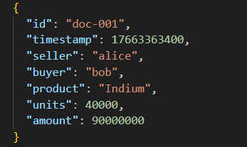
Chain of Product Scenario
Business setting of mutually distrusting companies, Transaction Server acts as a mediator.
DvP transactions are JSON documents with sensitive business data.
Transaction Server & Database are trusted but have no access to the content of the transactions.

Slide 4
01
Secure document format

Slide 5
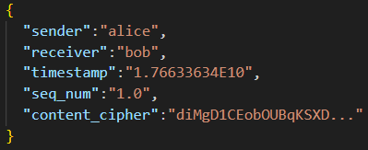

Secure Document - Format
DvP Transaction
Secure Document Output:
Document
Transaction Key
Agreement Signature

Slide 6
Transactions and their Metadata
Metadata holds:
The transactions are stored in the DB alongside their metadata.
Access control and security requirements are enforced with the help of the metadata.
List of encrypted transaction keys (sharedKeys[]): K_tx wrapped with RSA.
Agreement signatures: seller/buyer signatures over the transaction.
Share logs: list of who the transaction was shared with and by who.

Slide 7
02
Built infrastructure

Slide 8
System components
Client
Group Server
Transaction Server
Java (JAX-RS Client API)
Java Jakarta EE (JAX-RS)
Java Jakarta EE (JAX-RS)
Firewalls
Database
PostgreSQL + Docker
iptables

Slide 9
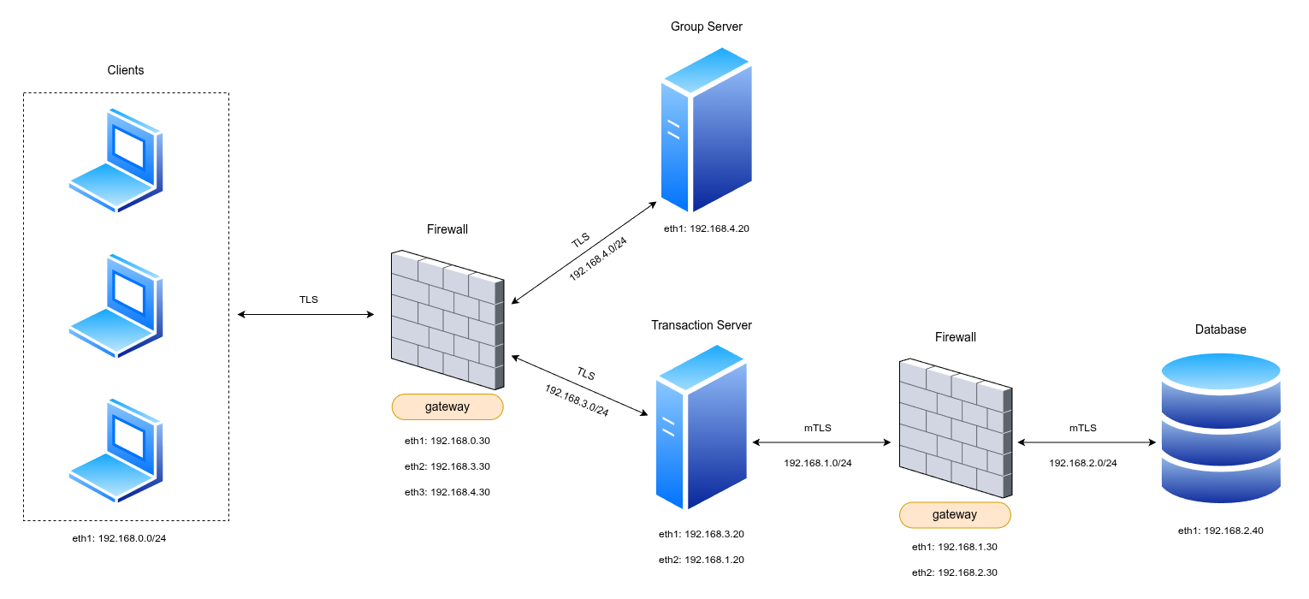
Built infrastructure
4
4 main machines:
Client
Transaction Server
Database
Group Server
2 firewalls:
Client-Servers Firewall
Transaction Server-DB Firewall
1
2
3

Slide 10
Built infrastructure
Additional Security - IP Table rules
Transaction Server
Group
Server
Database
- Address is unknown to clients
- Only accepts connections on port 8443 from the Clients network.
- Address is unknown to clients
- Only accepts connections on port 8081 from the Clients network.
- Only accepts connections on port 5432 from the Transaction Server’s IP address

Slide 11
03
Secure channels

Slide 12
Secure Channels
TLS: Client Server
mTLS: Server Database

Slide 13
04
Security challenge

Slide 14
Security challenge
Security Challenge A - Groups of partners
What changed
How it was implemented
- New Group Server validates membership and controls transaction key access.
- The Group Server acts as a trusted gatekeeper
- The Transaction Server continues to handle individual disclosures and stores group-based shares, while delegating membership authorization to the Group Server
- Group Server runs independently from the main Transaction Server
- The Group Server maintains a single key-pair to enable encryption/decryption of transaction keys shared with groups
- File-based storage that maps groups names to member lists (groups.json)

Slide 15
05
Key distribution

Slide 16
Key Distribution
User’s Public Key
Group Server’s Key Pair
- Assumptions:
Each user has access to every user’s public key
Each user assumes authenticity of pre-shared public keys
- RSA-2048 key pairs manually generated
- Assumptions:
Group Server is fully trusted by all users
- RSA-2048 key pair auto-generated at Group Server startup
- Group Server’s public key retrieved dynamically via REST API
- Enables centralized access control through encryption

Slide 17
06
Results and conclusion

Slide 18
Results
Security requirements satisfied
Security challenge implemented
- Confidentiality between buyer and seller is ensured via hybrid encryption
- Authentication on sharing is enforced through digital signatures
- Transaction integrity is maintained by using hashing
- Integrity of sharing lists is preserved through signed SharedLog entries
- Group Server fully responsible for group management
- Isolated service, independent from the remaining system
- Parties are able to share transactions details with groups of partners

Slide 19
Conclusion
Main requirements and goals of the project were accomplished.
Possible future improvements:
Public Key Infrastructure (PKI)
Key revocation mechanism
Web-based interface to improve usability

