Slide 1

Developer for a Day
© 2022 NTT DATA Corporation

Slide 2
Agenda
 |  | From | To | Duration
1 | Welcome, Introduction & Project Briefing | 10:00 | 10:45 | 0:45
2 | Coffee Break | 10:45 | 11:00 | 0:15
3 | Sprint I: Planning, Implementation, Daily | 11:00 | 13:00 | 2:00
4 | Lunch Break | 13:00 | 14:00 | 1:00
5 | Sprint II: Planning, Implementation, Daily | 14:00 | 16:00 | 2:00
6 | Coffee Break | 16:00 | 16:15 | 0:15
7 | Review & Retrospective | 16:15 | 16:45 | 0:30
8 | Feedback Session | 16:45 | 17:00 | 0:15

Slide 3
Agile Software Development
© 2022 NTT DATA Corporation

Slide 4
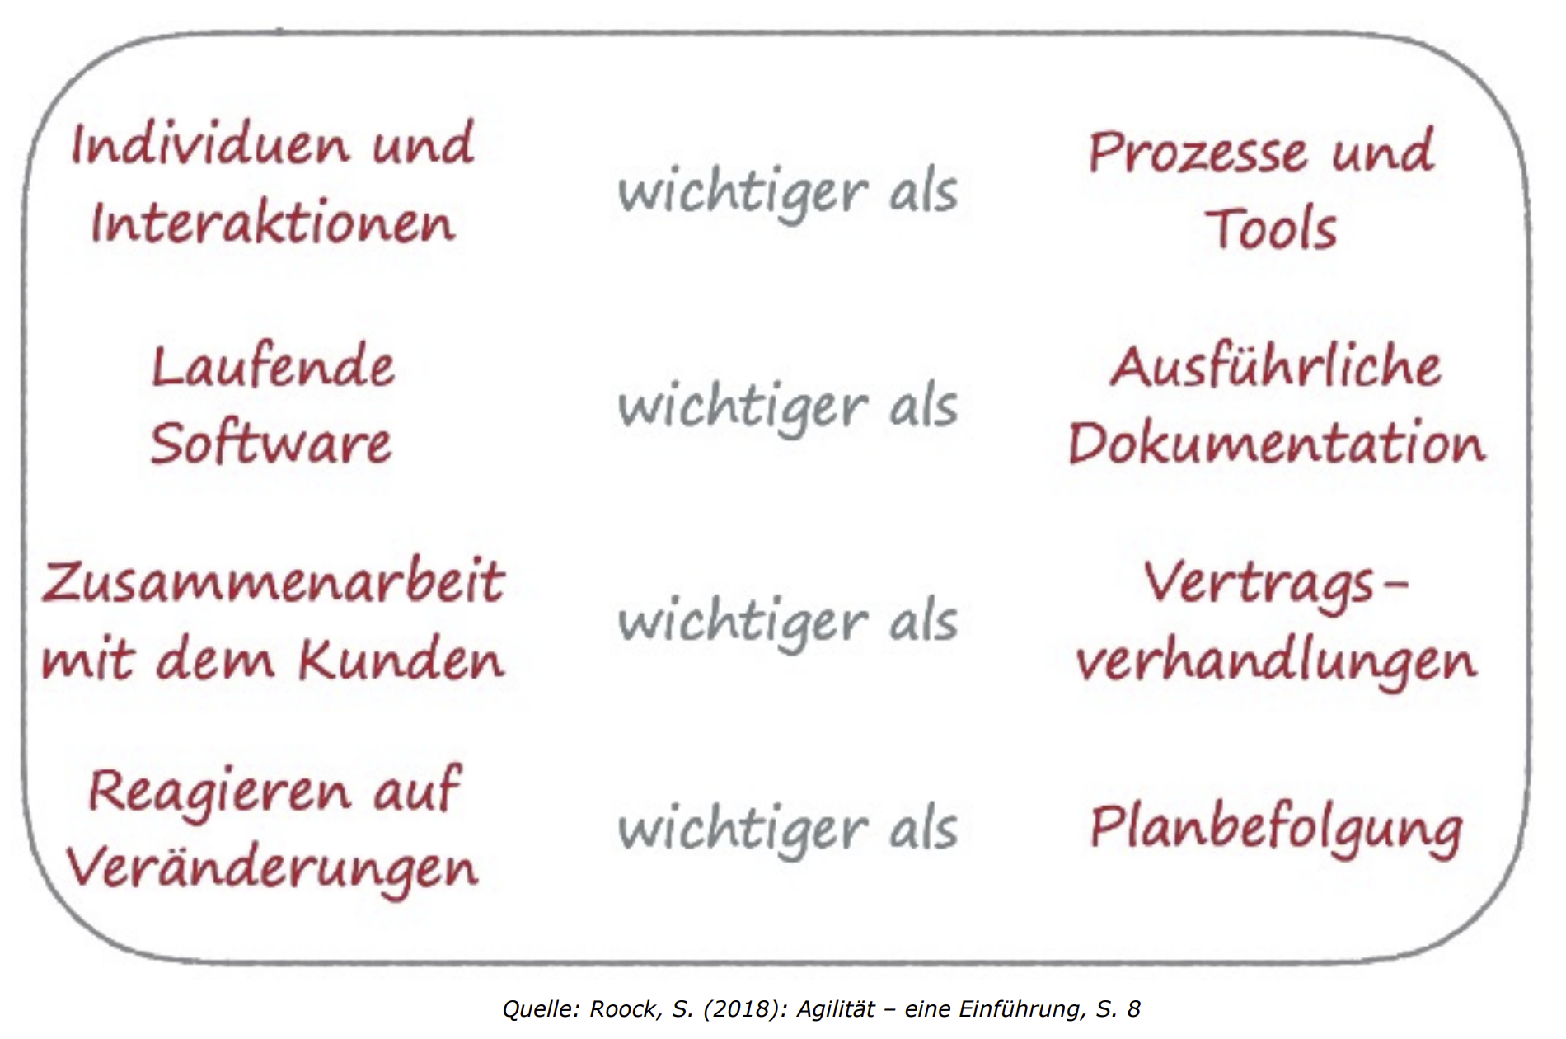
Vorgehensmodelle – Agil vs. Traditionell

Slide 5
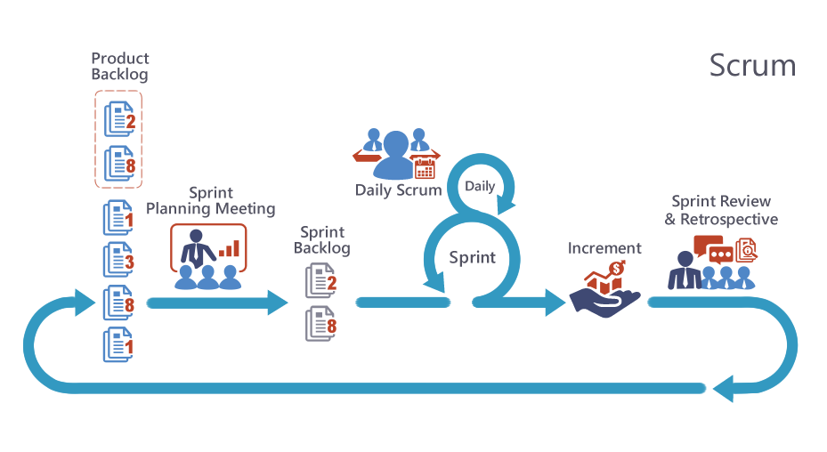

Slide 6
Introduction to Angular
© 2022 NTT DATA Corporation

Slide 7

Angular
Web Framework for modern Single-page Applications
Uses HTML, CSS and TypeScript
Comes with libraries for Routing, Forms, Animations, …
https://angular.io/guide/what-is-angular

Slide 8
Angular Components
import { Component } from '@angular/core';
@Component({
selector: 'hello-world',
template: `
<h2>Hello World</h2>
<p>This is my first component!</p>
`
})
export class HelloWorldComponent {
// The code in this class drives the component's behavior.
}
@Component Decorator defines template, styles and selector for Angular Component
To use the HelloWorldComponent call <hello-world></hello-world> inside another component.
Components often have 4 files:
hello-world.component.ts → For Business Logic
hello-world.component.html → How Component should render
hello-world.component.css → Style Component
hello-world.component.spec.ts → Test Component
Components are the building blocks for Angular Applications. They define specific functionality, looks and behavior for an Element.
https://angular.io/guide/what-is-angular#components

Slide 9
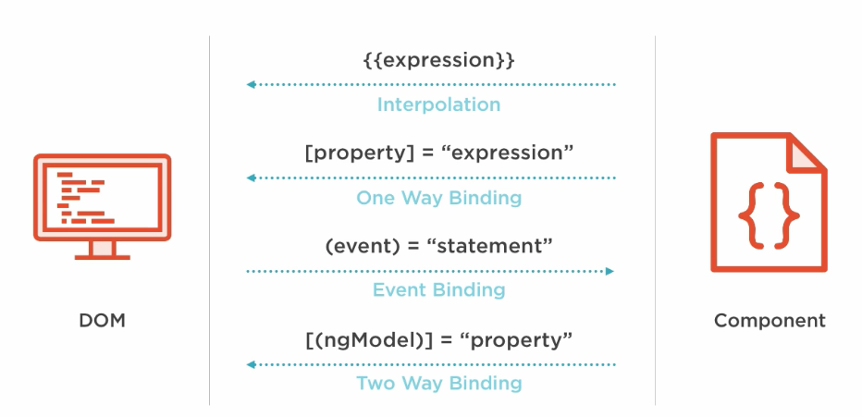
Templates
hello-world-interpolation.component.ts @Component ({
…
templateUrl: './hello-world-interpolation.component.html'
})
export class HelloWorldInterpolationComponent {
message = 'Hello, World!‘;
}
hello-world-interpolation.component.html
<p>My Message: {{message}}</p>
Every HTML Element comes with different properties that can be manipulated by Angular
https://angular.io/guide/property-binding
Components have an HTML template that declares how that component renders. You define this template either inline or by file path.
https://angular.io/guide/what-is-angular#templates

Slide 10
Dependency Injection
@Injectable({
providedIn: 'root',
})
export class WeatherStationService {
constructor(private http: HttpClient) {}
getStations() {
return
this.http.get('/api/station');
}
}
Classes with @Injectable often get called Service
To inject a Service use the constructor of the component
Service can be used without instantiating it by hand
export class HelloWorldDependencyInjectionComponent {
constructor(private stations: WeatherStationService) { }
getWeather() {
this.stations.getStations().subscribe(); ←Observable Subscription
}
}
With Dependency Injection, Angular handles the instantiation of the class for you. You just have to declare a class with @Injectable and the class can be injected into your component.
https://angular.io/guide/what-is-angular#dependency-injection

Slide 11
RxJS – Reactive Programming
Asynchronous data is handled with a stream which reacts to changes
Every instance that subscribes to an Observable gets notified
getStations(): Observable<string[]> {
return this.http.get ('/api/station');
}
// React to changes inside subscribe block
this.getStations().subscribe({
next(response) { console.log(response); },
error(err) { console.error('Error: ' + err); },
complete() { console.log('Completed'); }
});
// React to changes with operators like tap, map, …
this.getStations().pipe(
tap((x)=> console.log(x))
);
https://angular.io/guide/rx-library

Slide 12
Introduction to Quarkus
© 2022 NTT DATA Corporation

Slide 13

Quarkus
Low memory usage
Fast boot and first response
Integration of established open-source Java libraries and standards
Cloud-native stack tailored to Kubernetes

Slide 14
Quarkus Profiles
mvn quarkus:dev
used for local development
DEV services are automatically started as Docker containers
provides DEV UI, Health UI, Swagger UI …
mvn package
used for deployment on all stages
application can be executed locally with java -jar target/quarkus-app/quarkus-run.jar
mvn test
executes all unit and integration tests

Slide 15
Quarkus Configuration
Settings in application.properties under src/main/resources
Guides and references
Getting Started
https://quarkus.io/guides/getting-started
REST (JAX-RS)
https://quarkus.io/guides/rest-json
https://quarkus.io/guides/rest-client
Context and Dependency Injection (CDI)
https://quarkus.io/guides/cdi
Hibernate ORM with Panache (JPA)
https://quarkus.io/guides/hibernate-orm

Slide 16
Project Deep Dive
© 2022 NTT DATA Corporation

Slide 17


Architecture Overview
Master branch
GET /api/station
GET /api/weather/{stationName}
⋮
weather-ui
weather-station
postrgeSQL
weather-map

Slide 18
Architecture Overview
With all CRUD operations
GET /api/station
GET /api/weather/{stationName}
⋮
POST /api/station/{stationName}
DELETE /api/station/{stationName}
DELETE /api/station
weather-ui
weather-station
postrgeSQL
weather-map

Slide 19
Architecture Overview
After integration of weather-map in weather-ui
POST /api/station/{stationName}
DELETE /api/station/{stationName}
DELETE /api/station
weather-ui
weather-station
postrgeSQL
GET /api/station
GET /api/weather/{stationName}
⋮
GET /api/map
weather-map

Slide 20
Architecture Overview
With temperature conversion in weather-map
POST /api/station/{stationName}
DELETE /api/station/{stationName}
DELETE /api/station
weather-ui
weather-station
postrgeSQL
GET /api/station
GET /api/weather/{stationName}
⋮
GET /api/map?temperatureUnit=celsius
GET /api/map?temperatureUnit=fahrenheit
weather-map

