Slide 1
Project Scorpion formerly Project Matrix (MyBeeble)
Hashim Al-Assi
Nick Bishop
Lenka Konecny
Jerome Reyes

Slide 2
What is Project Scorpion?
Project Scorpion is a one-page web app that lists information for capstone projects and allows students to up-vote or down-vote them.

Slide 3
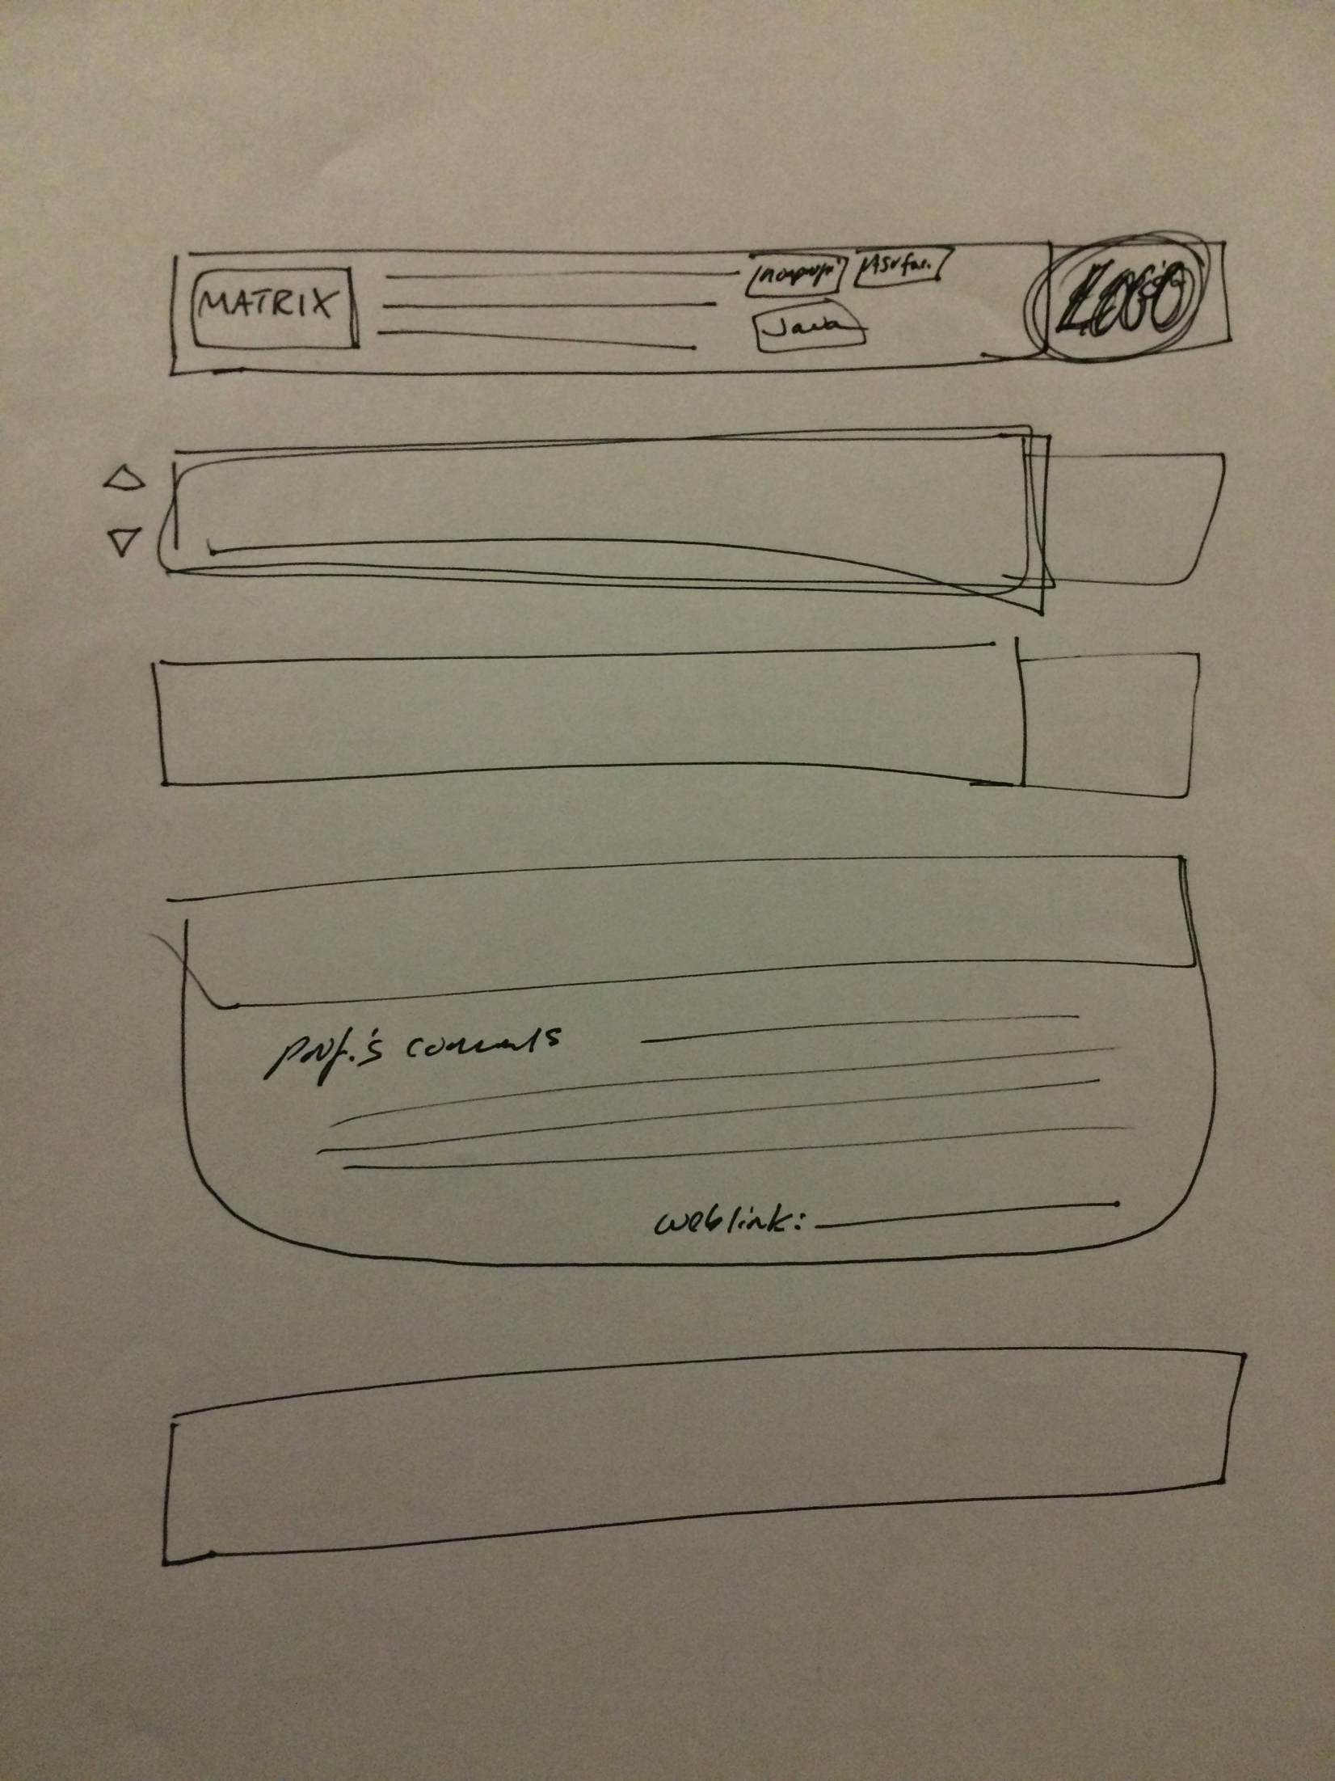
Client Sketch

Slide 4
What We Will Use
Python
Flask
Heroku
Postgres
PyCharm
Bootstrap

Slide 5
What We Have Finished At This Point
A lot of Tutorials
Installed all of the Programs and Various Sub Packages
Created Heroku Account and Provisioned a Database
Created Front-End Framework
Created a Basic App with Python
Diagram of Database Design

Slide 6
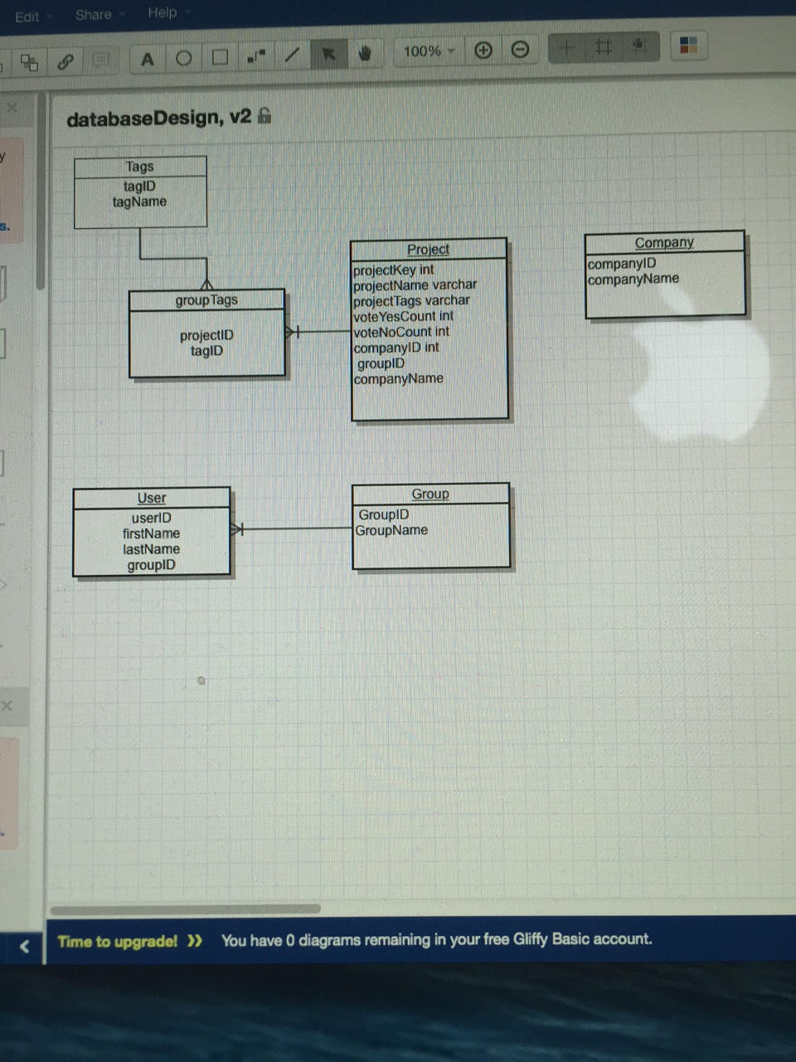
Database
Design

Slide 7
What’s Next?
Create Database Tables
Populate Database with Info from Current Projects
Connect Front-End to Display Info from Database
Implement Testing (CRUD)

Slide 8
Demo
Front End Framework
Python “Hello World” App
Heroku Database Dashboard

