Slide 1















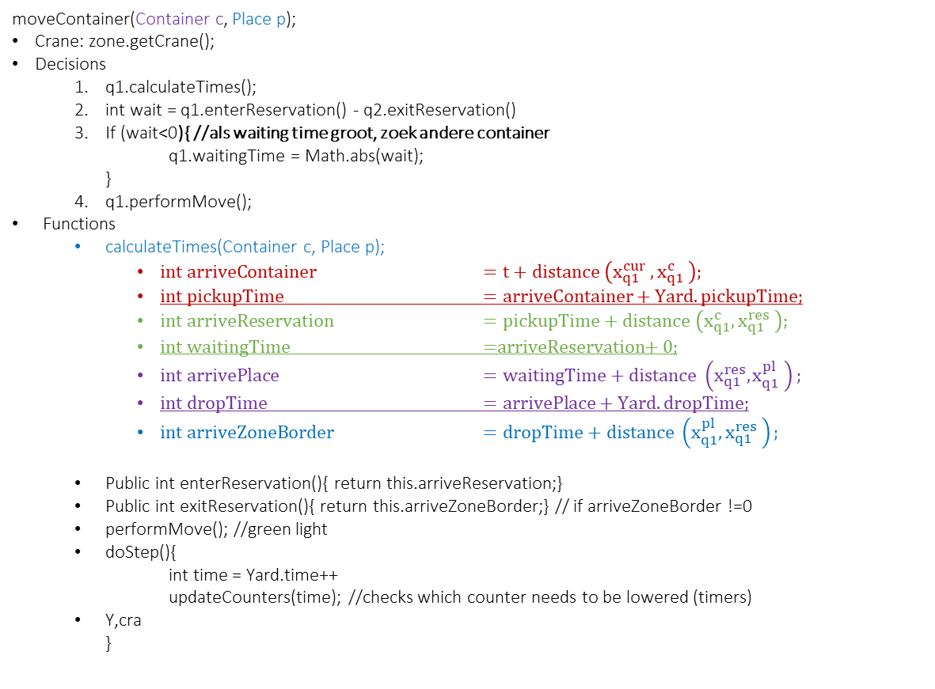
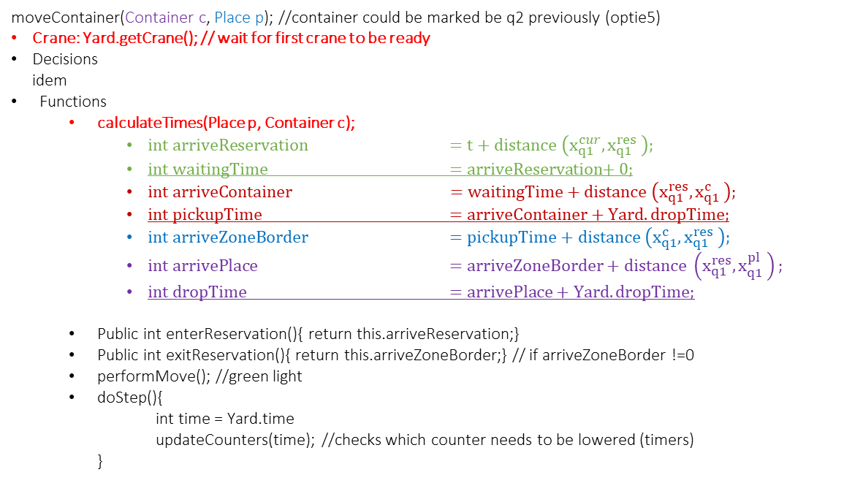
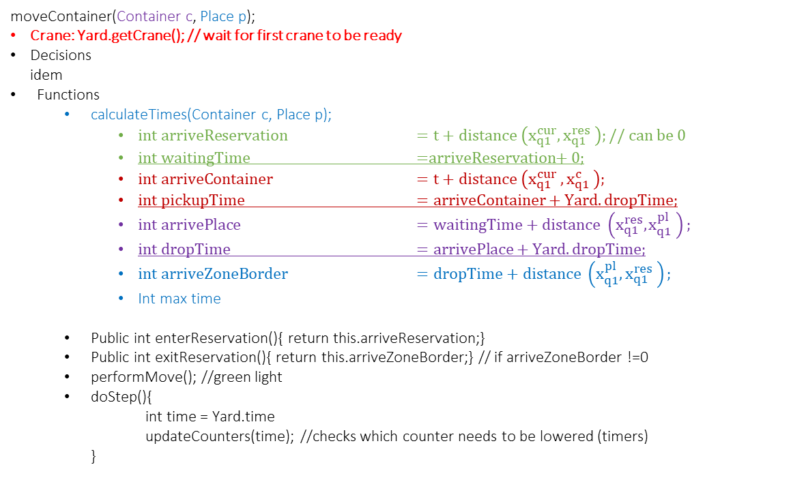
Optie 1
Mogelijke verplaatsingen
yard.moveContainer(Container c, Place p); //kunnen opvragen welke zone
Optie 2
$$x_{q1}^{res}$$
$$x_{q1}^{pl}$$
$$x_{q1}^{max}$$
$$x_{q1}^{min}$$
$$x_{q1}^{cur}$$
$$x_{q1}^{c}$$
moveContainer(Container c, Place p);
Crane: zone.getCrane();
Decisions
q1.calculateTimes();
int wait = q1.enterReservation() - q2.exitReservation()
If (wait<0){ //als waiting time groot, zoek andere container q1.waitingTime = Math.abs(wait); }
q1.performMove();
Functions
calculateTimes(Container c, Place p);
$int arriveContainer$ $=t+distance \left(x_{q1}^{cur} , x_{q1}^{c} \right);$
$int pickupTime$ $=arriveContainer+Yard.pickupTime;$
$int arriveReservation$ $=pickupTime+distance \left(x_{q1}^{c}, x_{q1}^{res} \right);$
$int waitingTime$ =$arriveReservation$+ 0;
$int arrivePlace$ $=waitingTime+distance \left(x_{q1}^{res}, x_{q1}^{pl} \right);$
$int dropTime$ $=arrivePlace+Yard.dropTime;$
$int arriveZoneBorder$ $=dropTime+distance \left(x_{q1}^{pl}, x_{q1}^{res} \right);$
Public int enterReservation(){ return this.arriveReservation;}
Public int exitReservation(){ return this.arriveZoneBorder;} // if arriveZoneBorder !=0
performMove(); //green light
doStep(){ int time = Yard.time++ updateCounters(time); //checks which counter needs to be lowered (timers)
Y,cra }
Optie 3
$$x_{q1}^{res}$$
$$x_{q1}^{c}$$
$$x_{q1}^{max}$$
$$x_{q1}^{min}$$
$$x_{q1}^{cur}$$
$$x_{q1}^{pl}$$
moveContainer(Container c, Place p); //container could be marked be q2 previously (optie5)
Crane: Yard.getCrane(); // wait for first crane to be ready
Decisions idem
Functions
calculateTimes(Place p, Container c);
$int arriveReservation$ $=t+distance \left(x_{q1}^{cur}, x_{q1}^{res} \right);$
$int waitingTime$ =$arriveReservation$+ 0;
$int arriveContainer$ $=waitingTime+distance \left(x_{q1}^{res}, x_{q1}^{c} \right);$
$int pickupTime$ $=arriveContainer+Yard.dropTime;$
$int arriveZoneBorder$ $=pickupTime+distance \left(x_{q1}^{c}, x_{q1}^{res} \right);$
$int arrivePlace$ $=arriveZoneBorder+distance \left(x_{q1}^{res}, x_{q1}^{pl} \right);$
$int dropTime$ $=arrivePlace+Yard.dropTime;$
Public int enterReservation(){ return this.arriveReservation;}
Public int exitReservation(){ return this.arriveZoneBorder;} // if arriveZoneBorder !=0
performMove(); //green light
doStep(){ int time = Yard.time updateCounters(time); //checks which counter needs to be lowered (timers) }
Optie 4
$$x_{q1}^{res}$$
$$x_{q1}^{c}$$
$$x_{q1}^{max}$$
$$x_{q1}^{min}$$
$$x_{q1}^{cur}$$
$$x_{q1}^{pl}$$
moveContainer(Container c, Place p);
Crane: Yard.getCrane(); // wait for first crane to be ready
Decisions idem
Functions
calculateTimes(Container c, Place p);
$int arriveReservation$ $=t+distance \left(x_{q1}^{cur}, x_{q1}^{res} \right);$ // can be 0
$int waitingTime$ =$arriveReservation$+ 0;
$int arriveContainer$ $=t+distance \left(x_{q1}^{cur} , x_{q1}^{c} \right);$
$int pickupTime$ $=arriveContainer+Yard.dropTime;$
$int arrivePlace$ $=waitingTime+distance \left(x_{q1}^{res}, x_{q1}^{pl} \right);$
$int dropTime$ $=arrivePlace+Yard.dropTime;$
$int arriveZoneBorder$ $=dropTime+distance \left(x_{q1}^{pl}, x_{q1}^{res} \right);$
Int max time
Public int enterReservation(){ return this.arriveReservation;}
Public int exitReservation(){ return this.arriveZoneBorder;} // if arriveZoneBorder !=0
performMove(); //green light
doStep(){ int time = Yard.time updateCounters(time); //checks which counter needs to be lowered (timers) }
Optie 0 = Optie 2
$$x_{q1}^{res}$$
$$x_{q1}^{pl}$$
$$x_{q1}^{max}$$
$$x_{q1}^{min}$$
$$x_{q1}^{cur}$$
$$x_{q1}^{c}$$

