Slide 1
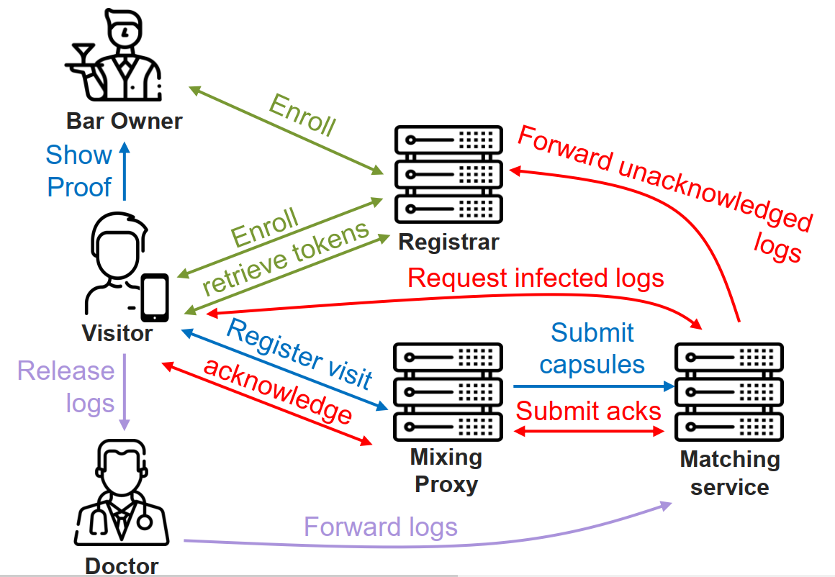
EVENTS THAT CAN OCCUR
VISITOR INSTALLATION Install Enroll Retrieve Own Token-set User & day specific
REGISTRATION @ BAR Scan qr (byte array) Register visit (send info in qr code) Submit capsules (FORWARD) ACK registration SHOW PROOF (green screen)
INFECTION List<Log> logs = releaseLogs() forwardLogs(logs)
MAKE DAILY-QR Enroll Retrieve Own Token-set Day, location, bar specifi
RETRIEV INFECTED LOGS Set timer Retrieve logs ACK notification before certain time FORWARD ACKS (for certain logs) FORWARD UNACKED logs DE-ANONYMIZE user and print info on screen
SERVICE | USERS
MATCHING SERVICE APPLICATION Visualize state of machine (Database) KNOWS “x peoples in a bar” CAN … MUST check incomming infection for signature of a docter | VISITOR APPLICATION Semi – minimal Qr code scanning : submitting string Has limited number of tokens each day (e.g. 6)
MIXING SERVICE APPLICATION Show queue at each time Must have a flush button (for the queue) KNOWS … CAN … MUST create signature that client can show to bar bar knows daily signature by enrolling as visitor at begin of day | BAR OWNER APPLICATION minimal
REGISTRAR APPLICATION Visualize state of machine (Database) KNOWS … CAN de-anonymize (ONLY called when infection message not acked) MUST … | DOCTOR APPLICATION Minimal Data transfer between doctor and visitor using a file
2
6
1
3
5
5
2
2
1
1
1
2
4
3
3
4
1
2

Slide 2
EVENTS THAT CAN OCCUR
VISITOR INSTALLATION Install Enroll (1) / login (*) Retrieve Own Token-set (daily) User & day specific
romeo
SERVICE | USERS
REGISTRAR APPLICATION Visualize state of machine (Database) KNOWS … CAN de-anonymize (ONLY called when infection message not acked) MUST … | VISITOR APPLICATION Semi – minimal Qr code scanning : submitting string Has limited number of tokens each day (e.g. 6)
3
2
1
3.
Registrar:
Each day: 48 *Sign(SecureRandom, currentDay) = tokenset
Koppeling van tokens aan phone number (Map)
Tokens verzenden naar visitor (NICK)

Slide 3
EVENTS THAT CAN OCCUR
REGISTRATION @ BAR Scan qr (byte array) Logging time Logging info qr (…) Register visit (send info in qr code) RMI Send Capsule (all info QR + 1 user token) user token = invalid (NIET VERWIJDEREN !!!!!) Sign capsule if valid token Submit capsules (FORWARD) Send AFTER some time / flush only when not receiving anymore ACK registration SHOW PROOF (green screen)
SERVICE | USERS
MATCHING SERVICE APPLICATION Visualize state of machine (Database) KNOWS “x peoples in a bar” CAN … MUST check incomming infection for signature of a docter | VISITOR APPLICATION Semi – minimal Qr code scanning : submitting string Has limited number of tokens each day (e.g. 6)
MIXING SERVICE APPLICATION Show queue at each time Must have a flush button (for the queue) KNOWS Tijdinterval tussen capsules met dezelfde id (tijd ophogen voor bepaalde user in bepaalde bar) Alles capsules ( CAN … MUST create signature that client can show to bar bar knows daily signature by enrolling as visitor at begin of day | BAR OWNER APPLICATION minimal
6
1
2
5
4
3

Slide 4
EVENTS THAT CAN OCCUR
INFECTION List<Log> logs = releaseLogs() forwardLogs(logs)
Romeo
SERVICE | USERS
MATCHING SERVICE APPLICATION Visualize state of machine (Database) KNOWS “x peoples in a bar” CAN … MUST check incomming infection for signature of a docter | VISITOR APPLICATION Semi – minimal Qr code scanning : submitting string Has limited number of tokens each day (e.g. 6)
MIXING SERVICE APPLICATION Show queue at each time Must have a flush button (for the queue) KNOWS … CAN … MUST create signature that client can show to bar bar knows daily signature by enrolling as visitor at begin of day | BAR OWNER APPLICATION minimal
REGISTRAR APPLICATION Visualize state of machine (Database) KNOWS … CAN de-anonymize (ONLY called when infection message not acked) MUST … | DOCTOR APPLICATION Minimal Data transfer between doctor and visitor using a file
1
2

Slide 5
EVENTS THAT CAN OCCUR
MAKE DAILY-QR Enroll Retrieve Own Token-set Day, location, bar specifi
nick
SERVICE | USERS
MATCHING SERVICE APPLICATION Visualize state of machine (Database) KNOWS “x peoples in a bar” CAN … MUST check incomming infection for signature of a docter | VISITOR APPLICATION Semi – minimal Qr code scanning : submitting string Has limited number of tokens each day (e.g. 6)
MIXING SERVICE APPLICATION Show queue at each time Must have a flush button (for the queue) KNOWS … CAN … MUST create signature that client can show to bar bar knows daily signature by enrolling as visitor at begin of day | BAR OWNER APPLICATION minimal
REGISTRAR APPLICATION Visualize state of machine (Database) KNOWS … CAN de-anonymize (ONLY called when infection message not acked) MUST … | DOCTOR APPLICATION Minimal Data transfer between doctor and visitor using a file
2
1

Slide 6
EVENTS THAT CAN OCCUR
RETRIEV INFECTED LOGS Set timer Retrieve logs ACK notification before certain time FORWARD ACKS (for certain logs) FORWARD UNACKED logs DE-ANONYMIZE user and print info on screen
SERVICE | USERS
MATCHING SERVICE APPLICATION Visualize state of machine (Database) KNOWS “x peoples in a bar” CAN … MUST check incomming infection for signature of a docter | VISITOR APPLICATION Semi – minimal Qr code scanning : submitting string Has limited number of tokens each day (e.g. 6)
MIXING SERVICE APPLICATION Show queue at each time Must have a flush button (for the queue) KNOWS … CAN … MUST create signature that client can show to bar bar knows daily signature by enrolling as visitor at begin of day | BAR OWNER APPLICATION minimal
REGISTRAR APPLICATION Visualize state of machine (Database) KNOWS … CAN de-anonymize (ONLY called when infection message not acked) MUST … | DOCTOR APPLICATION Minimal Data transfer between doctor and visitor using a file
6
5
2
1
3
4

