Slide 1





Oxyworld-psa Medisam Medikal Healthcare Equipments

Slide 2
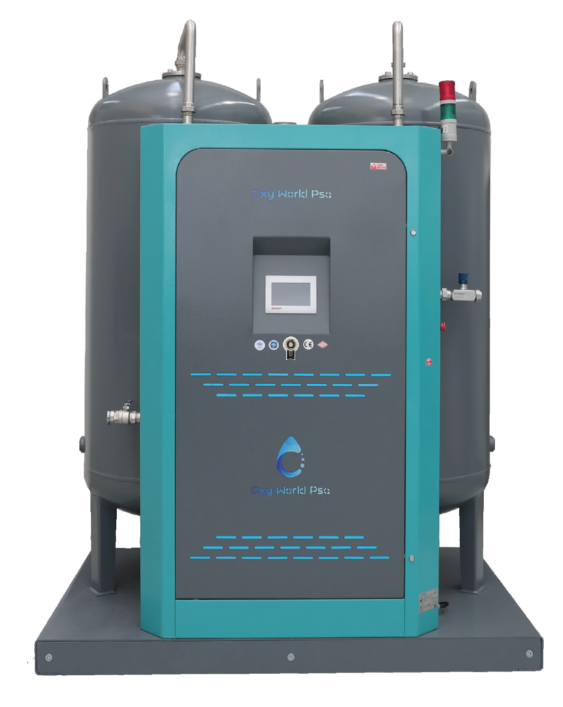
OXYGEN GENERATOR

Slide 3
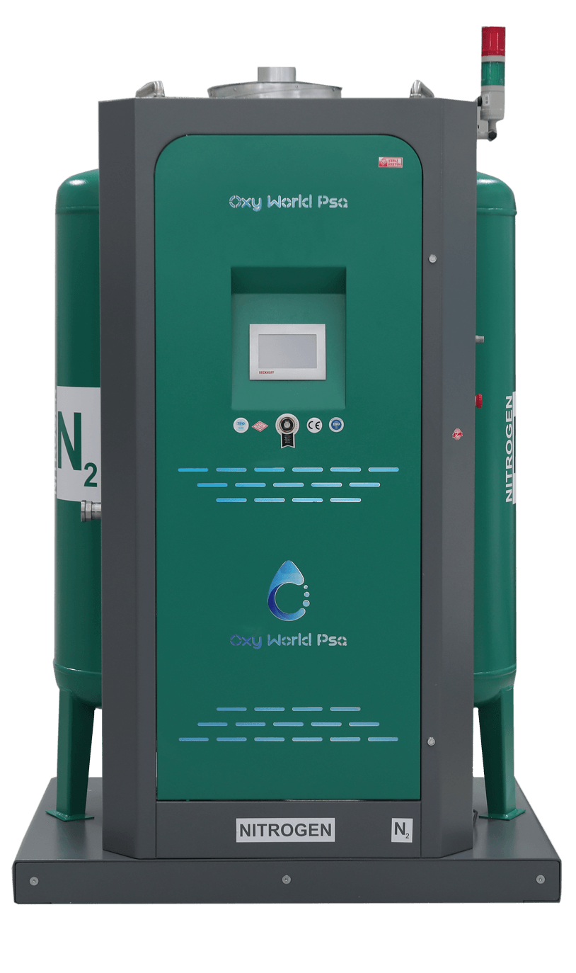
NITROGEN GENERATOR

Slide 4
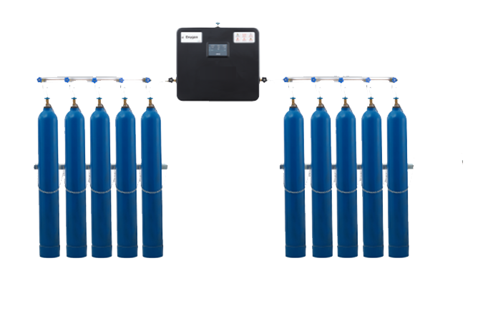
CYROGENIC TANKS

Slide 5
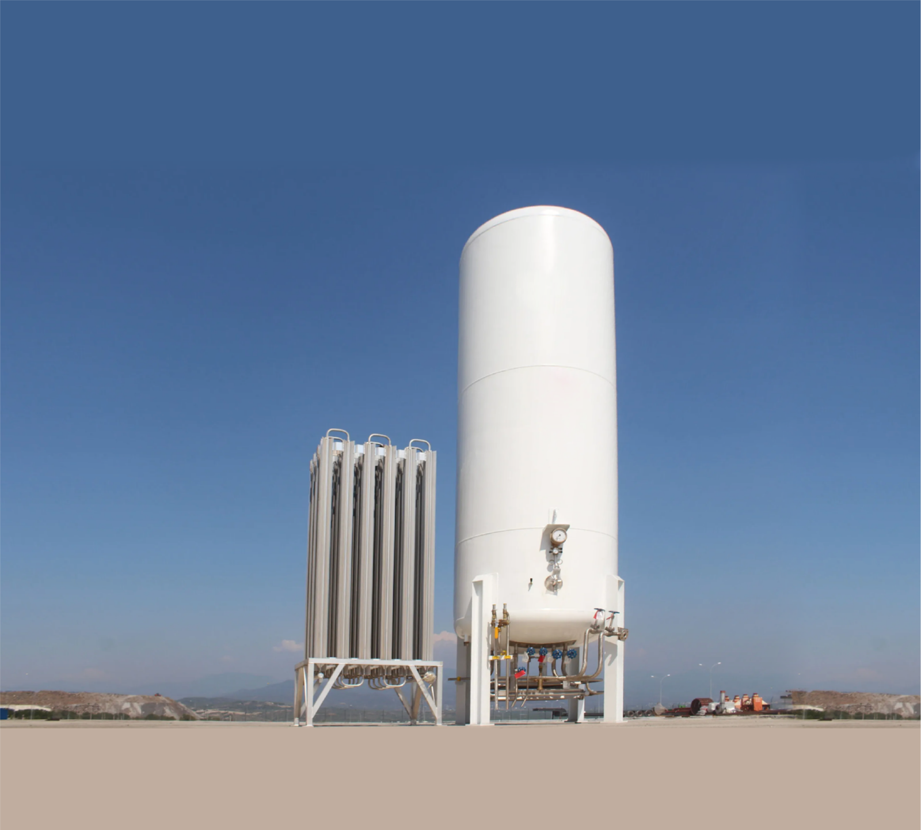
BS & DN GAS SOCKETS

Slide 6
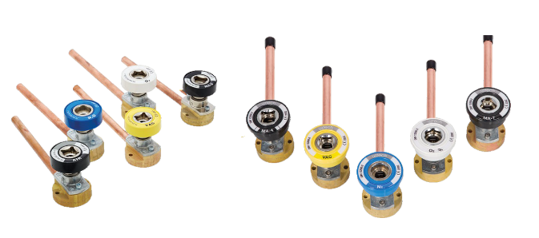
MODULAR SOCKET BOXES

Slide 7
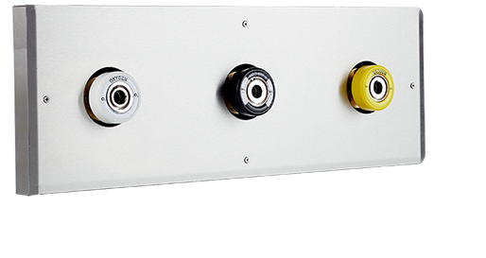
CENTRAL VACUUM APPARATUS

Slide 8
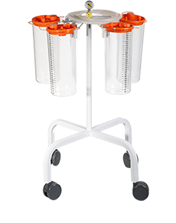
FLOW METER

Slide 9
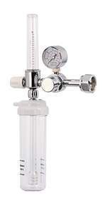
REGULATOR

Slide 10
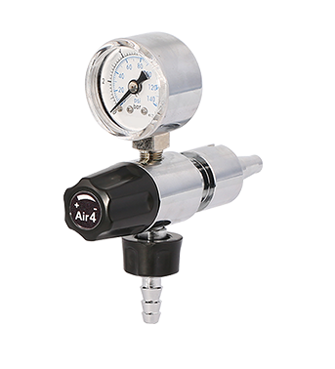
PENDANTS

Slide 11
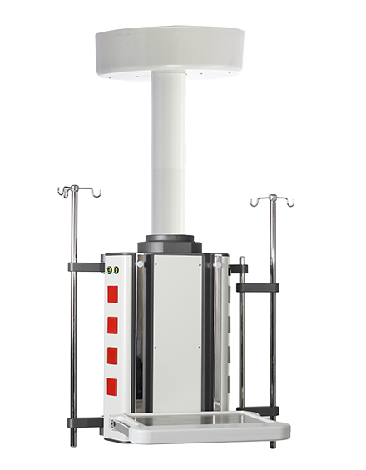
NURSE CALL SYSTEMS

Slide 12
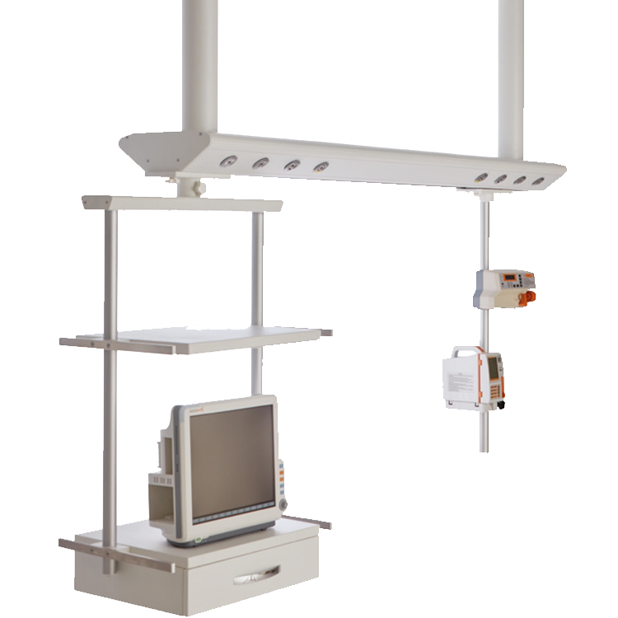
PENDANTS

Slide 13
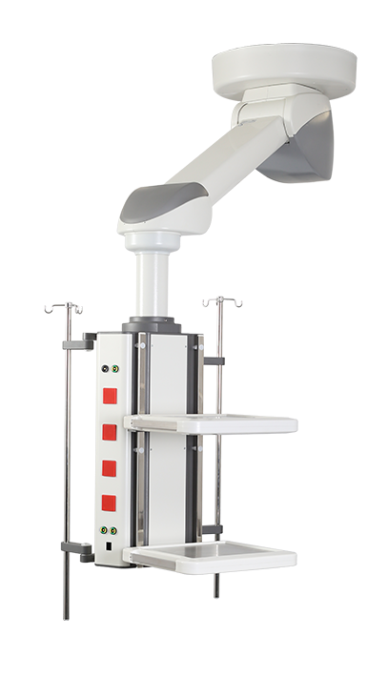
PENDANTS

Slide 14
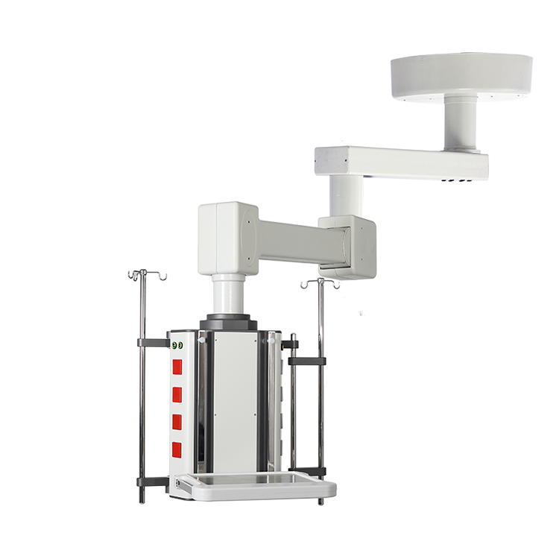
PENDANTS

Slide 15
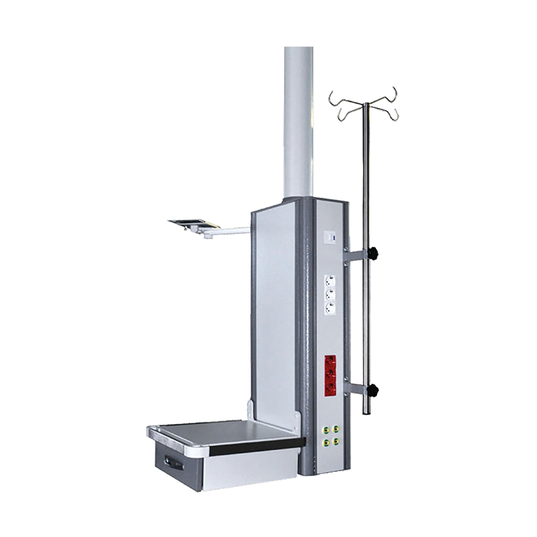
PENDANTS

Slide 16
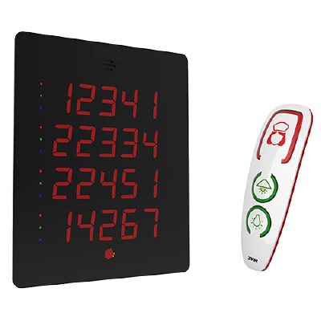
NURSE CALL SYSTEMS

Slide 17
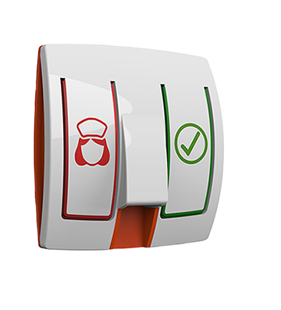
BEDSIDE CALL PANEL

Slide 18
Contact Us
Phone: +1 (868) 788-2753

