Slide 1
The Story of Kevin Mitnick
By: Nick van Houten
CSCI-405
Professor Sun
Due on: 02/25/26

Slide 2
Early Life
Kevin Mitnick was born in Van Nuys, California on 08/06/1963 (Codemotion, 2023)
Brought up by his mother, parents divorced when he was young
Was known for his intelligence at a young age, was very passionate about electronics
“Obtained an unrestricted FCC license to use a ham radio to listen to local police calls” (Codemotion, 2023)
Notes:
His parents divorce could have impacted his growth and focus on computer systems.

Slide 3
His first Hack
“In 1979, Kevin broke into The Ark, a computer at USC that handled administrative responsibilities. He soon found a vulnerability in the software and was able to gain access and remain hidden.” (Codemotion, 2023)
While he was good with computers, social engineering tactics take some time to perfect, and this was something he put a lot of focus into.
“Mitnick’s methods to gaining access are considered legendary, and a key part to his success at infiltration.” (Codemotion, 2023)
Notes:
His ability to remain hidden could have possibly led to his confidence later in his hacking career, where he did not cover his tracks and got caught.

Slide 4
On the Run for Two Years
“Mitnick hacked into Pacific Bell’s system to check how they were monitoring him, but he had no right to hack into this system, which is how the arrest warrant was issued.” (Sergeev, 2025)
“He worked under fake names - as a systems administrator at a law firm in Denver, as an IT worker at a hospital in Seattle under the name Brian Merril.” (Sergeev, 2025)
“According to Mitnick, it helped him a lot that the US authorities used a very bad photo that made him hard to recognize in real life.” (Sergeev, 2025)
“He was “leaked” by another hacker named Tsutomu Shimomura out of revenge, because Mitnick hacked into Shimomura’s home network system.” (Sergeev, 2025)
Notes:
He hacked into Pacific Bell because he wanted to know what they had on him, which led to him getting careless about his footprints, getting an arrest warrant issued.

Slide 5
The Downfall
In 1995, Mitnick was arrested by the FBI in North Carolina, which is when his hacking career officially ended.
He was so confident of his abilities that he started getting lazy and left a trail of evidence leading right to him.
He was charged with multiple computer crimes and pled guilty to all charges and was sentenced to 5 years in prison.
He was released in January 2000, after serving his 5 years.
Notes:
Will all of the evidence against him, there was no other choice than to plead guilty to all counts. This could have also reduced his original sentence.

Slide 6
Life after Prison
Mitnick had a change of heart after prison and decided to use his skills for the betterment of society.
“He worked as a cybersecurity consultant, speaker, and author.” (Codemotion, 2023)
He has written multiple books about his life of a hacker.
Notes:
His teachings are valuable, and there is a lot to learn from such a renowned hacker turned consultant, speaker, and author.

Slide 7
Books by Kevin Mitnick
The Art of Invisibility
Ghost in the Wires: My Adventures as the World’s Most Wanted Hacker
The Art of Intrusion: The Real Stories Behind the Exploits of Hackers, Intruders & Deceivers
The Art of Deception: Controlling the Human Element of Security
Transformational Security Awareness
Notes:
The Art of Intrusion and The Art of Deception are books that I want to read at some point, highlighting his prowess in social engineering and intrusion methods.

Slide 8
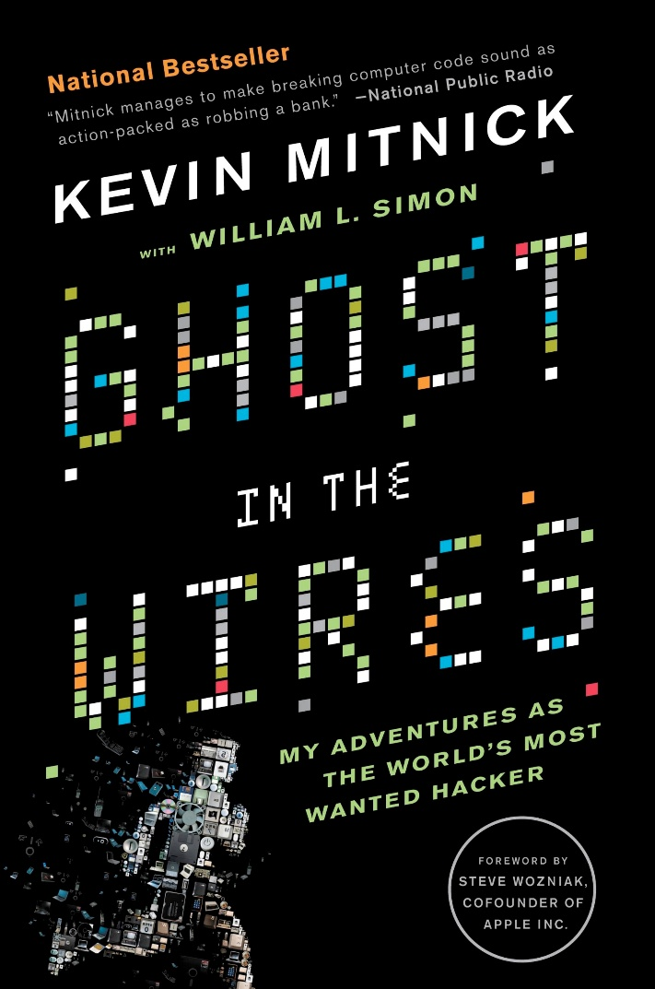
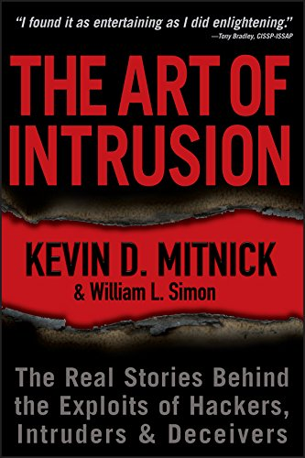
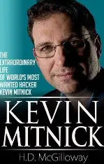
His Books (pictures obtained from Google)
His teachings can be very valuable for someone who wants to pursue a career in cybersecurity.
Notes:
A few of the books I want to read, learning about Mitnick has been very fruitful, I hope to learn a lot from his career.

Slide 9
The Legacy of Kevin Mitnick
Mitnick’s story can be seen as a cautionary tale and reminder of the importance of cybersecurity.
“His story highlights the vulnerability of human nature to social engineering.” (Codemotion, 2023)
He was one of the FBI’s most wanted.
He was able to turn his life around after getting caught, proving that his skills had positive value.
Notes:
I believe that his legacy is redeemed by his desire to teach and write about his time as a bad actor.

Slide 10
Conclusion
Kevin Mitnick was an exceptionally gifted hacker, and he was able to turn a new leaf to use his skills for the good of mankind.
His story should be read by anyone interested in cybersecurity.
Security measures are of vital importance, to protect sensitive data and systems. (Codemotion, 2023)
Kevin Mitnick died on July 16, 2023 to cancer. (Codemotion, 2023)
Notes:
His contributions to ethical hacking are massive, it is unfortunate his life was cut short due to cancer.

Slide 11
References
Codemotion. (2023, July 20). The life of Kevin Mitnick: The world’s most famous hacker. Codemotion Magazine. https://www.codemotion.com/magazine/cybersecurity/kevin-mitnick-the-worlds-most-famous-hacker/
Sergeev, Anry. (2025, January 17). The story of Kevin Mitnick: The world’s most famous hacker. GaGadget. https://gagadget.com/en/security/619553-the-story-of-kevin-mitnick-the-worlds-most-famous-hacker/

