Slide 1

Real Estate Development
A data driven approach to forecasting and predicting real estate opportunities

Slide 2
PROBLEM STATEMENT
Real estate is a very complex, rapidly changing market which makes it difficult for newly starting developers or homeowners identify great opportunities to invest in.

Slide 3
Business value
Maximize profit opportunities for developers who are starting a new business and accelerate their growth.
Identify trends in market data to help young owners target ideal buying conditions.

Slide 4

METHODOLOGY
Analysis of housing market data across the united states – Zillow data
Using timeseries analysis – arima modeling

Slide 5
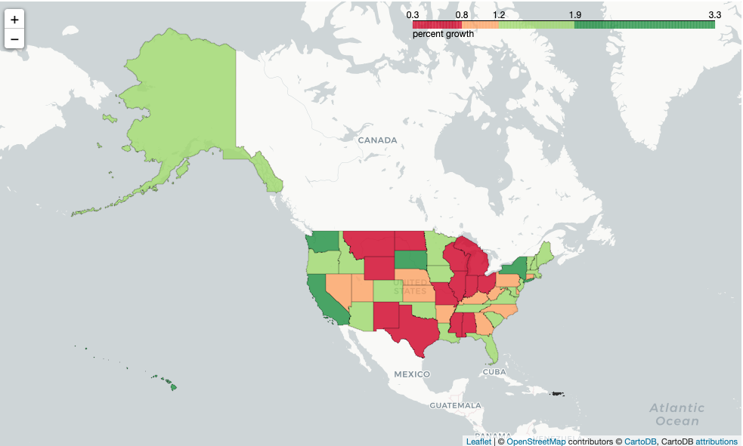
Property value growth across the United States

Slide 6
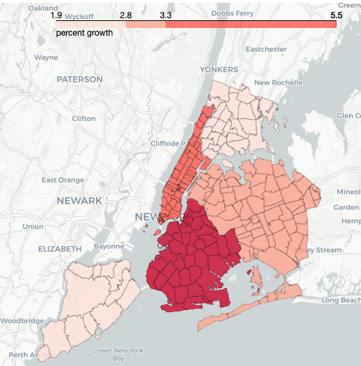
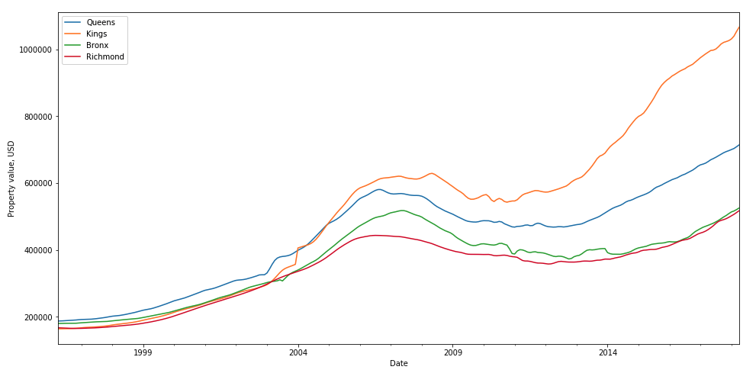
Property value growth for NYC – by borough

Slide 7
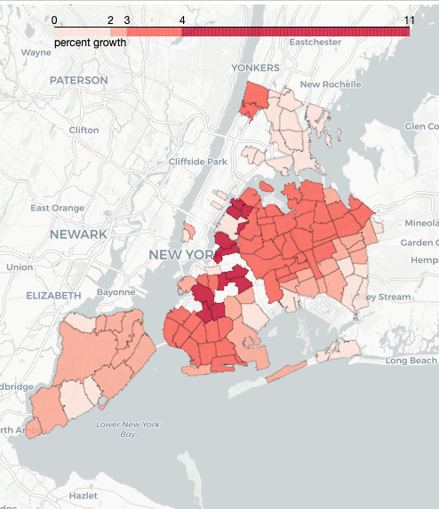
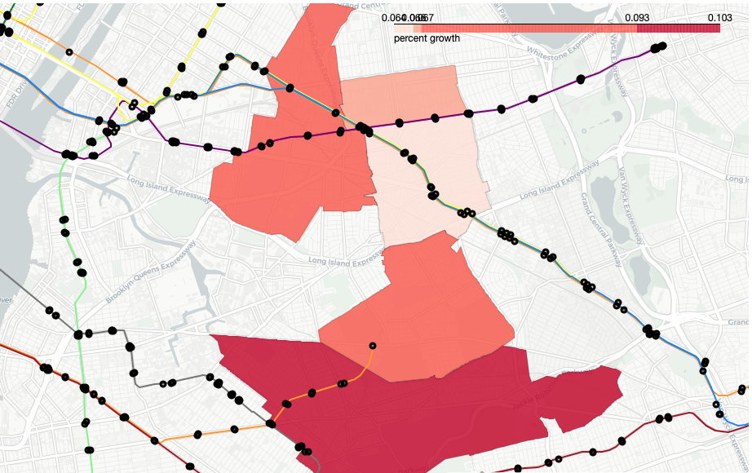
Property value growth for NYC – by zip code

Slide 8
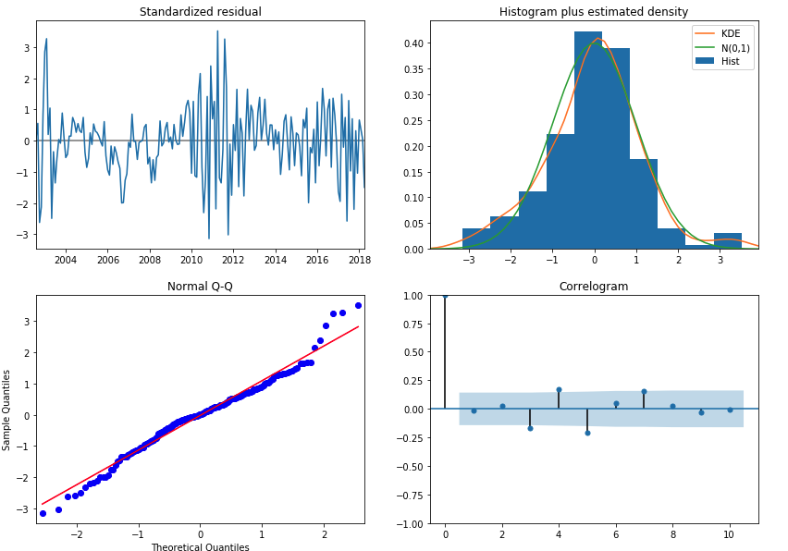
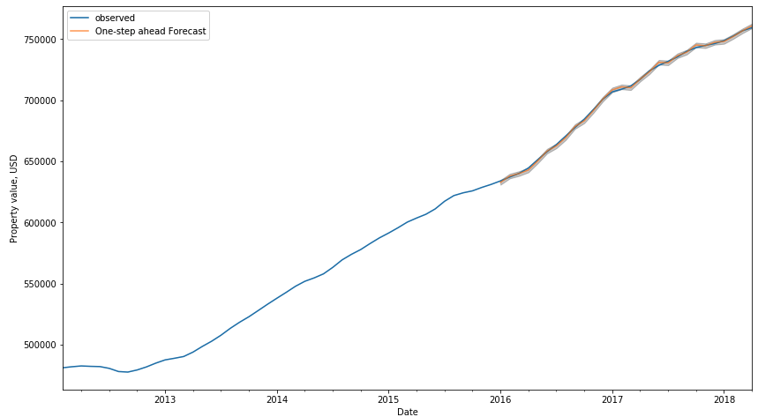
RESULTS

Slide 9
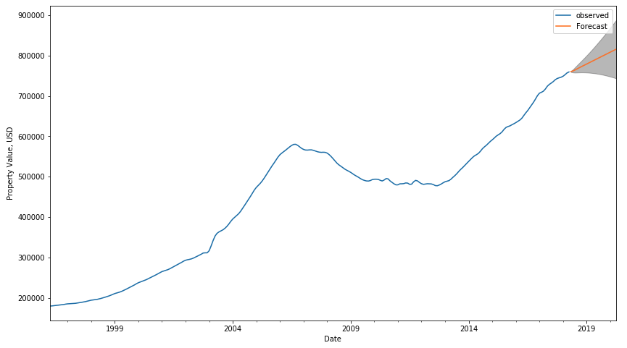
SUMMARY
The forecasted results yield an 80% confidence shows an increasing property value over the course of the next 2 years.
Endorse investing in these targeted zip codes.

Slide 10
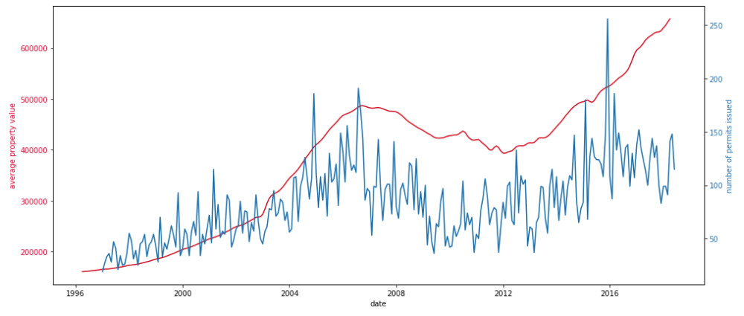
FUTURE CONSIDERATIONS
Incorporating future construction project into the model to predict how large-scale investments into an area can affect housing prices.
Current dataset does not include how the COVID-19 has impacted the market, extend dataset to more recent timeframes for analysis.
Adding additional external data to the model, ie number of permits issued by NYC DoB

Slide 11

THANK YOU

