Slide 1
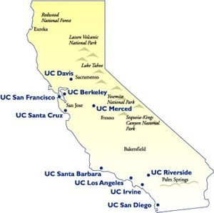

Predicting the student yield for the University of California
Final Iteration
Michal, Nick, Nelson

Slide 2

Updates
More Data-Preprocessing
Modeling and Prediction
Result Visualization
Future Work
Challenges

Slide 3
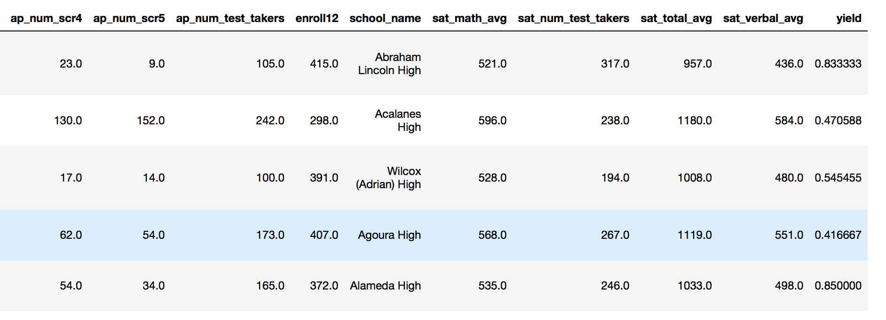
Data Pre-processing
30 Columns

Slide 4
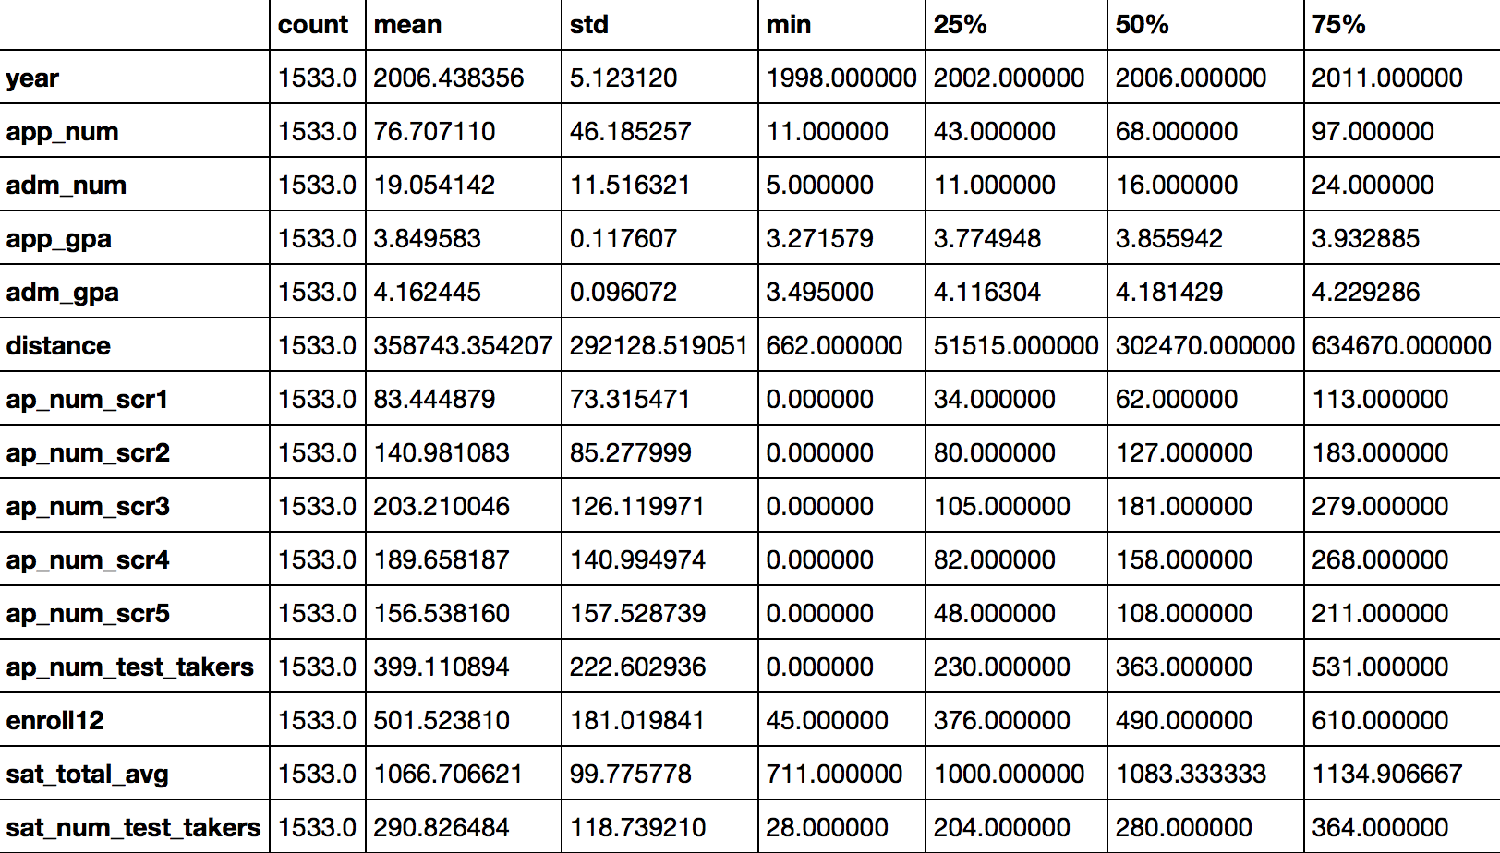

Slide 5
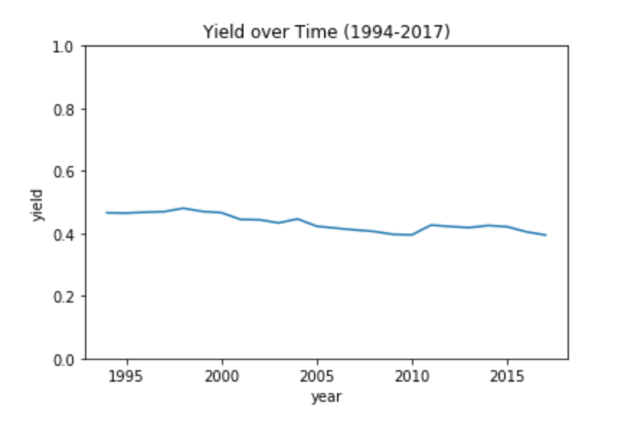
Baseline Model
Average Yield Rate: 0.45
for all schools
and all years

Slide 6
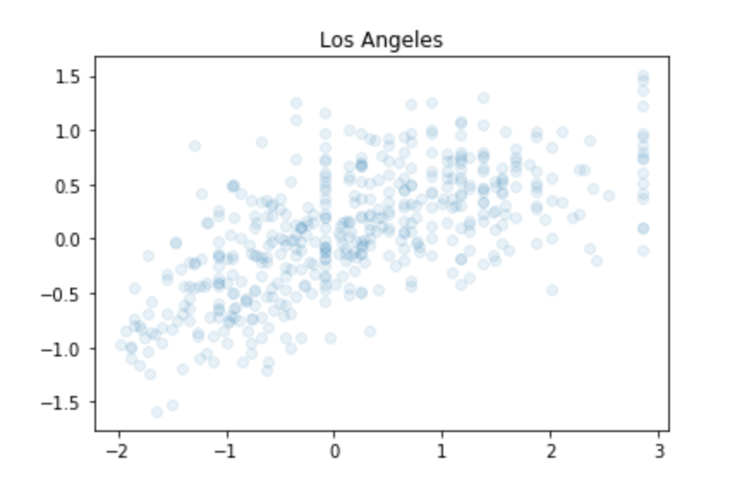
Linear Regression Model
Training features
Training-testing split: 70/30
Linear Regressor Model for individual campus
Predicted
Actual

Slide 7
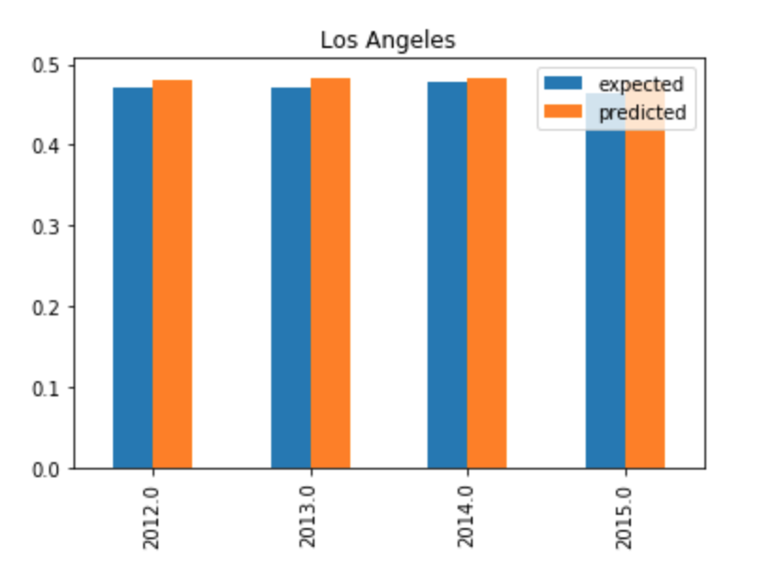
Results
Baseline Model: Yield Rate Prediction: 45%
Linear Regression Model
Both Models give us solid prediction

Slide 8

Future Work
Current high school names ended at “L”
Replenish more high schools test data
Cross-Validation Model (in progress)
Try different ML models
Incorporate more test scores

Slide 9

Challenges
Datasets merging
Poor correlation between existing variables
High school ID’s did not match up
API limit of Google Maps

