Slide 1
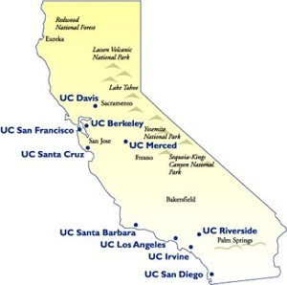

Predicting the student yield for the University of California
Final Iteration
Michal, Nick, Nelson

Slide 2

Updates
More Data-Preprocessing
Modeling and Prediction
Result Visualization
Future Work
Challenges

Slide 3
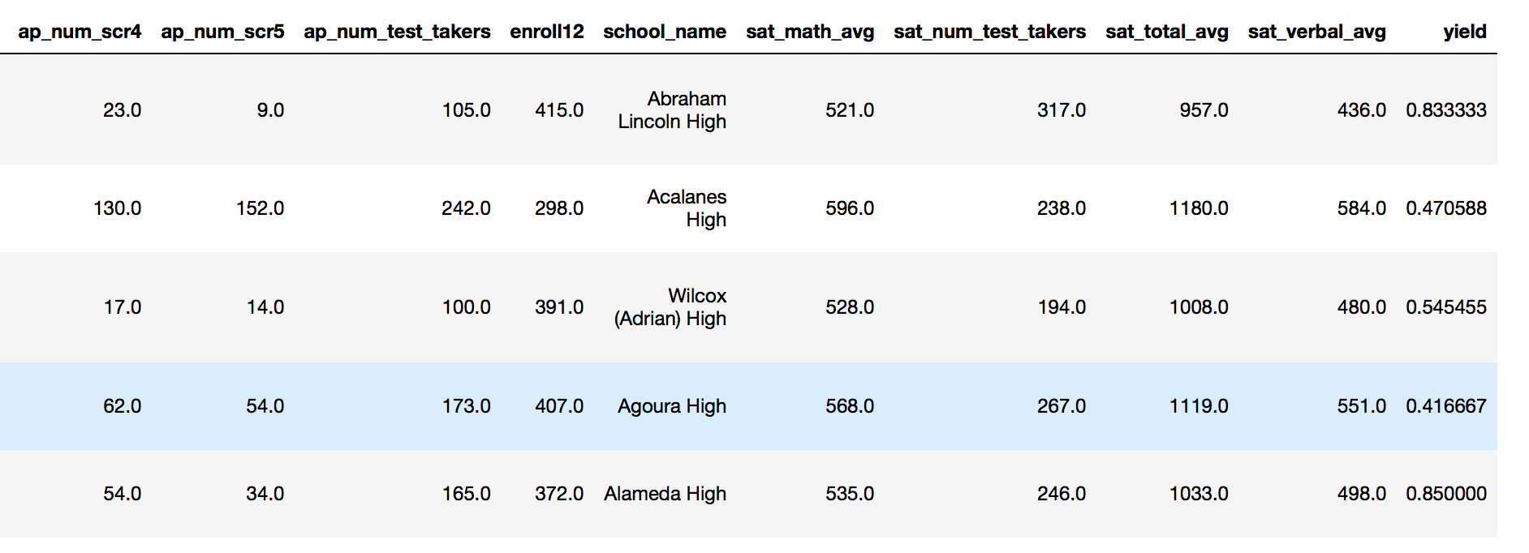
Data Pre-processing
30 Columns

Slide 4
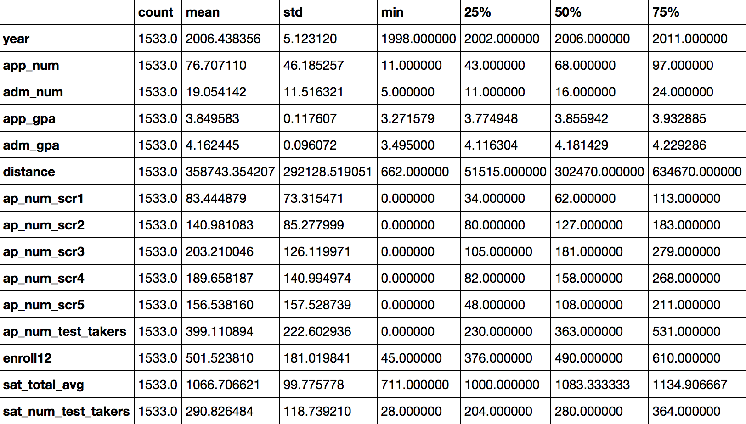

Slide 5
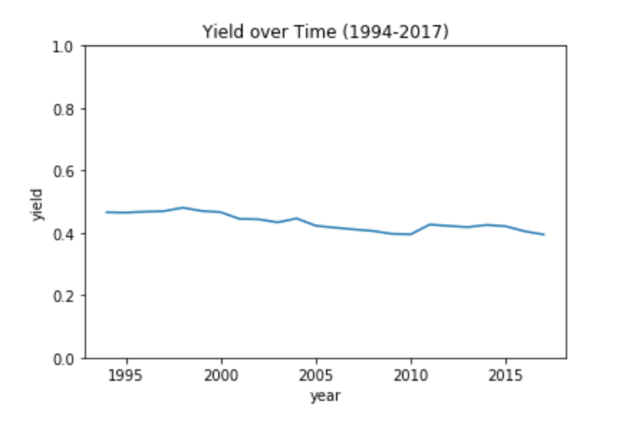
Baseline Model
Average Yield Rate: 0.45
for all schools
and all years

Slide 6
Linear Regression Model

Slide 7
Results

Slide 8

Future Work
Try different ML models
Incorporate more test scores

Slide 9

Challenges
More datasets merging
Poor correlation between existing variables
High schools ID did not match up
API limit of Google Maps

