Slide 1
SEC Filings Reading between the lines
By: Ulises Barroso, Nicholas Donahoe, Ryan Irvine, Alice Yu

Slide 2
Company Selection Process
Whatever you already have ☺

Slide 3


Text Analysis Methodology
1
2
Data Preprocessing
Document Selection
SEC EDGAR annual reports
SEC EDGAR quarterly reports
Extended stop words
Lemmatized words
Removed punctuation
Limited financial terms

Slide 4


Text Analysis Methodology
3
4
Vectorization
Model Selection
Tools:
Sklearn CountVectorizer
TF-IDF Vectorizer
Determined:
Word frequencies
Full corpus of words
80% train/test split
Components:
SEC report text
Stock price change from SEC filing date
Linear regression on stock price
One day after
One month after
3 months after
PCA / LDA on most frequent terms

Slide 5

Conclusions
 | Actual Label | Actual Stock Market Change | Actual | Predicted Label | Predicted
2019FANG | 1 | 0.22 | positive | 0.89 | positive
2014FANG | 1 | 1.63 | positive | 1.52 | positive
2016RRC | 1 | 0.54 | positive | 0.77 | positive
2016NFX | 1 | 0.99 | positive | 0.62 | positive
2017CXO | 1 | 1.63 | positive | 0.6 | positive
2019SM | 0 | -0.13 | negative | -0.2 | negative
2019ECA | 1 | 0.01 | positive | -0.22 | negative
2019EQT | 1 | 0.73 | positive | 1.5 | positive
2018CXO | 1 | 0.02 | positive | 0.7 | positive
2016GPOR | 1 | 0 | positive | 0.4 | positive
2014NFX | 1 | 0.99 | positive | 0.8 | positive
2015SM | 0 | -2.52 | negative | 0.9 | positive
2014CXO | 1 | 0 | positive | 0.04 | positive
1 day
48 training records
13 test records
85% accuracy

Slide 6
Conclusions
 | Actual Label | Actual Stock Market Change | Actual | Predicted Label | Predicted
2015FANG | 0 | -2.75 | negative | 1.28 | positive
2016NFX | 1 | 8.96 | positive | 1.55 | positive
2015LPI | 1 | 0.49 | positive | 0.27 | positive
2014MDU | 0 | -0.8 | negative | 1.55 | positive
2018NFX | 0 | -1.47 | negative | -0.25 | negative
2017SM | 0 | -5.34 | negative | -0.4 | negative
2016EQT | 1 | 4.08 | positive | -0.96 | negative
2016CXO | 1 | 14.83 | positive | 1.11 | positive
2017LPI | 0 | -0.99 | negative | -0.72 | negative
2018LPI | 1 | 0.2 | positive | -0.02 | negative
2018RSPP | 1 | 11.06 | positive | 1.8 | positive
2016MDU | 1 | 1.62 | positive | 1.62 | positive
2017RSPP | 1 | 0.1 | positive | 0.75 | positive
1 month
48 training records
13 test records
70% accuracy

Slide 7
Conclusions
 | Actual Label | Actual Stock Market Change | Actual | Predicted Label | Predicted
2015MDU | 0 | -2.05 | negative | negative | 0.57
2014CXO | 1 | 17.55 | positive | negative | 0.67
2015CXO | 1 | 5.55 | positive | negative | 0.8
2017EQT | 0 | -6.67 | negative | positive | 1.44
2018ECA | 1 | 1.53 | positive | negative | 0.12
2014EQT | 1 | 4.16 | positive | negative | 0.8
2016GPOR | 1 | 2.22 | positive | negative | 0.53
2015RSPP | 1 | 3.14 | positive | positive | 1.28
2017GPOR | 0 | -4.03 | negative | negative | 0.36
2016MDU | 1 | 4.06 | positive | positive | 1.35
2018RRC | 1 | 1.81 | positive | negative | 0.32
3 months
41 training records
11 test records
36% accuracy
(Removed NaNs)

Slide 8
Conclusions

Slide 9
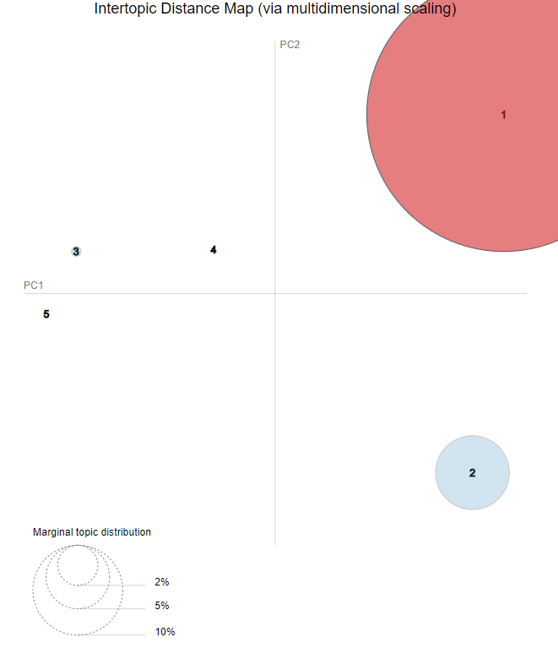
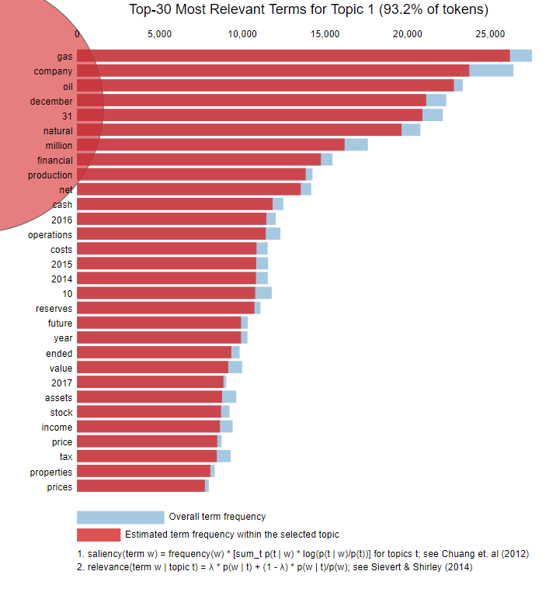
Conclusions
PCA & LDA Analysis:
5 topic selection
Need to greatly fine-tune our dictionary of terms

Slide 10
Future Improvement
Company Selection
Index company stocks to a common starting point based on Oil & Gas index funds
Data Selection
Include 8Ks, earnings calls transcripts, quarterly earnings reports
Limit to Management’s Discussion & Analysis text
Normalize data against commodities
Vectorization
Corpus of words needs to be further tuned and limited

Slide 11

Future Improvement
Model Selection
Topics honing for the PCA / LDA analysis
Model Timing
3-month model should be compared against upcoming quarterly number, rather than prior quarter stock change
Sentiment Analysis
Compare against Financial Terms weighted dictionary

