Slide 1
Sentinel: Adversarial Fraud Detection AI Platform
Nick Mwaura
Data Science Final Project · In-Person Presentation

Slide 2
Abstract
Purpose: detect credit-card fraud in real time and monitor adversarial drift
Primary algorithm: CatBoost gradient boosted trees (depth 6, 500 iterations)
Supporting: SMOTE (class balance), Isolation Forest (anomalies), KS drift tests
Data: credit_dt fraudTrain.csv / fraudTest.csv (~1.3M / 555k rows)
Results: ROC-AUC 0.9851, F1 0.6887, Precision 0.704, Recall 0.674
Platform: Sentinel web UI + FastAPI + seven-layer AI architecture

Slide 3
Existing System (Limitations)
What legacy fraud systems typically lack
Rule-based velocity limits and static blacklists
Batch-only ML with no post-deployment drift monitoring
No unified pipeline — training, scoring, monitoring in separate scripts
Kaggle PCA features only — no merchant category or geography
No governance linking model quality to serve / retrain decisions

Slide 4
Proposed System — Sentinel
Unified FraudAIPipeline: 10 orchestrated stages
13 engineered features including Haversine distance_km
REST API + Sentinel UI + WebSocket live stream
Model registry, telemetry, and model cards for audit
Governance layer: alert when ≥3 features drift (KS p < 0.05)

Slide 5
Data Resources
Source: fraudTrain.csv (train) · fraudTest.csv (test) — credit card transactions
Raw fields: amount, lat/long, merchant coords, category, gender, state, timestamp
Derived: trans_hour, trans_dow, distance_km (Haversine formula)
Target: is_fraud (0 = legitimate, 1 = fraud) — ~0.8% fraud in train sample
Caps: 200k train / 100k test rows for practical laptop training

Slide 6

Architecture Diagram — Seven Layers
Explanation:
• Top-down design: L1 Business sets policy; L4 ML Core computes predictions.
• L2 Experience is how users interact (Sentinel UI, API).
• L3 Orchestration runs the stage graph; L6/L7 handle versioning and audit.
• L5 Data feeds raw CSVs into the featurizer before modelling.

Slide 7
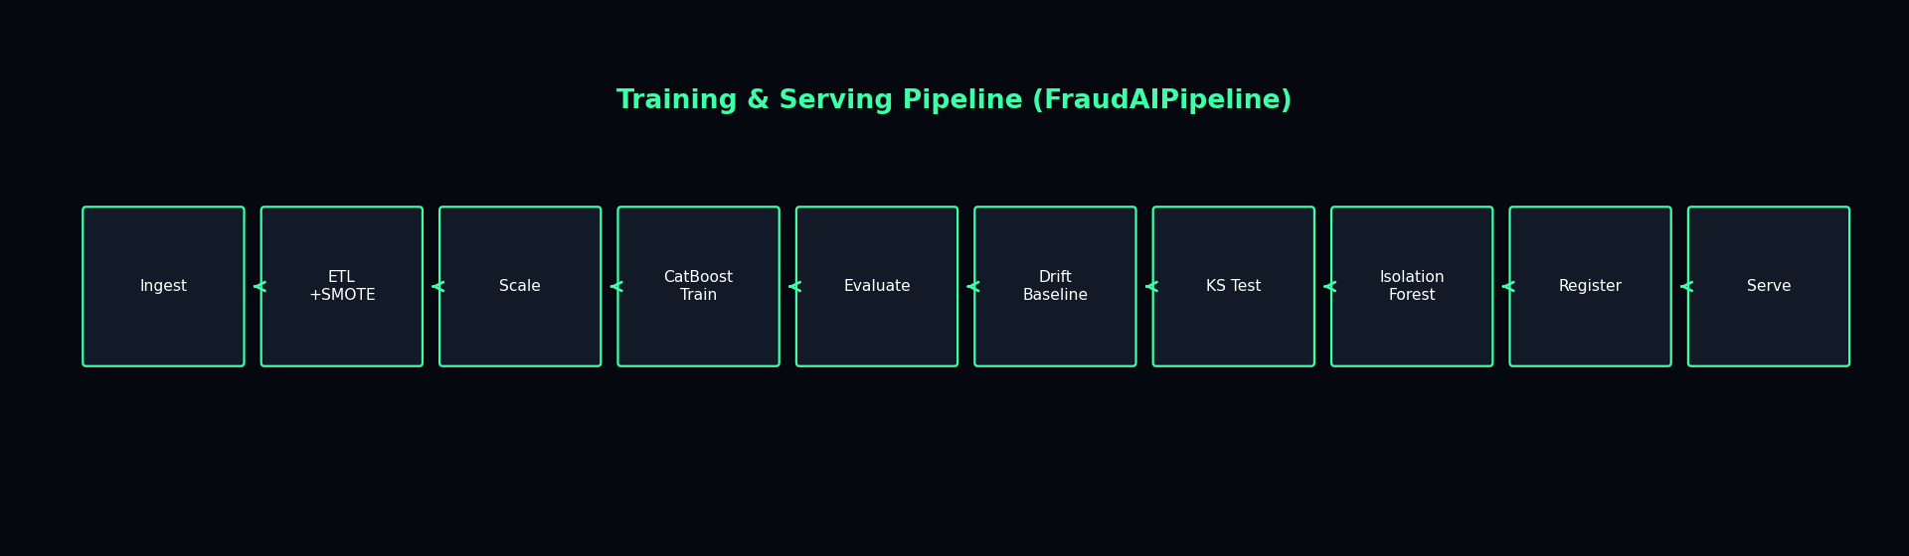
Pipeline Flow Diagram
Explanation:
• Sequential stages executed by python main.py.
• SMOTE applied only after ETL on training data — test set stays imbalanced.
• Drift baseline saved before serving; KS test compares test vs train distributions.
• Final model registered and promoted to production in the registry.

Slide 8
Algorithm 1 — SMOTE (Class Balancing)
x_new = x_i + λ · (x_neighbor − x_i), λ ∈ [0,1]
k_neighbors = 5, sampling_strategy = auto
Applied to TRAIN only — fraud class ~0.8% → balanced ~50/50
• Synthetic Minority Over-sampling Technique creates new fraud examples.
• Interpolates between a real fraud point and one of its k nearest fraud neighbours.
• Prevents CatBoost from ignoring the rare fraud class during training.
• Test set is never SMOTE'd — evaluation reflects real-world imbalance.

Slide 9
Algorithm 2 — Haversine Distance (Feature Engineering)
a = sin²(Δlat/2) + cos(lat₁)·cos(lat₂)·sin²(Δlon/2)
distance_km = 2 · R · arcsin(√a), R = 6371 km
Inputs: cardholder (lat, long) and merchant (merch_lat, merch_long)
• Computes great-circle distance between cardholder and purchase location.
• Flags geographically implausible transactions (e.g. card in NY, merchant in CA).
• Used as a numeric feature alongside raw coordinates in CatBoost.

Slide 10
Algorithm 3 — CatBoost (Primary Classifier)
F(x) = Σₜ₌₁^T η · hₜ(x), T=500 trees, η=0.05, depth≤6
P(fraud | x) = σ(F(x)) = 1 / (1 + e^(−F(x)))
Decision: fraud_prediction = 1 if P(fraud) ≥ 0.5
• Gradient boosting: each tree hₜ corrects errors of previous trees.
• Depth 6 = up to 6 sequential split rules per tree (category, amount, time…).
• auto_class_weights=Balanced penalises misclassified fraud more heavily.
• 500 trees × 13 scaled features → fraud probability in [0, 1].

Slide 11
Algorithm 4 — StandardScaler (Preprocessing)
x_scaled = (x − μ_train) / σ_train
Fit on SMOTE-balanced train; transform train & test identically
• Puts all 13 features on comparable scale (mean 0, variance 1).
• Critical for distance-based anomaly detection and stable tree splits.
• Scaler saved to artifacts/scaler.joblib for serving-time consistency.

Slide 12
Algorithm 5 — Kolmogorov–Smirnov Drift Test
KS = max_x | F_train(x) − F_test(x) |
Drift if p-value < α (α = 0.05)
Governance: alert if ≥3 features drift; block if ≥10
• Compares cumulative distribution of each feature: train vs production/test.
• Detected drift on unix_time and trans_dow — temporal shift between splits.
• Feeds L1 governance — operators alerted before model silently degrades.

Slide 13
Algorithm 6 — Isolation Forest (Anomaly Detection)
anomaly_score = −decision_function(x)
n_estimators = 100, contamination = 0.002
Shorter isolation path → higher anomaly score
• Unsupervised ensemble — no fraud labels needed at score time.
• Random trees isolate points; outliers need fewer splits to separate.
• Complements CatBoost in the live WebSocket stream for novel attack patterns.

Slide 14
Evaluation Metrics (Mathematics)
ROC-AUC = ∫ TPR(FPR) d(FPR)
Precision = TP / (TP + FP), Recall = TP / (TP + FN)
F1 = 2 · Precision · Recall / (Precision + Recall)
Accuracy = (TP + TN) / N — misleading when fraud < 1%
• Our test results: ROC-AUC=0.9851, F1=0.6887, Precision=0.704, Recall=0.674.
• Confusion matrix: TP=271, FN=131, FP=114, TN=99,484 (100k test rows).
• Balanced accuracy (0.836) is fairer than raw accuracy (0.998) under imbalance.

Slide 15
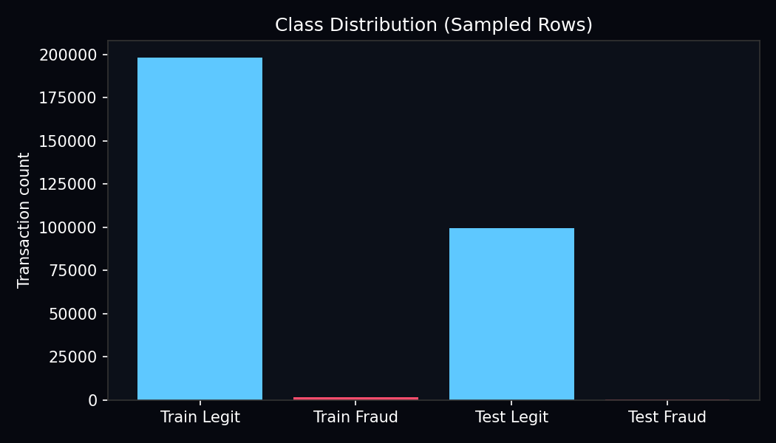
Visualization — Class Imbalance
What this shows:
• Blue bars = legitimate transactions; red = fraud.
• Train fraud rate ~0.82%; test ~0.40% — extreme imbalance (~1000:1).
• Justifies SMOTE on train and ROC-AUC/F1 as primary metrics, not accuracy.

Slide 16
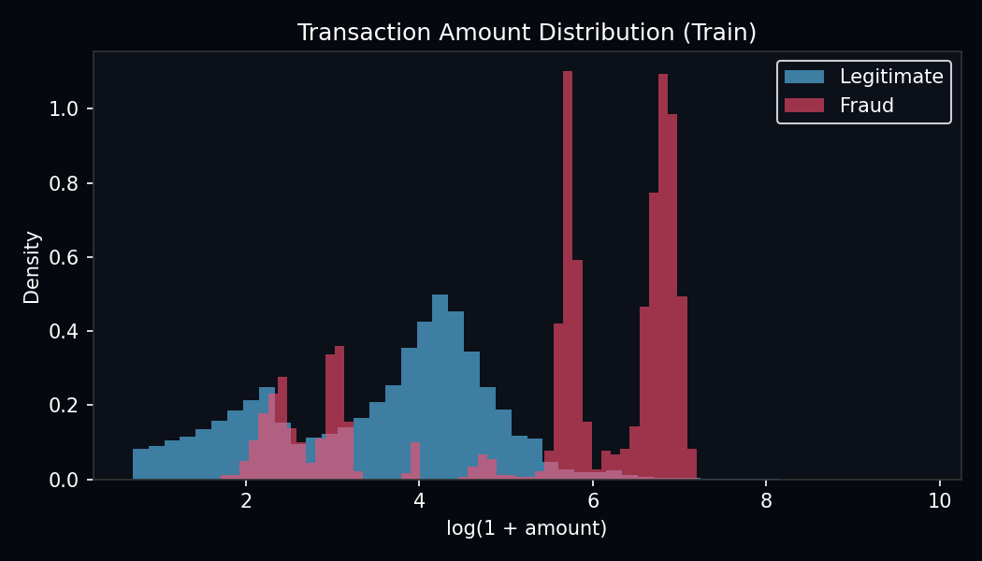
Visualization — Transaction Amount Distribution
What this shows:
• Histogram of log(1 + amount) for legit (blue) vs fraud (red).
• Fraud transactions skew toward higher amounts (mean ~$509 vs ~$68 legit).
• Confirms amt as the 2nd most important CatBoost feature after category.

Slide 17
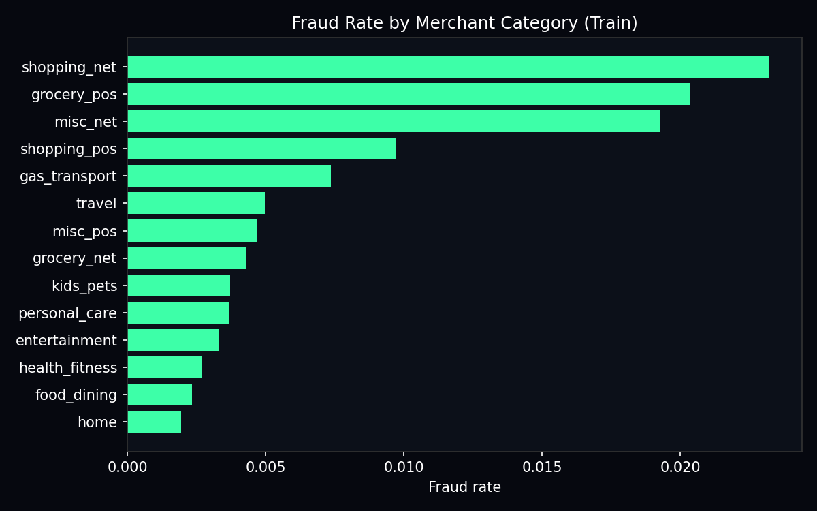
Visualization — Fraud Rate by Category
What this shows:
• Each bar = merchant category (shopping_net, travel, grocery, etc.).
• Category shows the widest fraud-rate spread — explains ~64% feature importance.
• CatBoost learns different risk profiles per merchant type.

Slide 18
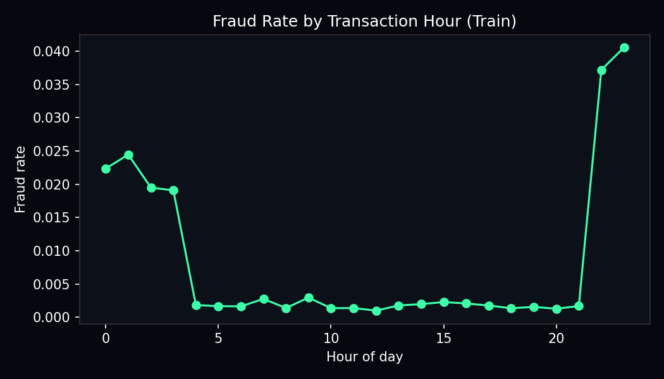
Visualization — Fraud Rate by Hour
What this shows:
• Line chart: fraud rate vs hour of day (0–23) from trans_date_trans_time.
• Temporal patterns motivate trans_hour and trans_dow as model inputs.
• KS drift on unix_time/trans_dow reflects train vs test time shift.

Slide 19
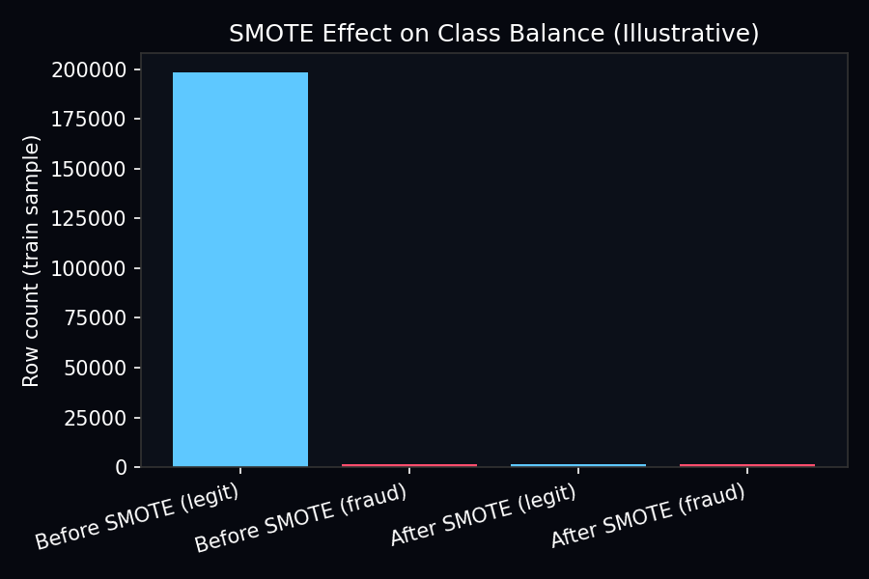
Visualization — SMOTE Class Balance
What this shows:
• Before SMOTE: ~198k legit vs ~1.6k fraud. After: classes balanced (~1:1).
• Synthetic fraud points fill the feature space between real fraud neighbours.
• Only training data is resampled — test evaluation stays realistic.

Slide 20
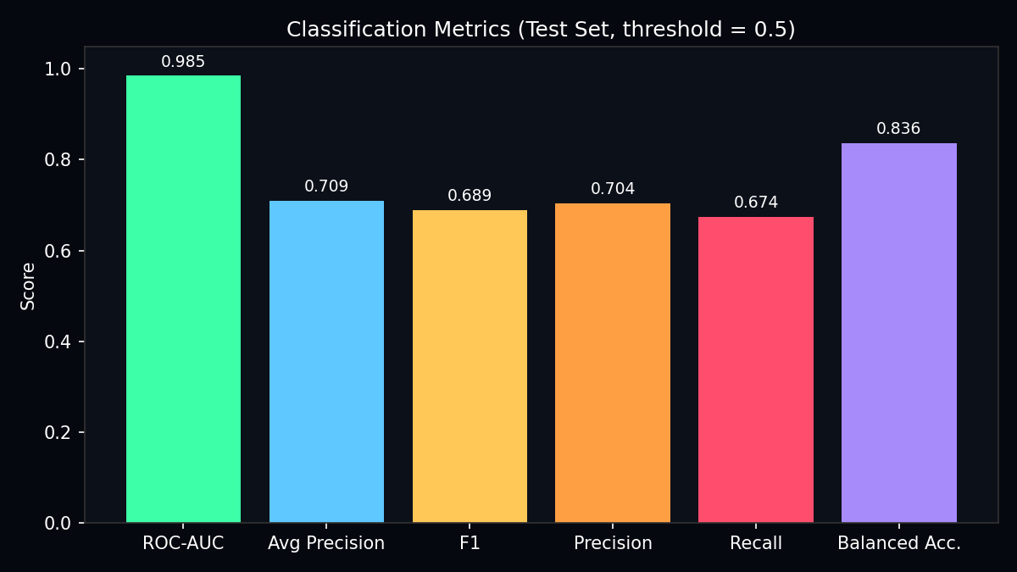
Visualization — Model Metrics Summary
What this shows:
• Bar chart of ROC-AUC, Average Precision, F1, Precision, Recall, Balanced Acc.
• ROC-AUC 0.985 = excellent ranking; F1 0.689 = realistic under imbalance.
• Average Precision (0.709) focuses specifically on the fraud class.

Slide 21
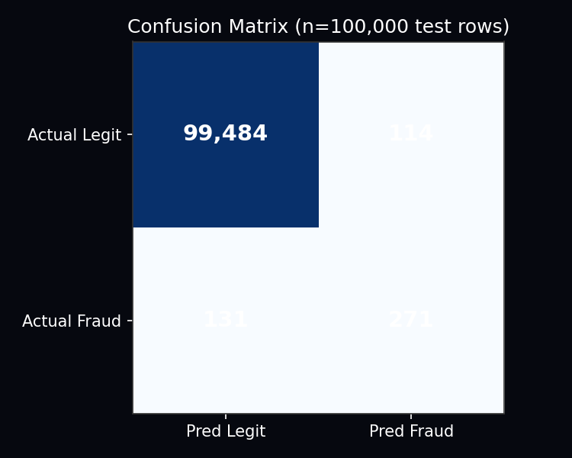
Visualization — Confusion Matrix
What this shows:
• Rows = actual class; columns = predicted class at threshold 0.5.
• 271 true positives (fraud caught); 131 false negatives (fraud missed).
• 114 false positives (legit flagged) — acceptable cost for fraud prevention.

Slide 22
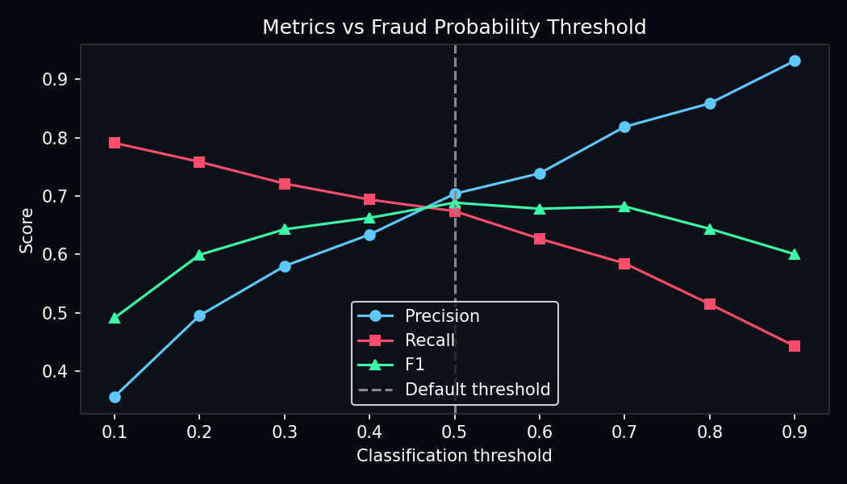
Visualization — Threshold Sensitivity
What this shows:
• Lines show precision (blue), recall (red), F1 (green) vs threshold.
• Lower threshold → more fraud caught but more false alarms.
• Default 0.5 balances precision (0.70) and recall (0.67).

Slide 23
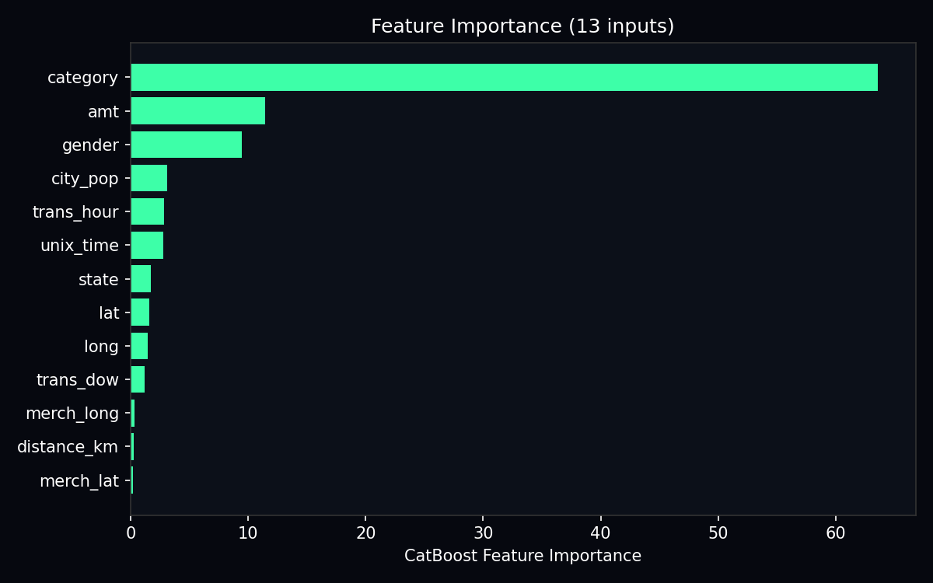
Visualization — Feature Importance
What this shows:
• CatBoost gain-based importance across all 500 trees.
• category dominates (~64%); amt (~11%); gender (~9%); geo features smaller.
• Guides feature engineering priorities and business interpretation.

Slide 24
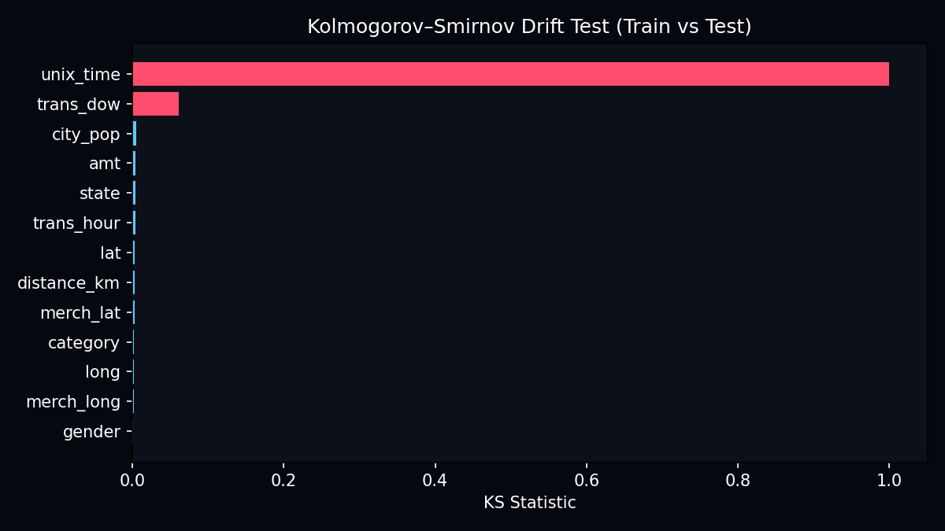
Visualization — KS Drift Report
What this shows:
• Red bars = drift detected (p < 0.05); blue = no significant drift.
• unix_time KS=1.0 — complete temporal distribution shift train→test.
• Governance uses this to alert operators before silent model degradation.

Slide 25
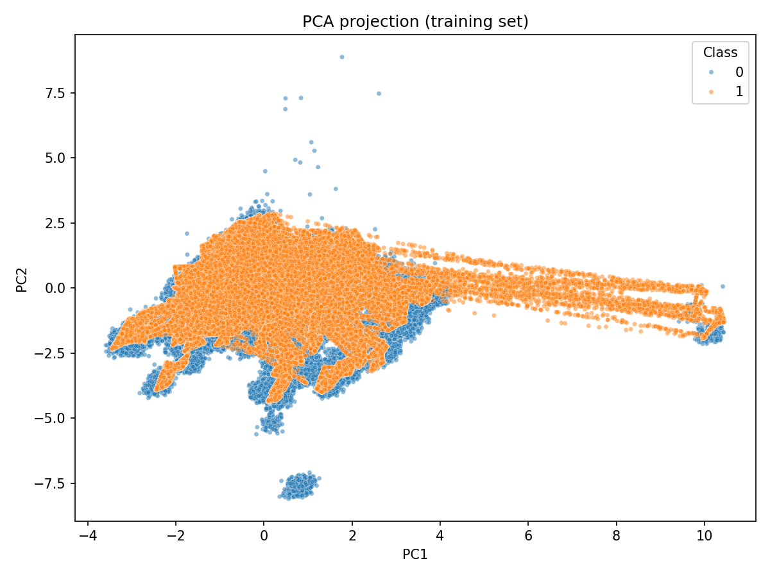
Visualization — PCA Projection (2D)
What this shows:
• 2 principal components of scaled training features after StandardScaler.
• Points coloured by Class: fraud (1) vs legitimate (0).
• Exploratory only — PCA is NOT fed to CatBoost (13 original features used).
• Shows partial separation of fraud in reduced 2D space.

Slide 26
Methodology Summary
1. Ingest fraudTrain / fraudTest CSVs
2. Featurize: time, Haversine distance, label-encode categoricals
3. Clean: dedupe, median impute
4. SMOTE balance training labels
5. StandardScaler fit/transform
6. Train CatBoost (500 trees, depth 6)
7. Evaluate on held-out fraudTest
8. Fit KS drift baseline; run drift check
9. Train Isolation Forest; register model; apply governance

Slide 27
Accuracies & Results
ROC-AUC: 0.9851 — strong fraud vs legit ranking
F1 Score: 0.6887 at threshold 0.5
Precision: 0.7039 — 70% of flags are true fraud
Recall: 0.6741 — 67% of fraud cases detected
Average Precision: 0.7093
Model: 500 CatBoost trees, depth 6, 13 features
Production version: v_f381139c (Model Registry)

Slide 28
Conclusions & Future Work
Conclusions:
Seven-layer architecture separates policy from ML computation
CatBoost + SMOTE achieves strong ROC-AUC on imbalanced fraud data
Visualizations confirm category and amount drive predictions
KS drift monitoring supports adversarial / temporal shift awareness
Future:
SHAP explanations, automated retrain, cloud deployment, API auth

Slide 29
Thank You
Nick Mwaura · Questions?

