Slide 1
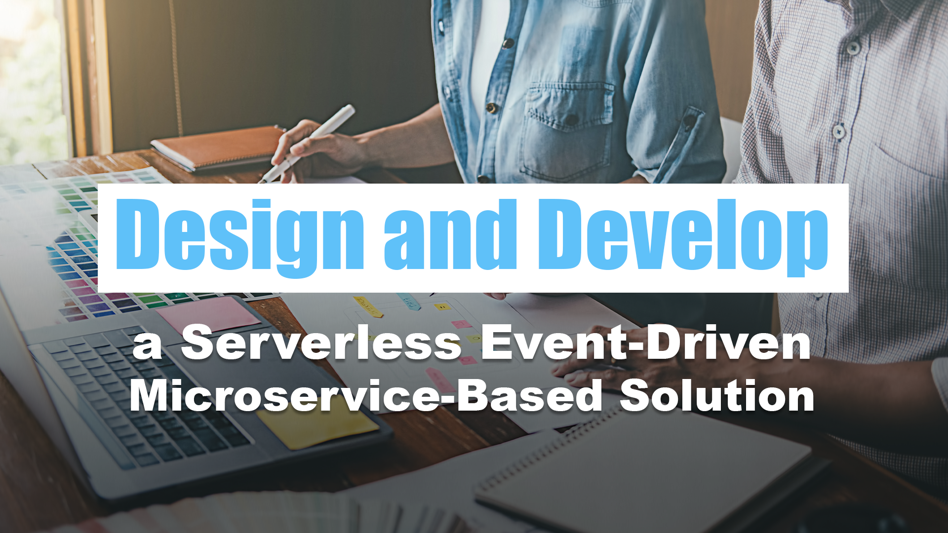
01 - Welcome

Slide 2



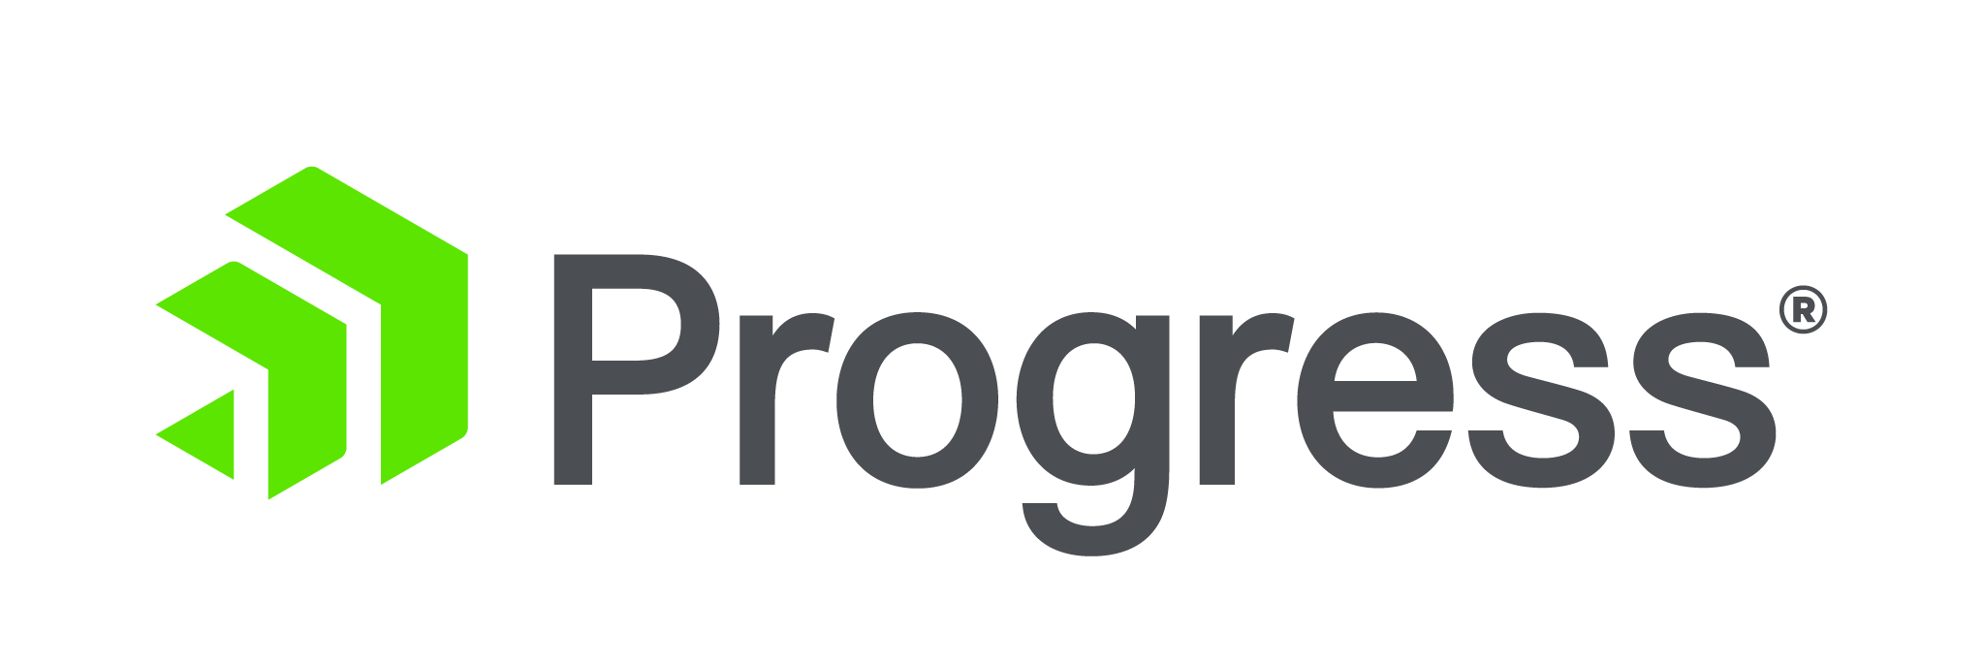


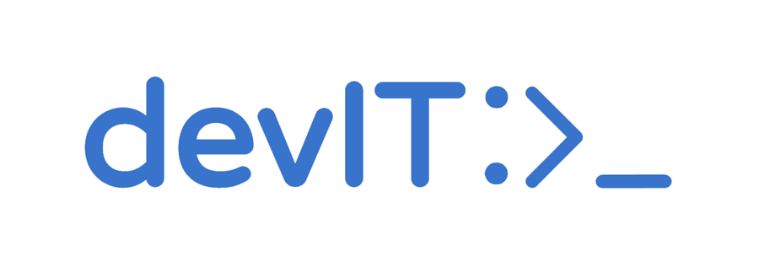



Thank you to the TechBash Sponsors

Slide 3
Logistics
Workshop Hours: 9:00 am to 5:00 pm
Lunch: 12:30 to 1:30
Breaks
WiFi: Cavin-Guest

Slide 4
Agenda

Slide 5
Agenda
Introductions
Notes:
Introductions
Introduce the workshop
Introduce me
Introduce you
Introduce the scenario

Slide 6
Agenda
Introductions
Architecting Solutions to Meet Customer Needs
Notes:
Learn about the essential techniques and strategies for architecting solutions that align with customer needs. Understanding and meeting customer requirements are crucial for delivering successful and valuable products or services. Through a combination of theoretical insights and hands-on experience, you will gain practical experience in designing customer-centric solutions that address real-world challenges.

Slide 7
Agenda
Introductions
Architecting Solutions to Meet Customer Needs
Understanding Customer Needs
Notes:
Understanding Customer Needs:
Techniques for identifying and analyzing customer requirements
Empathy mapping: putting yourself in the customer’s shoes
Defining customer personas and use cases

Slide 8
Agenda
Introductions
Architecting Solutions to Meet Customer Needs
Understanding Customer Needs
Architecting Customer-Centric Solutions
Notes:
Architecting Customer-Centric Solutions:
Key principles for designing solutions that address customer needs
Mapping customer requirements to solutions features
Balancing innovation with practicality in solution design

Slide 9
Agenda
Introductions
Architecting Solutions to Meet Customer Needs
Understanding Customer Needs
Architecting Customer-Centric Solutions
Cloud Architecture Principles
Notes:
Cloud Architecture Principles:
Understanding the principles of a well-architected cloud solution
Key considerations: security, reliability, performance, cost, and scalability
Designing for failure: Fault tolerance and disaster recovery
Leveraging cloud-native services and serverless computing

Slide 10
Agenda
Introductions
Architecting Solutions to Meet Customer Needs
Understanding Customer Needs
Architecting Customer-Centric Solutions
Cloud Architecture Principles
Cloud Solution Design Patterns
Notes:
Cloud Solution Design Patterns:
Introduction to common cloud solution design patterns
Patterns for web applications, data processing, and real-time analytics
Using containers and orchestration for scalable deployments

Slide 11
Agenda
Introductions
Architecting Solutions to Meet Customer Needs
Understanding Customer Needs
Architecting Customer-Centric Solutions
Cloud Architecture Principles
Cloud Solution Design Patterns
Hands-On Exercise: Design a Customer-Centric Solution
Notes:
Hands-On Exercise: Design a Customer-Centric Solution:
Participants will work in groups to design a cloud solution based on a provided use case
Using the techniques learned, each group will collaboratively architect a solution to meet the specific customer needs
Applying cloud architecture principles and design patterns learned in the workshop
Presenting and discussing the proposed cloud solution designs

Slide 12
Agenda
Introductions
Architecting Solutions to Meet Customer Needs
Building Serverless Event-Driven Architecture Solutions
Notes:
Event-driven architecture enables real-time communication and responsiveness in applications by using events to trigger actions. During this section, you will learn how to leverage Azure Event Hubs and Azure Functions to design and build scalable, event-driven solutions on the Azure cloud platform. Through a combination of theoretical explanations and practical exercises, you will gain a comprehensive understanding of key concepts and best practices for implementing EDA solutions.

Slide 13
Agenda
Introductions
Architecting Solutions to Meet Customer Needs
Building Serverless Event-Driven Architecture Solutions
Introduction to Azure App Configuration and Azure Key Vault
Notes:
Introduction to Azure App Configuration and Azure Key Vault:
Overview of Azure App Configuration and its role in managing application settings
Introduction to Azure Key Vault and its significance in securely storing and accessing secrets
Key benefits of use cases of both services

Slide 14
Agenda
Introductions
Architecting Solutions to Meet Customer Needs
Building Serverless Event-Driven Architecture Solutions
Introduction to Azure App Configuration and Azure Key Vault
Introduction to Event-Driven Architecture
Notes:
Introduction to Event-Driven Architecture:
Overview of event-driven architecture and its benefits
Explanation of key components: events, event producers, event consumers, and event brokers
Comparison of event-driven architecture with other architectural patterns

Slide 15
Agenda
Introductions
Architecting Solutions to Meet Customer Needs
Building Serverless Event-Driven Architecture Solutions
Introduction to Azure App Configuration and Azure Key Vault
Introduction to Event-Driven Architecture
Azure Event Hubs Fundamentals
Notes:
Azure Event Hubs Fundamentals:
Introduction to Azure Event Hubs: features and use cases
Understanding event publishers and event consumers
Creating an Azure Event Hub instance in the Azure portal
Configuring security and access control for Event Hubs

Slide 16
Agenda
Introductions
Architecting Solutions to Meet Customer Needs
Building Serverless Event-Driven Architecture Solutions
Introduction to Azure App Configuration and Azure Key Vault
Introduction to Event-Driven Architecture
Azure Event Hubs Fundamentals
Azure Functions Basics
Notes:
Azure Functions Basics:
Overview of Azure Functions: serverless compute service
Event-Driven triggers supported by Azure Functions
Creating a new Azure Function app in the Azure portal

Slide 17
Agenda
Introductions
Architecting Solutions to Meet Customer Needs
Building Serverless Event-Driven Architecture Solutions
Introduction to Azure App Configuration and Azure Key Vault
Introduction to Event-Driven Architecture
Azure Event Hubs Fundamentals
Azure Functions Basics
Connecting Event Hubs to Azure Functions
Notes:
Connecting Event Hubs to Azure Functions:
Exploring integration options between Event Hubs and Azure Functions
Configuring Event Hub triggers for Azure Functions
Understanding batch processing and parallelism

Slide 18
Agenda
Introductions
Architecting Solutions to Meet Customer Needs
Building Serverless Event-Driven Architecture Solutions
Introduction to Azure App Configuration and Azure Key Vault
Introduction to Event-Driven Architecture
Azure Event Hubs Fundamentals
Azure Functions Basics
Connecting Event Hubs to Azure Functions
Best Practices and Scaling
Notes:
Best Practices and Scaling:
Best practices for designing scalable event-driven architectures
Monitoring and troubleshooting event-driven applications
Understand scaling considerations for Event Hubs and Functions

Slide 19
Agenda
Introductions
Architecting Solutions to Meet Customer Needs
Building Serverless Event-Driven Architecture Solutions
Wrap Up
Notes:
Wrap-up and Q&A
Review of key takeaways from the workshop
Open Q&A session to address your questions and concerns

Slide 20
Introductions

Slide 21






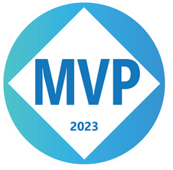
Who is Chad Green
chadgreen@chadgreen.com
TaleLearnCode
ChadGreen.com
ChadGreen & TaleLearnCode
ChadwickEGreen

Slide 22
Attendee Introductions

Slide 23
Introduction to today’s Scenario
Building Bricks’ Ecommerce System
Develop a user-friendly and secure ecommerce website for Building Bricks
Integrate a comprehensive product catalog showcasing LEGO products
Implement secure payment gateways to facilitate seamless transactions
Provide a personalized user account system for customers
Enable inventory management to track stock levels and prevent overselling
Handle the management of the order once placed through shipping
Provide a mechanism to send order confirmations and status updates
Optimize the website for search engines to improve online visibility
Ensure responsive design for optimal user experience across various devices
Integrate social media sharing and marketing capabilities
Implement analytics to track website performance and customer behavior
Notes:
Building Bricks, a company specializing in the retail of LEGO products, intends to establish a robust and efficient ecommerce system to enhance their online presence, improve customer experience, and increase sales revenue. Your company has been hired to build this solution for them and your team is responsible for the backend components.
The primary objectives for this project are as follows:

Slide 24
Introduction to today’s Scenario
Building Bricks’ Ecommerce System
Develop a user-friendly and secure ecommerce website for Building Bricks
Integrate a comprehensive product catalog showcasing LEGO products
Implement secure payment gateways to facilitate seamless transactions
Provide a personalized user account system for customers
Enable inventory management to track stock levels and prevent overselling
Handle the management of the order once placed through shipping
Provide a mechanism to send order confirmations and status updates
Optimize the website for search engines to improve online visibility
Ensure responsive design for optimal user experience across various devices
Integrate social media sharing and marketing capabilities
Implement analytics to track website performance and customer behavior

Slide 25
Introduction to today’s Scenario
User Stories (Epics)
Project Kickoff (Sprint 0)
Initialize Product Database
Place Order
Reserve Inventory
Inventory Update
Fulfillment
Close Order

