Slide 1
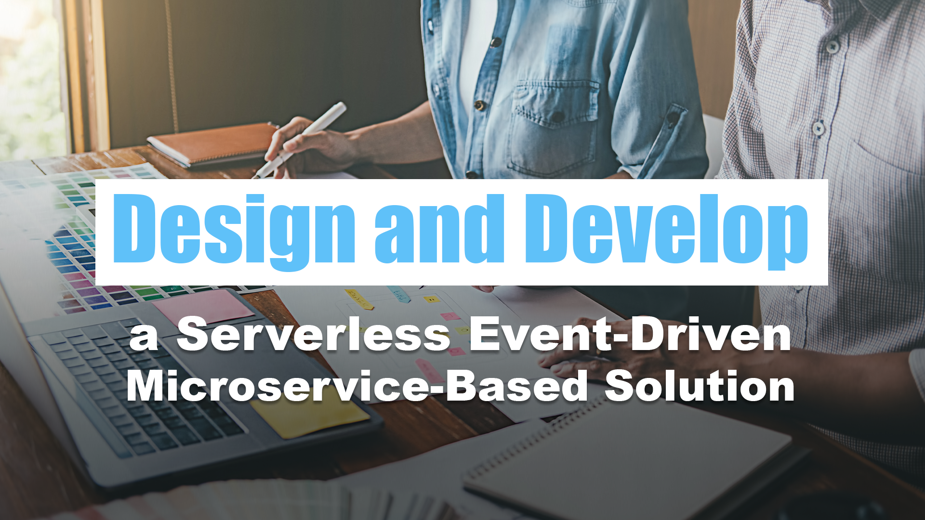
03 – Architecting Customer-Centric Solutions

Slide 2
Architecting Solutions to Meet Customer Needs
Design and Develop a Serverless Event-Driven Microservice-Based Solution

Slide 3
Understanding Customer Needs
Notes:
A software architect plays a crucial role in designing solutions that meet customer needs effectively. TO achieve this, they employ various techniques to identify and analyze customer requirements, understand their pain points, and design solutions that align with their goals. Some of these techniques include empathy mapping, defining customer personas, and creating use cases. Let’s explore each of these techniques and how they contribute to the software architect’s ability to design customer-centric solutions.

Slide 4
Identifying Customer Requirements
Engage with stakeholders
Notes:
Engage with stakeholders: The architect collaborates with stakeholders, including clients, end-users, and business analysts, to gather comprehensive requirements. This involves conducting meetings, interviews, and workshops to understand the stakeholders’ perspectives and needs.

Slide 5
Identifying Customer Requirements
Engage with stakeholders
Elicit requirements through surveys and feedback
Notes:
Elicit requirements through surveys and feedback: Feedback from existing customers or users can provide valuable insights into what works well and what needs improvement.

Slide 6
Identifying Customer Requirements
Engage with stakeholders
Elicit requirements through surveys and feedback
Analyze business processes
Notes:
Analyze business processes: The architect examines existing business processes to identity pain points and areas where software solutions can add value.

Slide 7
Empathy Mapping
Identify customer behaviors
Notes:
Empathy mapping is a technique that helps the software architect put themselves in the shoes of the customers or end-users. It involves understanding their emotions, needs, thoughts, and actions. This process aids in developing a deeper understanding of what drives customer behavior and what they value most.
Identify customer behaviors: Observe and analyze how customers interact with existing systems or products and understand their motivations and frustrations.

Slide 8
Empathy Mapping
Identify customer behaviors
Understand customer needs
Notes:
Understand customer needs: Analyze what customers expect from the software solution and what problems they need to solve.

Slide 9
Empathy Mapping
Identify customer behaviors
Understand customer needs
Create empathy maps
Notes:
Create empathy maps: Develop empathy maps that represent the user’s attitudes, thoughts, feels, and pain points. This visual representation aids in identifying user-centric design opportunities.

Slide 10
Empathy Map – Savvy Shopper Sarah
Says (Quotes)
“I love discovering new products and deals online.”
“User reviews and ratings are essential for my purchase decisions.”
“ I prefer shopping on platforms with a user-friendly interface.”
Think (Thoughts)
“Is this product worth the price?”
“I want to find the best deals and discounts available.”
“I hope this platform has a wide range of products to choose from.”
Do (Actions)
Regularly searches for online deals and discounts.
Reads product descriptions and reviews before making a purchase.
Compares prices and offerings on multiple e-commerce platforms.
Feel (Emptions)
Excited when finding a great deal.
Annoyed by hidden fees during the checkout process.
Satisfied when receiving excellent customer service.
Pain Points
Difficulty finding reliable customer reviews on certain products.
Long and confusing checkout process on some platforms.
Limited product selection on certain websites.
Gains
Finding exclusive discounts or early access to sales.
Having a seamless and enjoyable shopping experience.
Feeling confident in her purchases with helpful customer support.
Notes:
This empathy map provides insights into Savvy Shopper Sarah’s motivations, desires, and pain points as she interacts with the e-commerce platform. By understanding her perspective, the software architect can design a user-friendly, responsible, and feature-rich platform that addresses Sarah’s specific needs and enhances her overall shopping experience.

Slide 11
Defining Customer Personas
Conduct user research
Notes:
Customer personas are fictional characters that represent different segments of the target audience. They help the architect and development team understand users better and design solutions tailored their specific needs.
Conduct user research: Gather data on different user segments, such as demographics, preferences and goals.

Slide 12
Defining Customer Personas
Conduct user research
Develop personas
Notes:
Develop personas: Create detailed personas that include names, pictures, background stories, and key characteristics. These personas should represent typical users with distinct behaviors and needs.

Slide 13
Defining Customer Personas
Conduct user research
Develop personas
Align solutions with personas
Notes:
Align solutions with personas: Design the software solution to address the specific pain points and requirements of each persona.

Slide 14
Persona: LEGO Enthusiast Alan (AFOL)
Background
Alan is a 38-year old AFOL who has been passionate about LEGO since his childhood. He is a creative and detail-oriented individual who finds joy in building complex and intricate LEGO sets. Alans enjoys collecting and displaying LEGO sets from various themes and often participates in LEGO fan communities to share his creations and engage with other enthusiasts.
Demographics
Age: 38
Gender: Male
Interests: LEGO building, LEGO Technic, LEGO Architecture, LEGO Ideas
Location: Urban area, UK
Goals and Needs
Explore Exclusive Sets: Alan’s primary goal is to explore and collect exclusive LEGO sets that are not widely available in regular stores.
Quality and Complexity: He seeks LEGO sets that offer a challenging building experience with attention to detail and complex engineering.
Community Engagement: Alan values being part of the AFOL community and seeks platforms that connect him with like-minded LEGO enthusiasts.
Easy-to-Access Parts: He appreciates a platform where he can easily access individual LEGO parts and pieces for his custom builds and modifications.
Shopping Behavior
Online Shopper: Alan primarily shops online due to the convenience and the availability of rare and exclusive LEGO sets.
Limited Edition Collections: He keeps an eye out for limited edition LEGO collections and quickly makes purchase decisions to secure these exclusive items.
Loyalty to Themes: Alan is a fan of specific LEGO themes, such as LEGO Technic and LEGO Architecture, and often invests in multiple sets from these themes.
Challenges
Availability of Exclusive Sets: Finding authentic and exclusive LEGO sets can be a challenge, as they are often in high demand and limited quantity.
Navigating Large Inventories: With a vast selection of LEGO sets and parts, Alan needs a platform with efficient categorization and search functionality.
Preferred Platform Features
Exclusive Sets Selection: A dedicated section showcasing limited edition and exclusive LEGO sets would be appealing to Alan.
Community Forums and Events: A platform that hosts AFOL community forums, events, and contests would keep Alan engaged and connected.
Bricklink Integration: Integration with Bricklink, a platform for buying individual LEGO parts, would be valuable for Alan’s custom builds
Quote
“As an adult LEGO enthusiast, I love the challenge of building complex sets and collecting exclusive LEGO creations. Finding a platform that offers rare sets and connects me with the AFOL community would be a dream come true for my LEGO hobby.”

Slide 15
Creating Use Cases
Identify user goals and tasks
Notes:
Use cases outline how users interact with the software and describe specific scenarios and workflows. They serve as a valuable tools to ensure the software architect designs the system to meet actual user needs.
Identify user goals and tasks: Understand what users want to achieve and the steps they take to accomplish their objectives.

Slide 16
Creating Use Cases
Identify user goals and tasks
Describe interactions and actions
Notes:
Describe interactions and actions: Detail how users will interact with the software at each step, including input, output, and system responses.

Slide 17
Creating Use Cases
Identify user goals and tasks
Describe interactions and actions
Validate against requirements
Notes:
Validate against requirements: Use cases act as a validation tool, ensuring that the software design aligns with customer requirements and business objectives.
By combining these techniques, the software architect gains a comprehensive understanding of customer needs, aspirations, and pain points. This customer-centric approach allows them to design software solutions that not only meet functional requirements but also create positive user experiences and deliver real value to the customers. It fosters a deeper connection between the software and its intended users, increasing the likelihood of successful adoption and satisfaction.

Slide 18
User Story: Lego Lovers Unite!
As a LEGO enthusiast, I want to discover and explore a wide range of LEGO products, so I can find the perfect set to add to my collection and fuel my passion for building and creating.
Scenario
Alan, a passionate LEGO enthusiast, visits the e-commerce platform to explore new LEGO sets and add to his collection. He navigates through the various themes and discovers a limited-edition LEGO Technic set that catches his attention. The product page provides detailed specifications, multiple images, and positive reviews from other customers. Impressed with the set, Alan adds it to his wish list for future reference.
Later, he decides to make a purchase. The platform's user-friendly checkout process guides him through selecting his preferred payment method and provides order tracking information. After completing the purchase, Alan receives a confirmation email with all the relevant details. He is delighted with the seamless shopping experience and the exclusive LEGO set he purchased.
Additionally, Alan enjoys participating in the AFOL community section of the platform, where he shares his recent LEGO builds and interacts with other LEGO enthusiasts, fostering a sense of connection and inspiration within the LEGO community.
Acceptance Criteria
The platform should have clear and intuitive navigation, allowing users to easily browse LEGO sets by themes, age groups, and categories.
Users should be able to filter and sort products based on factors such as price, popularity, and availability.
Each Lego set should have detailed product descriptions, high-quality images, and customer reviews to help me make informed purchase decisions.
The platform should showcase exclusive and limited-edition LEGO sets, making it easy for me to find and purchase rare items.
I should be able to create a personal account to keep track of my wish list, order history, and loyalty rewards.
The platform should offer a seamless and secure checkout process, with various payment options and an order tracking system.
It should have a responsive design, ensuring a user-friendly experience across desktop and mobile devices.
The platform should have a dedicated section for AFOLs, featuring user-generated content, custom builds, and community forums.
I expect the platform to provide excellent customer support and assistance for any queries or issues related to my LEGO purchases.

Slide 19
Understanding Customer Needs
Identifying Customer Requirements
Empathy Mapping
Defining Customer Personas
Creating Use Cases
Notes:
By combining these techniques, the software architect gains a comprehensive understanding of customer needs, aspirations, and pain points. This customer-centric approach allows them to design software solutions that not only meet functional requirements but also create positive user experiences and deliver real value to the customers. It fosters a deeper connection between the software and its intended users, increasing the likelihood of successful adoption and satisfaction.

Slide 20
Cloud Architecture Principles
Notes:
A well-architected cloud solution adheres to a set of best practices and principles that ensure the system is reliable, secure, performant, cost-effective, and scalable. These principles are defined by cloud provides like AWS, Microsoft Azure, GCP and are designed to guide architects and developers in building robust and efficient cloud-based applications.
The five principles of a well-architected cloud solution are as follows:

Slide 21
Cloud Architecture Principles
Security
Implement strong access controls
Notes:
Implement strong access controls: Use identity and access management (IAM) to restrict access to resources and enforce the principle of least privilege.

Slide 22
Cloud Architecture Principles
Security
Implement strong access controls
Data protection
Notes:
Data protection: Encrypt data both in transit and at rest to maintain confidentiality and integrity.

Slide 23
Cloud Architecture Principles
Security
Implement strong access controls
Data protection
Network security
Notes:
Network security: Set up secure networks with firewalls, network access control lists (ACLs), and private subnets to protect against unauthorized access.

Slide 24
Cloud Architecture Principles
Security
Implement strong access controls
Data protection
Network security
DDoS protection
Notes:
DDoS protection: Employ Distributed Denial of Service (DDoS) protection mechanisms to safeguard against DDoS attacks.

Slide 25
Cloud Architecture Principles
Security
Reliability
Redundancy and fault tolerance
Notes:
Redundancy and fault tolerance: Design the solution with multiple availability zones to ensure high availability and resilience against failures.

Slide 26
Cloud Architecture Principles
Security
Reliability
Redundancy and fault tolerance
Load balancing
Notes:
Load balancing: Use load balancers to distribute traffic evenly across multiple instances, improving the overall reliability and performance.

Slide 27
Cloud Architecture Principles
Security
Reliability
Redundancy and fault tolerance
Load balancing
Automated recovery
Notes:
Automated recovery: Implement automated recovery mechanisms to detect failures and automatically replace or repair resources

Slide 28
Cloud Architecture Principles
Security
Reliability
Redundancy and fault tolerance
Load balancing
Automated recovery
Monitoring and alerts
Notes:
Monitoring and alerts: Set up comprehensive monitoring and alerting systems to proactively identify and address potential issues.

Slide 29
Cloud Architecture Principles
Security
Reliability
Performance Efficiency
Right-sizing resources
Notes:
Right-sizing resources: Optimize resource allocation to avoid over-provisioning and reduce costs.

Slide 30
Cloud Architecture Principles
Security
Reliability
Performance Efficiency
Right-sizing resources
Caching and content delivery
Notes:
Caching and content delivery: Use caching mechanisms and content delivery networks (CDNs) to improve application performance and reduce latency.

Slide 31
Cloud Architecture Principles
Security
Reliability
Performance Efficiency
Right-sizing resources
Caching and content delivery
Database optimization
Notes:
Database optimization: Design databases for efficient read and write operations, and consider managed database services for scalability and maintenance.

Slide 32
Cloud Architecture Principles
Security
Reliability
Performance Efficiency
Right-sizing resources
Caching and content delivery
Database optimization
Asynchronous processing
Notes:
Asynchronous processing: Employ asynchronous processing for long-running tasks to offload computational load from the main application.

Slide 33
Cloud Architecture Principles
Security
Reliability
Performance Efficiency
Cost Optimization
Pay-as-you-go
Notes:
Pay-as-you-go: Utilize cloud services with pay-as-you-go pricing models to align costs with actual usage.

Slide 34
Cloud Architecture Principles
Security
Reliability
Performance Efficiency
Cost Optimization
Pay-as-you-go
Resource tagging
Notes:
Resource tagging: Implement resource tagging for better cost allocation and monitoring.

Slide 35
Cloud Architecture Principles
Security
Reliability
Performance Efficiency
Cost Optimization
Pay-as-you-go
Resource tagging
Reserved instances
Notes:
Reserved instances: Consider purchasing reserved instances or savings plans for cost savings on long-term usage

Slide 36
Cloud Architecture Principles
Security
Reliability
Performance Efficiency
Cost Optimization
Pay-as-you-go
Resource tagging
Reserved instances
Use of managed services
Notes:
Use of managed services: Leverage managed services to reduce operational overhead and costs.

Slide 37
Cloud Architecture Principles
Security
Reliability
Performance Efficiency
Cost Optimization
Operational Excellence
Automation
Notes:
Automation: Automate routine tasks and deployments to increase efficiency and reduce the risk of human errors.

Slide 38
Cloud Architecture Principles
Security
Reliability
Performance Efficiency
Cost Optimization
Operational Excellence
Automation
Documentation
Notes:
Documentation: Maintain comprehensive documentation to aid in understanding, troubleshooting, and future development.

Slide 39
Cloud Architecture Principles
Security
Reliability
Performance Efficiency
Cost Optimization
Operational Excellence
Automation
Documentation
Performance testing
Notes:
Performance testing: Conduct regular load and performance testing to identify bottlenecks and optimize application performance.

Slide 40
Cloud Architecture Principles
Security
Reliability
Performance Efficiency
Cost Optimization
Operational Excellence
Automation
Documentation
Performance testing
Well-defined procedures
Notes:
Well-defined procedures: Establish clear incident management and response procedures to handle operational issues effectively.

Slide 41
Cloud Architecture Principles
Security
Reliability
Performance Efficiency
Cost Optimization
Operational Excellence
Notes:
By following these principles, architects and developers can build cloud solutions that are secure, reliable, efficient, cost-effective, and easy to maintain, providing a solid foundation for successful and scalable cloud-based applications.

Slide 42
Cloud Solution Design Patterns
Notes:
Cloud solution design patterns are reusable architectural patterns that provide solutions to common challenges and requirements encountered when building applications in the cloud. These patterns leverage the capabilities and services provided by cloud providers to optimize performance, scalability, and cost-effectiveness.
Some popular cloud solution design patterns include:

Slide 43




Cloud Solution Design Patterns
Load Balancing
Azure Traffic Manager
Azure Load Balancer
Azure Application Gateway
Azure Front Door
Notes:
Load Balancing
Distribute incoming traffic across multiple instances or services to ensure even workload distribution and improve application performance and availability.
Examples:
Elastic Load Balancing (ELB) on AWS
Load Balancer on Azure
Google Cloud Load Balancer on GCP

Slide 44
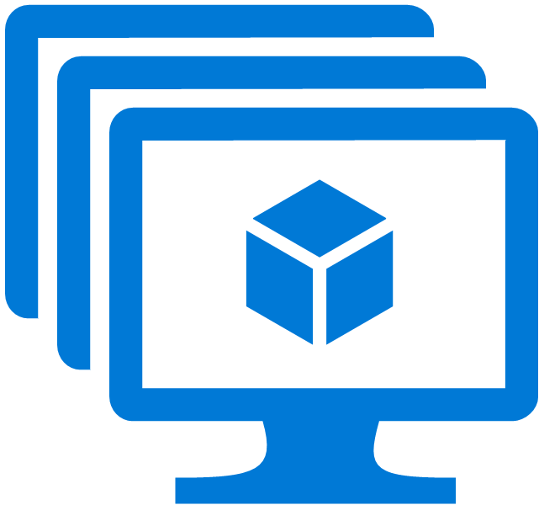
Cloud Solution Design Patterns
Load Balancing
Auto Scaling
Azure Virtual Machine
Scale Sets
Notes:
Auto Scaling
Automatically adjust the number of instances or resource based on real-time demand, ensuring that the application can handle varying workloads efficiently.
Examples:
Auto Scaling Groups on AWS
Virtual Machine Scale Sets on Azure
Managed Instance Groups on GCP

Slide 45

Cloud Solution Design Patterns
Load Balancing
Auto Scaling
Serverless Architecture
Azure Functions
Notes:
Serverless Architecture
Design applications to run without the need for managing servers explicitly, allowing developers to focus on code and reducing operational overhead.
Examples:
AWS Lambda
Azure Functions
Google Cloud Functions

Slide 46
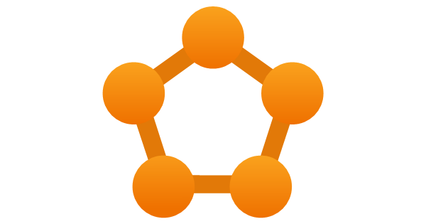
Cloud Solution Design Patterns
Load Balancing
Auto Scaling
Serverless Architecture
Microservices
Azure Service Fabric
Notes:
Microservices
Decompose a large monolithic application into smaller, independent services that can be deployed, scaled, and managed individually
Examples:
Amazon ECS
Azure Service Fabric
Google Kubernetes Engine (GKE)

Slide 47



Cloud Solution Design Patterns
Load Balancing
Auto Scaling
Serverless Architecture
Microservices
Event-Driven Architecture
Event Grid
Event Hubs
Service Bus
Notes:
Event-Driven Architecture
Design systems to respond to events and trigger actions based on specific events, enabling loosely coupled and asynchronous communication between components
Examples:
Amazon Simple Notification Service (SNS)
Azure Event Grid, Event Hubs, Service Bus
Google Cloud Pub/Sub

Slide 48
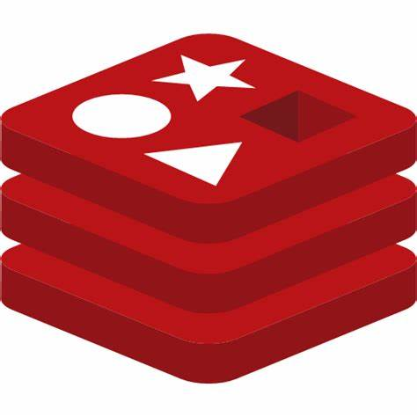
Cloud Solution Design Patterns
Load Balancing
Auto Scaling
Serverless Architecture
Microservices
Event-Driven Architecture
Caching
Azure Cache for Redis
Notes:
Caching
Use caching mechanisms to store frequently accessed data in-memory, reducing the need to retrieve data from the backend, and improving application performance
Examples:
Amazon ElasticCaache
Azure Cache for Redis
Google Cloud Memorstore

Slide 49
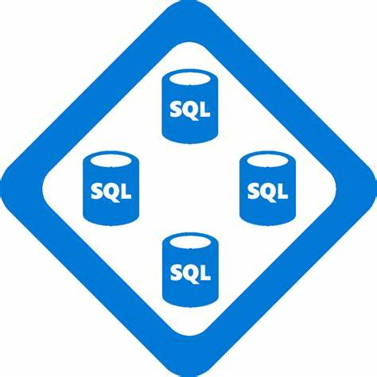
Cloud Solution Design Patterns
Load Balancing
Auto Scaling
Serverless Architecture
Microservices
Event-Driven Architecture
Caching
Database Scaling Patterns
Azure SQL Database
Elastic Pools
Notes:
Database Scaling Patterns
Optimize database performance and scalability by employing patterns such as sharding, partitioning, and read replicas.
Examples:
Amazon RDS Read Replicas
Azure SQL Database Elastic Pools
Google Cloud Spanner

Slide 50

Cloud Solution Design Patterns
Load Balancing
Auto Scaling
Serverless Architecture
Microservices
Event-Driven Architecture
Caching
Database Scaling Patterns
Hybrid Cloud
Azure Hybrid Cloud
Notes:
Hybrid Cloud
Design solutions that span both on-premises infrastructure and cloud services, allowing seamless integration and data sharing between the two environments.
Examples:
AWS Outposts
Azure Hybrid Cloud
Google Anthos

Slide 51
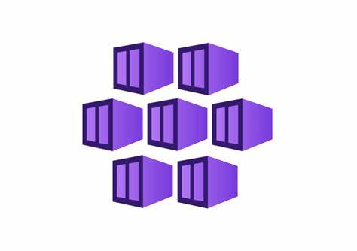
Cloud Solution Design Patterns
Load Balancing
Auto Scaling
Serverless Architecture
Microservices
Event-Driven Architecture
Caching
Database Scaling Patterns
Hybrid Cloud
Containerization
Azure Kubernetes Services
Notes:
Containerization
Package applications and their dependences into containers for portability and consistency across different environments.
Examples:
Docker,
Amazon Elastic Container Service (ECS)
Azure Kubernetes Service (AKS)
Google Kubernetes Engine (GKE)

Slide 52
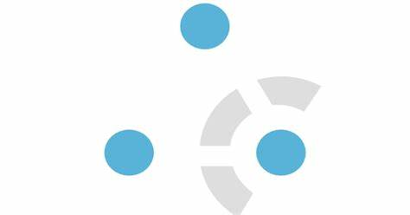
Cloud Solution Design Patterns
Load Balancing
Auto Scaling
Serverless Architecture
Microservices
Event-Driven Architecture
Caching
Database Scaling Patterns
Hybrid Cloud
Containerization
Big Data and Analytics
Azure HDInsight
Notes:
Big Data and Analytics
Architect solutions to process, store, and analyze large volumes of data using cloud-based big data and analytics services.
Examples:
Amazon EMR
Azure HDInsight
Google BigQuery

Slide 53
Hands-On Exercise: Design a Customer-Centric Solution
Design and Develop a Serverless Event-Driven Microservice-Based Solution
Notes:
Participants will work in groups to design a cloud solution based on a provided statement of work
Using the techniques learned, each group will collaboratively architect a solution to meet the specific customer needs
Applying cloud architecture principles and design patterns learned during the workshop
Presenting and discussing the proposed cloud solution designs

Slide 54

Hands-On Exercise
Statement of Work for Building Bricks’ E-Commerce Backend Development

Slide 55
User Stories
User Stories
Project Kickoff

Slide 56
User Stories
User Stories
Project Kickoff
Product Database
Notes:
As a product manager, I want to be able to manage the products that are available for purchase.

Slide 57
User Stories
User Stories
Project Kickoff
Product Database
Initialize Order
Place Order
The Purchase system receives the purchase order details from the e-commerce website, saves the data, and initiates the order processing workflow.

Slide 58
User Stories
User Stories
Project Kickoff
Product Database
Initialize Order
Place Order
Send Order Confirmation
After receiving a notification from the Purchase system that a purchase has been made, the Notice system will send the customer an email confirming the order. The email confirmation shall be logged for compliance reasons.

Slide 59
User Stories
User Stories
Project Kickoff
Product Database
Initialize Order
Place Order
Send Order Confirmation
Initialize Shipment
When an order is placed, the Shipping services initializes the shipping record so the shipping department can forecast upcoming work.

Slide 60
User Stories
User Stories
Project Kickoff
Product Database
Initialize Order
Reserve Inventory
Reserve Inventory
After receiving a notification from the Purchase system that a purchase has been made, the Inventory system will reserved the purchase products.

Slide 61
User Stories
User Stories
Project Kickoff
Product Database
Initialize Order
Reserve Inventory
Reserve Inventory
Update Purchase Status
If an ordered item is backordered, send the customer informing them that the order has been backordered.

Slide 62
User Stories
User Stories
Project Kickoff
Product Database
Initialize Order
Reserve Inventory
Reserve Inventory
Update Purchase Status
Send Backorder Notice
Once the inventory is reserved, the Purchase system will update the status of the purchase line item. If all of the line items for the purchase have been updated, then the purchase status will be updated.

Slide 63
User Stories
User Stories
Project Kickoff
Product Database
Initialize Order
Reserve Inventory
Inventory Update
Inventory Updated Notice
When there is an update to the inventory of a product, notify other systems of the updated inventory.

Slide 64
User Stories
User Stories
Project Kickoff
Product Database
Initialize Order
Reserve Inventory
Inventory Update
Inventory Updated Notice
Product Availability Update
When the inventory is updated, the affected product availability will be updated.

Slide 65
User Stories
User Stories
Project Kickoff
Product Database
Initialize Order
Reserve Inventory
Inventory Update
Fulfillment
Start Picking Order
Once the inventory is reserved for an order, the order is picked for shipment.

Slide 66
User Stories
User Stories
Project Kickoff
Product Database
Initialize Order
Reserve Inventory
Inventory Update
Fulfillment
Start Picking Order
Order Fulfillment
Once an order is shipped, notify other systems of the shipment.

Slide 67
User Stories
User Stories
Project Kickoff
Product Database
Initialize Order
Reserve Inventory
Inventory Update
Fulfillment
Start Picking Order
Order Fulfillment
Update Purchase Status on Shipment
Once an order is shipped, the Purchase system updates the status of the order.

Slide 68
User Stories
User Stories
Project Kickoff
Product Database
Initialize Order
Reserve Inventory
Inventory Update
Fulfillment
Start Picking Order
Order Fulfillment
Update Purchase Status on Shipment
Send Order Shipment Notice
Once an order is shipped, the Notice sends an email to the customer informing them that the order has been shipped.

Slide 69
User Stories
User Stories
Project Kickoff
Product Database
Initialize Order
Reserve Inventory
Inventory Update
Fulfillment
Close Order
Shipment Delivered
Once an order is delivered, the Shipping system will send out an OrderDeliveredMessage message.

Slide 70
User Stories
User Stories
Project Kickoff
Product Database
Initialize Order
Reserve Inventory
Inventory Update
Fulfillment
Close Order
Shipment Delivered
Update Purchase Status on Shipment Delivery
Once a shipment is delivered, the Purchase system will update the status of the order.

Slide 71
User Stories
User Stories
Project Kickoff
Product Database
Initialize Order
Reserve Inventory
Inventory Update
Fulfillment
Close Order
Shipment Delivered
Update Purchase Status
Send Order Delivered Notice
Once an order is delivered, the Notice sends an email to the customer informing them that the order has been delivered.

Slide 72
Hands-On Exercise
Work in groups to come up with possible solutions

Slide 73
Hands-On Exercise
Present Group Solutions

Slide 74
Solution we’ll implement
Microservices in the Solution
Core
Product
Website
Purchase
Inventory
Shipping
Notification
Notes:
Microservices in the solution:
Core: Provides core services to the microservices
Product: Responsible for managing product information
Website: Responsible for the e-commerce public website
Purchase: Handles order placement and processing
Inventory: Manages product inventory levels.
Shipping: Handles order shipping and tracking.
Notification: Sends order confirmation and status updates to customers.

Slide 75
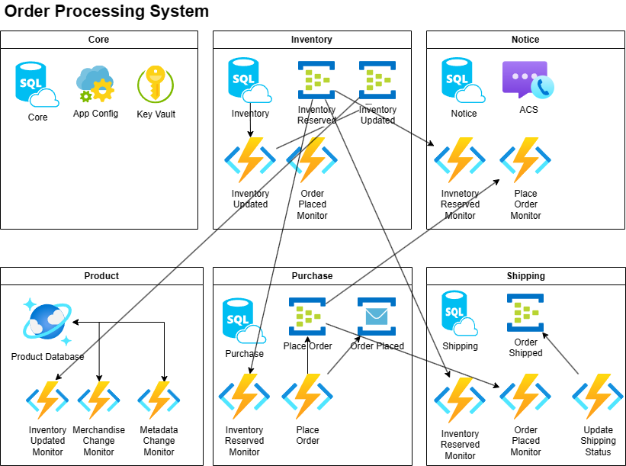
What we are going to build

