Slide 1
CMPLXSYS 530
Computer Modeling of Complex Systems
Cellular Automata and Conway’s Game of Life
2/13/18

Slide 2
Cellular Automata
Borrowing from Sayama p.185
Automata refers to a theoretical machine that changes its internal state based on inputs and its previous state (usually finite and discrete)
Cellular automata (CA) are automata arranged along a regular spatial grid, whose states are simultaneously updated by a state-transition function

Slide 3
Cellular Automata

Slide 4
Cellular Automata
So what?
Simple rules → Exceptionally complex outcomes (sometimes)
Prototypical example: Wolfram’s exploration of 1-D CA

Slide 5
Cellular Automata
Rule 50
00110010 = 50 in binary

Slide 6
Cellular Automata
Wolfram’s Classification
Class I – almost always evolve to same uniform pattern (boring!)
Class II – Simple pattern with nested structure (pretty!)

Slide 7
Cellular Automata
Wolfram’s Classification
Class III
CAs that produce patterns with the statistical properties of randomness
(surprising!...why?)

Slide 8
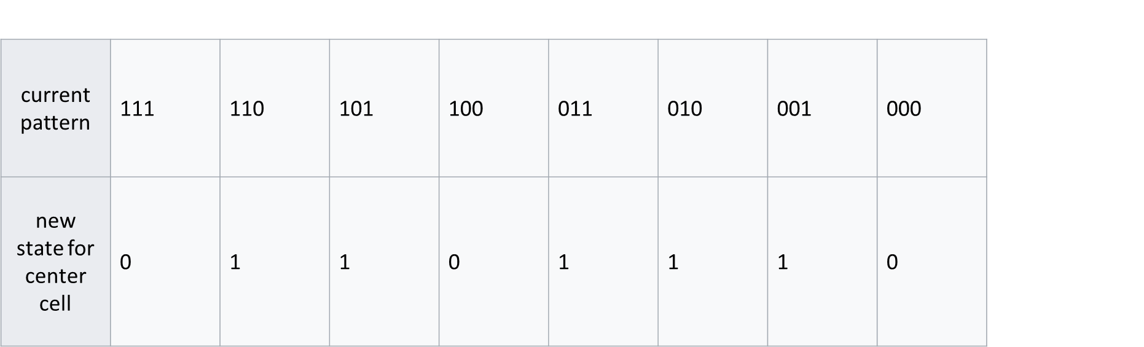
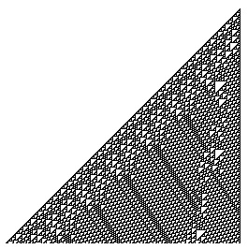
Cellular Automata
Wolfram’s Classification
Class IV
Evolve in complex ways that involve a mix of “chaotic” and “ordered” (Class II and Class IV)
Rule 110, 250 timesteps

Slide 9
Cellular Automata
Wolfram’s conjecture:
Class IV CAs are capable of universal computation
So far, this has been proven for Rule 110
(Bwaahh?!?!?!)
Wolfram, S. A New Kind of Science. Champaign, IL: Wolfram Media
Rule 110, 250 timesteps

Slide 10
Cellular Automata
Dimensionality
How many dimensions?
Neighborhood
Ex: Von Neumann, Moore, radius
State Set
How many states can a cell be in?

Slide 11
Cellular Automata
Boundaries
None, Periodic, Cut-off, Fixed
Rules
“Totalistic”, symmetrical (in different axes)
Starting States, number of cells, etc…

Slide 12
Cellular Automata
Wide World of CA
A lot of CA models have been developed, some with stronger connections to the Real World than others
Forest Fire model
Sand Heap/Avalanches
Majority Rule and Voter Models
Diffusion Limited Aggregation (DLA) and Percolation

Slide 13
Cellular Automata
Wide World of CA
Arguably there is no CA so famous or well-loved, however, than that of Conway’s Game of Life*
It has inspired countless articles, entire communities of hobbyists, and even helped give rise to an entire research subfield known as “Artificial Life”
*Note: GoL has also been proven to be capable of universal computation!!! (Crazy!!!)

