Slide 1
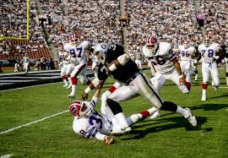
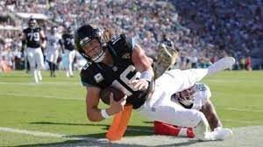
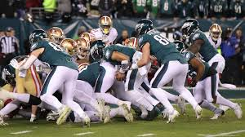
Menu
Players
Teams
Rosters
Stats On Tap
Run Downhill
Let’s dive into the rushing rates around the NFL and how that relates to win percentage. Fantasy football implications abound!
Past
Players
Past Articles
Make the Move
Which team is most likely to relocate this offseason? Who should? Find out who’s city is safe!
Push Eagles, Push?
How are the Eagles getting away with this Tush Push? Let’s look at the average yards for QB sneaks and the average yards for Jalen Hurts’s touchdowns.

