Slide 1

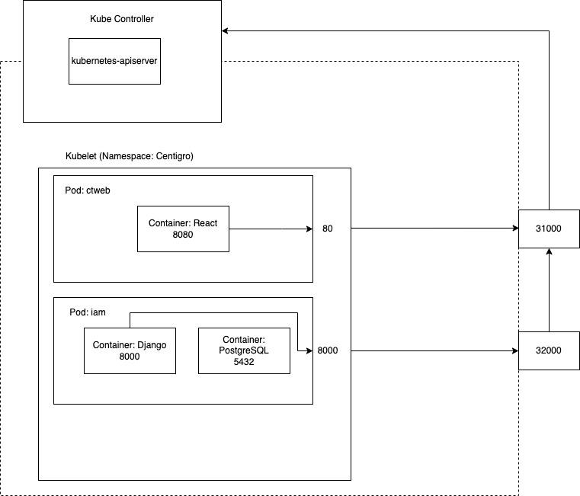
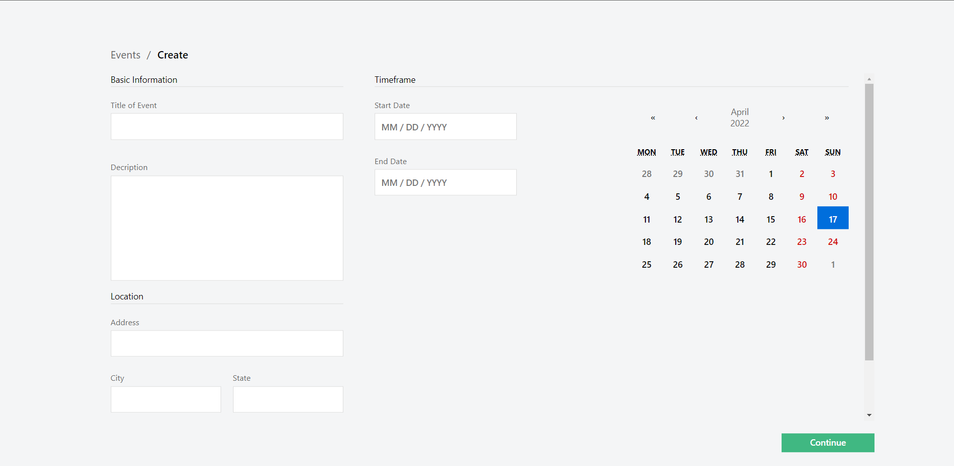
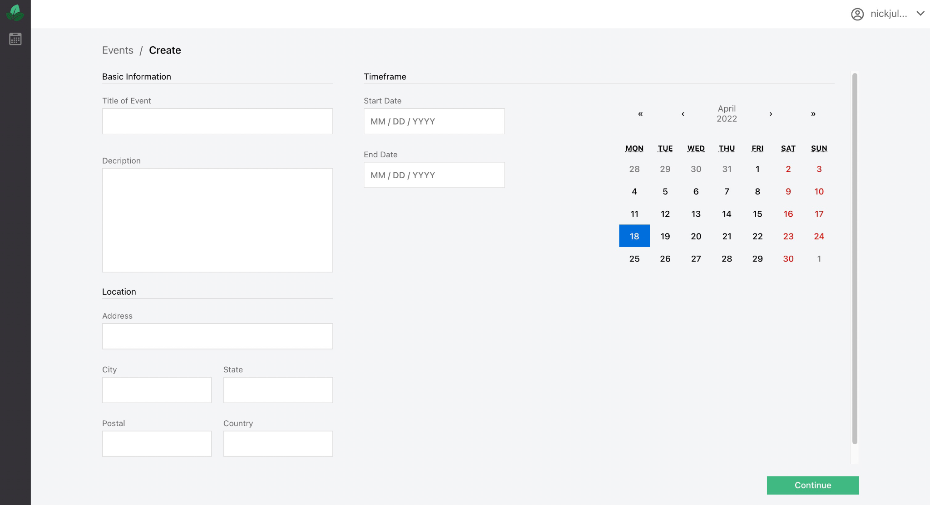
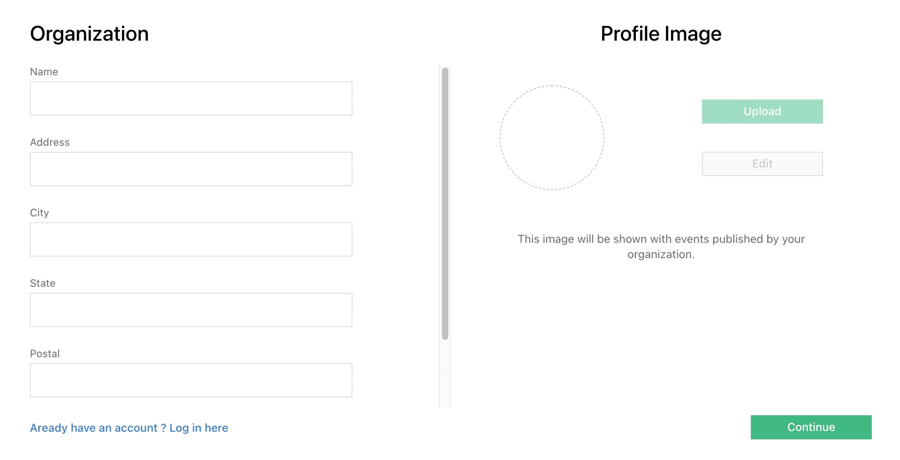
Centigro is a corporate social responsibility system that connects companies with their local communities through incentivized environmental events.
Design
React WebUI
Django REST API w/ PostgreSQL
Kubernetes auto-deployment
Jenkins CDCI
https://github.com/NickJ202/csc468-course-project.git
Nick Juliano, Patrick O’Donnell, Nick Dobslaw, Enrico Mazza, Sindhu Budhavarapu

