Slide 1
Visa for lisa
An ML project for a fictional bank
From Nikolay Kirilov, student at Amsterdam tech

Slide 2
Problem Definition
The goal is to help the marketing department of a fictional bank called Galaxy Bank to properly target people with offers for a personal loan.
This matters because they want to efficiently use their budget, lower the cost, and increase the ROI.
The success criteria for the project, in my opinion, are to have an F1 score above 93%.

Slide 3

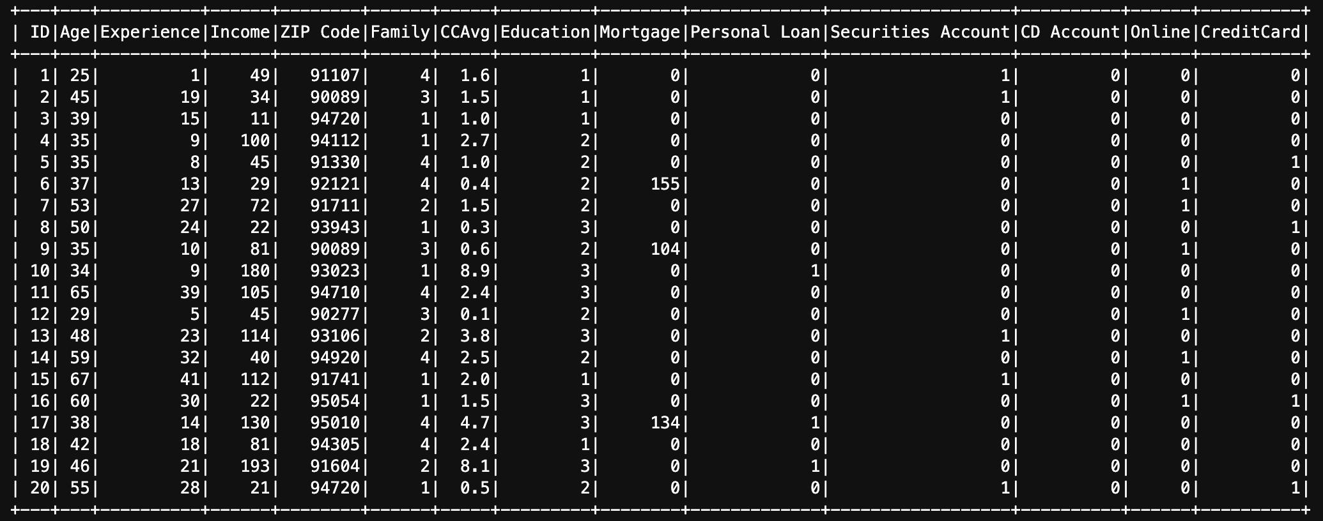
Data
The data source is provided in the project description and can be found on Kaggle, as well: https://www.kaggle.com/code/krantiswalke/bank-personal-loan-modelling-supervised-learning/input
We have 5000 samples and 14 features.

Slide 4

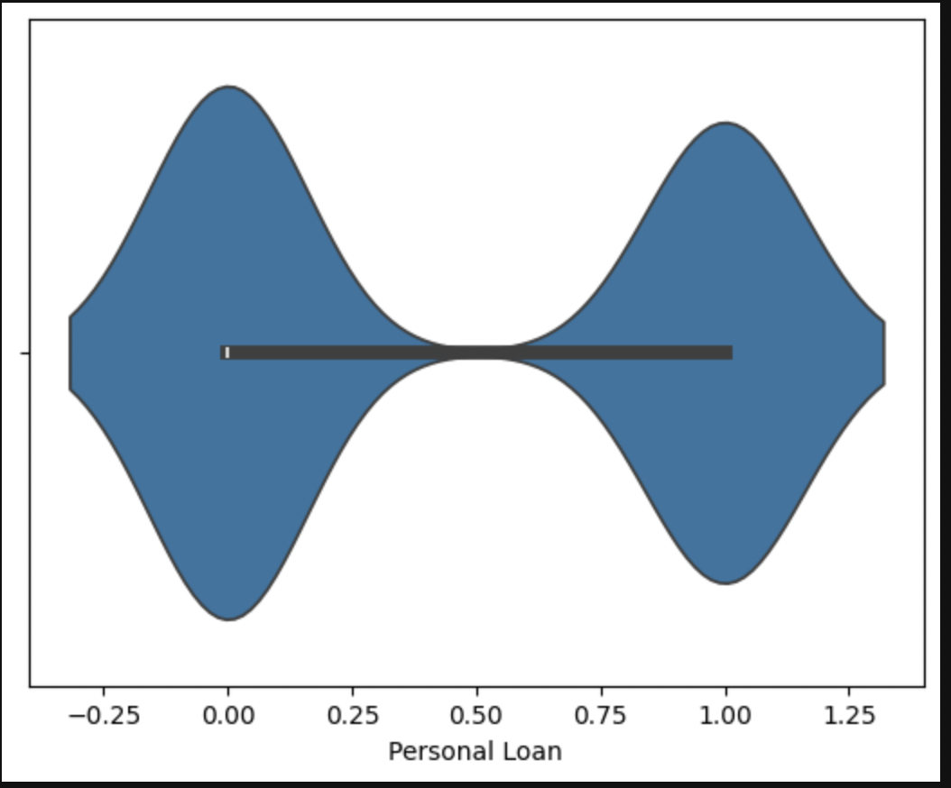
Data preprocessing
Although the data was initially pretty clean and without any null values, I implemented normalization using log and target encoding. Then, I implemented feature engineering, where I created 3 features that later on turned out not to help the model perform better. The data was balanced, so I did not further balance it.

Slide 5
Exploratory Data Analysis
First, I checked if the data is balanced enough by displaying our target variable as a violin plot.

Slide 6
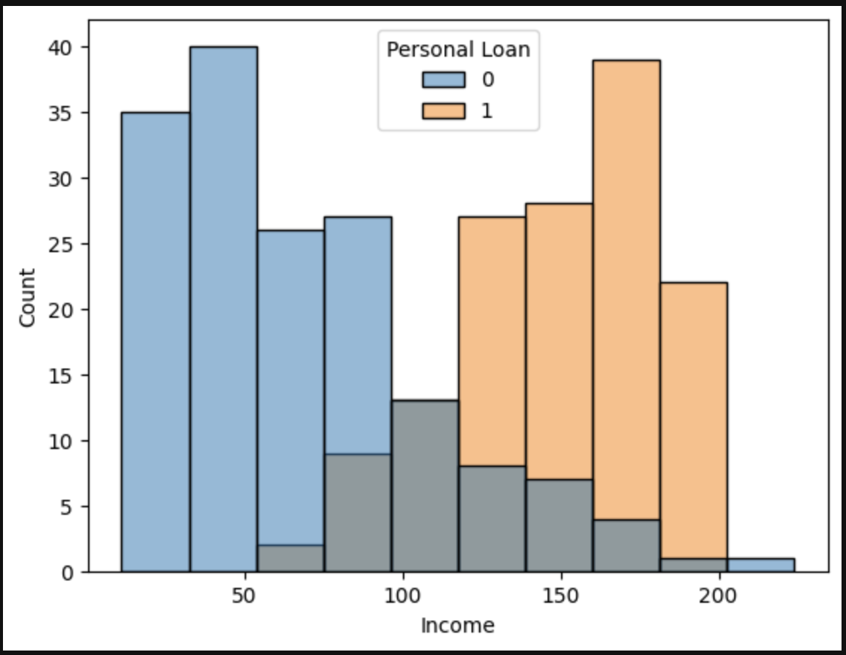
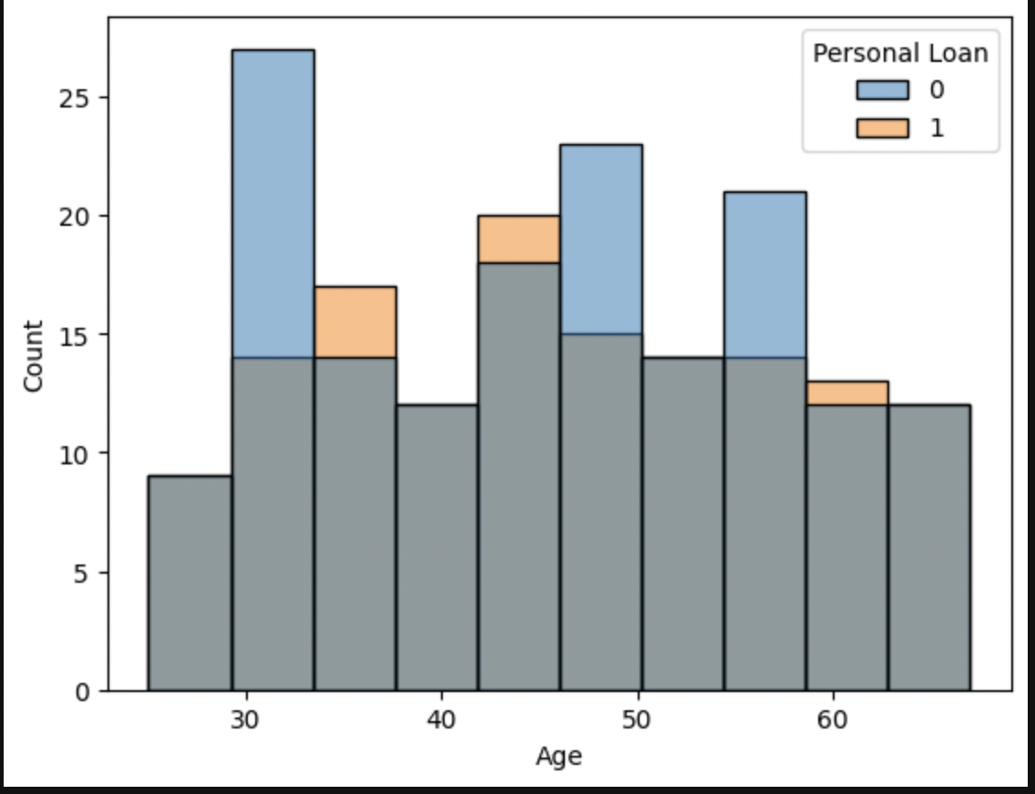
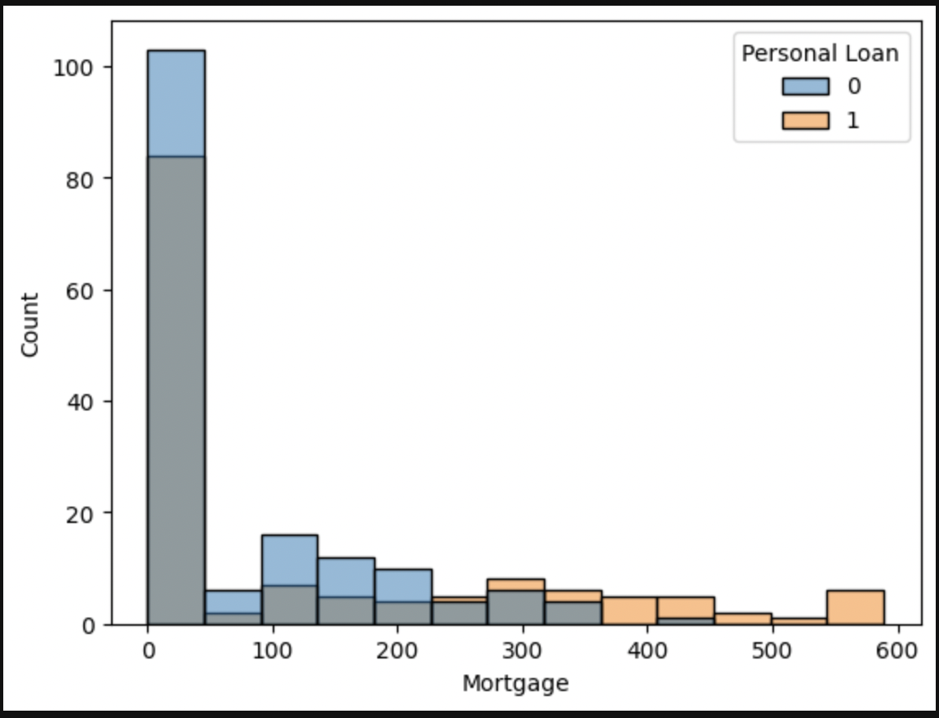
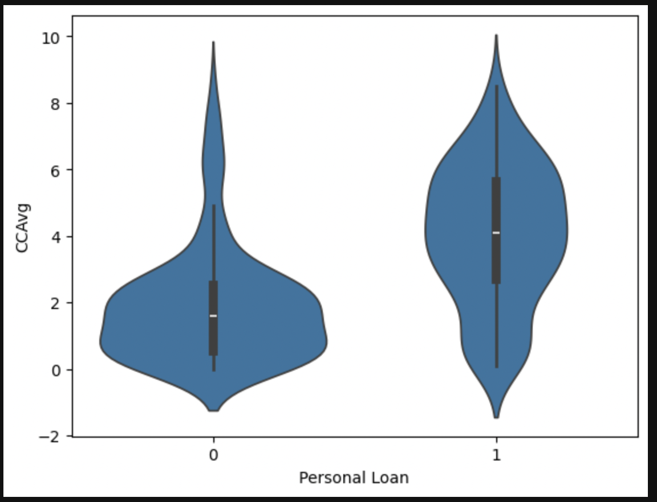
Exploratory Data Analysis
Then I checked for some key correlations between the features.
It turned out that there is a huge correlation between the target and the Income – the higher it is, the more likely to get a personal loan.
For the Age feature, it turned out that there is no straight connection.
When it comes to the Mortgage, it seems that there is a slight correlation between having a bigger mortgage and a personal loan.
For the credit card average feature, I can easily state that the higher it is, the more likely to get a personal loan.

Slide 7
Methodology
Although it is a classification problem, I have chosen Linear Regression with thresholding for a baseline, and other regression and classification algorithms to test. I have split the data 75 to 25 percent and then done hyperparameter optimization for the F1 score. I utilized pyspark and mllib because I wanted to showcase my ability to work with those libraries. Moreover, I used optuna for the hyperparameter optimization and seaborn for visualization.

Slide 8
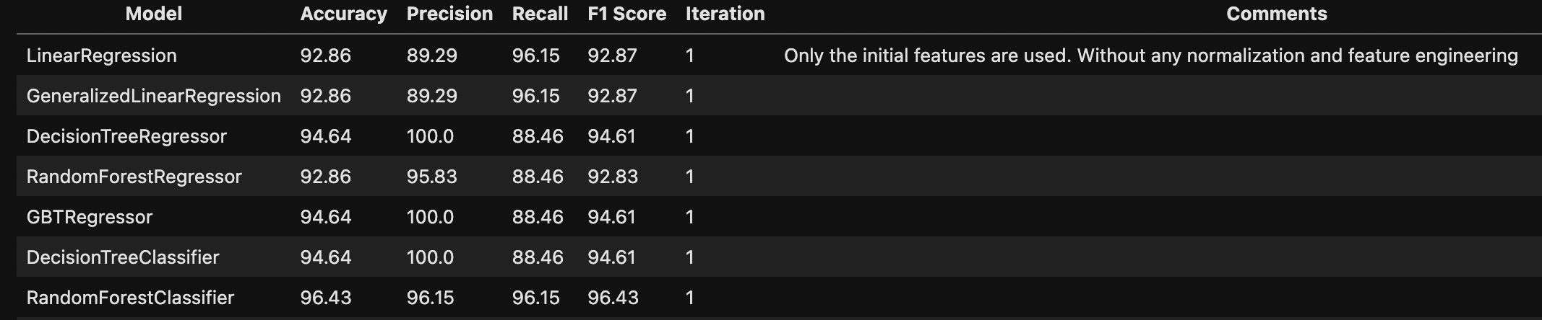
Experiments & Results
I have conducted multiple experiments that can be found in the notebook and in the next slides. Generally, the RandomForestRegressor performed the best. During the first iteration with the raw data, the Linear Regression F1 score was 92.87, while the RandomForestRegressor was 92.83. It turned out that the baseline is better than the advanced algorithm. The RandomForestClassifier, achieved 96.43. However, later on in the third iteration, it turned out that the last one was much better.

Slide 9
Experiments & Results
However, when I added all features (raw, normalized, engineered), it seems the RandomForestRegressor performed the best in the second iteration, but still worse than RandomForestClassifier from the first iteration.
Model | Accuracy | Precision | Recall | F1 Score | Iteration
LinearRegression | 94.64 | 100.0 | 88.46 | 94.61 | 2
GeneralizedLinearRegression | 94.64 | 100.0 | 88.46 | 94.61 | 2
DecisionTreeRegressor | 92.86 | 100.0 | 84.62 | 92.78 | 2
RandomForestRegressor | 96.43 | 100.0 | 92.31 | 96.41 | 2
GBTRegressor | 91.07 | 100.0 | 80.77 | 90.94 | 2
DecisionTreeClassifier | 92.86 | 100.0 | 84.62 | 92.78 | 2
RandomForestClassifier | 94.64 | 100.0 | 88.46 | 94.61 | 2

Slide 10
Experiments & Results
On the third iteration, where I trained the model only on the raw features and the normalized ones, it turns out that the F1 Score for the RandomForestRegressor is the best overall so far - 98.21.
Model | Accuracy | Precision | Recall | F1 Score | Iteration
LinearRegression | 94.64 | 100.0 | 88.46 | 94.61 | 3
GeneralizedLinearRegression | 94.64 | 100.0 | 88.46 | 94.61 | 3
DecisionTreeRegressor | 94.64 | 100.0 | 88.46 | 94.61 | 3
RandomForestRegressor | 98.21 | 100.0 | 96.15 | 98.21 | 3
GBTRegressor | 94.64 | 100.0 | 88.46 | 94.61 | 3
DecisionTreeClassifier | 94.64 | 100.0 | 88.46 | 94.61 | 3
RandomForestClassifier | 94.64 | 100.0 | 88.46 | 94.61 | 3

Slide 11
Experiments & Results
After the fourth iteration, where I added the ‘Mortgage_to_Income’ feature the F1 Score for the RandomForestRegressor is again the highest; however it is worse than the previous test.
Model | Accuracy | Precision | Recall | F1 Score | Iteration
LinearRegression | 94.64 | 96.0 | 92.31 | 94.63 | 4
GeneralizedLinearRegression | 94.64 | 96.0 | 92.31 | 94.63 | 4
DecisionTreeRegressor | 94.64 | 100.0 | 88.46 | 94.61 | 4
RandomForestRegressor | 96.43 | 100.0 | 92.31 | 96.41 | 4
GBTRegressor | 94.64 | 100.0 | 88.46 | 94.61 | 4
DecisionTreeClassifier | 94.64 | 100.0 | 88.46 | 94.61 | 4
RandomForestClassifier | 96.43 | 100.0 | 92.31 | 96.41 | 4

Slide 12
Experiments & Results
After adding ‘Mortgage_to_Income’ and ‘Income_times_CCAvg’, it turns out the RandomForestRegressor and RandomForestClassifier have the highest F1 Score, but the score from the third iteration of the RandomForestRegressor is still the highest among all the tests. In conclusion, the RandomForestRegressor performs the best without the feature engineering, but after the raw fields were normalized, with an F1 Score of 98.21%. I believe this score is high enough to say that the model performs really good.
Model | Accuracy | Precision | Recall | F1 Score | Iteration
LinearRegression | 94.64 | 100.0 | 88.46 | 94.61 | 5
GeneralizedLinearRegression | 94.64 | 100.0 | 88.46 | 94.61 | 5
DecisionTreeRegressor | 92.86 | 100.0 | 84.62 | 92.78 | 5
RandomForestRegressor | 96.43 | 100.0 | 92.31 | 96.41 | 5
GBTRegressor | 91.07 | 100.0 | 80.77 | 90.94 | 5
DecisionTreeClassifier | 92.86 | 100.0 | 84.62 | 92.78 | 5
RandomForestClassifier | 96.43 | 100.0 | 92.31 | 96.41 | 5

Slide 13
Conclusion & Future Work
In conclusion, I would suggest utilizing the RandomForestRegressor algorithm with the hyperparameters from the optimization session because it performed the best, thus the marketing costs will be lower, and so the ROI will be higher.
What I learned from this project is that I should never underestimate any task, data, or model, and always try to do more than required.

Slide 14
Thank you for the attention!
Author: Nikolay Kirilov
You can find me on my GitHub: https://github.com/NickKirilov

