Slide 1
Language Detection
By CodeCube
Neel Desai
Nick Kornienko
Mansi Vekariya
Kelly Nguyen

Slide 2
Problem Overview
Building a Language detection model capable of distinguishing between and identifying audio spoken in English, French and Spanish
Follow CRISP-DM methodology for building the model
Reason
Language detection acts as the first part for translation, which can allows people from different parts of the world to communicate with each other

Slide 3
Step 1: Business Understanding
We want to build a language recognition model, that can identify if the audio presented to it is in English, French or Spanish.
The target is to have a model which has a overall accuracy of 90%
And the precision for each individual class should be greater than equal to 90%
The model should be able to be deployed on a low powered system, without needing GPU for inference

Slide 4
Step 2: Data Understanding
Data Source
We used open source audio corpus data available on https://commonvoice.mozilla.org/
English audio version used
Common Voice Delta Segment 14.0
French audio files version used
Common Voice Corpus 1
Spanish audio file versions used
Common Voice Delta Segment 12.0

Slide 5
Data Understanding Continued
 | English | French | Spanish
Recorded Duration (Hours) | 70 | 80 | 52
Number of Voices | 1212 | 1697 | 373
Number of Files | 44045 | 75022 | 36655
Average length | 5.7 s | 3.7 s | 5.0 s
Sampling Rate (Hz) | 22050 | 22050 | 22050

Slide 6
Step3: Data Preprocessing
First Step would be to arrange all the audio files in proper folder structure
Secondly for each of the audio file, we will represent it as numbers and extract other information such as sampling rate and length of the audio for the file
And lastly we will generate the Mel Frequency Cepstral Coefficients(MFCC) for each of the audio files (40 per file)
Handling class bias
We will be using MFCCs values for training our model

Slide 7
Data Preprocessing Continued
Reason For Using MFCCs for training the model
MFCCs are capable of representing phonetically relevant feature
MFCCs are resilient to noise
MFCCs also act as a dimensionality reduction, where it will be able to represent any file with a certain numbers of coefficients

Slide 8
Step 4: Modelling
We will be trying a Number of neural network architectures to find the model that works the best for us
We have 2 main types of Neural Networks which we tried
Recurrent Neural Networks using Long Terms Short Term Memory
1D Convolution Neural Network
Reason being in an audio file the last data is directly related to the present data and the above 2 methods are really good at capturing this relations
After testing a bunch of different models we finalized a 5 layer 1D –CNN

Slide 9
Training Pipeline
Represent Audio as Numbers
Extract MFCCs
One-Hot encoding label
Reshaping data to None,40,1
Evaluate
Model Training

Slide 10
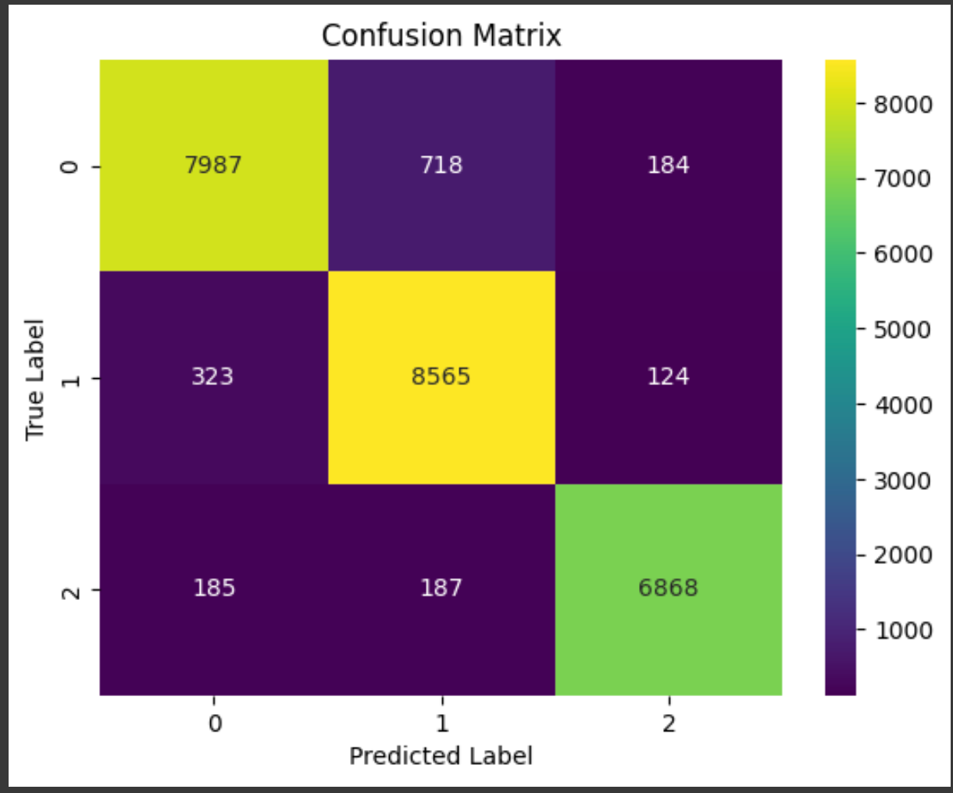
Evaluation

Slide 11
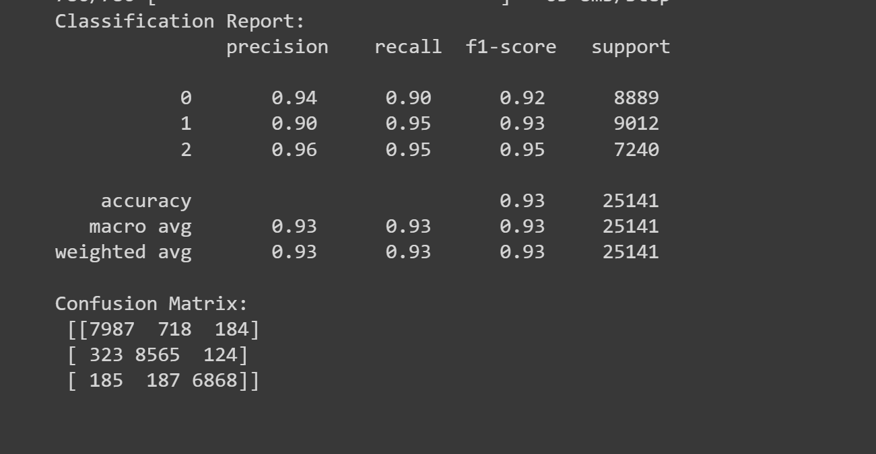
Evaluation

Slide 12
Deployment
Register the Model on Azure Machine Learning
Create a custom environment, for running the model which includes all the needed python packages
Create a scoring script which Azure ML Endpoint will us for inference

Slide 13
Inference Pipeline
Client
Azure ML Endpoint
Load Audio file and generate MFCCs for it
ask
Model
Inverse OneHot encode prediction
prediction

Slide 14
Future Scope
Including the ability to distinguish more languages
Handling longer audio files
Building an entire application around it
Adding language transcription and translation capabilities

Slide 15
Demo Time

