Slide 1


Pandas on Jupyter: Improving Your Data Analysis Workflow
Nick Macro
PyOhio 2018
NickMacro
@NickMacro

Slide 2
About Me
Physics graduate student at OSU in the Zhong Group
Measure and analyze time dependent spectroscopic data
Work with lots of tabular data
Passionate about transparent methods and data analysis techniques

Slide 3
Overview
Introduction to tools used in talk
Compare and contrast two different data analysis workflows
Incremental steps to perform analysis in python

Slide 4


Slide 5
Open source interactive programming environment
Consists of cells that are run individually
Code cells are executed sections of either code or Mark Down
Custom widgets can be made for interactivity
Language agnostic
Python, R, Fortran, Julia, and many more
Can be exported to a variety of formats
PDF, LaTeX, reveal.js, and others

Slide 6
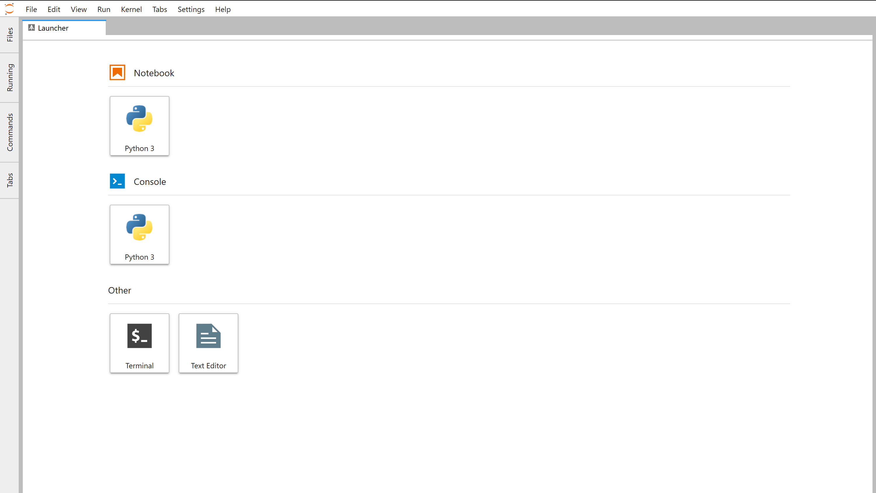

Slide 7
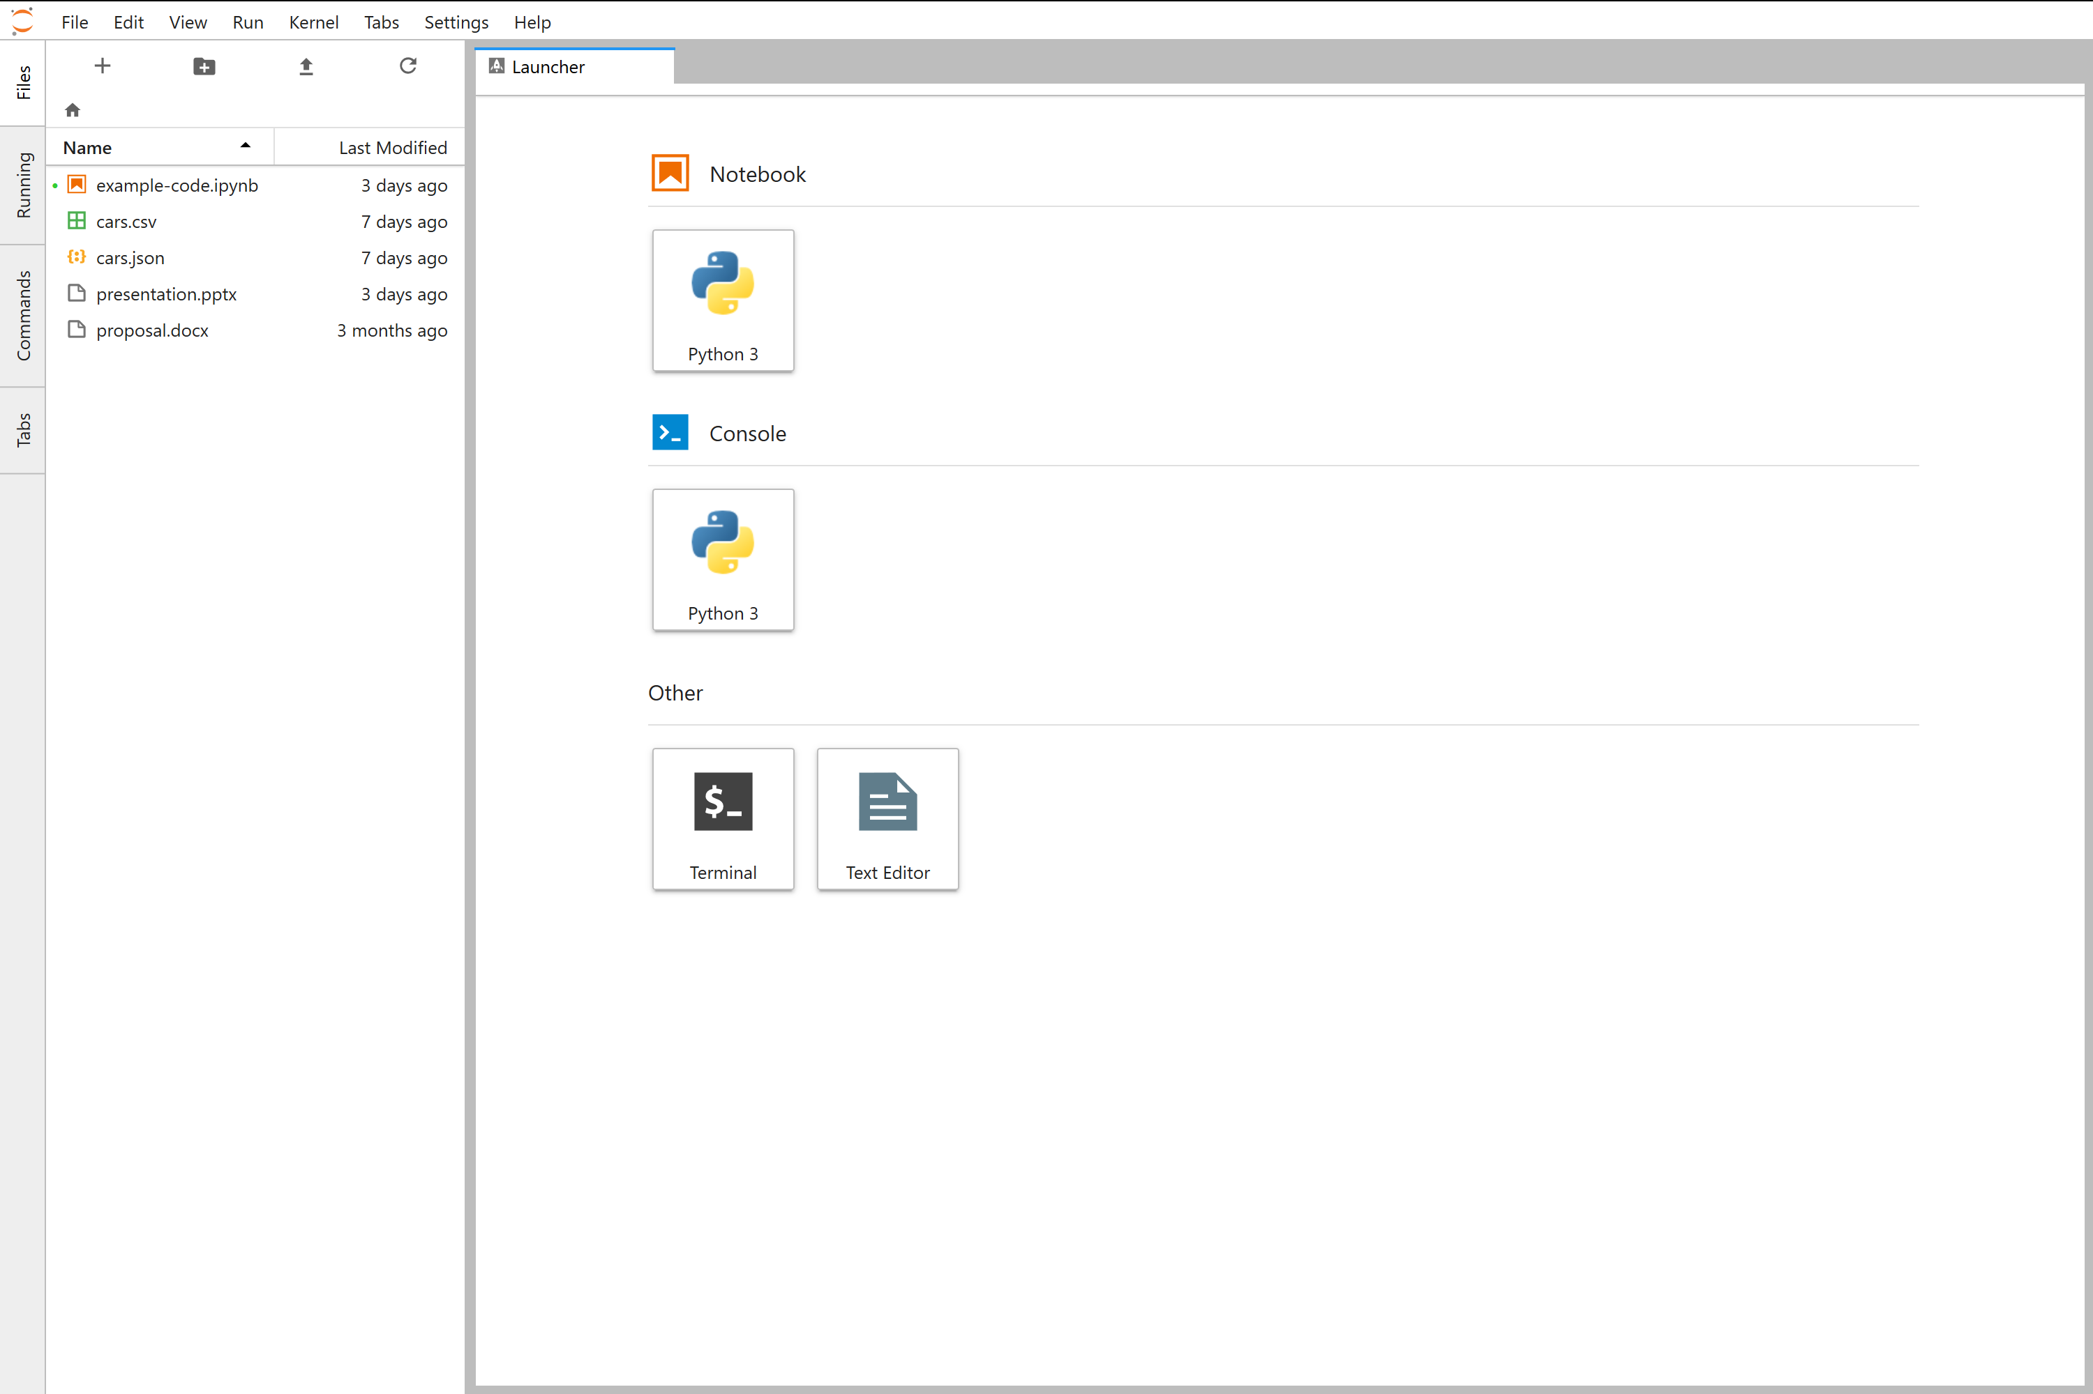

Slide 8
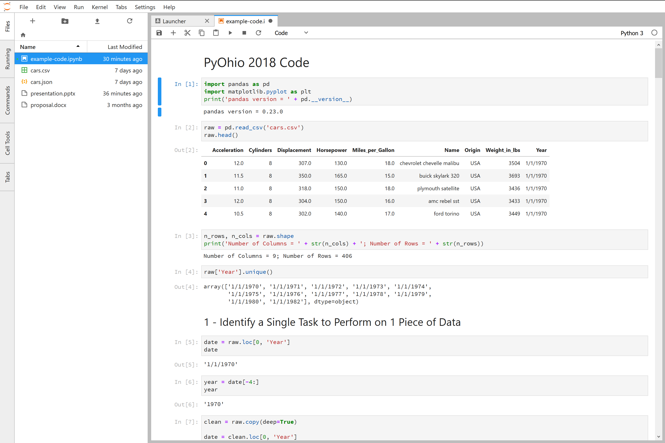

Slide 9


Slide 10
Primarily used for data organization and manipulation
1D Structure: Series
Consists of a name, index, and values
2D Structure: DataFrame
Consists of a name, index, column names, and values
Values can be plotted using built-in functions that utilize Matplotlib
Transformations, filtering, and grouping can be performed
>2D structures can be created using hierarchical indexing

Slide 11
A Typical Data Analysis Workflow Using Excel
Pros | Cons
Familiar environment | Difficult to make transparent & reproducible
Less coding knowledge requirement | Hard to scale to large data sets
Good for quick visualizations | Can depend on manual tasks if outside programs are needed
Widely used tool so sharing is easier

Slide 12
A Typical Data Analysis Workflow in Python
Pros | Cons
Highly automatable and scalable | Programming knowledge required
Testable analysis
Easier to make processes transparent and reproducible
Documentation of steps is built into Jupyter Notebooks

Slide 13
Road Map
Get your data into python (typically using pandas)

Slide 14
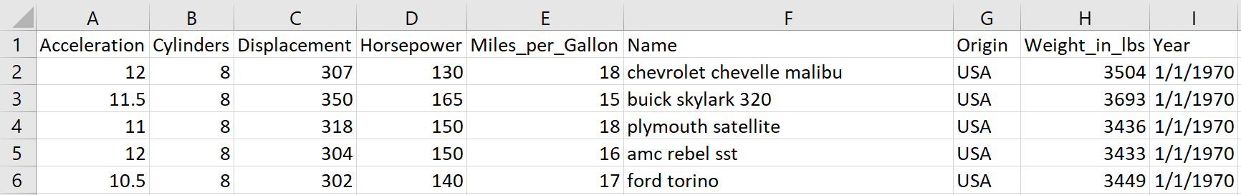
Import Data

Slide 15
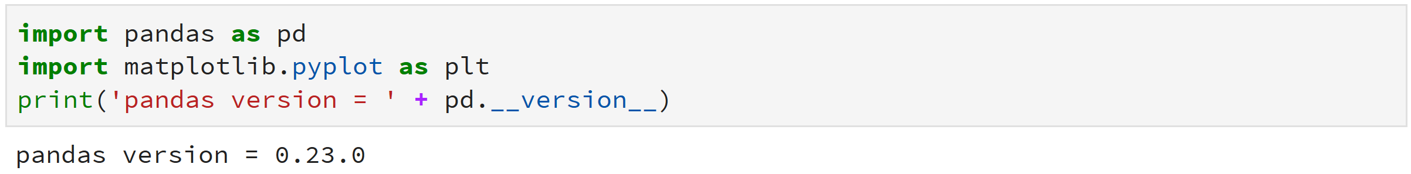

Slide 16
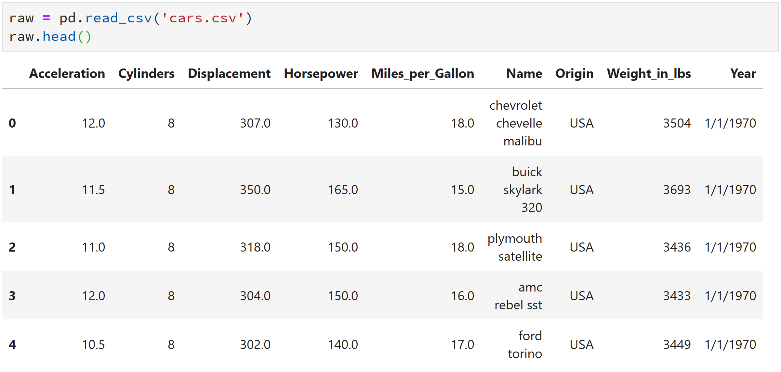

Slide 18
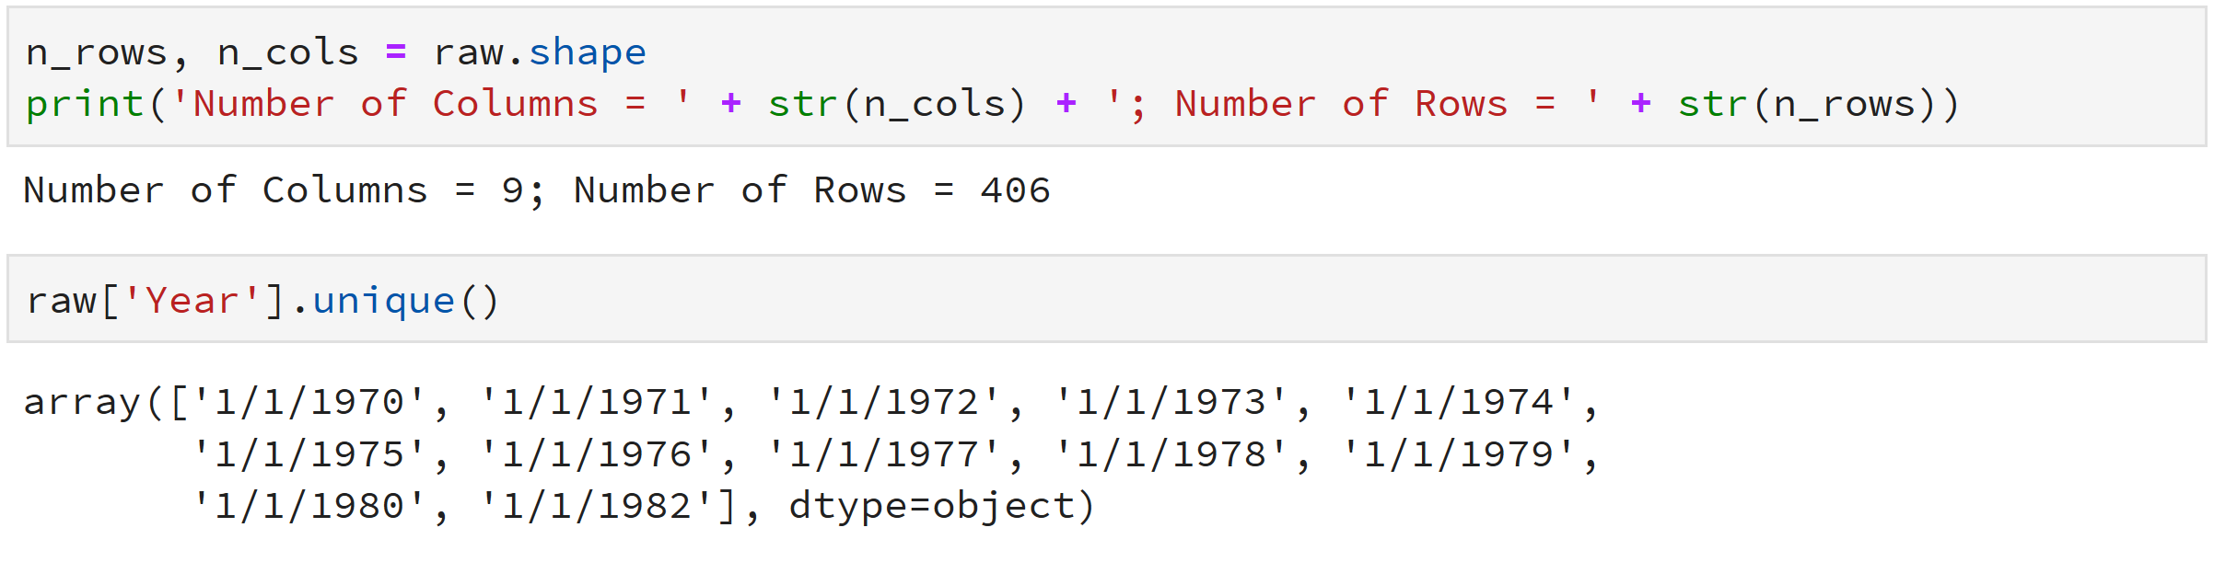

Slide 22
Road Map
Get your data into python
Perform a single instance of one analysis task (e.g. averaging, data cleaning, initial visualization)

Slide 23
Task Clean the year column

Slide 24
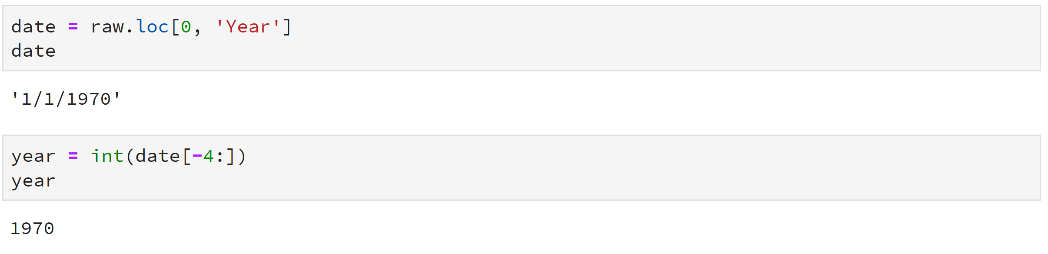

Slide 28
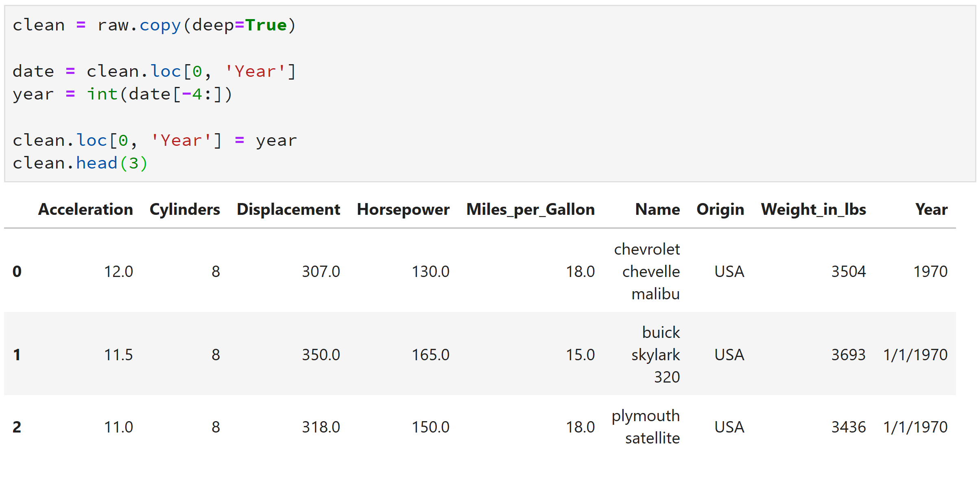

Slide 30
Road Map
Get your data into python
Perform a single instance of one analysis task
Write a function for that single task

Slide 32
Road Map
Get your data into python
Perform a single instance of one analysis task
Write a function for that single task
Automate that task by iterating over more data

Slide 33
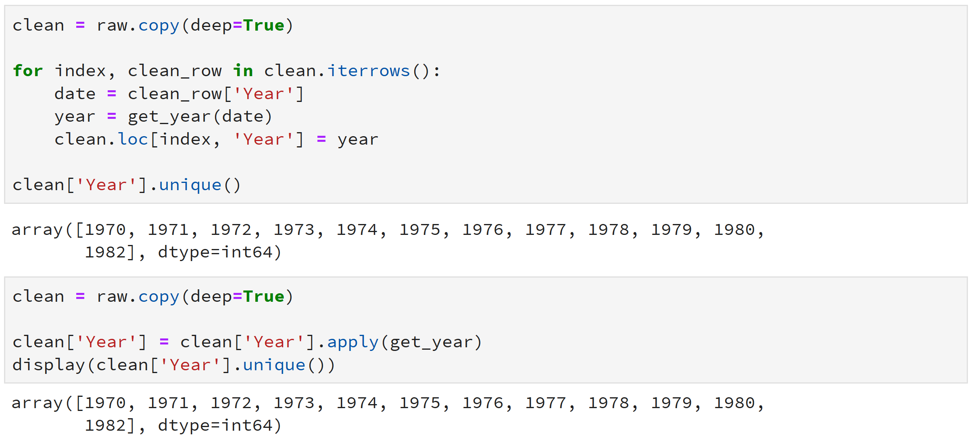

Slide 37
Road Map
Get your data into python
Perform a single instance of one analysis task
Write a function for that single task
Automate that task by iterating over more data
Output the result

Slide 38
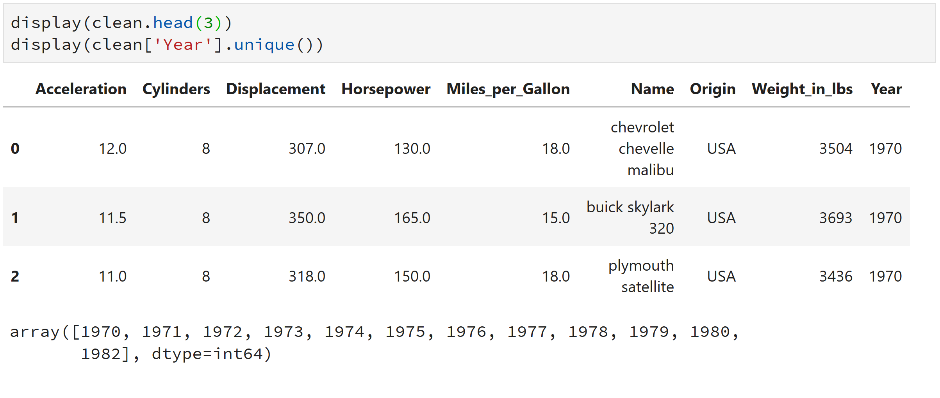

Slide 40
Road Map
Get your data into python
Perform a single instance of one analysis task
Write a function for that single task
Automate that task by iterating over more data
Output the result
Repeat steps 2 – 5 for additional tasks

Slide 41
Task Plot various columns vs. time

Slide 42
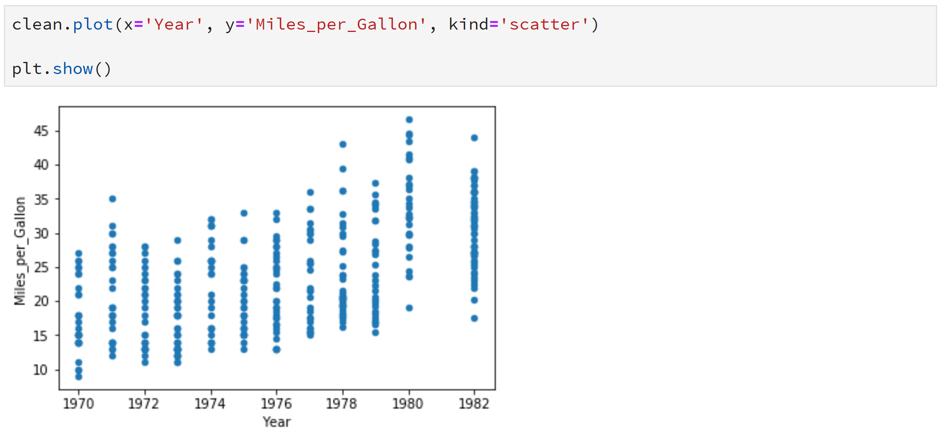

Slide 44
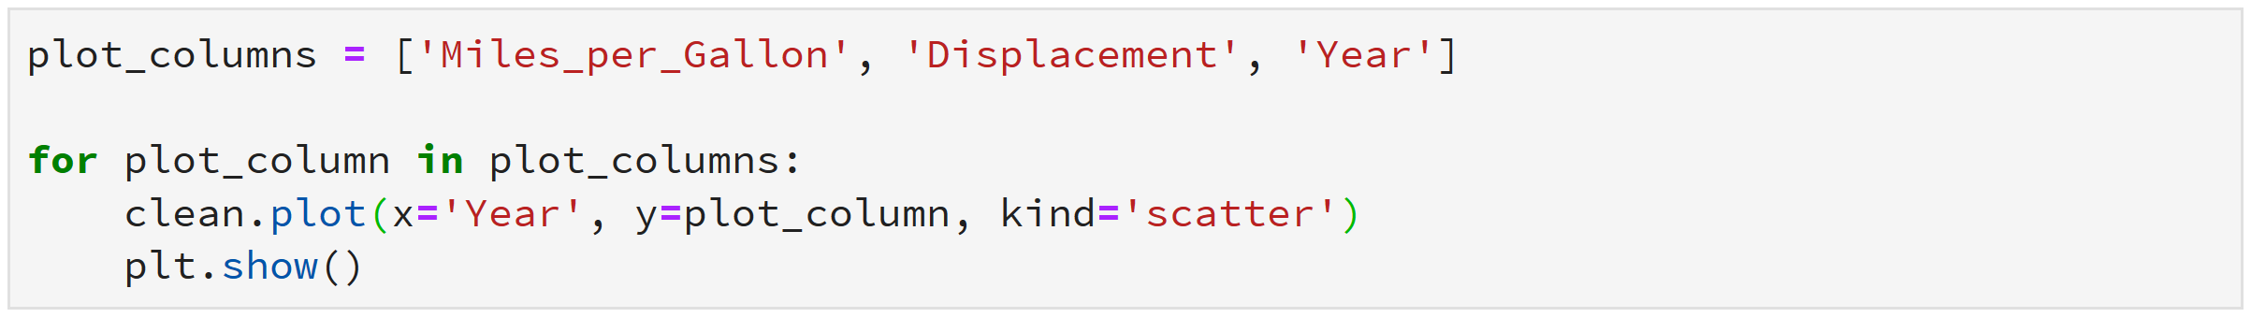
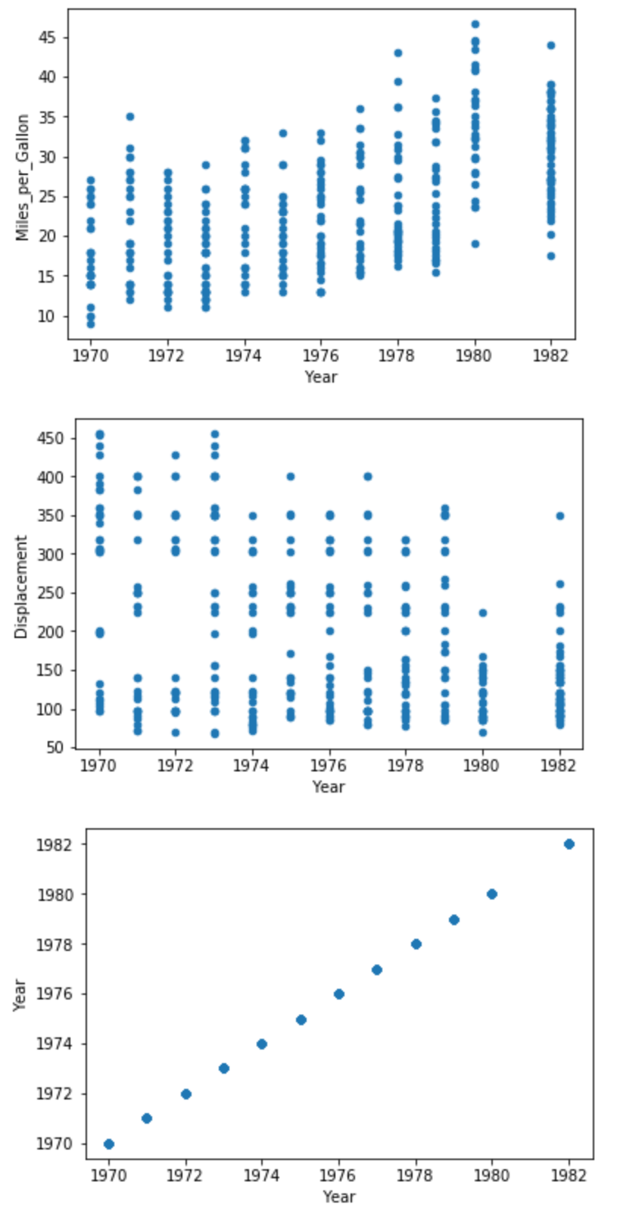

Slide 45
Task Plot correlation matrix

Slide 46
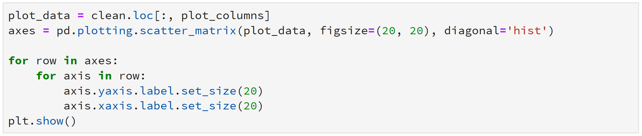

Slide 47
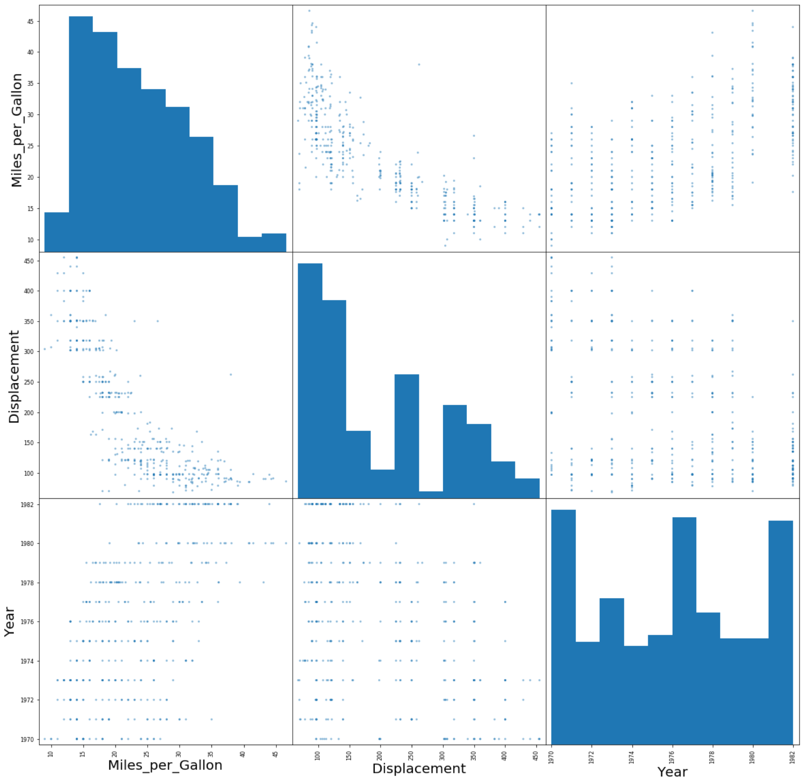

Slide 48
Task Average over each year’s values

Slide 49
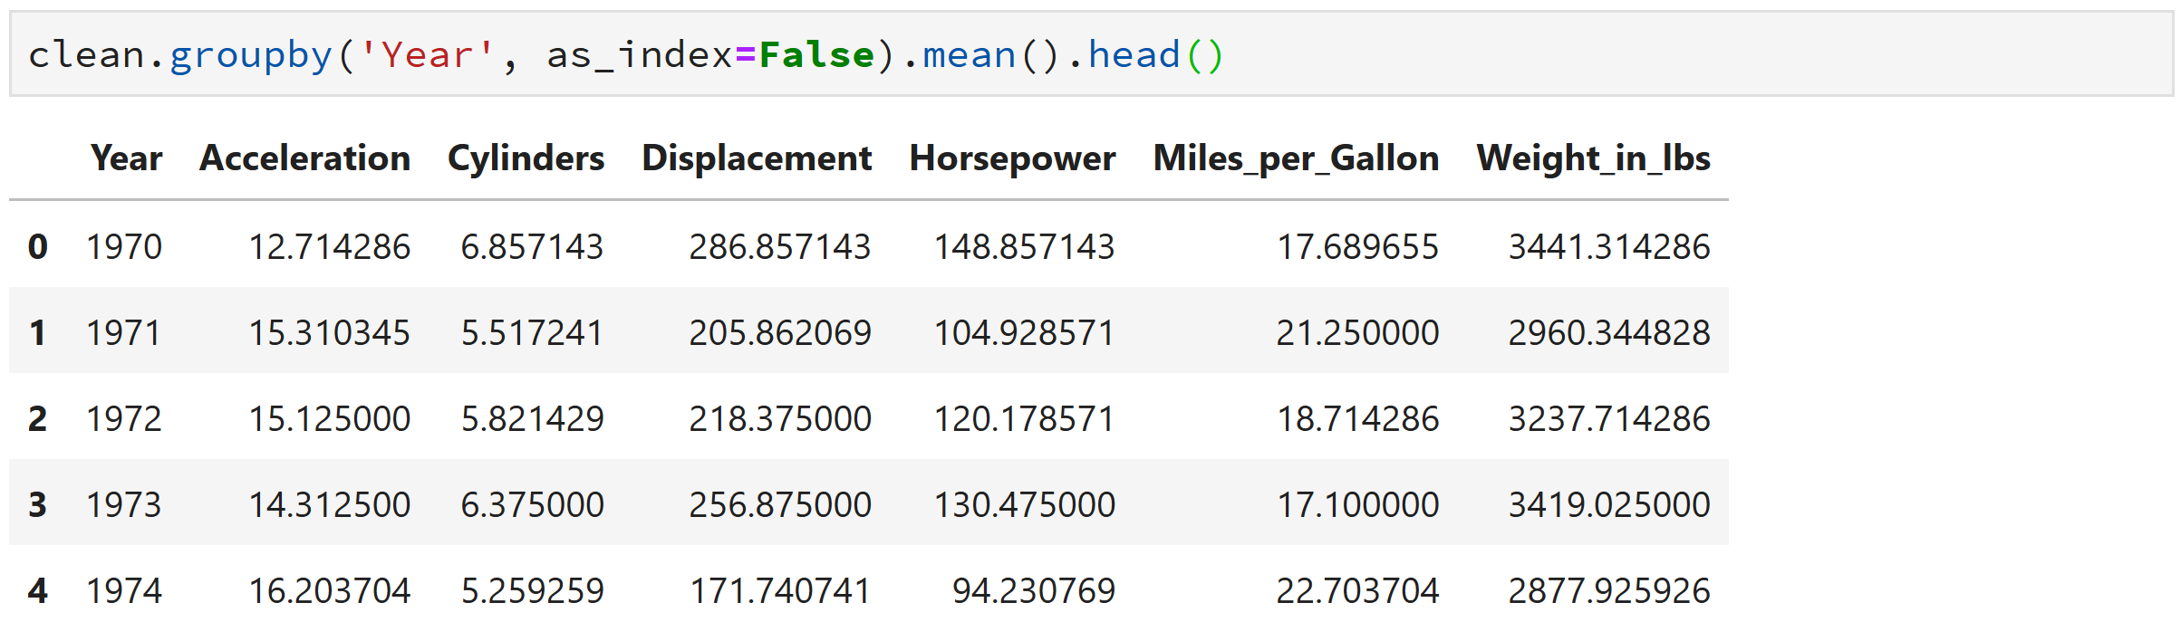

Slide 51
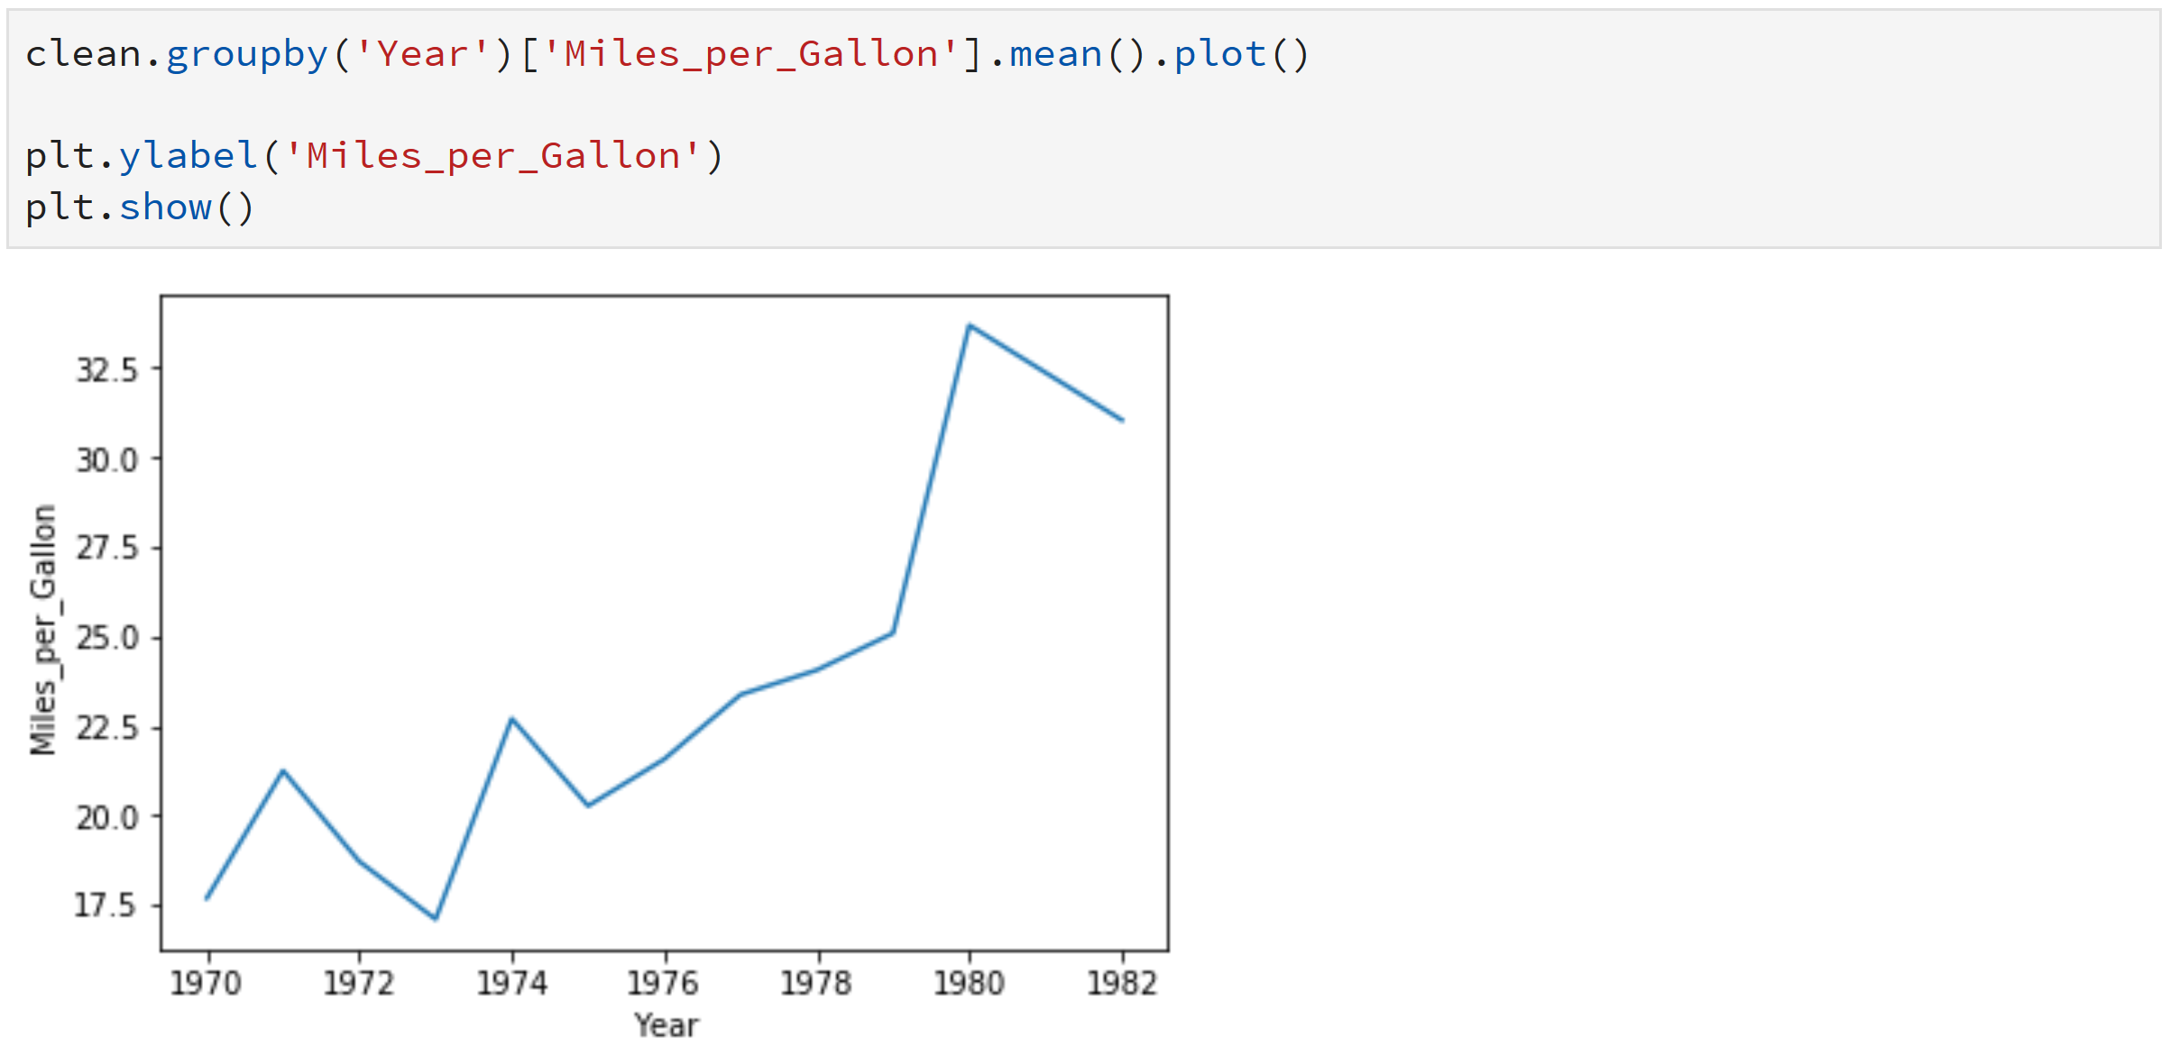

Slide 52
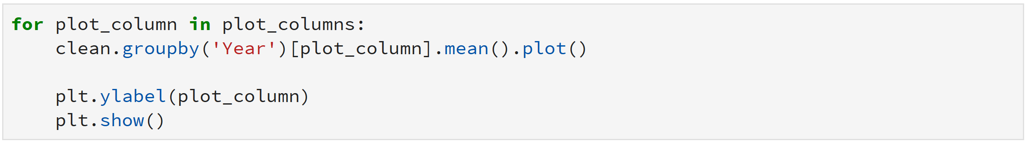
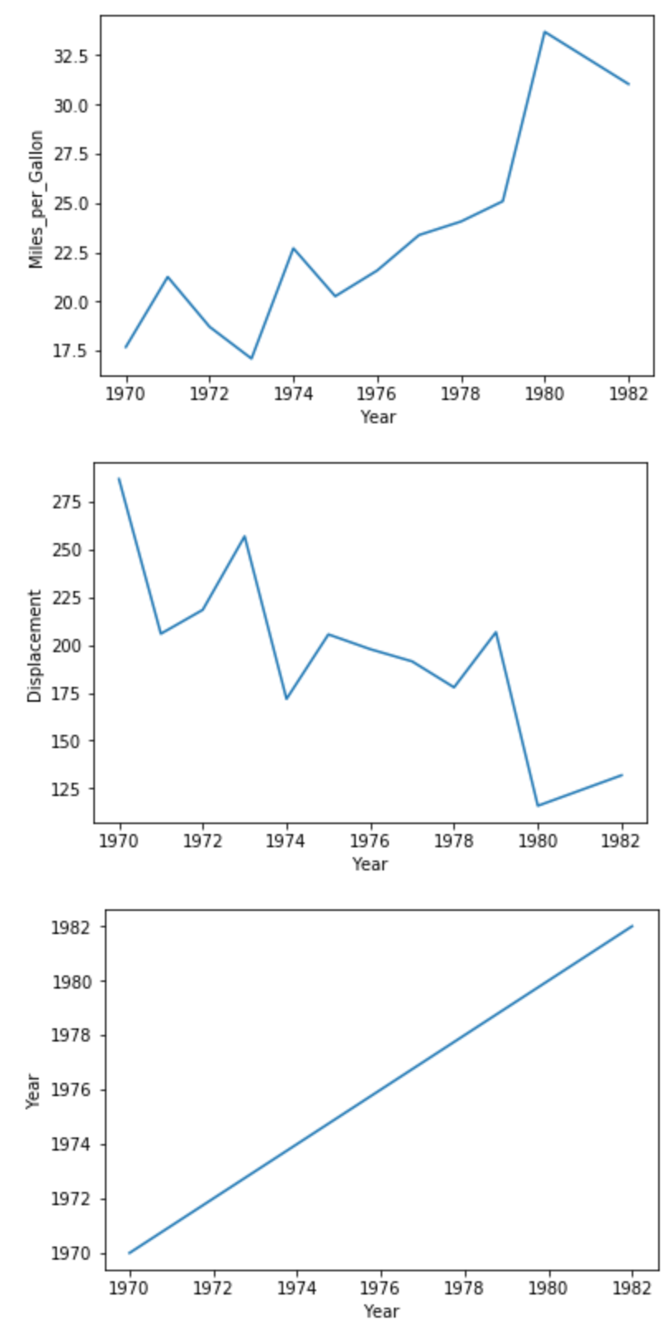

Slide 53
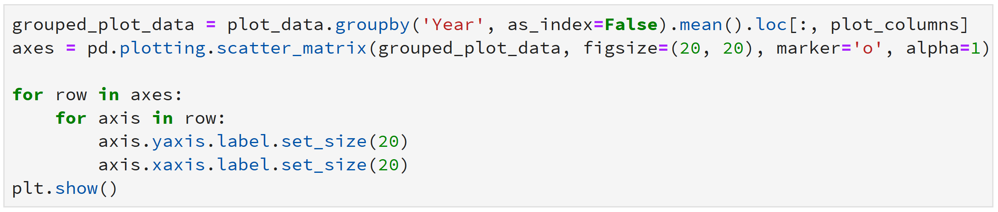

Slide 54
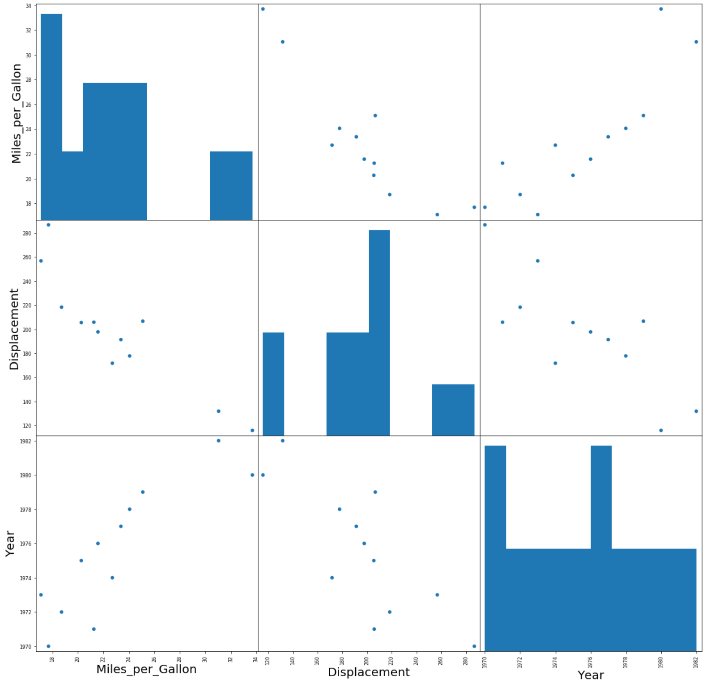

Slide 55
Road Map
Get your data into python
Perform a single instance of one analysis task
Write a function for that single task
Automate that task by iterating over more data
Output the result
Repeat steps 2 – 5 for additional tasks

Slide 56
Summary
Pandas and Jupyter are excellent tools that can be used to perform transparent data analysis
Incremental improvements can be used to convert an existing data analysis workflow into one in python

Slide 57
Thank You!
NickMacro
@NickMacro

