Slide 1
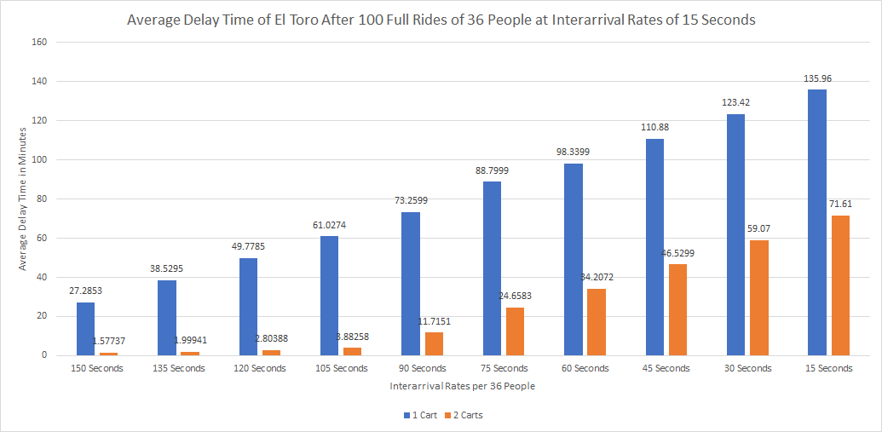
Determining When a Second Cart Should Be Added to El Toro
Authors: Nick Mariasi, Ethan Misale CSC 332: Modeling and Simulation
Abstract
Results
The worst part about going to a theme park is waiting in line all day and then only being able to ride half of the rides in the park. Theme parks choose to add more vehicles to a ride to cut these wait times but at what point is this decision made? Our group decided to explore this by calculating average delay times for El Toro, with different interarrival rates to simulate when would be the optimal average delay time to add a second vehicle to El Toro.
Results for one cart were generated using a ride size of 36 people with a load time of 62 seconds and unload time of 16 seconds. For two carts, load time and unload time were omitted as they would not be needed if a second cart was present. For both carts, the ride time was set to 102 seconds as that's the actual ride time of El Toro, the ride this study is based on. As for what was determined an acceptable delay time, we came to the conclusion that 60 minutes would be acceptable meaning that at around 120 seconds a second cart would need to be added.
On the graph, the blue line represents only 1 cart being utilized while the orange line represents 2 carts. The X-axis on the graph displays the interarrival rates of the 36. This means that a value of 15 means there’s 36 people coming in every 15 seconds, a value of 30 means 36 people coming in every 30 seconds and so on. The Y-axis simply displays the average delay time in minutes, or how long a person is waiting waiting upon entering the queue.
Introduction
The simulation was based off of the El Toro ride at Six Flags Great Adventure in New Jersey. Variables such as ride size and ride time were gathered from actual data on the roller coaster. The simulation was run with both one cart and two carts, with results being generated separate from one another to determine the optimal average delay time to add a second cart in an effort to reduce delay time significantly.
Figure 1: Average Delay Time in intervals of 15 seconds per 36 people
Methods
Inspiration
Conclusions
●Batch arrival was used, meaning each arrival was set up to be 36 people, the ride size of the roller coaster meaning that the ride will not run unless it’s full
●For both the one cart and two cart tests, the ride ran 100 times, serving a total of 3600 people
●Exponential distribution was used to generate random interarrival times
●We used Lehmer’s random number generator, which we developed to work with our code, to acquire random exponential distributed numbers for our interarrival rates.
●We generated the average delay times on 15 second interarrival time intervals ranging from 15 to 150 seconds
Our inspiration came from our knowledge of being able to simulate a queue of people and being able to calculate average wait times from that. We also were inspired by our real life experiences of waiting hours before boarding a rollercoaster and witnessing a second vehicle being added to a roller coaster to help compensate for the wait times of the ride.
From our results, we can conclude that a second cart should be added to El Toro when a full rides worth of people are arriving every 2 minutes to keep the delay times under hour with one car. We also conclude that wait times are significantly decreased when a second car is added because the average delay time for one cart with an interarrival rate of 105 seconds for 36 people (or about 1 person every 4 seconds), is about 2 minutes longer than the average delay time of two carts, when 36 people are arriving every 30 seconds (or just over one person a second). A second cart on El Toro should almost always be used because the ride is decently long for a rollercoaster and load and unload times are a never a factor.

