Slide 1

By. Mikha Muliadi, Nick Mateus, and Jason Surendran
“Predict your tomorrow, today”

Slide 2


Product Overview
Gathers Stock Data From Yahoo
Stock Prediction Capabilities
Dual Stock Comparison
Provides Accurate Display

Slide 3

Sample Stocks
GE
SIEGY
MT
TD
CM
RY
BMO
AMD
BTC-CAD
MSFT
TSLA
RCI
FB
AMZN
NFLX
GOOG

Slide 4
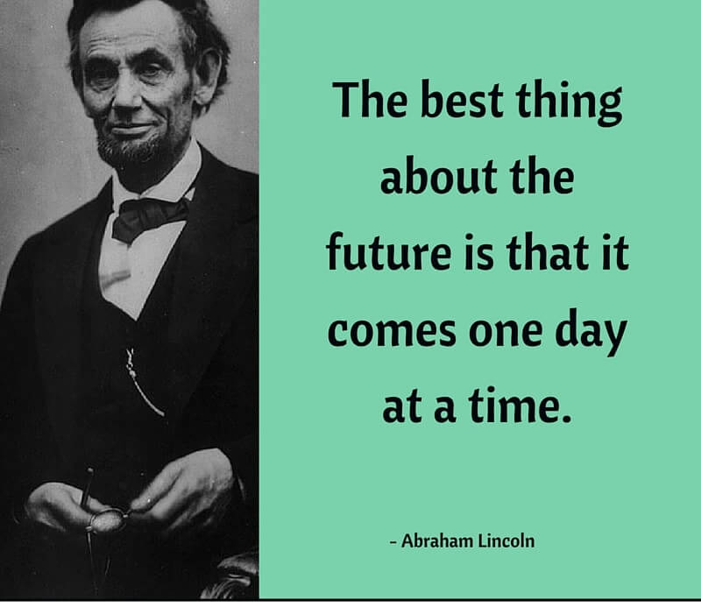


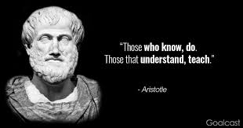

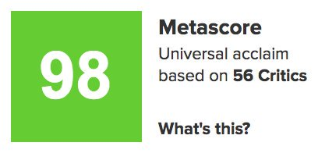
Reviews

Slide 5
References
https://www.mathworks.com/matlabcentral/fileexchange/5784-real-time-stock-viewer
https://www.mathworks.com/help/matlab/ref/uicontrol.html
https://www.mathworks.com/matlabcentral/fileexchange/68361-yahoo-finance-data-downloader
https://www.mathworks.com/matlabcentral/fileexchange/68534-yahoo-finance-data-loader?s_tid=FX_rc2_behav

