Slide 1
Sprint Goals
Laura Klions lk876914
Chase King ck240617
Jeff Parker jp344916
Nick Maude nm346217

Slide 2
Accomplished in First Sprint
Chase: Built and ran the Hello World program using Android Studio and an Android device in USB Debugging mode.
Laura: Download android studio, become familiar with the software and create basic hello world app, learn Java syntax, collect data in arc
Nick:became familiar with Android Studio and created a Hello World program.
Jeff: Sample Hello World App and Implemented C++ version of code to read and calculate probabilities that certain rooms in arc are open. Also converted the code to Java and fixed compatibility issues.
All: Began data collection.

Slide 3
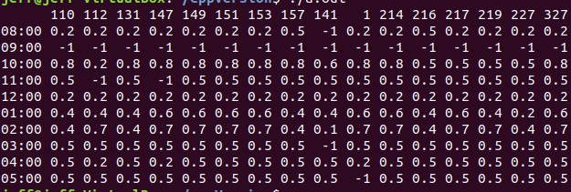
Output from C++ version

Slide 4
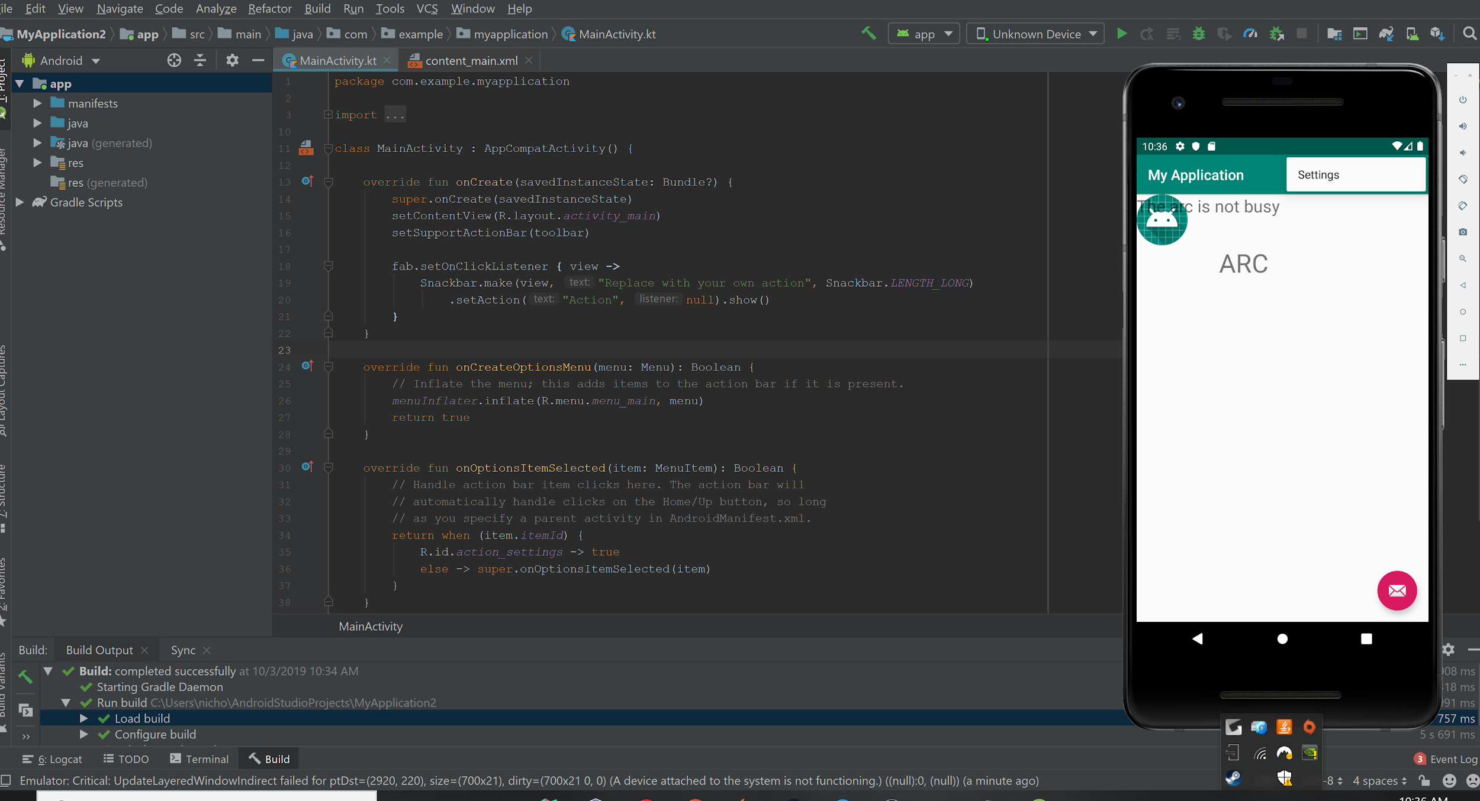
Hello World App

Slide 5
Second Sprint
Collect more data (5 times per week each) (all)
Continue to analyze data (Chase)
C++ class of functions (Nick)
Integrate C++ Class/Java Convert into Android Studio App (Jeff)
Create more concrete page design for App (Laura)
Commit Progress to Repository (all)

Slide 6
Roadblocks
All: Changed location due to complexity of data collection (Boyd->Arc)
Jeff: How can I integrate external C++ / Java code to be usable in Android Application
Chase: Still inexperienced with Java, needs to do more Android Studio familiarization.
Nick: had trouble running android vm for application testing
Laura: Had trouble enabling virtual device for testing on android studio

Slide 7
Transformation
Our project has changed from a collection of data from the dining halls to an app that displays the projected busyness of the study rooms and group tables in the Academic Research Center.
We are working on a new project name.

